Slide 1


Slide 2

Notes:
Radiating Domains Outer Ring

Slide 3
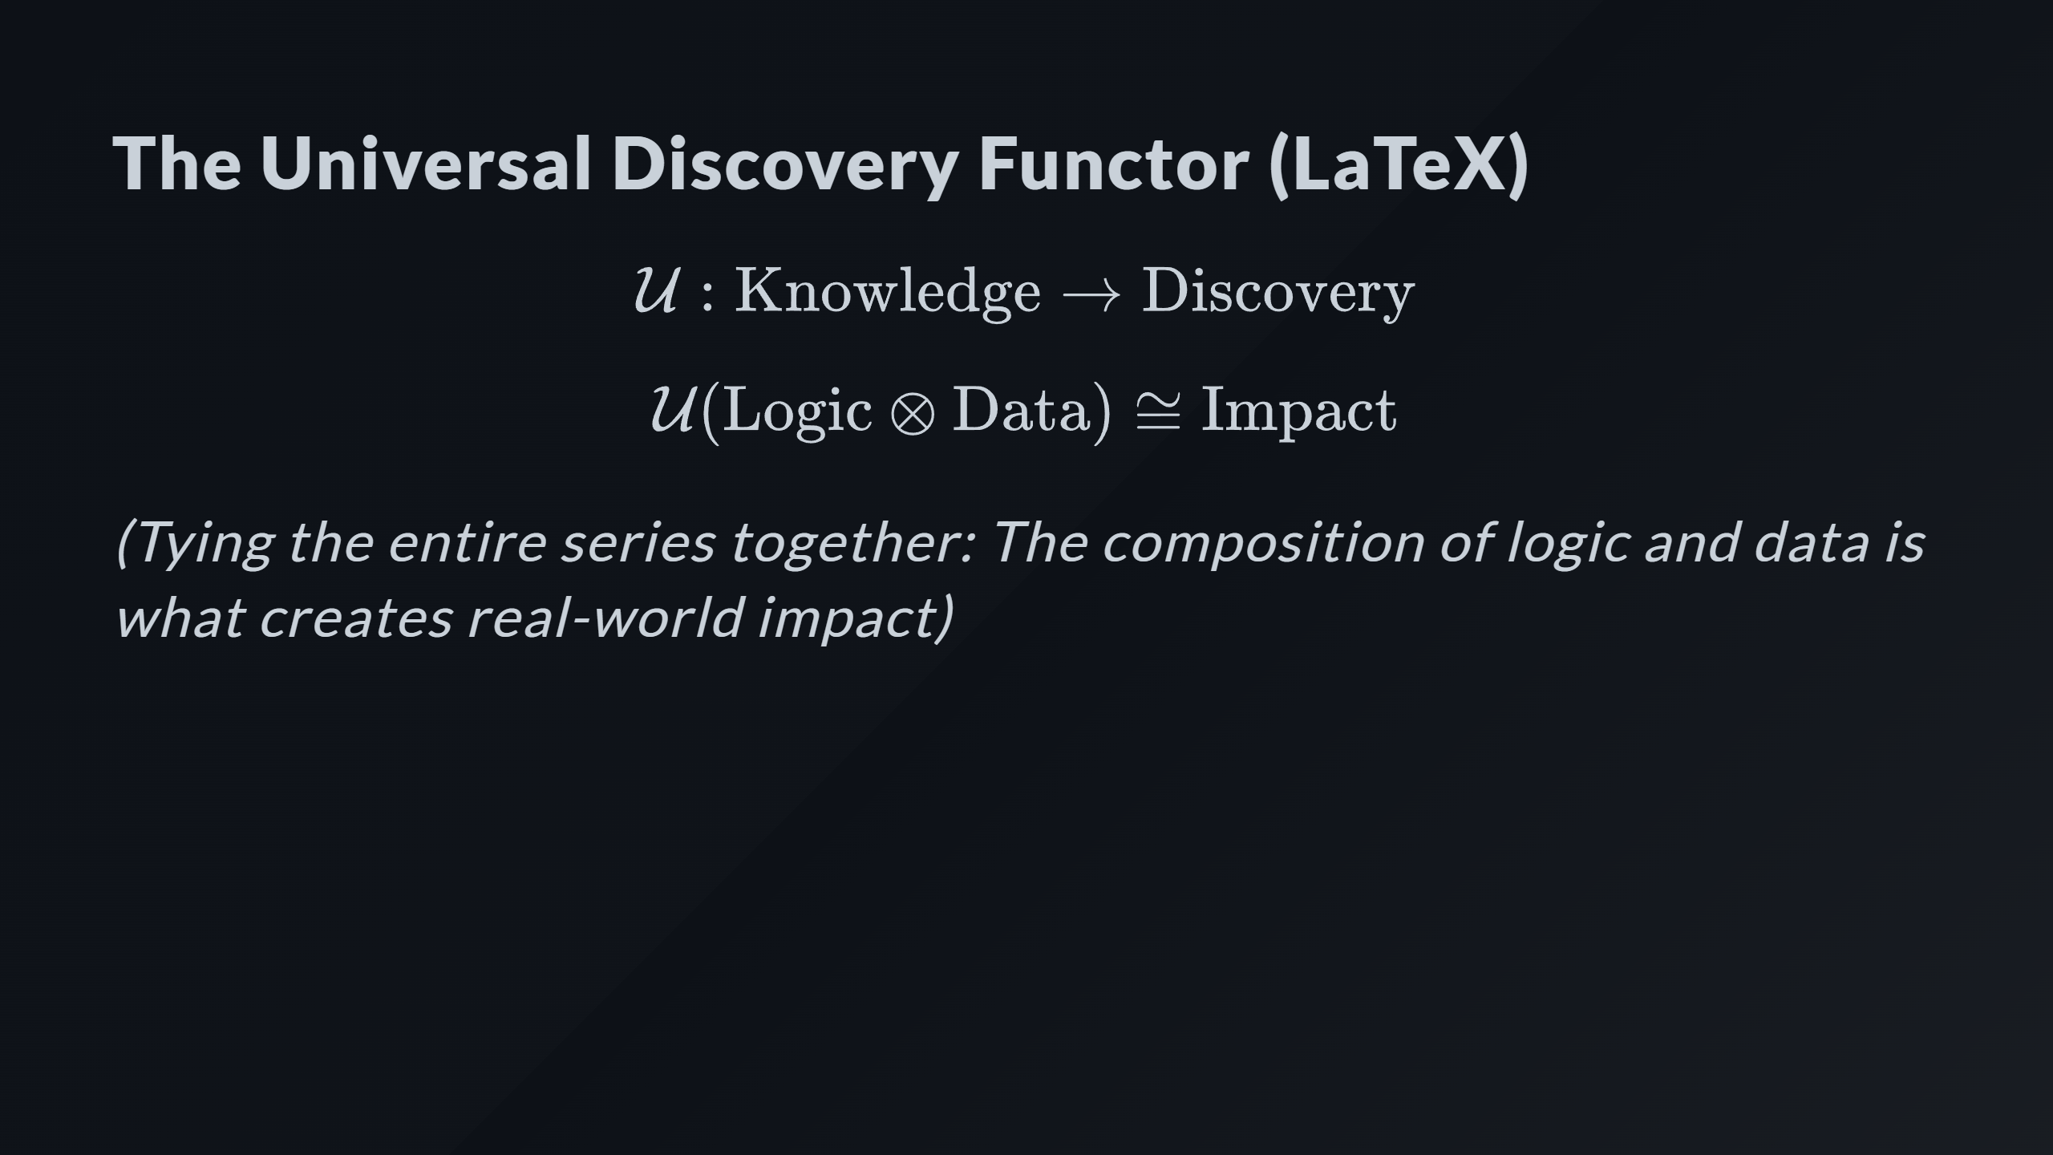

Slide 4


