Slide 1
Skills Tracker
Broc Hammett
@JayhawkChief on GitHub

Slide 2
Description
Skills Tracker is an online journaling system for new programmers to keep track of their learning. This helps them self-manage and organize to diminish getting lost in the journey of coding. Detailed topics of programming languages, frameworks, operating systems, and so on.

Slide 3
Features
User authentication
Create your learning skill topic
Add or edit an entry for summarizing under a specific topic

Slide 4
Planning - User Stories
Motivated from helping new programmers begin their tech career alike me by tracking their programming skills. In the software development field, we must continue learning on our own and on the job because technology grows rapidly. By staying on the course and be successful, it’s very important to self-manage. Software development is a big world!

Slide 5
Planning - Database
User authentication is one of features for Skills Tracker. People may register an account to create the topics and track of what they are currently learning on their own or on the job. Database will store the login, password, topics, and entries.

Slide 6
Technology Stack
Python
Django framework
Bootstrap
MySQL (in progress)

Slide 7
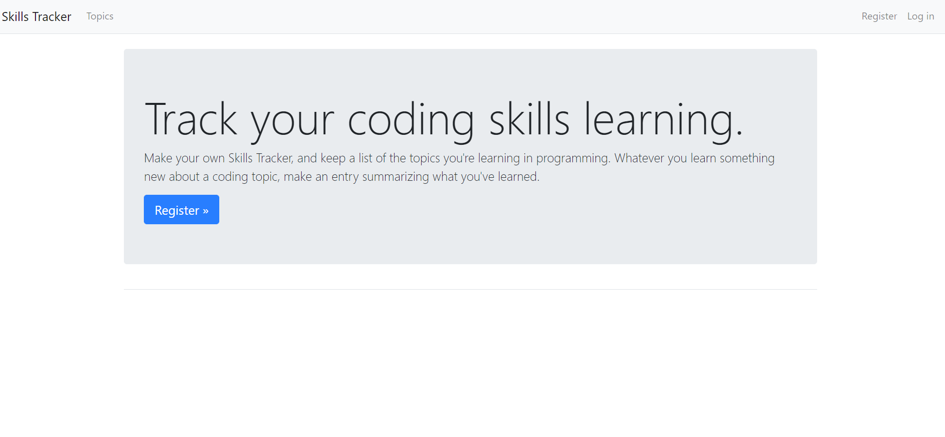
Demo
skills-tracker-launchcode.herokuapp.com

Slide 8
What I Learned
Navigating Django framework and administration
Insert Bootstrap to the project
More about user authentication using Python and Django
Deploy my web application with Heroku
Managing .gitignore file to avoid giving away my secret key!

Slide 9
What’s Next
Query or search parameters for a topic/entry from your own account
Improved user interface
Finalize database engine
Notes:
Be specific! If you mention another feature describe why that features is necessary, or what problem it solves. If you mention changing the UI mention specific technologies, or libraries you will use to do that. If you mention a technology, or feature you don’t know yet tell them how you plan on learning it.

