Slide 1
The Linux Scheduler: Complicatedly Simple Calculations
Presented by: Dustin Hauptman, Kurt Slagle

Slide 2
Background
Our research was investigating what benefit was gained from the code inside the scheduler.
Specifically targeting the CFS scheduler
10,000 lines of code
Only targeting mathematical operations
Logical operations might change behavior of scheduler
Different scheduler?
Structures would take a long time to refactor

Slide 3
Platform
Tested on a Dell Latitude 5580
Intel i7-7820HQ
16 GB DDR4
Toshiba MQ01ACF050 HDD
Ubuntu 16.04
Kernel Version 4.17-rc1
Still in the oven

Slide 4
Problems
When it came to implementing and testing the new code there were a few problems
Floating point operations are disabled in the kernel
Stick with integer operations
Need to have a Ubuntu 16.04 distribution on a computer to test the kernel
Only one machine would allow for the Ubuntu distribution

Slide 5
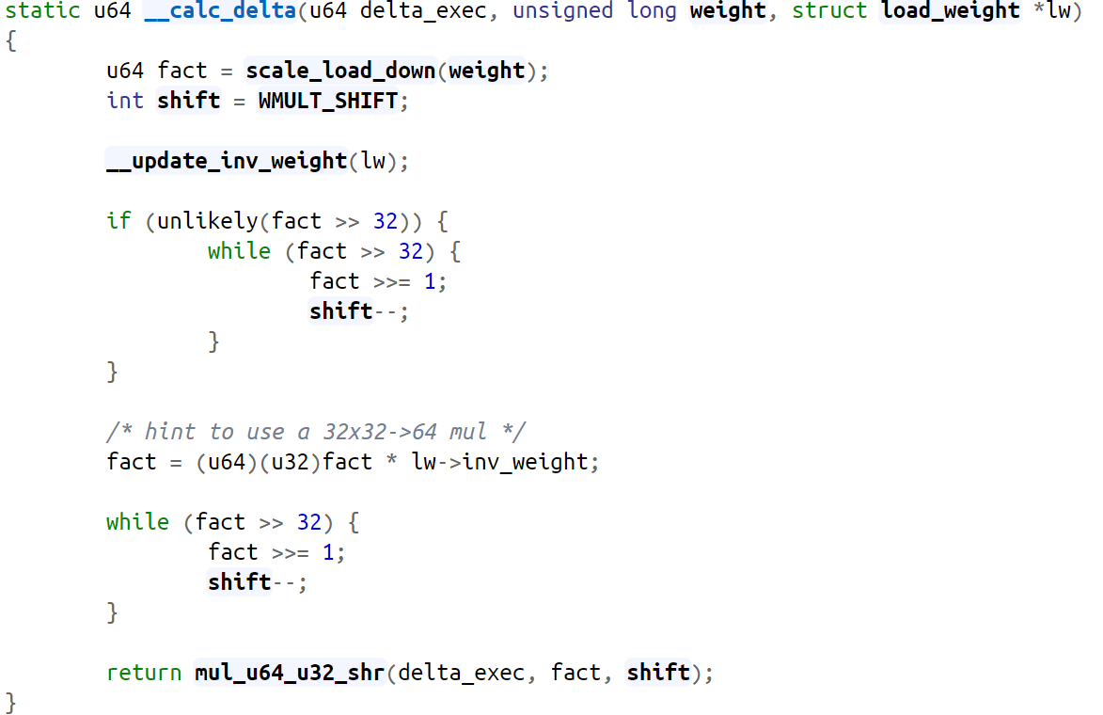
Code
Right shift by 10
32

Slide 6
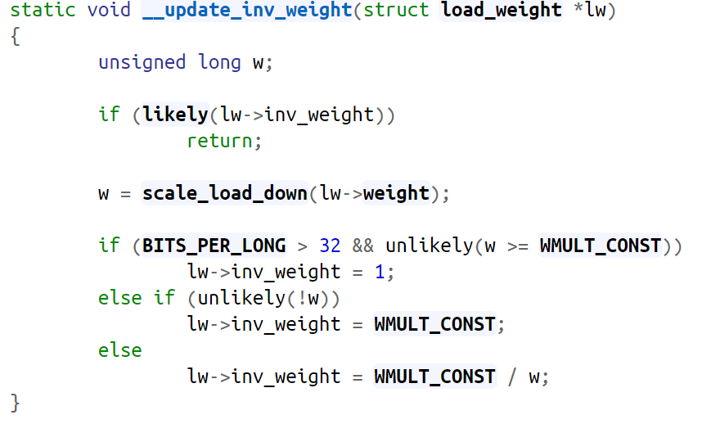
Code
32 for our system
(~0U) = 2³² - 1

Slide 7
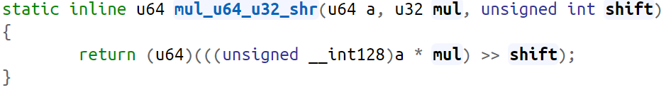
Code

Slide 8
Our code
10/10 - NYT
Short, Sweet, to the point – WaPo
Needs more Spiderman – Daily Bugle
Wow – Owen Wilson

Slide 9
Performance Analysis
To test the performance of the different codes we used hackbench
Linux scheduler benchmark that creates a bunch of threads/processes that need to communicate to each other
4 versions
hackbench (default)
hackbench –p –T (Threads and Pipes)
hackbench -s 1024 -l 500 -g 30 -f 50
hackbench -s 1024 -l 500 -g 10 -f 50 -p -T
Use trace_printk to show output
Allows us to view which process is calling the code at a given point of time
Typically see this function called 10,000+ times in less than a second

Slide 10
Performance Analysis
The performance of the CFS varies depending on whether or not cgroups are being used
Processor ticks spent inside __calc_delta (w/o cgroups):
CFS Implementation:
Min: 18
Max: 823
Mean: 78.2313
Standard Deviation: 30.755
Our Implementation:
Min: 22
Max: 947
Mean: 56.7398
Standard Deviation: 49.6664

Slide 11
Performance Analysis
The performance of the CFS varies depending on whether or not cgroups are being used
Processor ticks spent inside __calc_delta (w/ cgroups):
CFS Implementation:
Min: 15
Max: 52090 *
Mean: 33.5771
Standard Deviation: 380.924 *
Our Implementation:
Min: 21
Max: 1422
Mean: 40.6316
Standard Deviation: 54.8499
* Massive spikes of unknown origin impact results
* These spikes did not appear in our implantation, but we cannot rule that the cause of the spikes is inside the CFS implementation

Slide 12
Performance Analysis

Slide 13
Performance Analysis
hackbench
CFS Implementation:
Min: 0.113
Max: 0.161
Mean: 0.12769
Standard Deviation: 0.009447
Our Implementation:
Min: 0.114
Max: 0.161
Mean: 0.12899
Standard Deviation: 0.009638

Slide 14
Performance Analysis
hackbench –p –T
CFS Implementation:
Min: 0.078
Max: 0.172
Mean: 0.09782
Standard Deviation: 0.014983
Our Implementation:
Min: 0.076
Max: 0.167
Mean: 0.09867
Standard Deviation: 0.016088

Slide 15
Performance Analysis
hackbench -s 1024 -l 500 -g 30 -f 50
CFS Implementation:
Min: 15.027
Max: 16.993
Mean: 15.54649
Standard Deviation: 0.327979
Our Implementation:
Min: 14.958
Max: 15.785
Mean: 15.2886
Standard Deviation: 0.126911

Slide 16
Performance Analysis
hackbench -s 1024 -l 500 -g 10 -f 50 -p -T
CFS Implementation:
Min: 6.639
Max: 7.806
Mean: 7.05999
Standard Deviation: 0.204925
Our Implementation:
Min: 6.437
Max: 7.552
Mean: 7.00331
Standard Deviation: 0.171336

Slide 17
Performance Analysis

Slide 18
Accuracy Analysis
The Accuracy of the CFS varies depending on whether or not cgroups are being used
Accuracy of __calc_delta (w/o cgroups):
CFS Implementation:
Min: 0.852623
Max: 1
Mean: .995713
Standard Deviation: .00419022
Our Implementation:
Min: 0.999834
Max: 1
Mean: 0.99998
Standard Deviation: .00002

Slide 19
Accuracy Analysis
The Accuracy of the CFS varies depending on whether or not cgroups are being used
Accuracy of __calc_delta (w/ cgroups):
CFS Implementation:
Min: 0.999999
Max: 1
Mean: 0.999999
Standard Deviation: .00000005
Our Implementation:
Min: 1
Max: 1
Mean: 1
Standard Deviation: 0

Slide 20
Notes
From our initial performance analysis there is no significant difference between our code and their code
Both at the macro and micro level
However, when using no CGROUPS their accuracy degrades while ours remains the same

Slide 21
Notes
When not using cgroups, the check inside hints to take the likely branch, but lw->inv_weight is unlikely to be non-zero and thus possibly mispredicting.

Slide 22
Conclusion
At the macro and micro level there is no noticeable difference between code performance
However, it seems that the old implementation of CFS looses accuracy when not using cgroups
Normal usage vs special case usage
Ours may not handle all edge cases
No instability was observed on system
Could change with system used

Slide 23
Future Work
Need another system to work on
Target different architectures
32-bit vs 64-bit
Intel, ARM, etc.
Change different code chunks
Find the low hanging fruit first before logical
Other schedulers
RT, FIFO, RR, etc.

Slide 24

Questions

