Slide 1
PrimeTrust Bank Plc
LanceBox
A Simple Invoicing Mobile App with Onboarding
Case-Study Presentation | Online Assessment - IT Wholesales Banking Recruitment Drive
Presented by:
Adetunji Adegbite
Candidate, Senior Analyst, Mobile Development
September 2026

Slide 2
Agenda
What this presentation covers
1. Business Objective & Requirements
2. Solution & Tech Stack
3. System Architecture & Folder Structure
4. Features & Screens Implemented (Demo Flow)
5. State Management
6. Error Handling
7. Responsiveness
8. Code Quality, Scalability & Performance
9. Documentation
10. Next Steps & Roadmap
LanceBox | PrimeTrust Bank Plc - Senior Analyst, Mobile Development - Case Study
02

Slide 3
Business Objective
Why LanceBox?
▪ Onboarding: A frictionless sign-up and profile-setup flow so PrimeTrust Bank customers can open/integrate their account in seconds.
▪ Invoicing: A guided, 3-step invoice creation flow - Invoice Details, Bank Details and PDF Preview - built for SMEs, freelancers and business owners.
▪ Bank-grade foundation: Designed as a clean, scalable, cross-platform mobile app that fits PrimeTrust's digital-first, global-expansion strategy.
▪ Single codebase: One Flutter codebase targeted at both Android and iOS, reducing build and maintenance cost.
▪ Audience: Approximately 12,000 active core-banking users and the broader business-customer base across 790+ branches.
Assignment brief
✓ Screens & features - per the Figma design spec
✓ Error handling - clear, user-friendly validation
✓ Responsiveness - device-size aware UI
✓ Code quality - readability, state mgmt, scalability
✓ Performance - fast load, lean resource usage
✓ Documentation - README, guides, screenshots
LanceBox | PrimeTrust Bank Plc - Senior Analyst, Mobile Development - Case Study
03

Slide 4
Technology Stack
Chosen for speed to market, performance and developer productivity
Flutter & Dart
Riverpod
Cross-platform UI framework (single codebase - Android + iOS). Dart 3.4.x, Material Design 3 theming.
Reactive state management - compile-safe, testable providers; avoids InheritedWidget boilerplate.
MVVM-style layer
image_picker
Clear separation: presentation (views/widgets) / states (view-models) / shared (theme, constants).
Native gallery / camera picking for the business-logo upload in onboarding.
flutter_pdfview + shimmer
flutter_svg
LanceBox | PrimeTrust Bank Plc - Senior Analyst, Mobile Development - Case Study
04
Native PDF rendering for the invoice preview with a shimmer loading skeleton.
Scalable, resolution-independent SVG iconography.

Slide 5
System Architecture
Feature-oriented layout with a clean MVVM-style separation of concerns
Folder structure
lib/m
App entry - ProviderScope wraps a central MaterialApp + route table
presentation/
UI layer - views & reusable widgets (onboarding, auth, dashboard, invoice flow)
states/
View-model layer - Riverpod StateNotifier + immutable models (sign_up, set_up, invoice)
shared/
Theme (colors/fonts), constants (routes, validators, errors), responsive extensions & assets
utils/
Cross-cutting helpers (e.g. ImageUtils for image picking/upload)
Key decisions:
Barrel files for clean imports • centralized Routes constants and named navigation • single-source AppColors / AppFonts • responsive sizing helpers on BuildContext • backend (Firebase) isolated behind commented config, so a real API layer can slot in without UI churn.
LanceBox | PrimeTrust Bank Plc - Senior Analyst, Mobile Development - Case Study
05

Slide 6
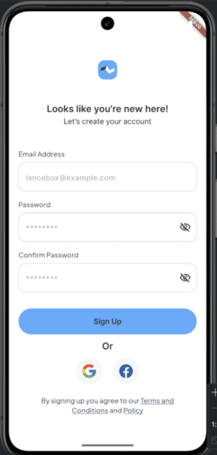
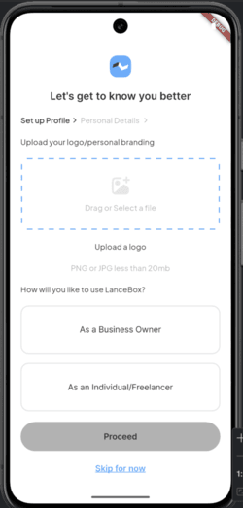
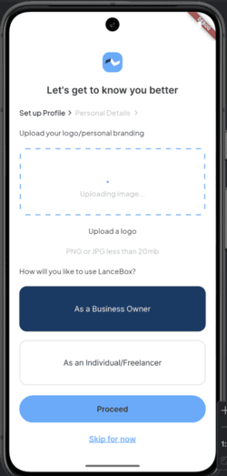
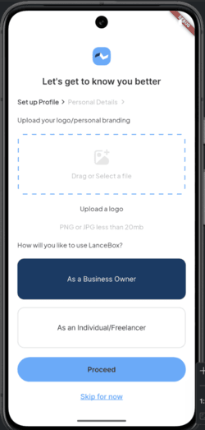
Feature Walkthrough
Onboarding: Sign-Up -> Profile Setup -> Dashboard
Onboarding flow - from account sign-up to the customer dashboard
Sign-Up
Email + password, social login, live form validation
Profile Setup
Multi-step onboarding UI
Logo Upload
image_picker + simulated progress
Account Type
Business Owner vs Freelancer
LanceBox | PrimeTrust Bank Plc - Senior Analyst, Mobile Development - Case Study
06

Slide 7
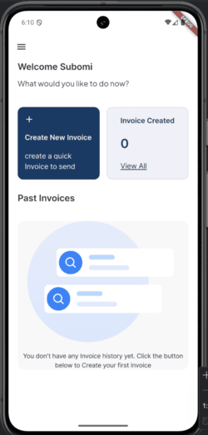
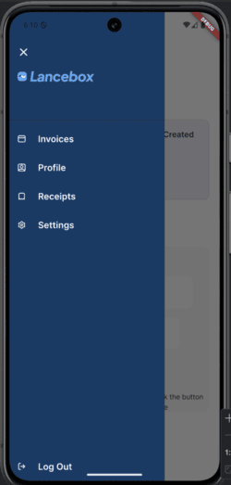
Feature Walkthrough
Invoicing: Dashboard -> Create Invoice -> Bank Details -> Preview
Dashboard home, drawer navigation and the guided 3-step invoice creation flow
Step 1 - Invoice Details
Invoice number, client & your name, date, currency, title, itemized quantity/price, VAT, shipping and computed totals.
Step 2 - Bank Details
Bank number, bank name, account name and payment terms.
Step 3 - Preview
Design-accurate PDF preview (flutter_pdfview) with shimmer placeholder, Download & Send-to-client actions.
Dashboard
Welcome home + Create New Invoice card
Side Drawer
Invoices / Profile / Receipts / Settings
LanceBox | PrimeTrust Bank Plc - Senior Analyst, Mobile Development - Case Study
07

Slide 8
State Management
Riverpod StateNotifier + immutable models
Why Riverpod over alternatives (setState / Bloc / Provider):
▪ ProviderScope at root: dependency wiring and state lifecycle are managed once, app-wide (main.dart:17).
▪ StateNotifier pattern: UI never mutates state directly - it calls methods on a notifier that emits a new immutable state.
▪ Immutable models: every state transitions via copyWith - predictable and easy to test.
▪ Testability: providers can be overridden per-test; no globals or singletons.
▪ Scalable: add new features by adding models + providers without touching existing screens.
Example - invoice selection
class InvoiceState extends
StateNotifier<InvoiceStateModel> {
void selectCreateInvoice() {
state = state.copyWith(
selection: 0, isLoading: false
);
}
}
final invoiceProvider =
StateNotifierProvider<InvoiceState,
InvoiceStateModel>((ref) => InvoiceState());
LanceBox | PrimeTrust Bank Plc - Senior Analyst, Mobile Development - Case Study
08

Slide 9
Error Handling
User-friendly, layered error management
Three layers of protection across the app:
1 - Form Validation
Field-level validators in the StateNotifier (email regex, >= 8-char password, confirm-match). Errors surface inline under fields and clear the moment they are fixed.
2 - Centralized Errors
LanceBoxError constants map UI messages to known auth/network scenarios (userNotFound, emailAlreadyInUse, weakPassword, internetConnection) - backend-ready.
3 - Visual Feedback
Loading spinners + disabled buttons while processing, a FormError list widget, and explicit uploading / uploaded / error states on the logo upload screen.
No silent failures: every async/processing path shows a disabled control or a progress state, so users always know what the app is doing.
LanceBox | PrimeTrust Bank Plc - Senior Analyst, Mobile Development - Case Study
09

Slide 10
Responsiveness
Design-system aware sizing that adapts to any device
Laid out against a 375 x 812 (iPhone) design reference, then scaled fluidly:
▪ BuildContext helpers: dynamicScreenHeight / dynamicScreenWidth / percentScreenWidth compute sizes proportional to the actual screen (shared/constants/extensions.dart).
▪ Flutter layout primitives: Flexible / Expanded rows, Expanded columns and SafeArea let every screen reflow gracefully across phones and tablets.
▪ Bundle with fonts: Pretendard (9 weights) + Plus Jakarta Sans scale to fit -- no hard-coded pixel text sizes.
▪ SVG iconography: resolution-independent icons never pixelate on high-density/retina displays.
▪ Consistent gutters: spacing derives from the same scale constants on every screen for a uniform look.
▪ Verified on: Android emulator + iOS simulator at multiple screen sizes.
Result:
the same Figma-accurate visual rhythm on a compact Android handset and a large iOS tablet - no fixed-width layouts, no overflow errors.
LanceBox | PrimeTrust Bank Plc - Senior Analyst, Mobile Development - Case Study
10

Slide 11
Code Quality, Scalability & Performance
Built to be maintained and extended
Code Quality
Scalability
Performance
▪ Single-purpose, reusable widgets (DefaultButton, InputField, FormError, ProgressSection) so screens are thin and declarative.
▪ Barrel files keep imports clean; flutter_lints analysis passes with no warnings.
▪ Immutable state models + copyWith - clear, readable diffs.
▪ Descriptive 39-commit git history tracks feature-by-feature delivery.
▪ Feature-oriented folders let new modules (Receipts, Settings, Analytics) drop in without refactoring.
▪ Riverpod providers are composable and can be delegated per feature.
▪ Backend seam already designed - Firebase config is isolated, ready to enable real auth, storage and history.
▪ Riverpod only rebuilds the widgets that consume changed state - minimal over-rebuild.
▪ Shimmer skeleton + native PDF rendering (flutter_pdfview) keep the heaviest screen responsive.
▪ Single-page assets: SVG icons over image files cut bundle weight.
▪ Snappy simulated network states demo real-world async behaviour.
LanceBox | PrimeTrust Bank Plc - Senior Analyst, Mobile Development - Case Study
11

Slide 12
Documentation
Code is only as good as its guide
README.md
Project overview, feature list, tech stack, install/run guide (flutter pub get & flutter run), usage walkthrough, contributing and license.
Screenshots
Seven captured screenshots of Sign-Up, Profile Setup, logo upload, dashboard and drawer embedded in the README for a visual tour.
In-code structure
Self-documenting folder layering (presentation / states / shared / utils), barrel files and class-level comments.
Git history
39 focused commits across onboarding, Riverpod wiring, drawer navigation, invoice flow and refactors - a readable audit trail.
Repository: github.com/Jayhymn/lance_box - open the README for the full picture.
LanceBox | PrimeTrust Bank Plc - Senior Analyst, Mobile Development - Case Study
12

Slide 13
Live Demonstration
End-to-end user journey
1
2
3
4
5
6
Sign Up
Create account with validated email + password
Onboarding
Upload logo & choose account type
Dashboard
Welcome screen + drawer navigation
Create Invoice
Itemized details, VAT & totals
Bank Details
Account & payment terms
Preview PDF
Shimmer load + download / send actions
›
›
›
›
›
10-Minute demo script:
walk through the screens above on an emulator, highlighting validation, the upload progress state, step navigation and the PDF preview.
LanceBox | PrimeTrust Bank Plc - Senior Analyst, Mobile Development - Case Study
13

Slide 14
Next Steps & Roadmap
From demo to production
Implemented
Roadmap
Sign-up + onboarding + full invoice creation flow
Backend integration - real PDF generation, email delivery, API services
Done
Soon
Real authentication (Firebase Auth) and persistent user/invoice history
Profile, Receipts & Settings screens, analytics, notifications
Now
Later
The current build already demonstrates the full UX, error handling, responsive layout and architecture the production app will be built on - making the leap to a live backend minimal.
LanceBox | PrimeTrust Bank Plc - Senior Analyst, Mobile Development - Case Study
14

Slide 15
Thank you
Feeding back is welcome - questions and discussion after the demo.
Adetunji Adegbite
Candidate - Senior Analyst, Mobile Development
PrimeTrust Bank Plc • September 2026
github.com/Jayhymn/lancebox

