Slide 1
Edge-First Triage & Segmentation for Gigapixel Pathology
VAE-Triage (WSI QC + GMM tissue components) · High-resolution U-Net segmentation
• Real data: 7 CAMELYON16 breast lymph-node WSIs (203k tiles @20x) + ISPRS Potsdam
• Everything measured on a 4-core CPU – no GPU – i.e. edge conditions
• GMM-based, label-free, explainable gate in front of heavy deep models

Slide 2
Problem
A WSI is ~10^10 pixels; most of it should never reach the GPU
• Pyramidal JPEG-TIFF, 100k × 200k px, 1–4 GB per slide
• 69.6% of 203,168 tiles in our 7 slides are empty glass (30–78% per slide)
• Some tissue tiles are unusable: blur, pen ink, folds, bubbles, exposure, JPEG
• Heavy models (U-Net / DeepLab / ViT-MIL) cost 10–100 ms per tile on GPU
• Goal: decide cheaply, per tile, at the edge: tissue? usable? what's in it?

Slide 3
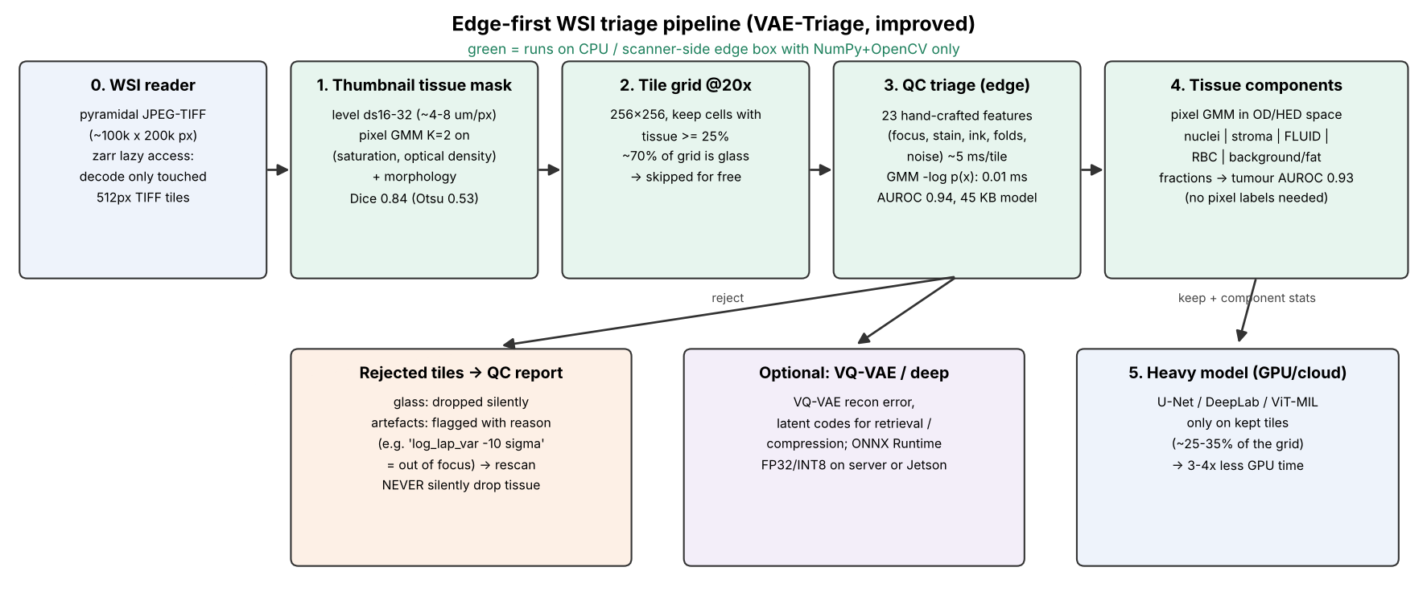
Pipeline

Slide 4
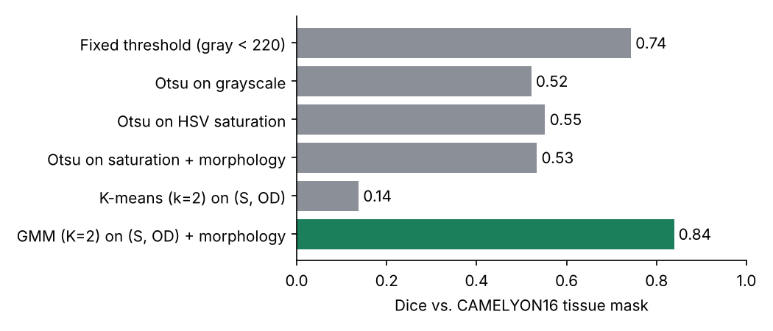
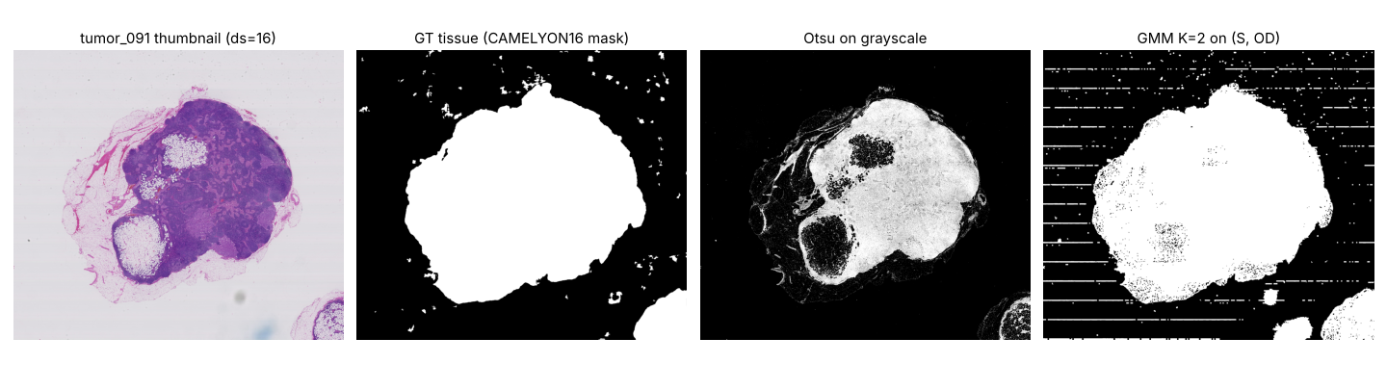
Stage 0 – tissue detection on the thumbnail
Pixel GMM (K=2) on saturation + optical density
• GMM Dice 0.84 vs Otsu 0.53 vs k-means 0.14
• Glass = tight cluster, tissue = broad cluster → needs unequal covariances

Slide 5
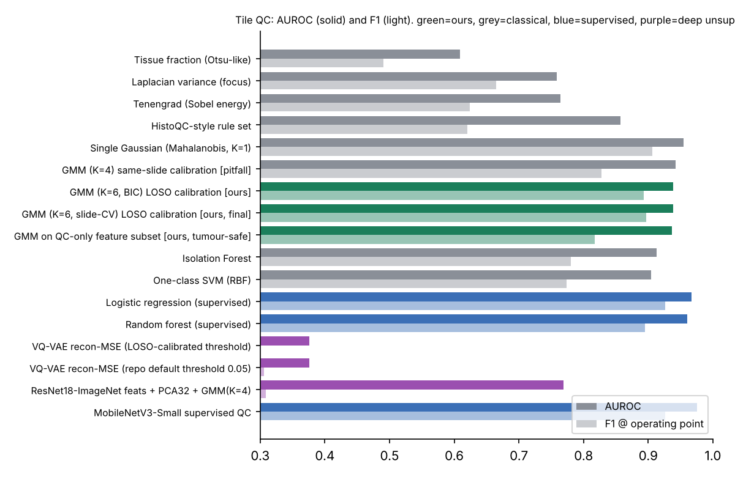
Stage 1 – tile QC with a GMM density
23 physics features → −log p(x), threshold = 95% clean pass on UNSEEN slides
• GMM: AUROC 0.939, F1 0.897, spec 0.928
• Single Gaussian 0.954 (few slides → simplest density wins)
• Laplacian 0.76 · HistoQC-style 0.86 · IsoForest 0.91
• Supervised MobileNetV3 0.976 (needs labels)
• 45 KB model · 0.01 ms score · 2.1 ms features (128 px)

Slide 6
Why unsupervised: artefacts never seen in training
Model | bubble | pen ink | fold | JPEG
Logistic regression (sup.) | 0.13 | 0.64 | 0.41 | 0.46
Random forest (sup.) | 0.07 | 0.64 | 0.24 | 0.22
GMM K=1 (unsup.) | 0.61 | 0.83 | 0.91 | 0.96
GMM K=6 (unsup.) | 0.64 | 0.85 | 0.94 | 0.99
• Production scanners create failure modes nobody annotated → novelty detection
• Best design: GMM gate for the unknown + small supervised head for known artefacts

Slide 7
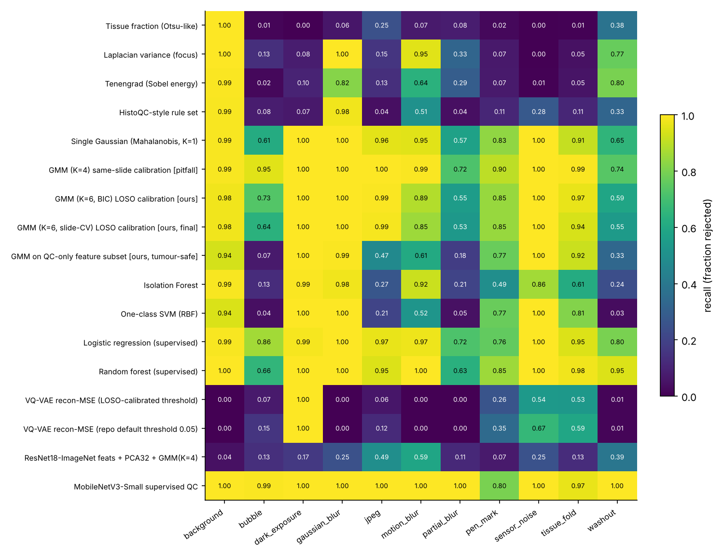
Per-artefact recall

Slide 8
Two traps we found (and fixed)
• Calibration trap: threshold from tiles of the SAME slides
  – specificity 0.69 and 43% of tumour tiles rejected on new slides
  – leave-one-slide-out calibration → specificity 0.93, tumour rejected 3.5%
• VQ-VAE reconstruction error as QC score: AUROC 0.376 (worse than chance)
  – blurred / empty tiles are smooth → EASIER to reconstruct → look 'normal'
  – keep VQ-VAE as compressor/tokeniser + tumour-novelty signal (0.749)
• BIC over-estimates K: tiles of one slide are not i.i.d. → select K on held-out slides

Slide 9
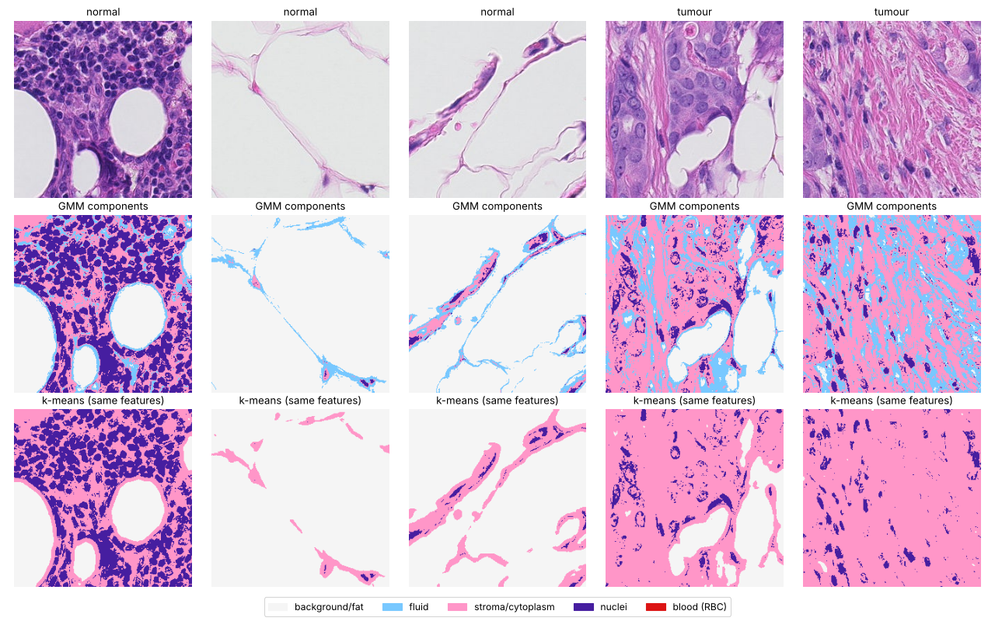
Stage 2 – GMM tissue components incl. FLUID
Beer–Lambert → OD → colour deconvolution (H, E) → pixel GMM
• Components: nuclei · stroma/cytoplasm · fluid · blood · fat/glass
• Fluid = pale, eosin-dominant, low OD (plasma, oedema, proteinaceous fluid)
• k-means on same features: no fluid cluster
• Cross-slide stability: 79% pixel agreement
• 5 fractions → tumour AUROC 0.93

Slide 10
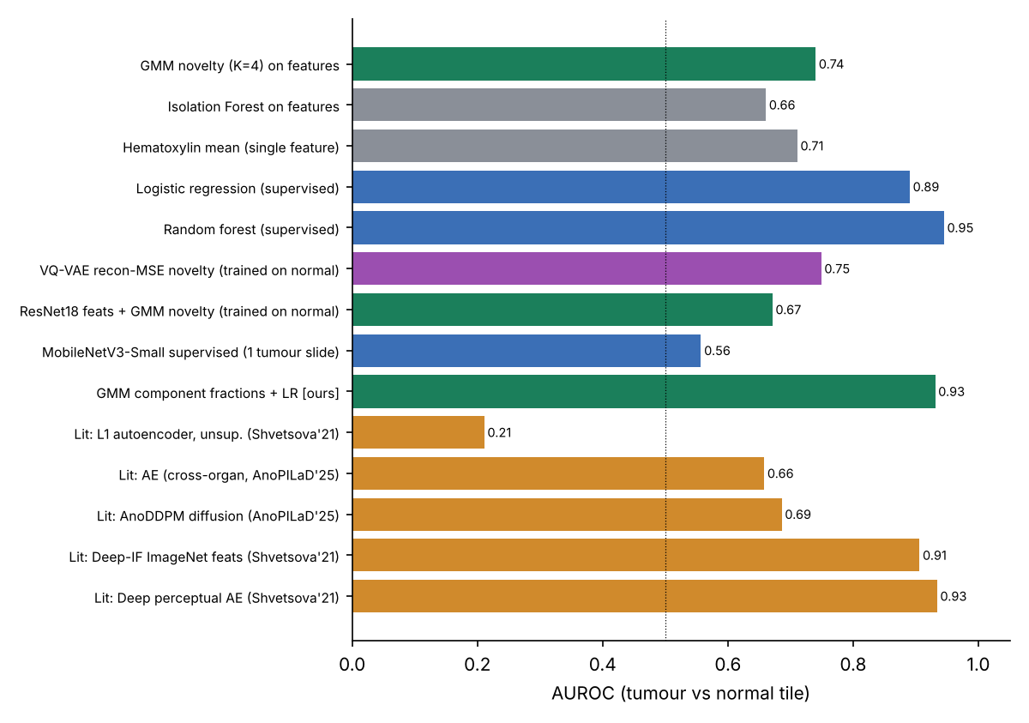
Tumour vs normal tiles
Unsupervised scores vs supervised vs literature

Slide 11
Edge cost (measured, 4-vCPU, no GPU)
Component | ms / tile | Size | Note
Features (23-D) + GMM | 2.1 + 0.01 ms | 45 KB | no labels, explainable
VQ-VAE ONNX Runtime FP32 / INT8 | 22.9 / 22.7 ms | 2.9 / 0.8 MB | INT8: smaller, not faster
MobileNetV3-S ORT FP32 / INT8 | 0.6 / 1.4 ms | 6.1 / 1.7 MB | needs labels per artefact
ResNet-18 features (PyTorch) | 15.8 ms | 45 MB | generic, weak for QC
• Slide with 29k grid tiles → ~8.8k tissue tiles → QC in ~5 s on 4 cores
• Only ~30% of the grid reaches the GPU model → 3–4× less compute
• Always measure on target hardware (INT8 was slower on this CPU)

Slide 12
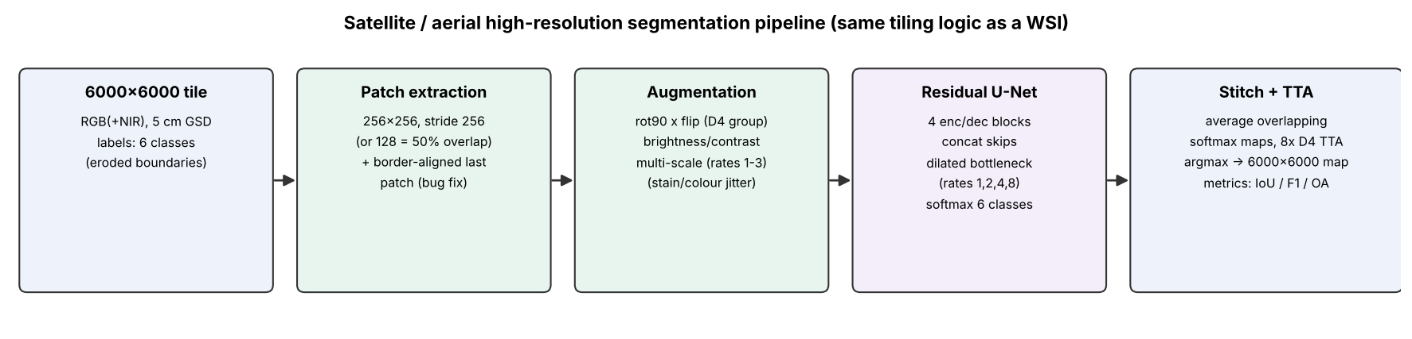
Project 2 – high-resolution segmentation
Residual U-Net + dilated bottleneck, patch stitching, 8× TTA
• Same problem as WSI segmentation: image ≫ network input
• Bugs fixed: last 112 px of each 6000-px tile never predicted (3.7% of pixels); num_classes fell back to 5
• Terminology: 'residual' blocks are concatenations (DenseNet-style)

Slide 13
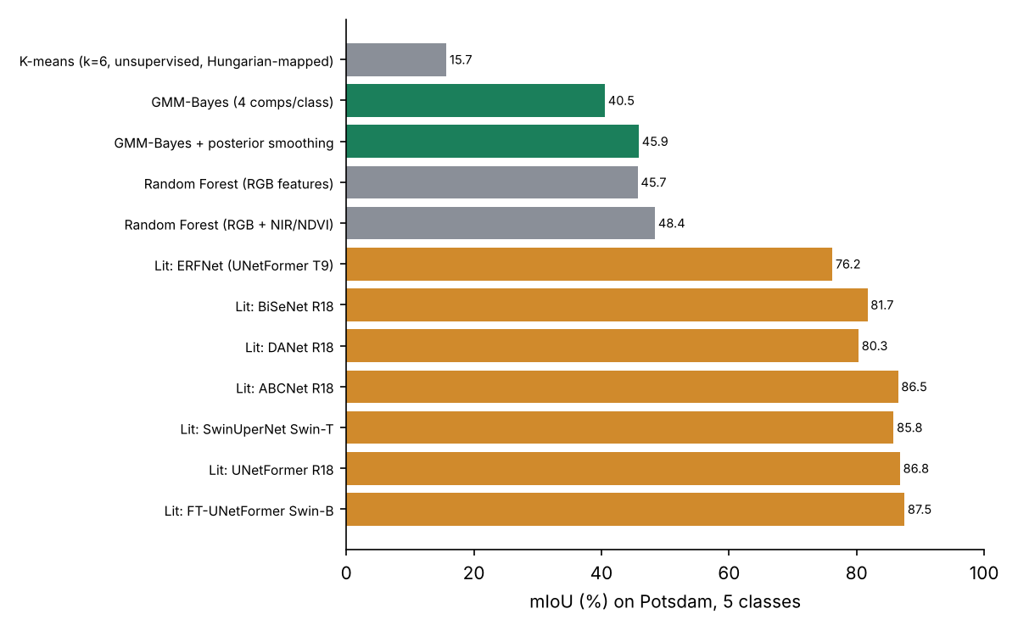
Potsdam results vs literature
Classical pixel classifiers (minutes on CPU) vs published deep models
• k-means 15.7 → GMM-Bayes 40.5 → + posterior smoothing 45.9
• Random forest 45.7 → + NIR/NDVI 48.4
• Deep SOTA 86.5–87.5: shape & context need a CNN/transformer
• → GMMs for colour/density problems, U-Net for semantics

Slide 14
What I changed and what's next
• Done: fixed crashes, real WSI reader, tissue mask, GMM QC + export, LOSO calibration,
  – GMM tissue components (fluid), explainable rejections, benchmarks on real slides
• Next: stain augmentation + many slides for supervised heads (1-slide CNN → 0.56 AUROC)
• Next: feature-space (perceptual) anomaly score instead of pixel MSE (lit. 0.66 → 0.93)
• Next: U-Net with pretrained encoder, 50% overlap + Gaussian blending, Dice+CE loss
• Next: export GMM to C/ONNX for scanner software; GMM likelihood as drift monitor

Slide 15
60-second summary
• 70% of a slide is glass: a K=2 GMM on the thumbnail removes it (Dice 0.84)
• A GMM density on 23 physics features flags bad tiles: AUROC 0.94, 45 KB, explainable
• It catches artefact types it never saw (64–99% vs 7–64% for supervised)
• A pixel GMM in optical-density space separates nuclei, stroma, fluid, blood, fat
• Only good tissue reaches the U-Net – cheap decisions at the edge, expensive ones on the GPU

