Slide 1



N-Queen Visualizer
Welcome to the N-Queen Visualizer project. This presentation will explore the fascinating N-Queens problem, its solution, and how we can visualize it through an interactive tool.
by Reaper

Slide 2

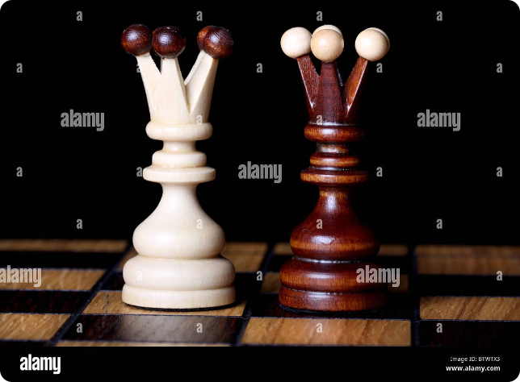
Introduction to the N-Queen Problem
The Challenge
The N-Queens problem involves placing N chess queens on an N x N chessboard so that no two queens threaten each other.
Key Constraint
Queens can move horizontally, vertically, and diagonally, making it challenging to arrange them without conflict.
Computational Complexity
Solving the N-Queens problem involves exploring a vast number of possible arrangements, making it computationally complex.

Slide 3

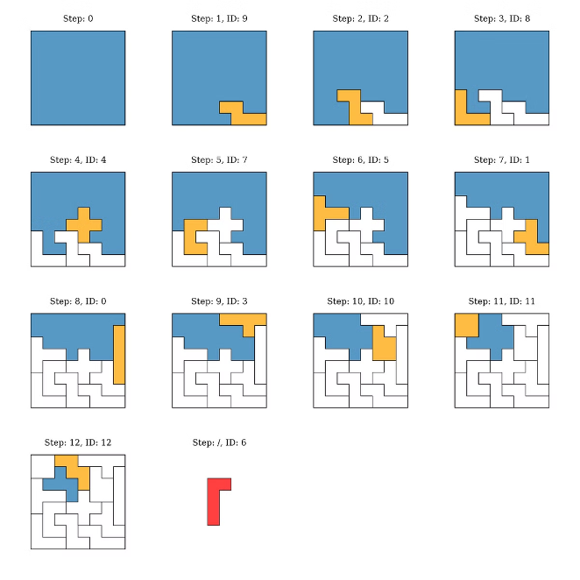
Backtracking Algorithm Explanation
1
Initialization
Start by placing a queen in the first column of the board.
2
Placement Check
Check if the queen's position is valid, i.e., if it's not under attack from other queens.
3
Recursive Placement
If valid, recursively place a queen in the next column. If invalid, backtrack to the previous column and try a different position.
4
Solution Found
If all N queens are placed successfully, you've found a solution. If no solution is found after backtracking, the problem has no solution for the given board size.

Slide 4

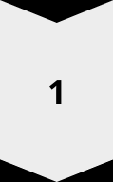
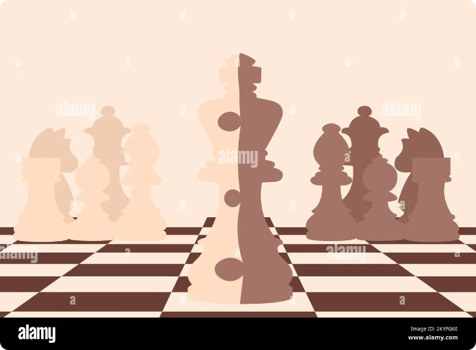
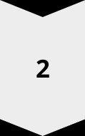
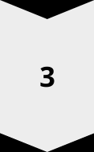
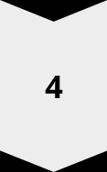
Visualizing the N-Queen Solution
Board Representation
Use a grid-like interface to visually represent the chessboard.
Queen Placement
Visually mark the positions of the queens on the board using distinctive icons or colors.
Attack Paths
Optionally, highlight the potential attack paths of each queen to provide a clearer understanding of the solution.
Animation
Animate the backtracking algorithm's steps to demonstrate the process of finding a solution.

Slide 5
User Interface Design
Board Size Selection
Solution Display
Control Buttons
Allow users to choose the size of the board (N) using a dropdown menu or input field.
Clearly display the solution found by the algorithm, highlighting the placement of queens on the board.
Include buttons to start, pause, and step through the backtracking process for interactive exploration.

Slide 6

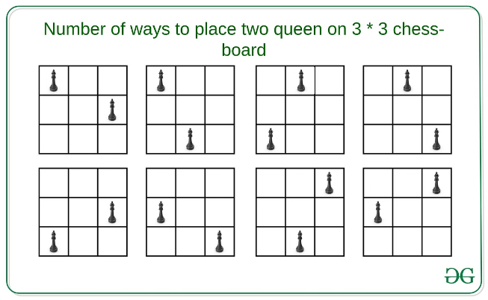
Implementing the Visualization
1
Programming Language
Choose a suitable programming language, such as Python or JavaScript, for implementing the visualization.
2
UI Framework
Select a UI framework, such as React or Vue.js, for building an interactive user interface.
3
Algorithm Implementation
Implement the backtracking algorithm efficiently to find solutions and generate visual updates.
4
Visualization Library
Utilize a visualization library or framework to create an engaging and interactive representation of the board and the algorithm.

Slide 7

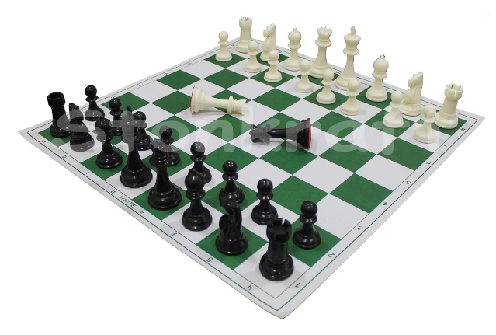
Handling Different Board Sizes
Board Size
Number of Solutions
4
2
8
92
12
14,772,512

Slide 8

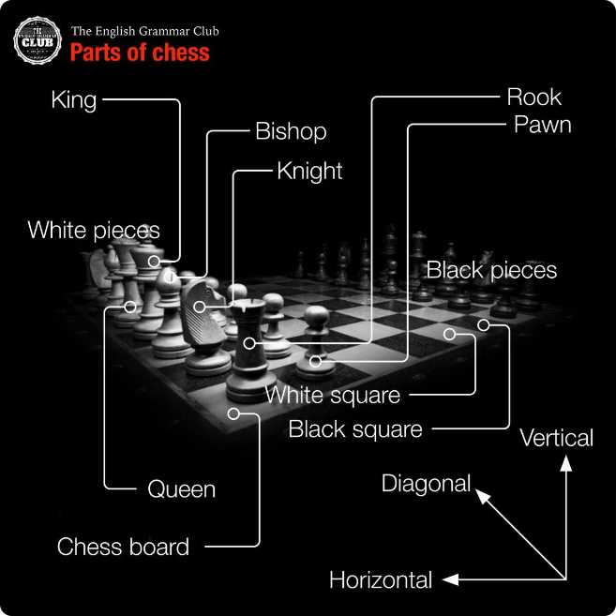



Conclusion and Future Enhancements
Interactive Exploration
Enable users to explore different board sizes and solutions interactively.
Performance Optimization
Optimize the backtracking algorithm for speed and efficiency, particularly for larger board sizes.
Additional Features
Explore incorporating additional features, such as different chess piece types or advanced visualization techniques.

