Slide 1
评分方法
一、实训项目将占60%
二、课后作业将占30%：每周上完课将会布置课后作业，学生要独立完成。不能完全抄袭网上的例子。
二、课堂表现10%：主要看参与度

Slide 2
课后作业
1、提交时间：每周三下午2：00前
2、提交方法：上传到github上指定的文件夹
3、要求：
1）、能在xcode上运行出正确结果
2）、每周二上课前抽查课后作业的设计思路，是怎么实现的等

Slide 3
上次回顾
一、cocoaPods安装使用
二、gitHub的使用

Slide 4
cocoaPod使用
1、将要引用的库加入Podfile内:例如
pod ‘AFNetworking’
2、开始导入:pod install
3、搜索是否有：pod search AFNetworking
4、更新库：pod update

Slide 5
cocoaPods随堂测试
https://github.com/PureLayout/PureLayout
把上面的工程用cocoaPods安装

Slide 6
gitHub使用
1、Fork要更改的目录：fork可以理解为“复刻”，意为复印一份你的拷贝
2、clone到本地
3、commit本地的更改
4、pull request本地的更改到fork的人：pull request意思就是申请更改、被fork的人可以看到你的更改，做批准或否定

Slide 7
实例一(storyBoard)
目标：使用storyboad建立一个segue（就是Push到另一个viewController),并用一个UILabel显示Push的次数
提示：在UINavigationController的rootController建立一个Uibutton和UIlabel，点击button可以push到别一个ViewController.，并在UILabel上显示

Slide 8
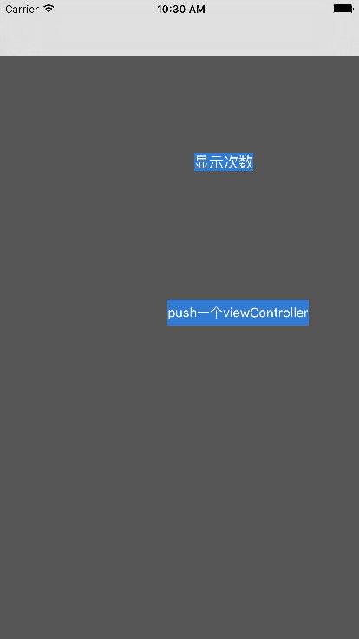

Slide 9
实例二（AutoLayout）
步骤
建立一个UITablviewCell的子类AutoLabelCell
建立一个NSArray* arr = [NSArray arrayWithObjects:@"Intrinsic Content SizeThe intrinsic content size is the size a view prefers to have for a specific content it displays. For example, UILabel has a preferred height based on the font, and a preferred width based on the font and the text it displays. A UIProgressView only has a preferred height based on its artwork, but no preferred width. A plain UIView has neither a preferred width nor a preferred height.Compression Resistance and Content HuggingEach view has content compression resistance priorities and content hugging priorities assigned for both dimensions. These properties only take effect for views which define an intrinsic content size, otherwise there is no content size defined that could resist compression or be hugged.",@"Intrinsic Content SizeThe intrinsic content size is the size a view prefers to have for a specific content it displays. For example, UILabel has a preferred height based on the font, and a preferred width based on the font and the text it displays. A UIProgressView only has a preferred height based on its artwork, but no preferred width. A plain UIView has neither a preferred width nor a preferred height.Compression Resistance and Content HuggingEach view has content compression resistance priorities and content hugging priorities assigned for both dimensions. These properties only take effect for views which define an intrinsic content size, otherwise there is no content size defined that could resist compression or be hugged.",@"Intrinsic Content SizeThe intrinsic content size is the size a view prefers to have for a specific content it displays. For example, UILabel has a preferred height based on the font, and a preferred width based on the font and the text it displays. A UIProgressView only has a preferred height based on its artwork, but no preferred width. A plain UIView has neither a preferred width nor a preferred height.Compression Resistance and Content HuggingEach view has content compression resistance priorities and content hugging priorities assigned for both dimensions. These properties only take effect for views which define an intrinsic content size, otherwise there is no content size defined that could resist compression or be hugged.", nil]
把这个arr的内容装载到AutoLabelCell上
技术提示：autoLabelCell需要使用autoLayout来布局

Slide 10
