Slide 1
实例一(storyBoard)
目标：使用storyboad建立一个segue（就是Push到另一个viewController),并用一个UILabel显示Push的次数
提示：在UINavigationController的rootController建立一个Uibutton和UIlabel，点击button可以push到别一个ViewController.，并在UILabel上显示

Slide 2
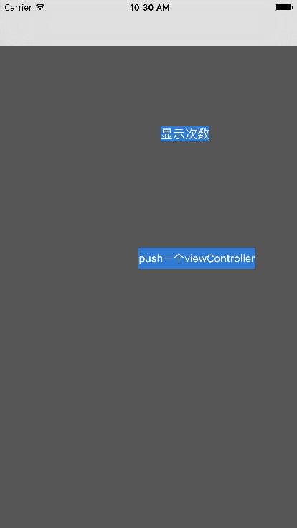

Slide 3
实例二（AutoLayout）
步骤
建立一个UITablviewCell的子类AutoLabelCell
建立一个NSArray* arr = [NSArray arrayWithObjects:@"Intrinsic Content SizeThe intrinsic content size is the size a view prefers to have for a specific content it displays. For example, UILabel has a preferred height based on the font, and a preferred width based on the font and the text it displays. A UIProgressView only has a preferred height based on its artwork, but no preferred width. A plain UIView has neither a preferred width nor a preferred height.Compression Resistance and Content HuggingEach view has content compression resistance priorities and content hugging priorities assigned for both dimensions. These properties only take effect for views which define an intrinsic content size, otherwise there is no content size defined that could resist compression or be hugged.",@"Intrinsic Content SizeThe intrinsic content size is the size a view prefers to have for a specific content it displays. For example, UILabel has a preferred height based on the font, and a preferred width based on the font and the text it displays. A UIProgressView only has a preferred height based on its artwork, but no preferred width. A plain UIView has neither a preferred width nor a preferred height.Compression Resistance and Content HuggingEach view has content compression resistance priorities and content hugging priorities assigned for both dimensions. These properties only take effect for views which define an intrinsic content size, otherwise there is no content size defined that could resist compression or be hugged.",@"Intrinsic Content SizeThe intrinsic content size is the size a view prefers to have for a specific content it displays. For example, UILabel has a preferred height based on the font, and a preferred width based on the font and the text it displays. A UIProgressView only has a preferred height based on its artwork, but no preferred width. A plain UIView has neither a preferred width nor a preferred height.Compression Resistance and Content HuggingEach view has content compression resistance priorities and content hugging priorities assigned for both dimensions. These properties only take effect for views which define an intrinsic content size, otherwise there is no content size defined that could resist compression or be hugged.", nil]
把这个arr的内容装载到AutoLabelCell上
技术提示：autoLabelCell需要使用autoLayout来布局

Slide 4
