Slide 1
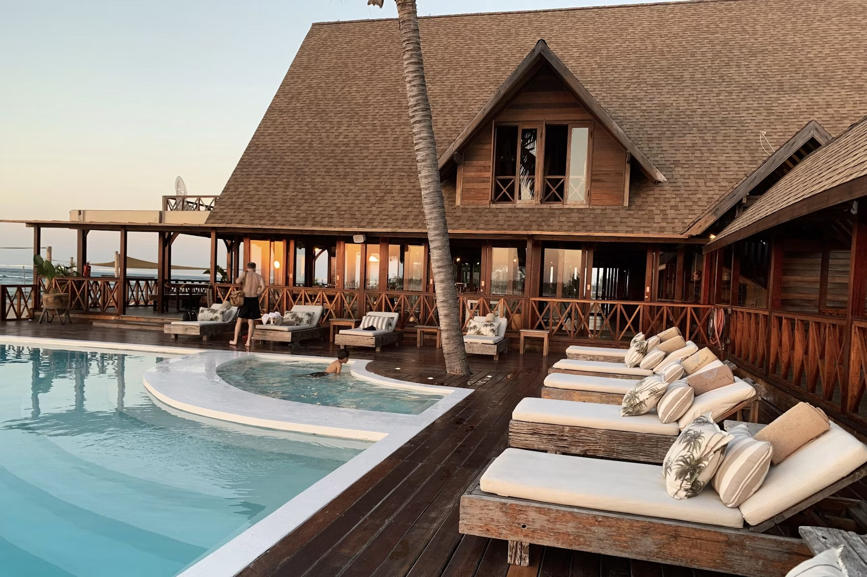
T
Truvora
Turn guest feedback into reviews, reputation, and growth.
A simple platform and service package for hotels that want more review opportunities, better guest insight, and a stronger online presence.
Client Pitch Deck
Talk track: Open with the business outcome: more trust online, less manual follow-up, and a system hotels can actually use.

Slide 2
THE CHALLENGE
Hotels lose reputation momentum when guest feedback is manual.
Most hotels know reviews matter. The hard part is asking consistently, responding quickly, and organizing every signal.
Manual follow-up breaks
Negative feedback gets missed
Online presence goes stale
• Front desk teams get busy
• Guests leave before being asked
• No single place to track outreach
• Issues stay hidden until public reviews
• Managers lack fast visibility
• Follow-up notes are scattered
• Review replies fall behind
• Social pages look inactive
• Future guests see silence
Talk track: Frame the pain gently: they are not doing anything wrong; they just need a repeatable process.

Slide 3

SOLUTION
One workflow for guest outreach and reputation follow-up.
• Send SMS/email review requests
• Capture private feedback and comments
• Track sent, opened, responded, and Google clicks
• Keep notes and follow-ups in one dashboard
Built for hotel teams, not tech teams
Talk track: Position this as operational simplicity: one place to request, record, and act.

Slide 4
PLATFORM FLOW
From guest stay to actionable feedback.
The platform keeps the process simple for staff and easy for guests.
1
2
3
4
5
>
>
>
>
Hotel setup
Guest entry
Request sent
Guest rates
Dashboard updates
Add Google review link and message templates.
Enter guest name, phone, email, and stay date.
SMS/email sends a unique feedback link.
Guest selects stars and may add comments.
Owner sees feedback, status, and notes.
Talk track: Walk them through this as a real operational process, not just software features.

Slide 5
COMPLIANT REVIEW HANDLING
We record feedback without blocking public review access.
Google review behavior has to be handled carefully. The platform is designed around that reality.
What we can record
What we cannot record
Why this matters
• Star rating selected on our page
• Comments entered before redirect
• Whether Google review button was clicked
• Whether a Google review was submitted
• What the guest posted on Google
• Any private Google account action
• Keeps process transparent
• Avoids unfair review gating
• Protects hotel reputation practices
Talk track: This builds trust. Be clear: we track the intent and internal feedback, not private activity on Google.

Slide 6
SERVICE PACKAGES
Choose the level of support your hotel needs.
Start with outreach, add reputation support, or include social media management.
Guest Outreach
Reputation Management
Social Management
$149
$249
$349
/ month
/ month
/ month
Best for hotels that want consistent guest review requests.
Best for hotels that want help replying to reviews.
Best for hotels that want reputation and visibility support.
• SMS review requests
• Email review requests
• Feedback dashboard
• Status and comments
• Everything in Outreach
• Review reply workflow
• Professional response support
• Follow-up notes
• Everything in Reputation
• Facebook post management
• Social content coordination
• Premium workflow
More feedback opportunities
Better public reputation
Reviews plus visibility
Talk track: Do not sell price first. Sell the level of workload they want removed from their team.

Slide 7
PACKAGE 1
Guest Outreach: $149/month
For hotels that want a simple system to ask guests for reviews after their stay.
Included
Client talk track
• SMS and email review request sending
• Guest feedback page with star rating and comments
• Dashboard for sent, opened, responded status
• Google review link tracking and follow-up notes
• Helps staff stay consistent without manual reminders
• Gives owners visibility into guest sentiment
• Best starter option when the main goal is more review opportunities
• Great fit for teams already handling replies themselves
Talk track: Use this package when the client says they mainly need more reviews or a better request process.

Slide 8
PACKAGE 2
Reputation Management: $249/month
For hotels that want outreach plus support managing and replying to reviews.
Included
Client talk track
• Everything in Guest Outreach
• Online review reply management
• Professional response drafting
• Follow-up workflow for guest issues
• Public replies are also read by future guests
• Fast, thoughtful replies reduce damage from negative reviews
• Shows the hotel is active and attentive
• Useful when staff do not have time to manage every reply
Talk track: This is the natural upgrade for owners who care about perception, not just review volume.

Slide 9
PACKAGE 3
Social Management: $349/month
For hotels that want guest outreach, review support, and social media visibility.
Included
Client talk track
• Everything in Reputation Management
• Facebook post management
• Social content coordination
• Visibility workflow for hotel updates
• Premium service support
• Reviews build trust while social keeps the hotel visible
• An active online presence supports future bookings
• Good option for owners who want fewer online tasks to manage
• Useful for properties with events, offers, or seasonal updates
Talk track: Sell this as the full online presence package: feedback, reputation, and visibility together.

Slide 10
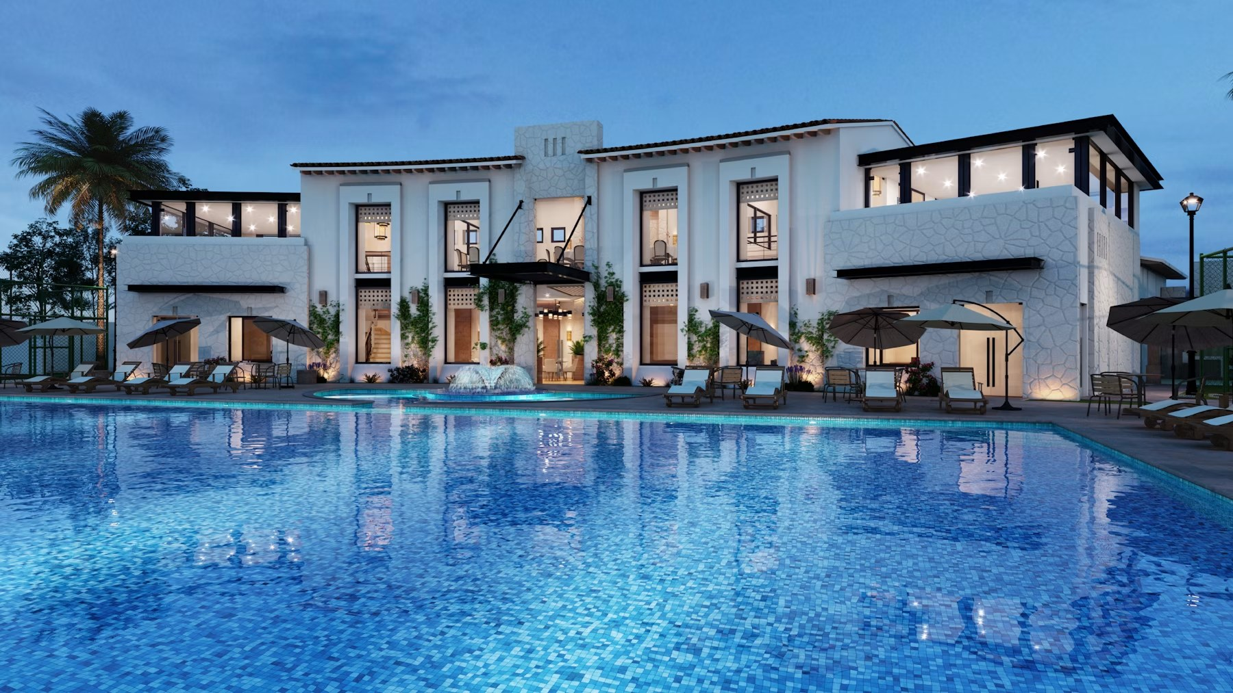
WHAT THE OWNER SEES
A dashboard built around action.
Performance
Guest records
Follow-up
• Total requests sent
• Positive and negative feedback
• Open and response activity
• Star rating and comments
• Google click status
• Stay date and contact details
• Internal notes
• Guest issue tracking
• Real-time updates
Talk track: Show that the dashboard is not just reporting; it helps the owner decide who needs follow-up.

Slide 11
TRIAL AND BILLING
Simple monthly packages with clear service rules.
The platform is designed to let hotels try it, then continue only when they choose a paid package.
7-day trial
Monthly renewal
Cancellation
• Every hotel account starts with a 7-day trial
• Trial lets the owner test the workflow
• Paid package required after trial
• Packages renew monthly
• Package changes apply next renewal
• Current service remains active until then
• 60-day notice to cancel
• Service stays active during notice
• Dashboard shows expiry date
Talk track: Keep this simple. The client should feel the billing terms are clear and predictable.

Slide 12
NEXT STEP
Start with a 7-day trial and choose the package that matches your goals.
• Guest Outreach if you need more review opportunities
• Reputation Management if you need review reply support
• Social Management if you want reputation plus visibility
Let us set up your hotel account
Talk track: Close by asking which outcome matters most: more reviews, better reputation, or stronger online presence.

