Slide 1

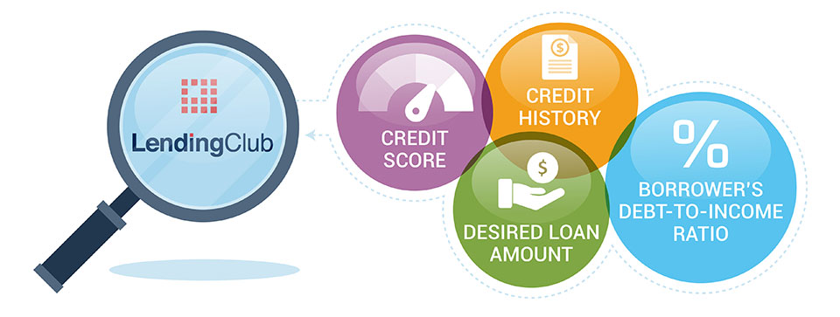
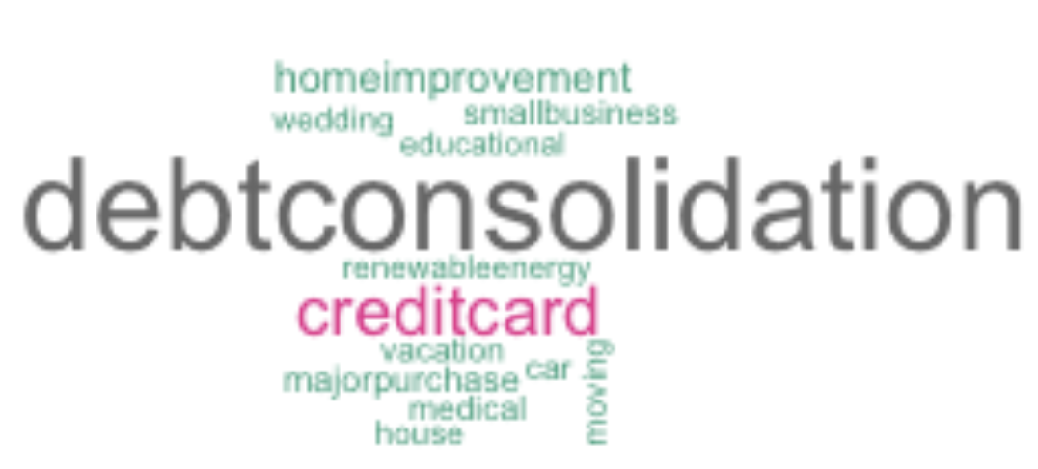
A Case study on
Loans
- JAYAKUMAR SEKAR

Slide 2
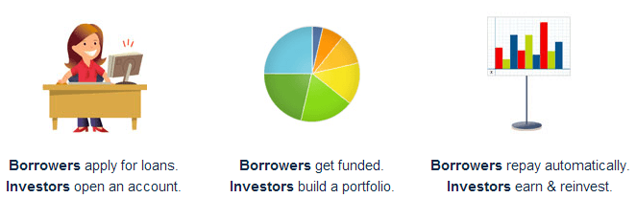
The Business Objective
About Lending Club
Lending Club (LC) is a peer-to-peer online lending platform connecting borrowers and investors, enabling borrowers to obtain a loan, and investors to purchase notes backed by payments made on loans.
https://en.wikipedia.org/wiki/Lending_Club
Objective
To identify patterns which indicate if a person is likely to default or not using Exploratory Data Analysis. By identifying these risky loan applicants, such defaulting loans can be reduced thereby cutting down the amount of credit loss to the Lending Company

Slide 3
About the Data
Key Attributes for Analysis
Issues taken care in the given data
Loan Attributes
Consumer Attributes
Home Ownership
Annual Income
Verification status
Address State
Employment Length
NA values
Unnecessary columns that are of not much use for Analysis)
Dates as strings
Loan term as string
Percentages as strings
Outliers
Loan amount
Interest rate
Installment
Loan status
Loan grade/sub-grade,
Issue date
Term
Installment
purpose
Consumer Financial Attributes
Debt to income ratio
Credit line age
Total_Acc
Revolving Util. rate
Revolving Balance
Pub_rec
inq_last_6mths
Earliest_Credit line
delinq_2yrs

Slide 4
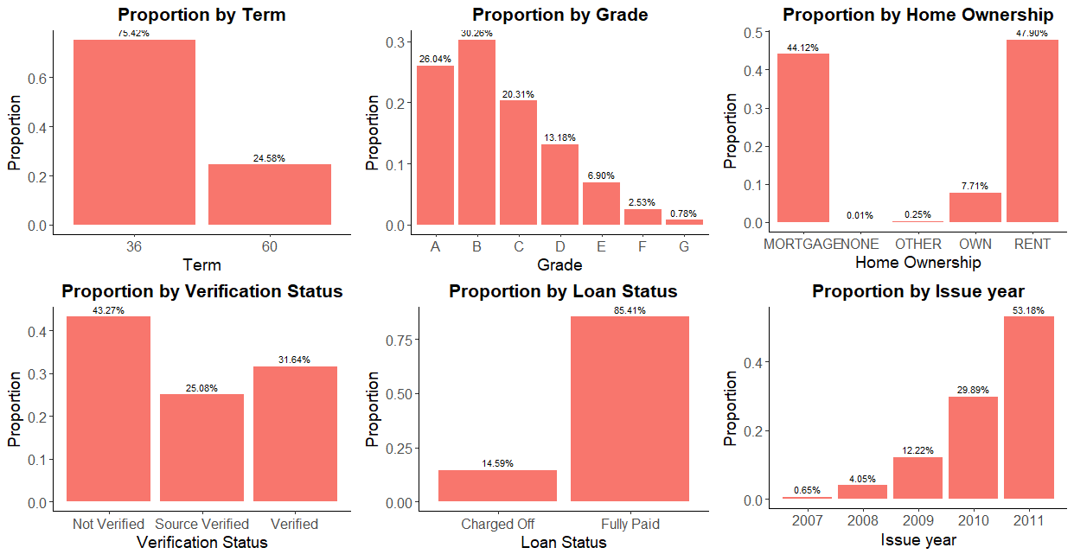
Univariate Analysis
Categorical variables
Majority (~75%) of the loans are for 36 month tenure
Grade B has highest loans followed by A. The number decrease with Grade G having least loans.
Majority (~92%) of the borrowers are either in Mortgaged or Rented houses
In ~43% of cases, borrowers income seems to be not verified
~1 out of 7 cases are charged off
The number of loans issued is consistently on the rise

Slide 5
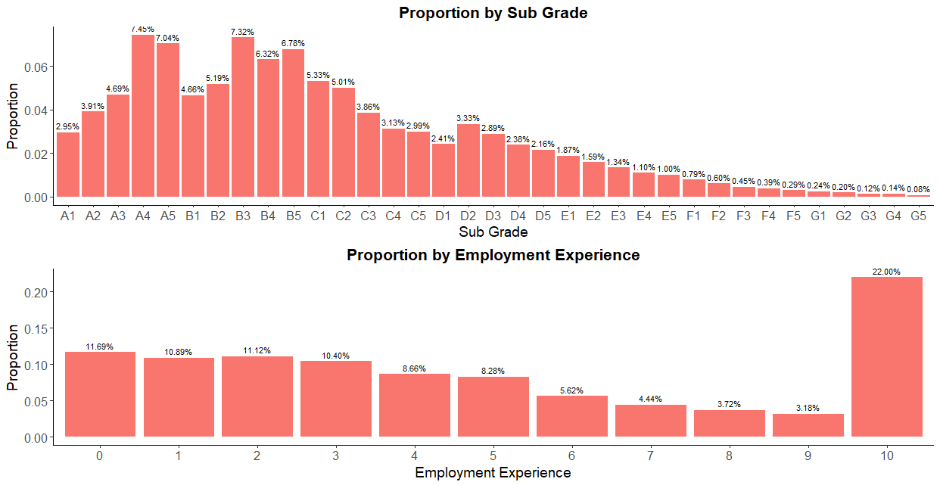
Univariate Analysis
Categorical variables contd…
Looking at a more granular level, within grades the proportion varies by levels. In A & B grades, the proportion increases as the level increases (from 1 to 5) whereas in most of the other grades the proportion decreases as the level increases.
Borrowers with less years of employment experience are the ones who have requested for more loans
Note : The proportion is more in 10 years since the experience spread is more as it includes all 10+ years observations.

Slide 6
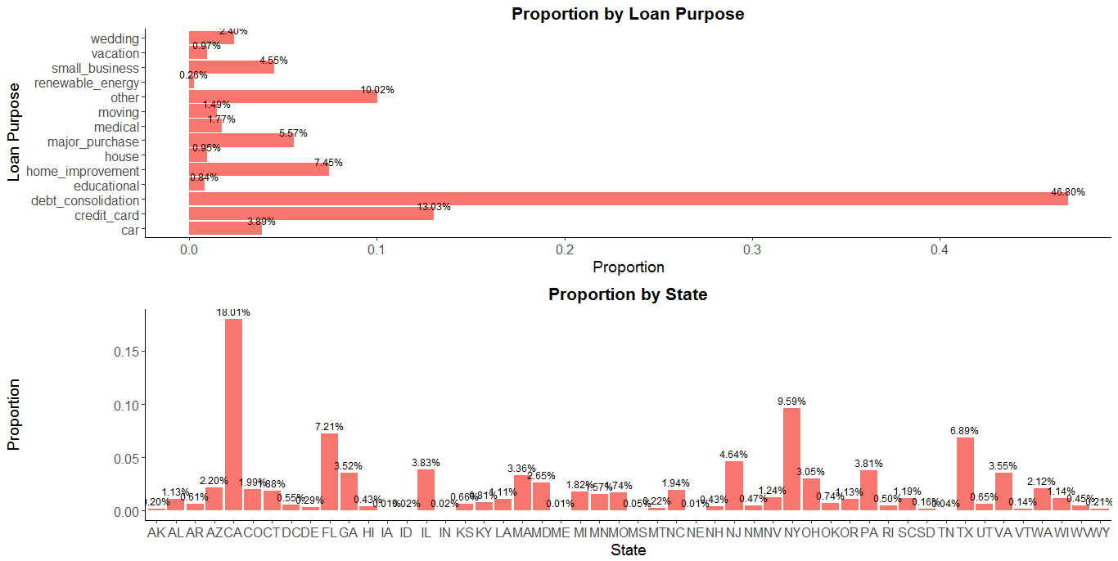
Univariate Analysis
Categorical variables contd…
Top 5 purposes for which loans were applied
1. Debt consolidation - 46.80%
2. Credit card - 13.03%
3. Other - 10.02%
4. Home improvement - 7.45%
5. Major purchase - 5.57%
Most borrowers are from state of California (18%) followed by New York (10%), followed by Florida(7%). Together they constitute 35% of the loans.

Slide 7
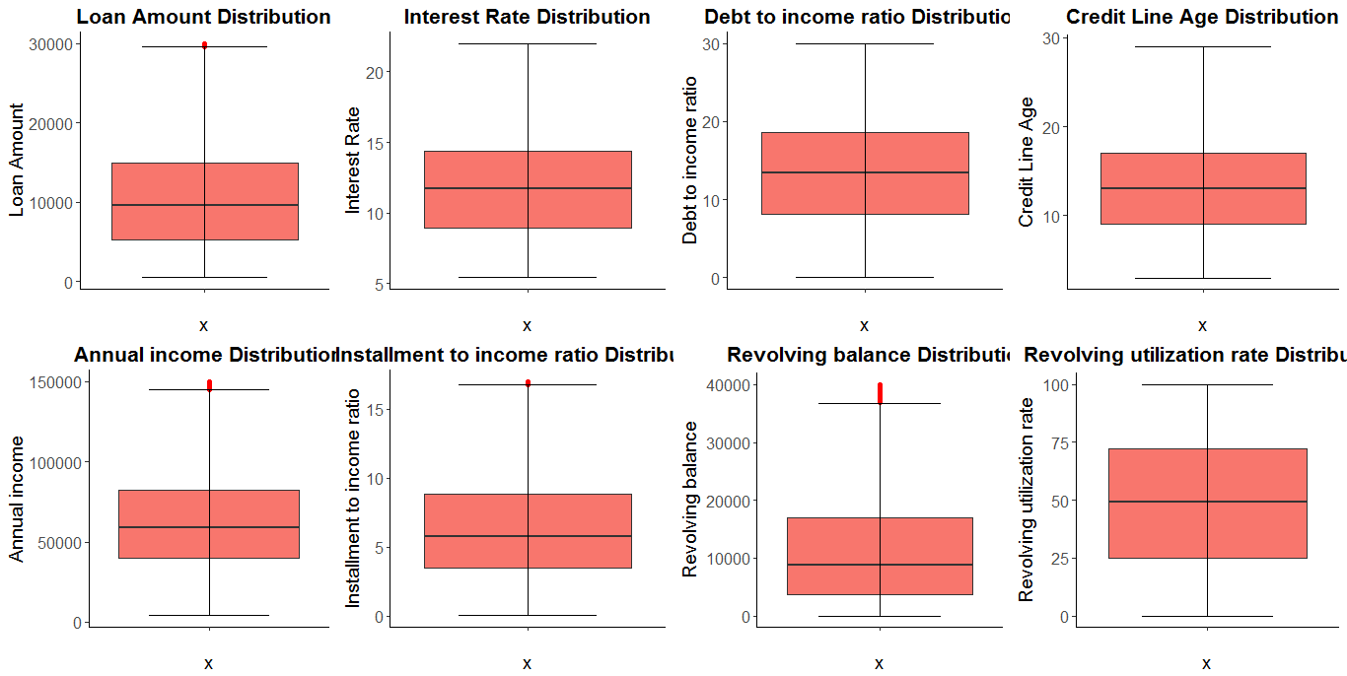
Univariate Analysis
Continuous variables
Loan amounts range from $500 to $35000 with an average of $9600
Outliers greater than $30000 (only 1% records) are capped to $30000
Interest rates range from 5% to 24% with and average of 11%
Outliers greater than 23% (0.5% records) are capped to 23%
Lending Club borrowers has dti ranging from 0 to 30 with an average of 13.
Lending Club borrowers has credit history ranging from 3 to 51 years with an average of 13 years
Outliers greater than 29 (only 2% records) are capped at 29
Average of $58k of annual personal income
Outliers greater than 150K (only 8% records) are capped at 150k.
Should not be impacting the analysis on the target variable since we are just capping
Lending Club borrowers has iti ranging from 0 to 32 with an average of 6.
Outliers in iti > 17% capped to 17%.

Slide 8
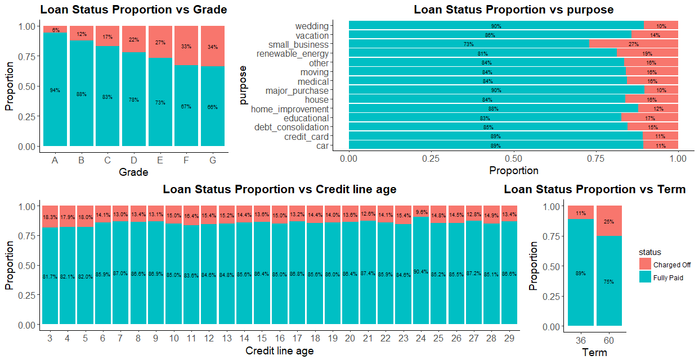
Multivariate Analysis
Categorical variables
Grades
There is a clear relationship between the grade assigned by Lending Club and the loan status as follows.
94 % of A-grade loans are fully paid. This percentage gradually lowers down to 66% for G-grade loans.
Loan purpose
The less risky loan purpose are wedding loans/major purchase purpose loans with a 90% repayment rate. And the most risky is small businesses funding, with a 73% repayment rate
Credit line age
More risk of defaulting with borrowers of Credit line age <=5
Term
More Charge offs in 60 month tenures than 36 months tenure.

Slide 9
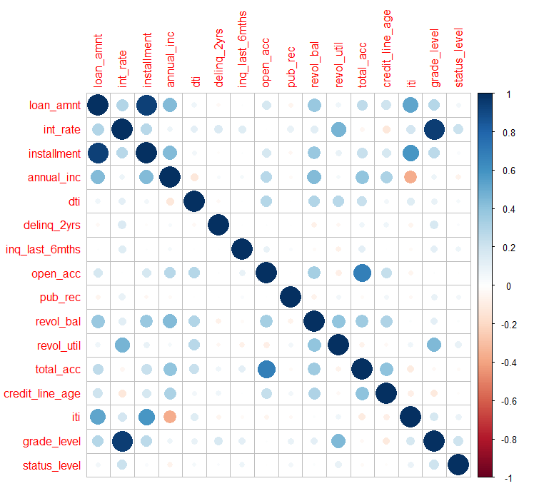
Multivariate Analysis
Continuous variables
Categorical variables - Grades & Status shows +ve correlation on the below:
1) Revolving utilization rate
2) Loan Amount
3) Credit Line age
4) Annual income
5) Interest rate
6) Installment to income ratio
.

Slide 10
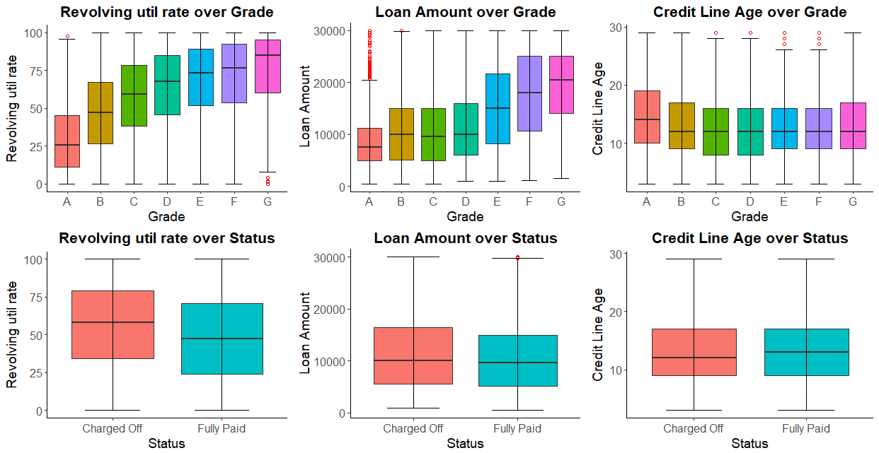
Multivariate Analysis
Continuous variables Vs Categorical
Defaulting rate is more for borrowers with higher revolving utilization rates
Grades assigned based on Loan amount, Revolving line utilization rate, dti, earliest_cr_line (credit line age),
Charged off loan seems to be more for higher revolving util rates
Loan amounts and credit line age on an average shows some correlation on the defaulting rate

Slide 11
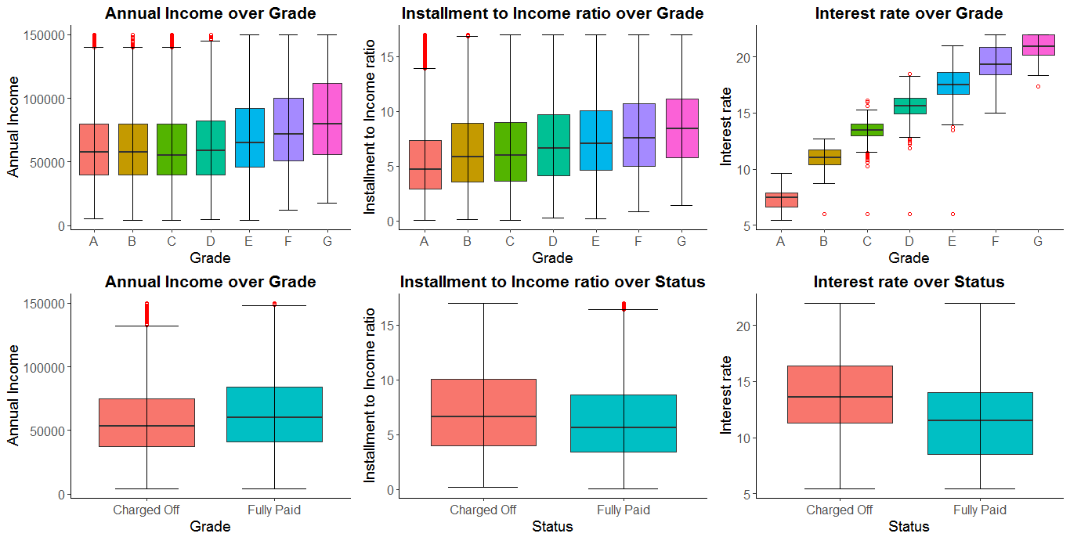
Multivariate Analysis
Continuous variables Vs Categorical contd…
Defaulting rate is more when the
Annual income is low
Installment to income ratio is high and
Interest rate is high
Annual income
Interestingly annual income is bit higher for Grades E through G
On an average Borrowers with lower annual income tend to default more.
Installment to Income ratio
Lowest Installment to income ratio in Grade A and highest iti in Grade G
Charged off loan has higher installment to income ratio on an average than Fully paid loans
Interest rates
Grade A loans has lowest interest rate and Grade E with highest interest rate.
Charged off loan has higher interest rates on an average than Fully paid loans

Slide 12
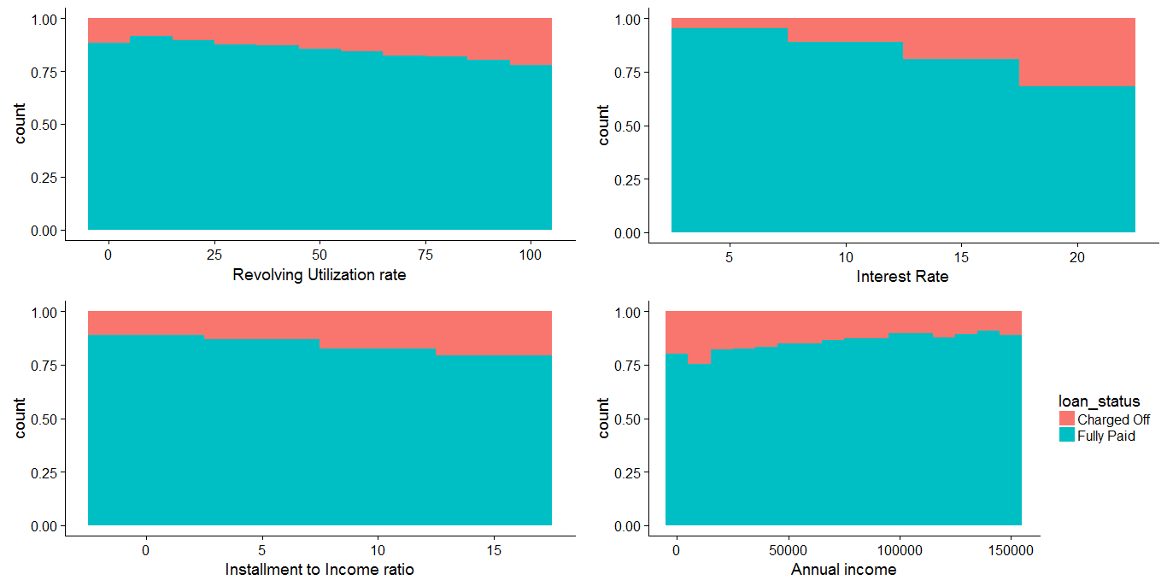
Segmented Analysis
Continuous variables using bin buckets
Defaulting rate depends on the following variables. Strong dependency in the below order :
Interest rate
Installment to income ratio
Revolving utilization rate
Annual income

Slide 13
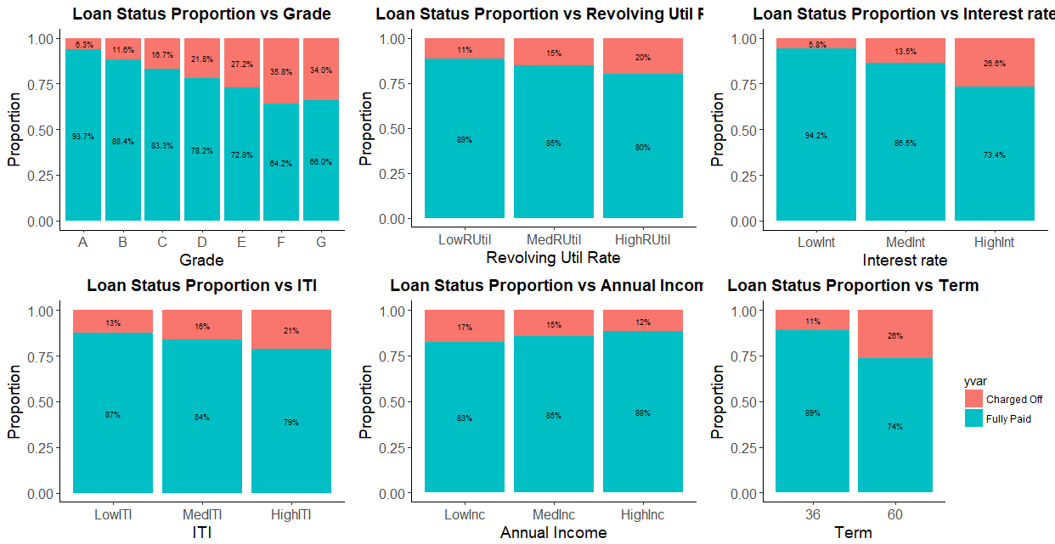
Segmented Analysis
Categorical & Continuous (Segmented) variables
The above plots are for Debt Consolidation. Similar are the plots for other loan purposes. Though the impact of the above variables on the defaulting rate may vary based on the purpose of the loan, those are the common most strongly influencing variables

Slide 14
Segmented Analysis
Summary
E
F
G
Grades
Defaulting rate increases to 80%
(~4 out of 5 borrowers default)
for Small Business, Renewable energy, Educational loans:
Defaulting rate increases to 50%
(~1 out of 2 borrowers default)
for Debt Consolidation, Credit Card types of loans
>15%
Higher interest rates
60 Months
Higher loan tenure
>15%
Higher installment to income ratio
<50K
Lower Income (< 50 K)

Slide 15
Conclusion
The study results show that below are the strong variables impacting defaulting rate
Grade :
There is a clear relationship between the grade assigned by Lending Club and the probability of default.
of 94.4% of A-grade loans were reimbursed. This percentage gradually decreases to 61.8% for G-grade loans.
Loan Purpose:
Loans for Debt consolidation and Credit card constitute 60% of total loans. Loan purpose is also a factor explaining default: Wedding is the less risky loan purpose and Small business is the riskiest.
Loan Tenure:
Defaulting rate depends on Loan tenure. Higher the loan tenure (60 months), Higher is the defaulting rate.
Interest rate:
On an average Charged off loans paid higher interest rates (13%) than the fully paid loans (11%). i.e Higher the interest rate, Higher the probability of default is.
Over years interest rates for Grade D through E has been seen increasing especially post 2011 there is a steep rise.
Borrower Characteristics: Annual income, Installment to Income ratio, Revolving utilization rate
Fully paid borrowers have less Installment to income ratio compared to the defaulting ones.
Fully paid borrowers have an average of $60K annual income against defaulting borrowers with only an average of $53K annual income
Revolving utilization rate is more (average 58.20%) for charged off loans than that of fully paid loans (average 47.50%)

