Slide 1


A Case study on Uber’s Demand vs Supply
- JAYAKUMAR SEKAR

Slide 2
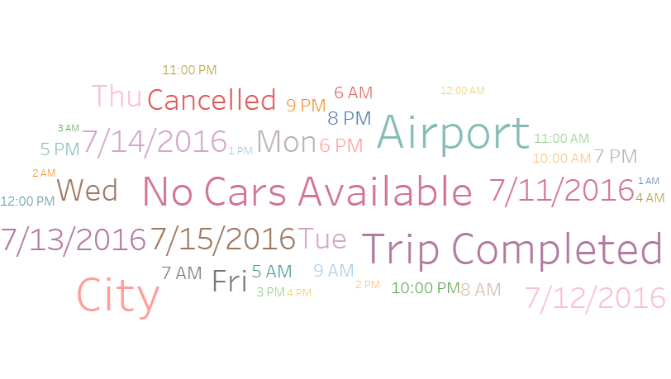
The Business Problem
Business Problem
High cancellation or non availability of cars for customers travelling to and from the airport.
Impacts
If driver cancels the request of customers or if cars are unavailable, Uber loses out on its revenue.
Customer dissatisfaction
Brand name losing value.
Assumptions
The drop point for a request made in city is assumed to be airport and vice versa.
The given data is only for 5 days. Assumption is the sample is a good representation of the entire population of Uber requests.

Slide 3
The Data in hand
Description | Masked data set containing Uber cab request details
Source | UpGrad case study assignment
Format | .csv (comma separated values)
Number of observations | 6745
Number of variables | 6
Each row is | A cab request made by a customer
Sampling method | All cab requests made for 5 days (Days 11 through 15 in the month of June for the year 2016)
Column Name | Type | Description | Missing | Uniques | Top
Request id | Number | A unique identifier of the request | 0 | 6745 | 619, 867, 1807, 2532, 3112, 3879, …
Pickup point | Text | The point from which the request was made | 0 | 6745 | "Airport", "Airport", "City", "Airport","City", "Airport",…
Driver id | Number | The unique identifier of the driver | 3914 | 300 | 1, 1, 1, 1, 1, 1, 1, 1, 1, 2, 2, 2, …
Status | Text | The final status of the trip, that can be either completed, cancelled by the driver or no cars available | 0 | 3 | "Trip Completed", "Trip Completed", "Trip Completed"…
Request timestamp | Date timestamp | The date and time at which the customer made the trip request | 0 | 5 | "11/7/2016 11:51", "11/7/2016 17:57", "12/7/2016 9:17",…
Drop timestamp | Date timestamp | The drop-off date and time in case the trip was completed | 2650 | 5 | "11/7/2016 13:00", "11/7/2016 18:47", "12/7/2016 9:58"…

Slide 4


The Demand vs Supply
What is the average demand from airport to city and city to airport?
What is the total # of Cabs/Drivers available?
 | Airport | City
Total demand | 3238 | 3507
Percentage | 48% | 52%
Number of Cars/Drivers
300
What is the expected average # of trips a driver should complete per week in order to meet the demand we have
Are there any hours during which there is more demand than the available Cabs/Drivers
Airport | City
11 | 12
5 AM | 6 AM | 7 AM | 8 AM | 9 AM
445 | 398 | 406 | 423 | 431
What is the current average # of trips
a driver completes per week?
5 PM | 6 PM | 7 PM | 8 PM | 9 PM | 10 PM
445 | 398 | 406 | 423 | 431 | 304
Airport | City
4 | 5
With the available 300 drivers it wouldn't be possible to meet the peak demand. We would need additional Cabs/Drivers to meet the peak demand. If additional cabs/Drivers added, then the expected average seen on the left might become less.
To meet the available demand, a driver should complete at least 23 trips(11 Airport, 12 City) in a week (Mon - Fri) between airport and city whereas the current average is only 9 trips (4 Airport, 5 City).

Slide 5
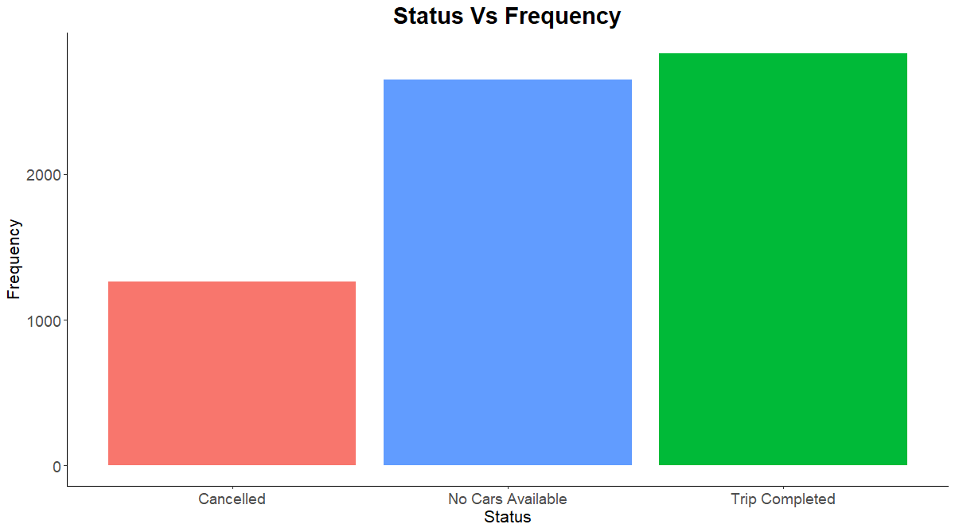
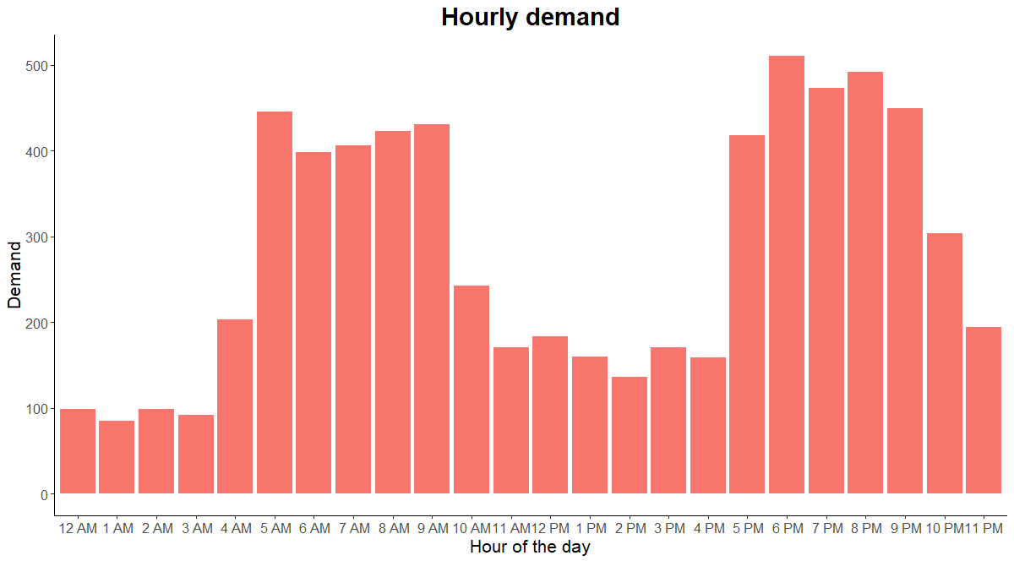
Exploring causes for the Demand vs Supply gap contd..
How many( or what % of) trips got completed /cancelled or trips for which no cars where available?
How does the demand look like for each hour?
Cancelled | No Cars Available | Trip Completed
19% | 39% | 42%
Less than 50%(~42%) of the trips got completed.
For ~40% of the trips, demand is not being met as no cars are available.
~20% of the trips are being cancelled by the drivers
There are 2 spikes in demand at certain hours of the
day.

Slide 6
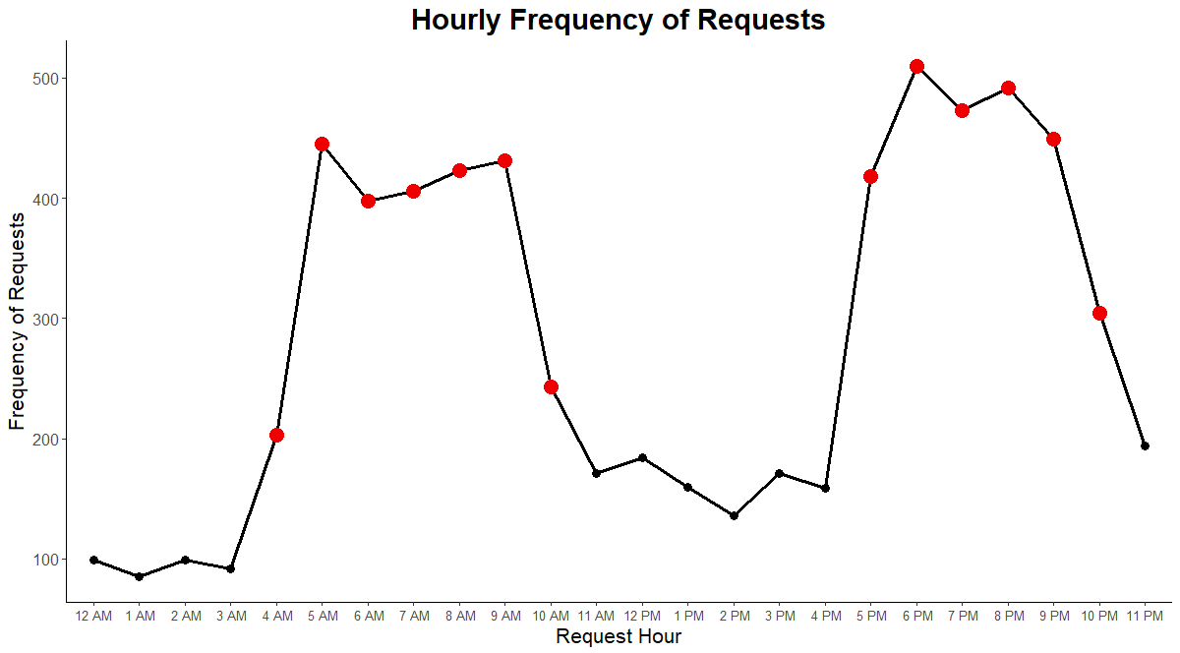
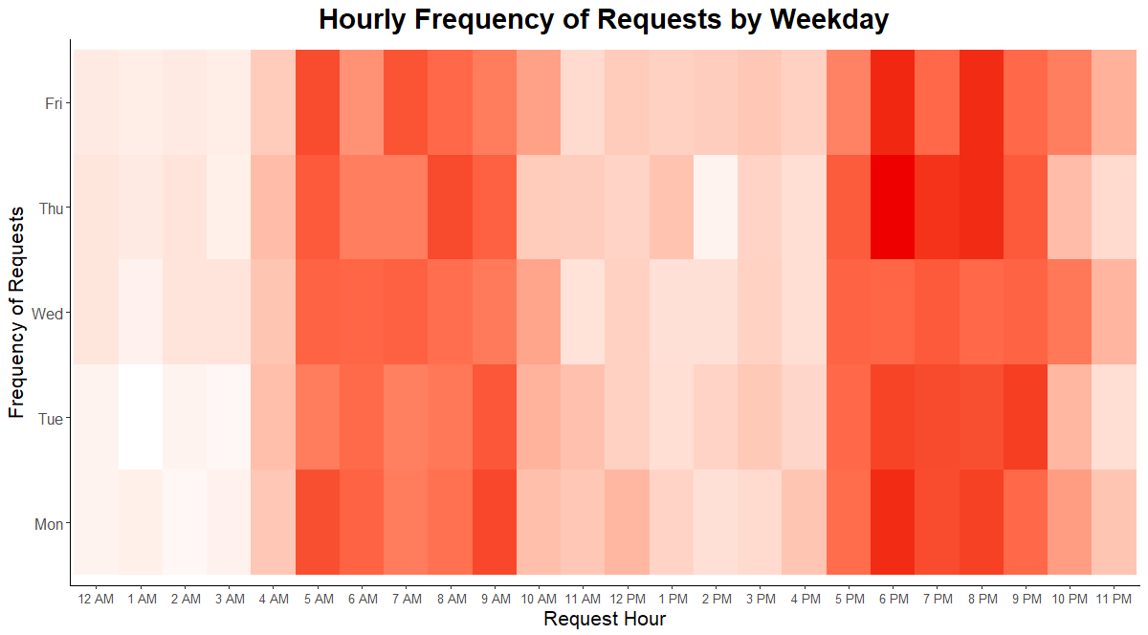
Identifying the Peak hours
What are the peak hours of the requests?
How does the peak hours look across weekdays?
Peak times : 4 AM to 10 AM & 5 PM to 10 PM across all weekdays

Slide 7
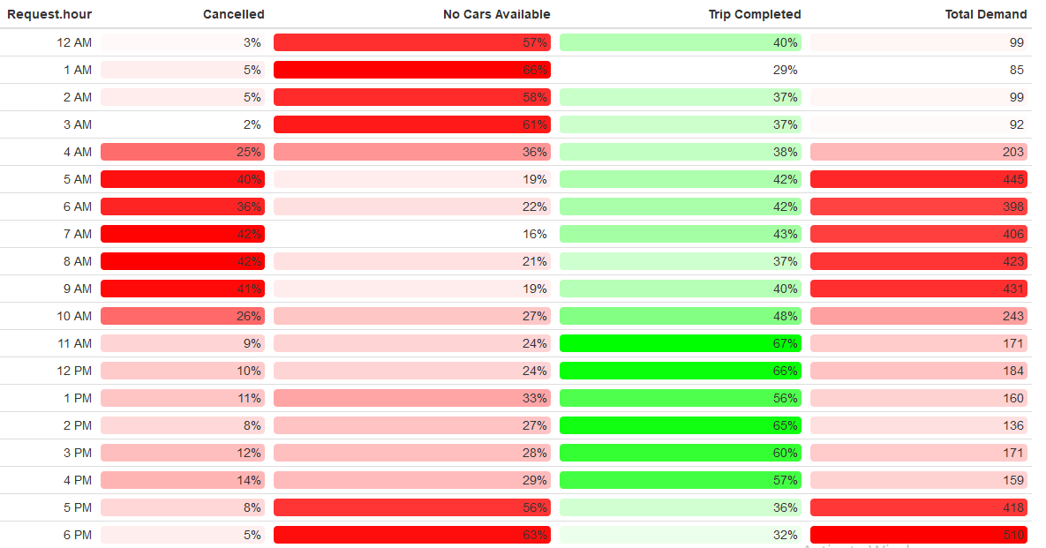
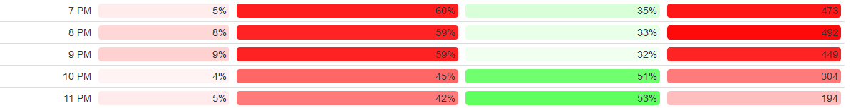
Quantifying the Peak hours
How does the proportion of various statuses look like during the peak hours?
Peak times > 200 Requests
> 25% Cancellations @ 4 AM to 10 AM (Morning peak time)
> 45% unavailability of cars @ & 5 PM to 10 PM (Evening peak time) (Based on the total demand, we will focus our analysis on peak hours considering hours where total demand is >200)
.

Slide 8

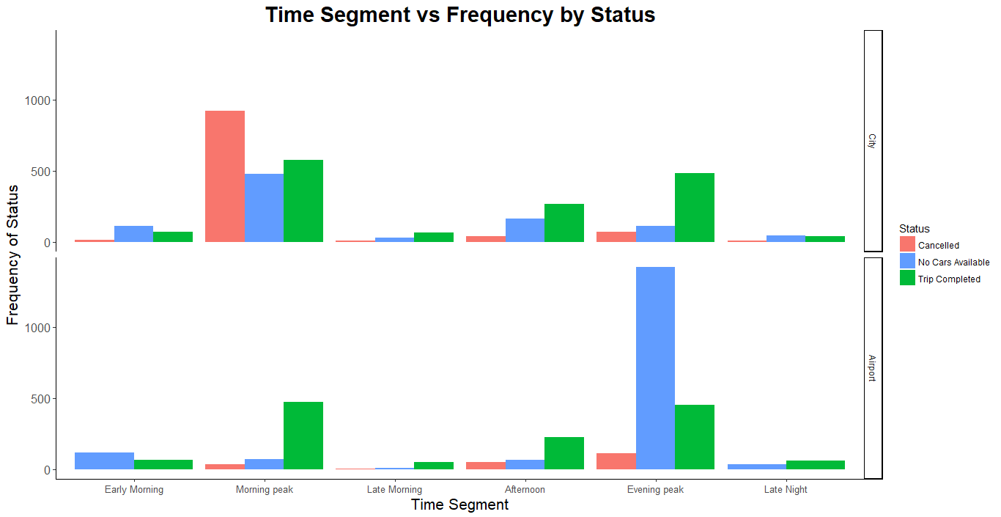
Focusing on challenges based on Time Segments
How does status vary for different time segments especially during peak hours?
How does the demand vary for different time segments based on pickup points especially during peak hours?
Challenge 1 : Morning peak hour window(4 AM to 10 AM) - Demand is higher in City. Cab Cancellations are higher.
Challenge 2 : Evening peak hour window(5 PM to 10 PM) - Demand is higher in Airport. Cabs unavailability is higher.
Early Morning : 12 AM - 5 AM | Morning peak : 4 AM - 10 AM | Late Morning : 10 AM - 11:59 AM
Afternoon : 12 PM - 5 PM | Evening peak : 5 PM - 10 PM | Late Night : 09 PM - 11:59 PM

Slide 9
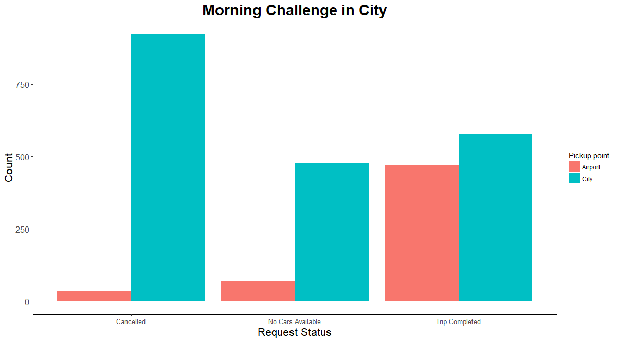
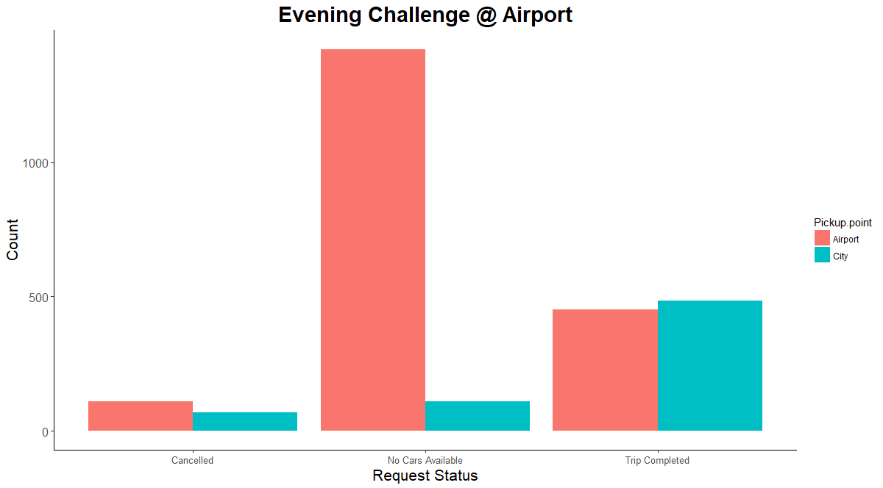
Focusing on challenges based on Time Segments
What does more (cancellations/unavailability of cars) mean? Can we quantify? How much are the numbers?
Cancelled | No Cars Available | Trip Completed
47% | 24% | 29%
Cancelled | No Cars Available | Trip Completed
6% | 72% | 22%
No. of trips completed is only 29% and the cancellations are around 47%.
No. of trips completed is only 22% whereas the cab unavailability is around 72%.
What is the expected average & actual average # of trips a driver takes in a week during the Morning/Evening peak hours
Expected average trips during morning and evening peak hours is 7 (or less if we add additional cabs/drivers) per week (5 days Mon – Fri ) whereas the current average trips is only 2 per week (5 days – Mon - Fri)

Slide 10
Summary of Insights and Proposed Solution
Challenges in City:
During Morning peak hour timeslot in the city:
Average trips completed is only 2 per week whereas expected is around 7 per week
Demand more than the available Cabs/Drivers.
47% cancellations by the drivers.
Possible causes :
More outbound flights from the airport during Morning peak hours
Demand to reach airport from the city is more.
Very little inbound flights at the airport.
A driver who is taking a pickup to the airport at this time may not have a customer to pickup from the airport back to the city or may have to wait a considerable amount of time to get a return pickup.
During this idle time he might make money by doing other trips in the city. Hence the driver prefers not to go to the airport and cancels the trips
Proposed Solution :
Peak hour charges (1.25x, 1.5x, 1.75x or 2x times the base price based on the hour demand) for the customers.
Use the additional income from the peak hour charges
to provide Weekly Incentives for drivers who take trips from city to airport during the morning peak hours.
To compensate for the idle time at the airport.
Levy cancellation charges to drivers if they cancel more than 2 times in a week during the peak time slots.
Add additional Cabs/Drivers to meet the peak hour demand.
No. of trips based incentives if the driver completes more than the expected average # of 7 trips per week (5 trips if additional cabs added) from city to Airport during the peak hours.
Challenges @ Airport:
During Evening peak hour timeslot @ the Airport:
Average trips completed is only 2 per week whereas expected is around 7 per week.
Demand more than the available Cabs/Drivers.
72% unavailability of cabs.
Possible causes :
More incoming flights at the airport during Evening peak hours.
Demand @ the airport is higher.
Very little outbound flights from the airport.
The number of cabs reaching the airport during this timeslot is very less resulting in the shortage of the cabs at the Airport.
The drivers prefer not to go to the airport empty (without any passengers)
Proposed Solution :
Starting 4 PM every day, identify cabs that are in and around a set (say 5 KM) radius from airport. Flash a message on the Mobile App, indicating that they are eligible for a weekly incentive if they reach Airport and take the pickup during the peak hours at the Airport.
Add additional Cabs/Drivers to meet the peak hour demand.
No. of trips based incentives if the driver completes more than the expected average # of 7 trips per week (5 trips if additional cabs added) from city to Airport during the peak hours.

