Slide 1
ECG Paper Digitization
How printing and tracing can change probability reliability
10-minute research presentation | PTB-XL | synthetic creased pages

Slide 2
1. Why this problem matters
A model can be accurate at ranking cases but wrong about how confident it should be.
Clean digital ECG
→
Paper / scan / trace
→
Prediction probabilities
If a model says 90%, roughly 90% of similar cases should be correct. Calibration error measures the gap between reported probability and observed frequency.

Slide 3
2. Research question and hypothesis
Question
Does tracing a synthetic PTB-XL paper page change classwise calibration, and does the change differ by diagnosis?
Hypothesis
The same digitization artifacts may affect probability reliability differently across diagnoses and across voltage representations.

Slide 4
3. Data and model
Dataset: PTB-XL 1.0.3
Classifier
• 12-lead ECGs
• 100 Hz, 10 seconds
• 5 diagnostic superclasses
• 17,084 train | 2,146 validation | 2,158 test
Compact 1D residual network
BCE + AdamW
Seed 42
Checkpoint selected on fold 9

Slide 5
4. The controlled comparison
Same data • same seed • same architecture • same split
Arm A
Per-lead standardized
Removes absolute voltage scale
Arm B
Raw millivolts
Keeps absolute voltage scale
VS
Primary question: does the representation change vulnerability to tracing?

Slide 6
5. Paper-to-digital pipeline
Clean waveform
→
Synthetic paper page
wrinkles + creases
→
Trace recovery
column max-finder
→
Paired evaluation
The same test record is scored twice: clean versus traced. Average trace SNR: 9.06 dB.

Slide 7
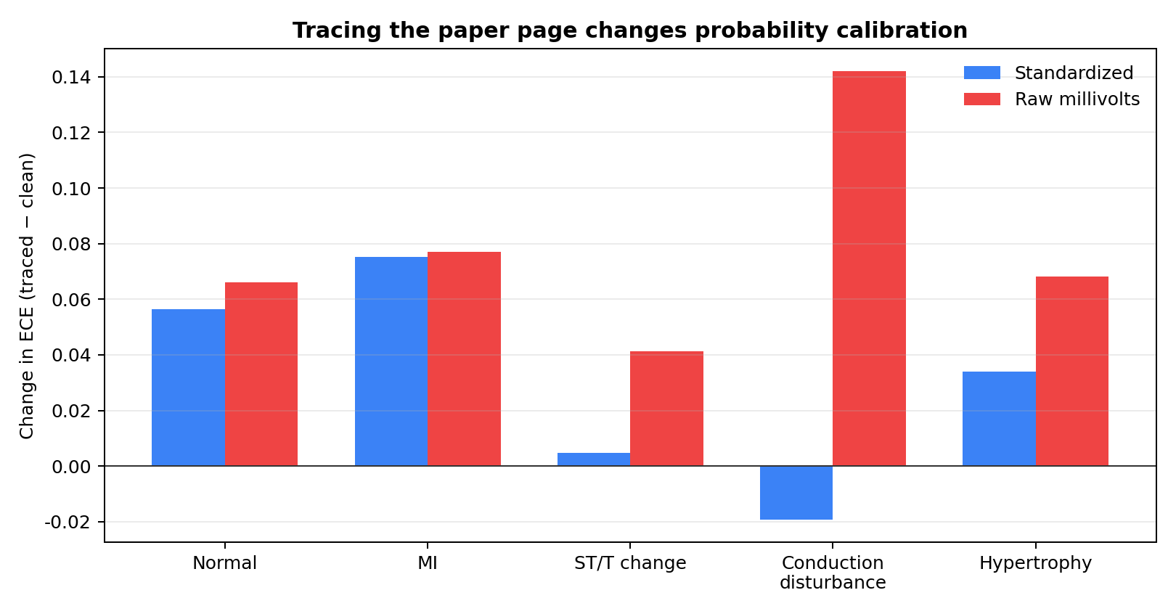
6. Main result: calibration changes by class
Positive = worse probability calibration after tracing

Slide 8
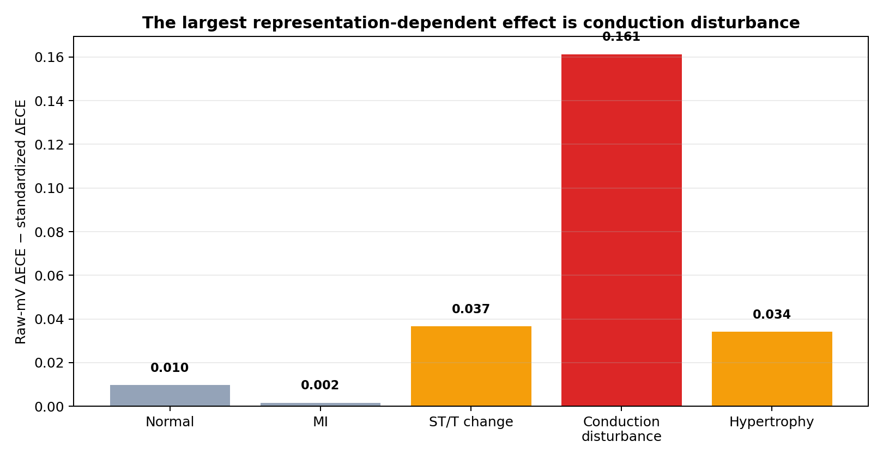
7. Main finding: raw millivolts are more vulnerable
Conduction disturbance contrast: +0.161 (patient-bootstrap interval ≈ 0.136–0.171)

Slide 9
8. What does this mean?
For conduction disturbance:
This is not just a reconstruction-quality story. CD records had similar SNR to non-CD records, and oracle amplitude matching removed only part of the shift.
Raw-mV model: +0.142 ΔECE
Standardized model: −0.019 ΔECE
Difference: +0.161

Slide 10
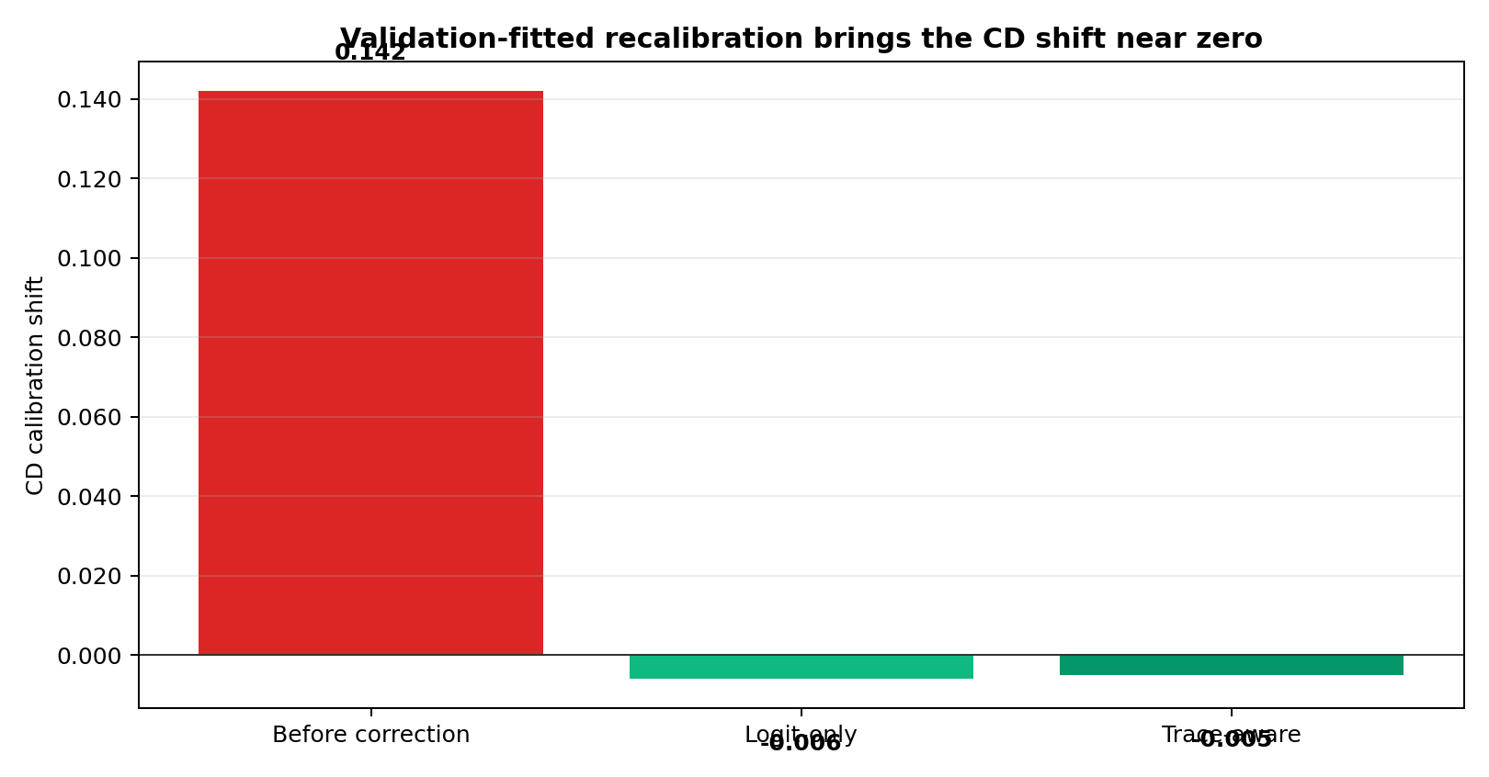
9. Did we improve the probability error?
A validation-fitted recalibration map reduces the shift near zero without retraining the classifier.

Slide 11
10. Novelty, contribution, and limits
Contribution
Limits
• Paired classwise calibration study after ECG paper digitization
• Shows dependence on voltage representation
• Separates calibration from AUROC and reconstruction quality
• Demonstrates a practical recalibration fix
• Synthetic creased pages only
• One primary seed and architecture
• Real color scans not yet scored
• Not a clinical deployment claim
Take-home: paper digitization can preserve useful ranking while quietly damaging probability reliability.

