Slide 1
Honey Production in the US
SQL-INJECTORS:
Shilpa Khanolkar | Justin Le | Nikita Patel | Alli Sklar

Slide 2
Motivation
The motivation behind this group project was to use data to create multiple visualizations in order to answer a series of questions surrounding honey production in the United States from 1998 to 2012. What we hope to accomplish from this project was to be able to have users draw their own conclusions through data visualizations presented on our webpage.

Slide 3
Questions
How has honey production yield changed from 1998 to 2012 and how does that compare to the total use of pesticides per year?
How has honey production yield changed from 1998 to 2012 and how does that compare to the max temperature per year?
Are there any trends in bee colony population in the United States from 1998 to 2012.

Slide 4
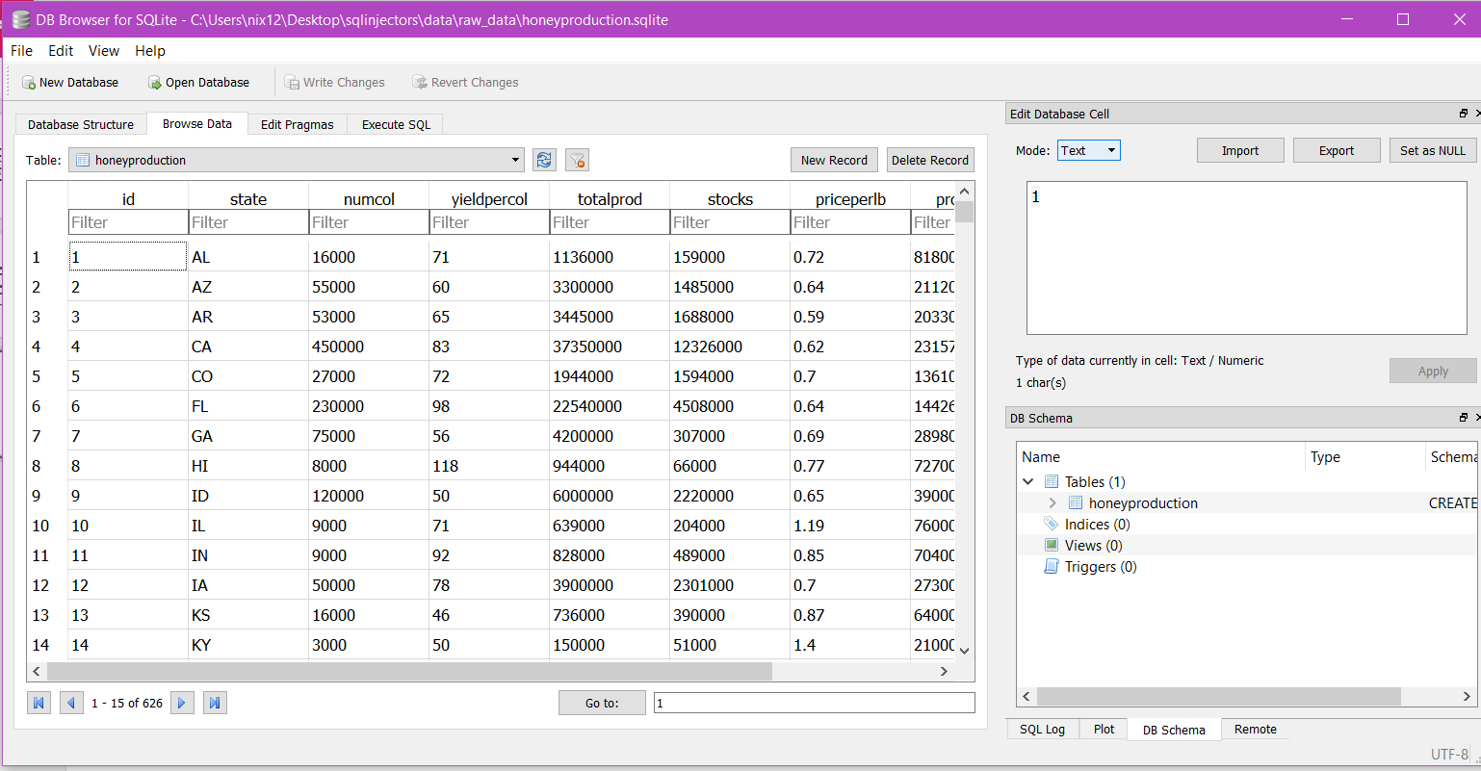
Data Source and
Database used
Our dataset was from kaggle.
We used sqlite to store our data.

Slide 5
Libraries used
Plotly(bubble plot)
Leaflet(choropleth/bubble map, geojson)
Highmaps(new library used to plot colony population trend)
Particle JS(homepage)

