Slide 1
Lord Of Space
Developed by Jaylen Terry

Slide 2
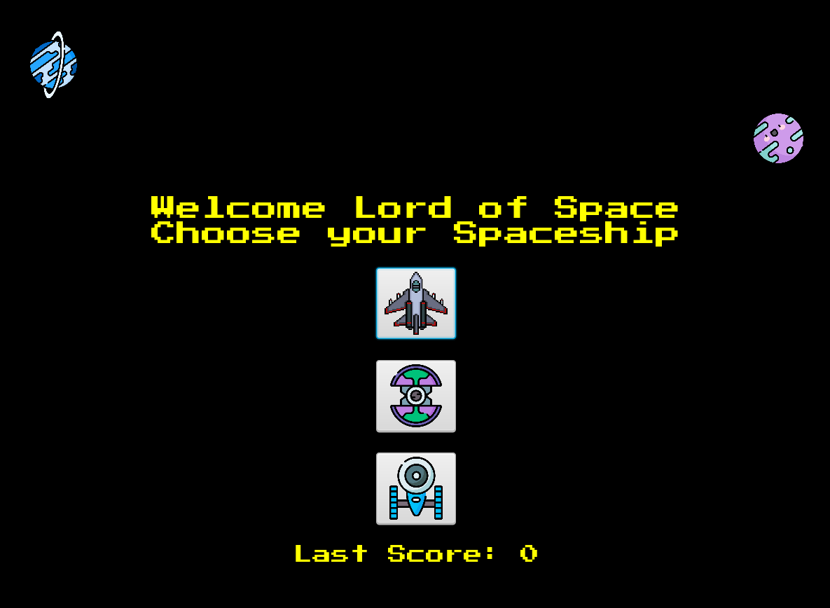
Overview
Arcade style space shooter game inspired by the classic Space Invaders game
Players control a spaceship, dodging and destroying incoming enemy ships and meteoroids

Slide 3
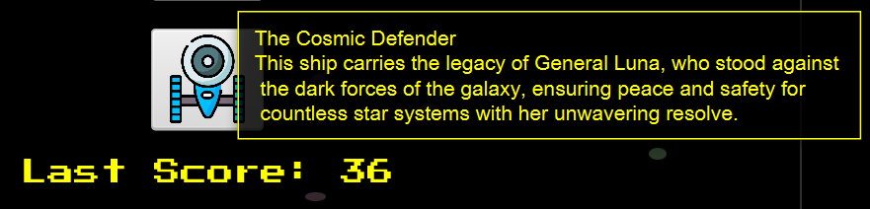
Features
Multiple enemy types and species
Different spaceships for players to choose from with unique backstories
Score tracking and display
Simple controls
Animated background for immersive gameplay
EXPLOSIONS!!

Slide 4



Spaceships
The Starlight Voyager Once a beacon of hope, sailed through the cosmos under Captain Orion’s command
The Cosmic Defender Carries the legacy of General Luna, ensuring peace and safety for countless star systems
The Nebula Striker Shrouded in mystery, the vessel of choice for the Shadow Phantom

Slide 5








Enemy Species
Zorgon Invader
Galactic Gorgons
Quantum Scavenger
Galactic Ghoul
Sinister species that feed on the energy of stars and planets, leaving a trail of cold lifeless celestial bodies in their wake
Relentless attackers from the Zorgon nebula, known for their swift strikes
Ruthless space pirates who plunder and sabotage unsuspecting ships
Small but dangerous, these scavengers pick apart ships and stations, repurposing technology for there evil plans

Slide 6
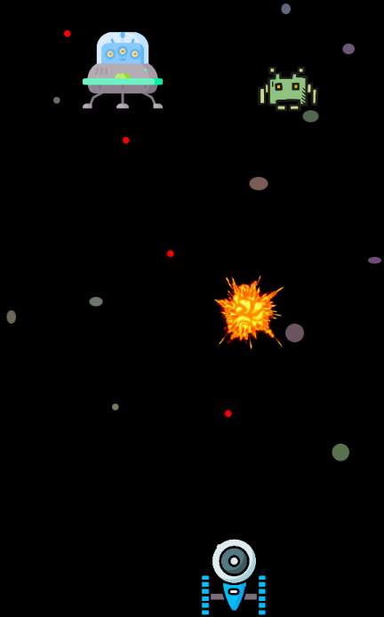
Gameplay Mechanics
Use mouse to move the spaceship horizontally
Right or left click to shoot at enemy ships
Dodge incoming enemy ships and meteoroids
Destroy as many enemies as possible to increase score

Slide 7
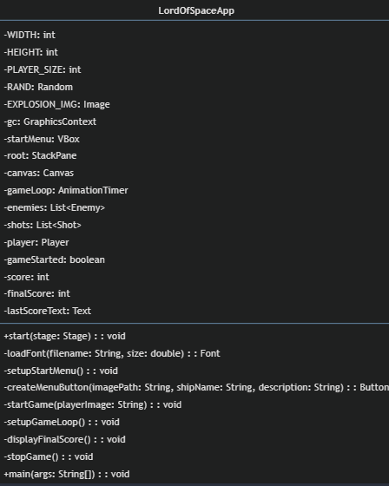
Code Design (UML)

Slide 8
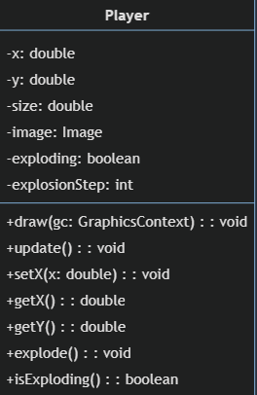
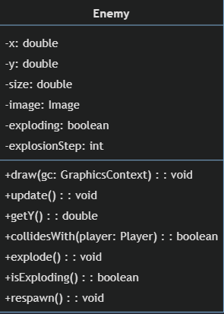
Code Design (UML)

Slide 9
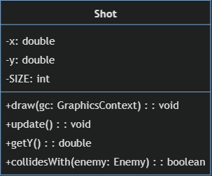
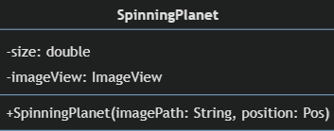
Code Design (UML)

Slide 10
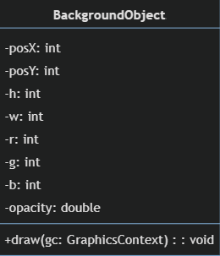
Code Design (UML)

Slide 11
Installation
Requires Java and JavaFX
Clone or download the repository
Navigate to the project directory
Compile the game using ‘javac --module-path "/path/to/javafx-sdk/lib" --add-modules javafx.controls,javafx.fxml,javafx.graphics,javafx.media,javafx.swing,javafx.web LordOfSpaceApp.java’
Run the game using’ javac --module-path "/path/to/javafx-sdk/lib" --add-modules javafx.controls,javafx.fxml,javafx.graphics,javafx.media,javafx.swing,javafx.web -cp. LordOfSpaceApp’
Replace `/path/to/javafx-sdk/lib` with the actual path to the JavaFX SDK library on your machine.

Slide 12
Conclusion
Lord of Space brings back the fun of classic arcade games with a modern twist. It's a game that draws you in with its exciting gameplay and interesting story. Whether you're a serious gamer or just looking for a fun way to relax, this game is definitely worth checking out. It's all about enjoying a good old space adventure in a new way.

Slide 13
Credits
Developed by Jaylen Terry
Graphics made by Freepik from www.flaticon.com

