Slide 1
Ies final project GROUP 5

Slide 2
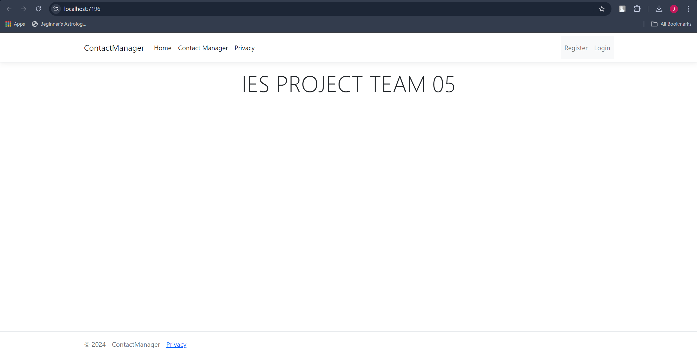
About us
At Contoso, we empower organizations to foster collaborative thinking to further drive workplace innovation. By closing the loop and leveraging agile frameworks, we help business grow organically and foster a consumer first mindset.

Slide 3
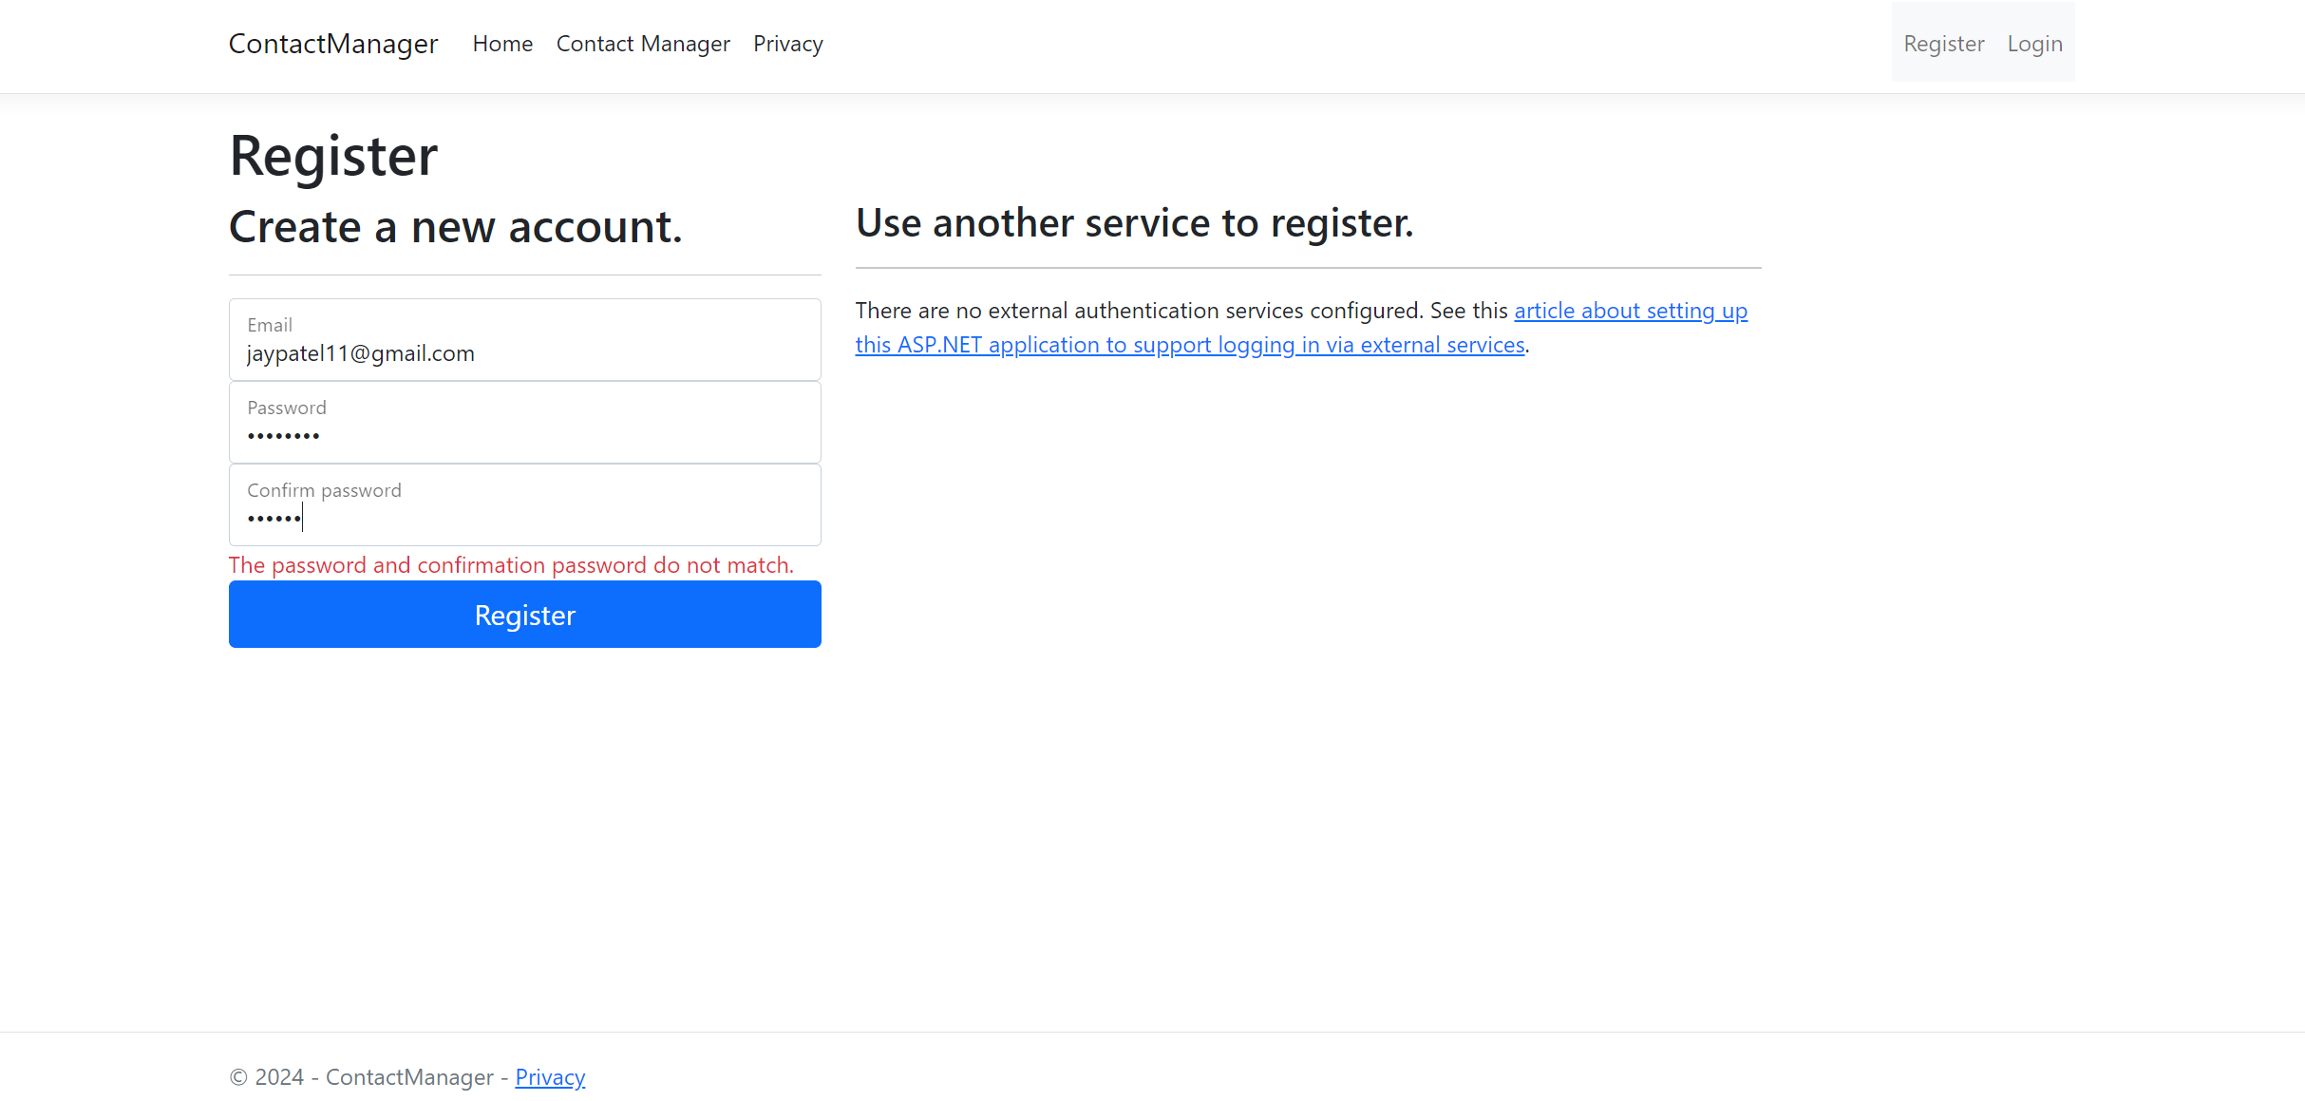

Slide 4
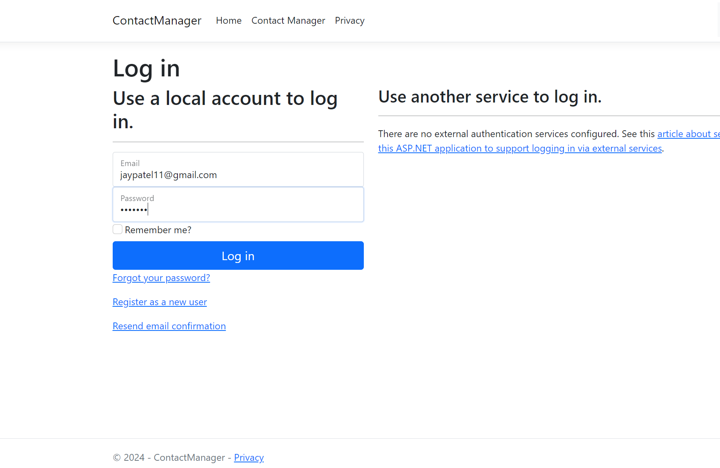

Slide 5
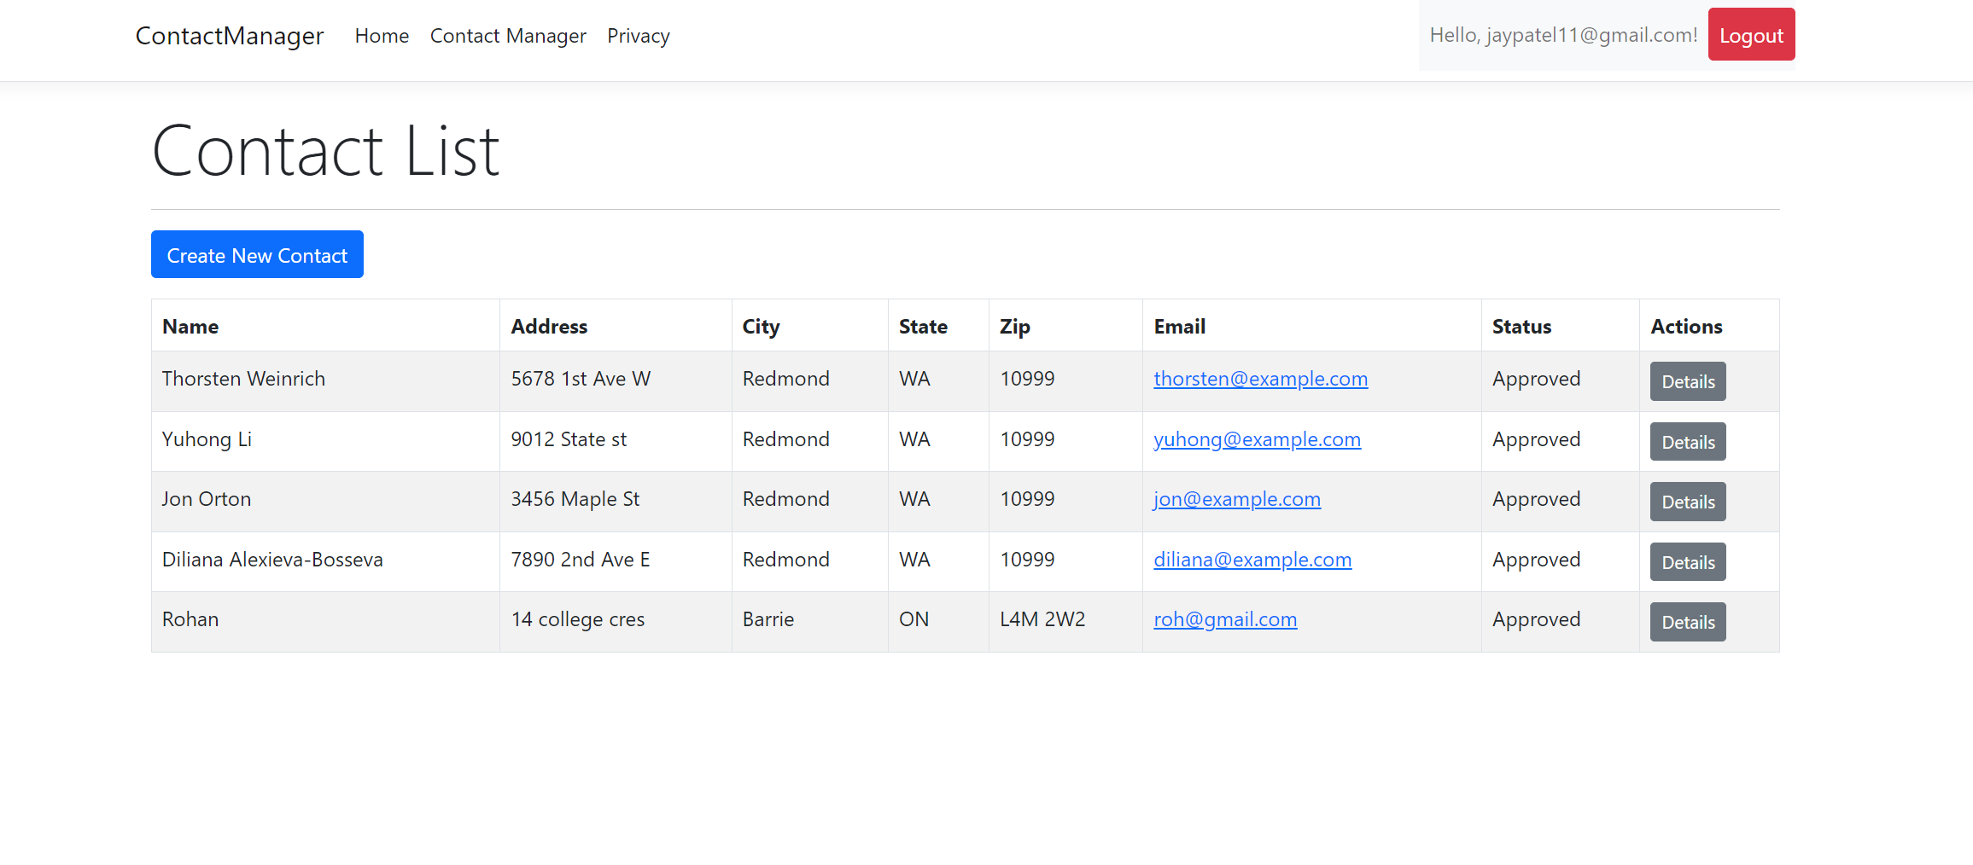
All contact details

Slide 6
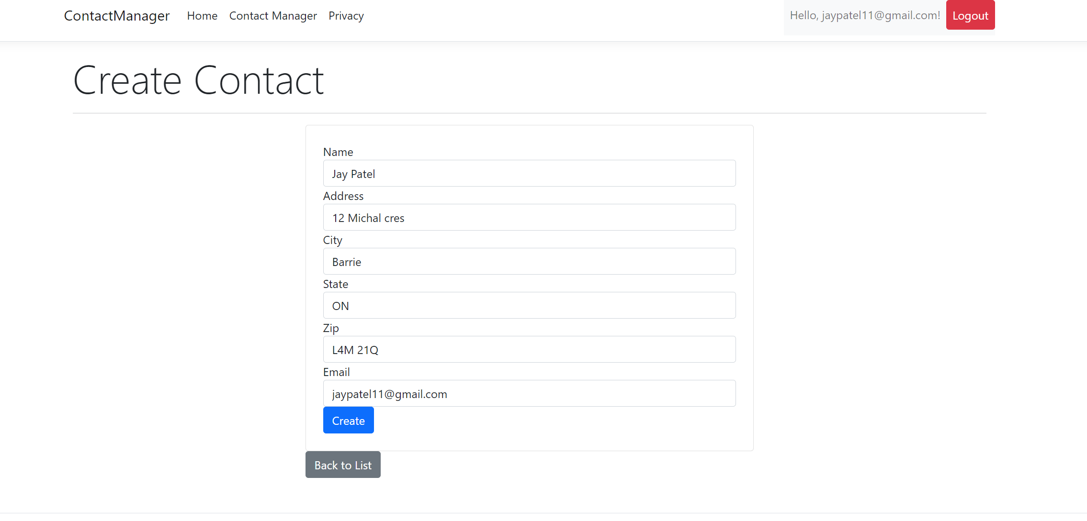
Create contact for user
Market gap: few, if any, products on the market help customers like we do
Customers: 66% of US consumers spend money on multiple products that only partially resolves their issue
Financials: millennials account for about a quarter of the $48 billion spent on other products in 2018
Costs: loss of productivity costing consumers thousands of dollars
Usability: customers want something easy to use that helps make their life easier

Slide 7
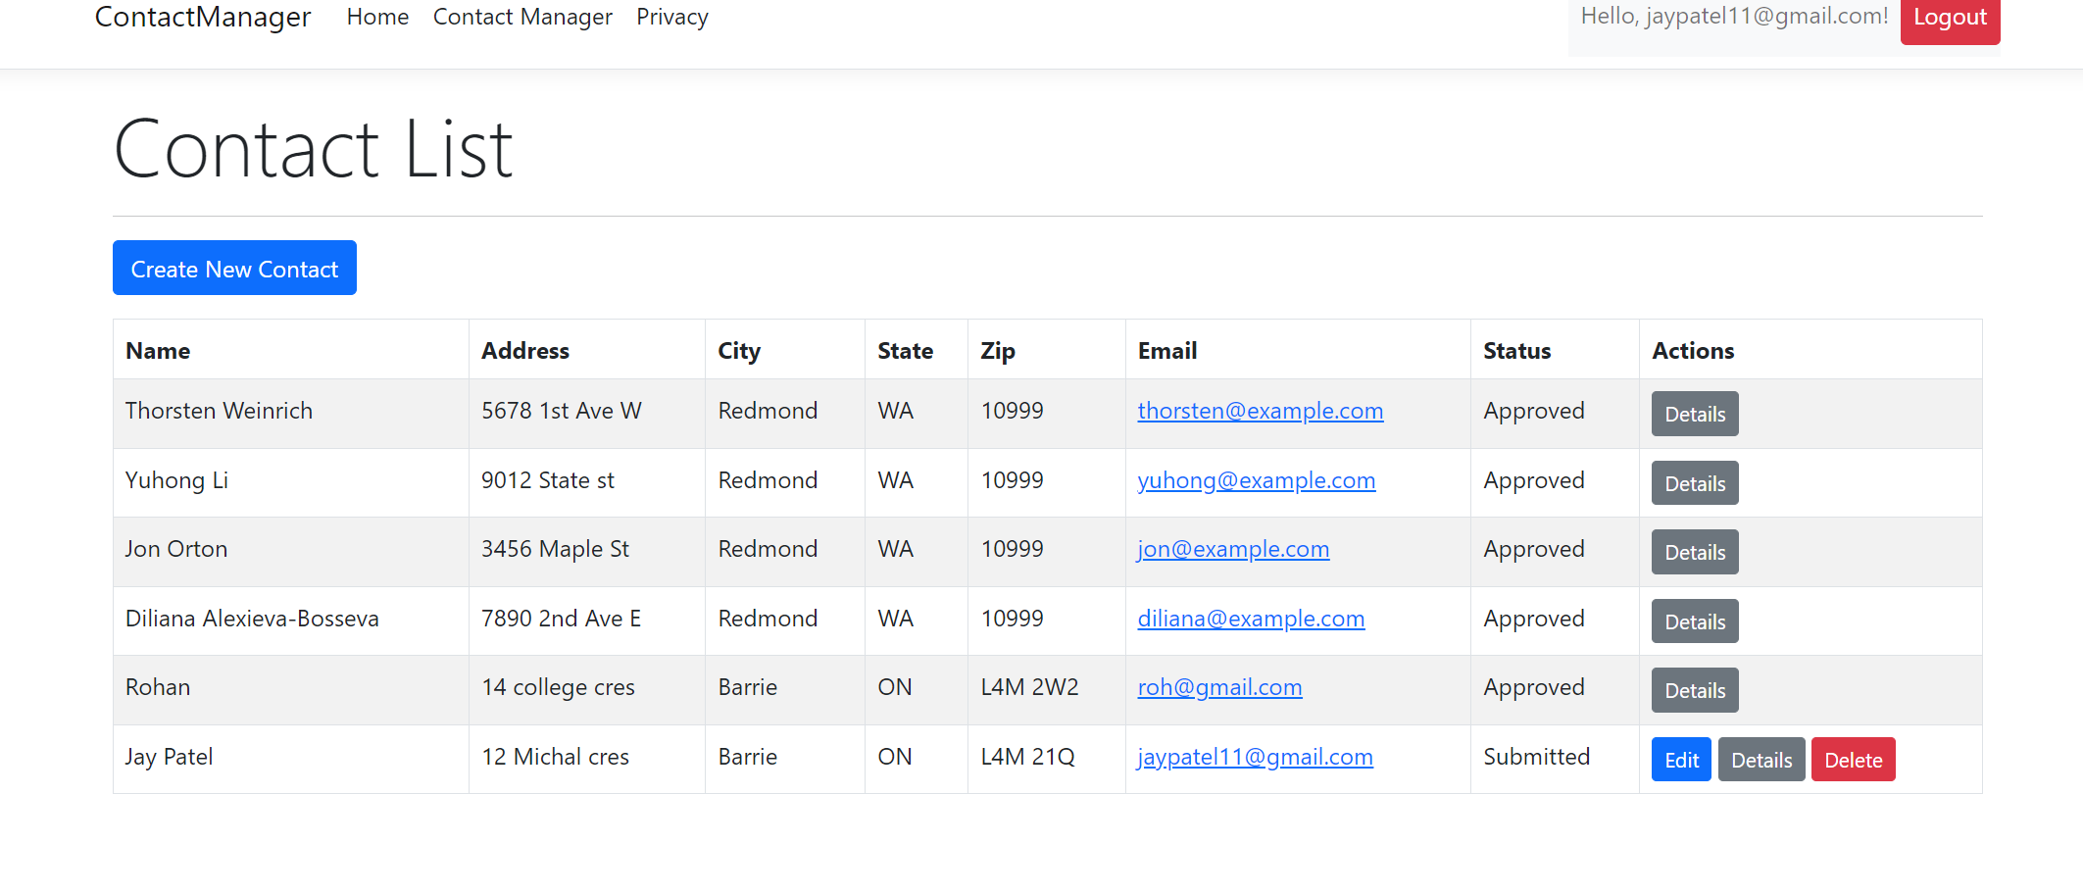
Contact list
Online store and market swap

Slide 8
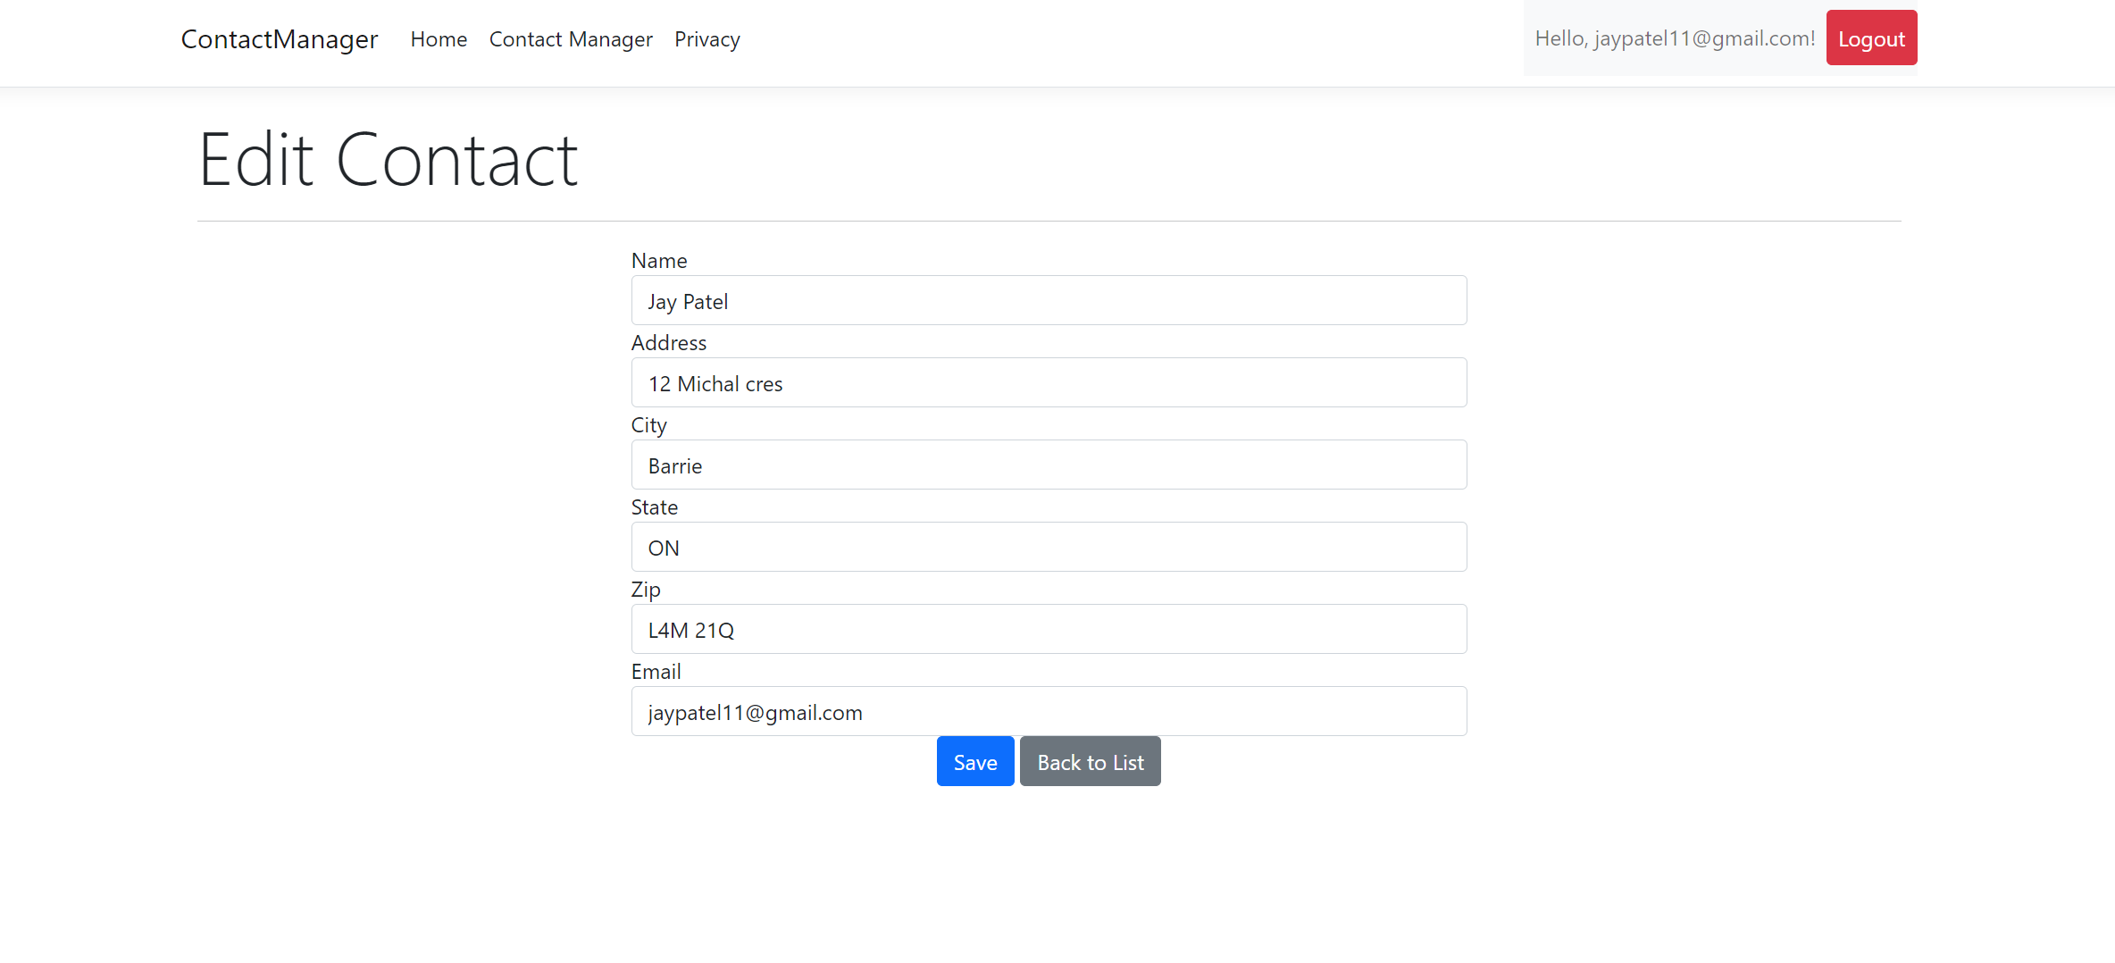
Edit contact for user

Slide 9
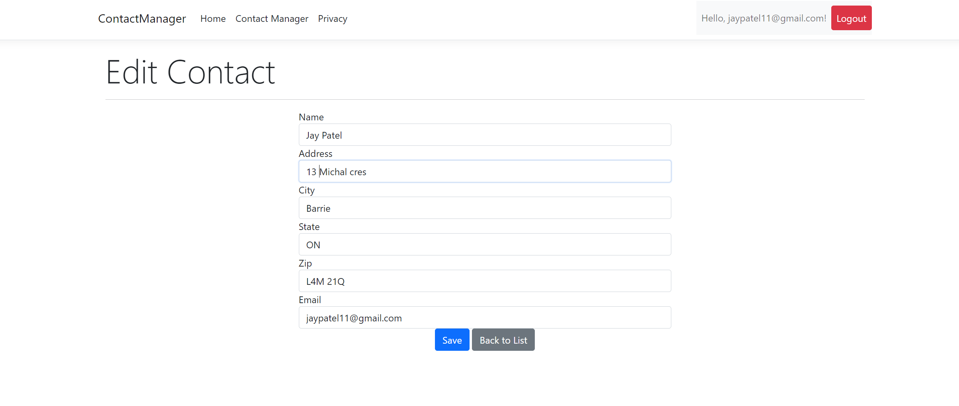
UPDATED CONTACT DETAILS

Slide 10
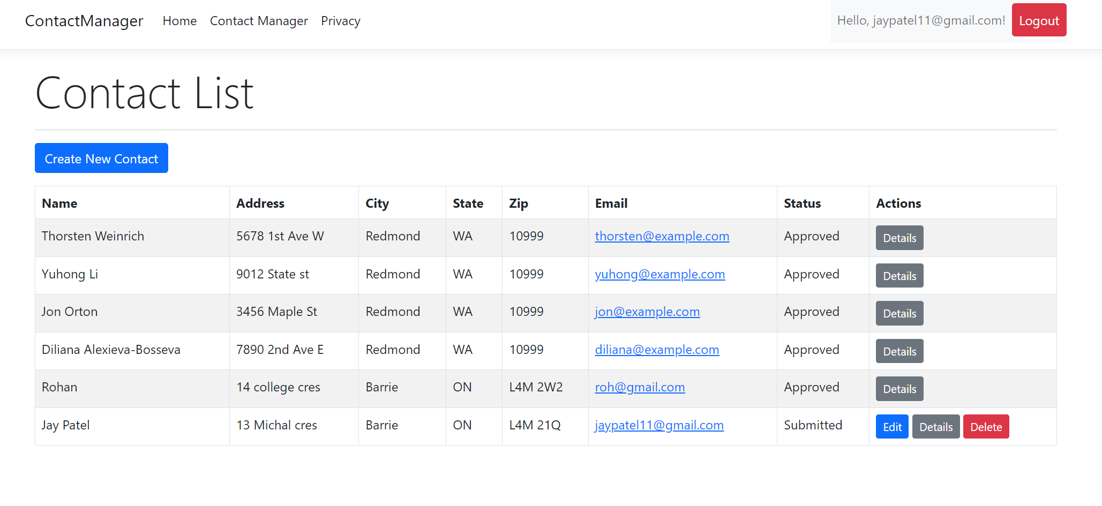
Growth strategy
Feb 20XX: roll out product to high profile or top-level participants to help establish the product
May 20XX: release the product to the public and monitor press release and social media accounts
Oct 20XX: gather feedback and adjust product design as necessary

Slide 11
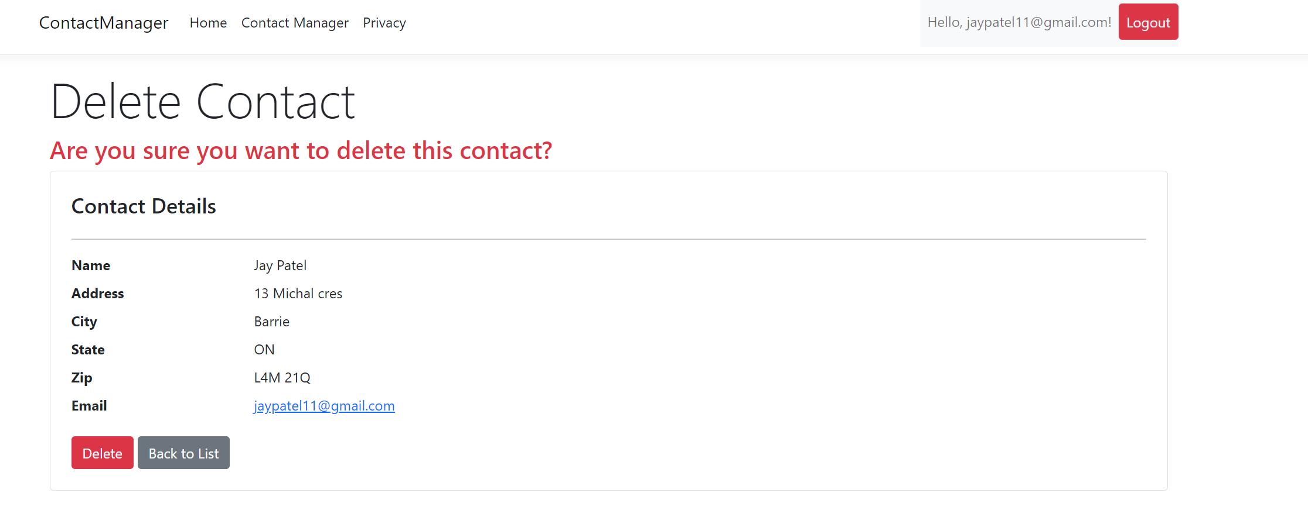
Market overview

Slide 12
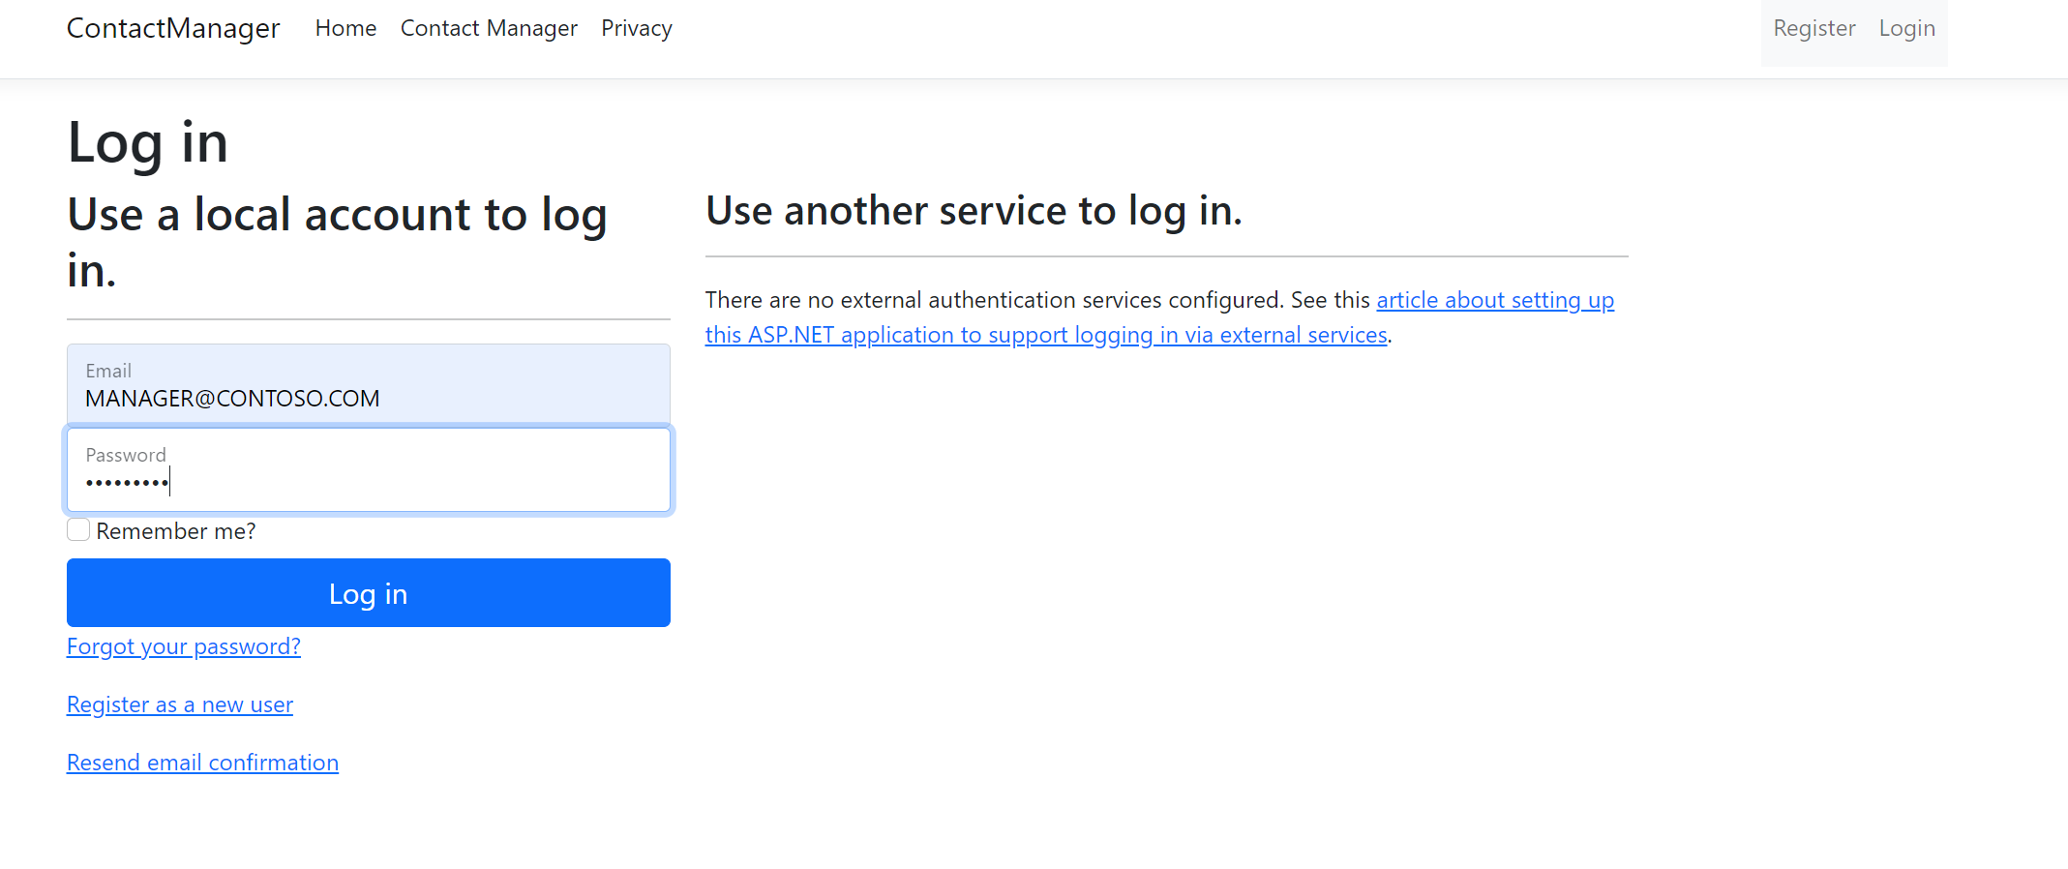
Login for the manager
Manager can approve and reject the request of the user contact

Slide 13
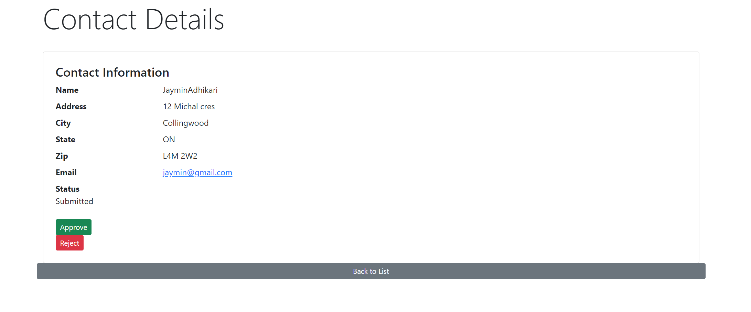
Financials

Slide 14
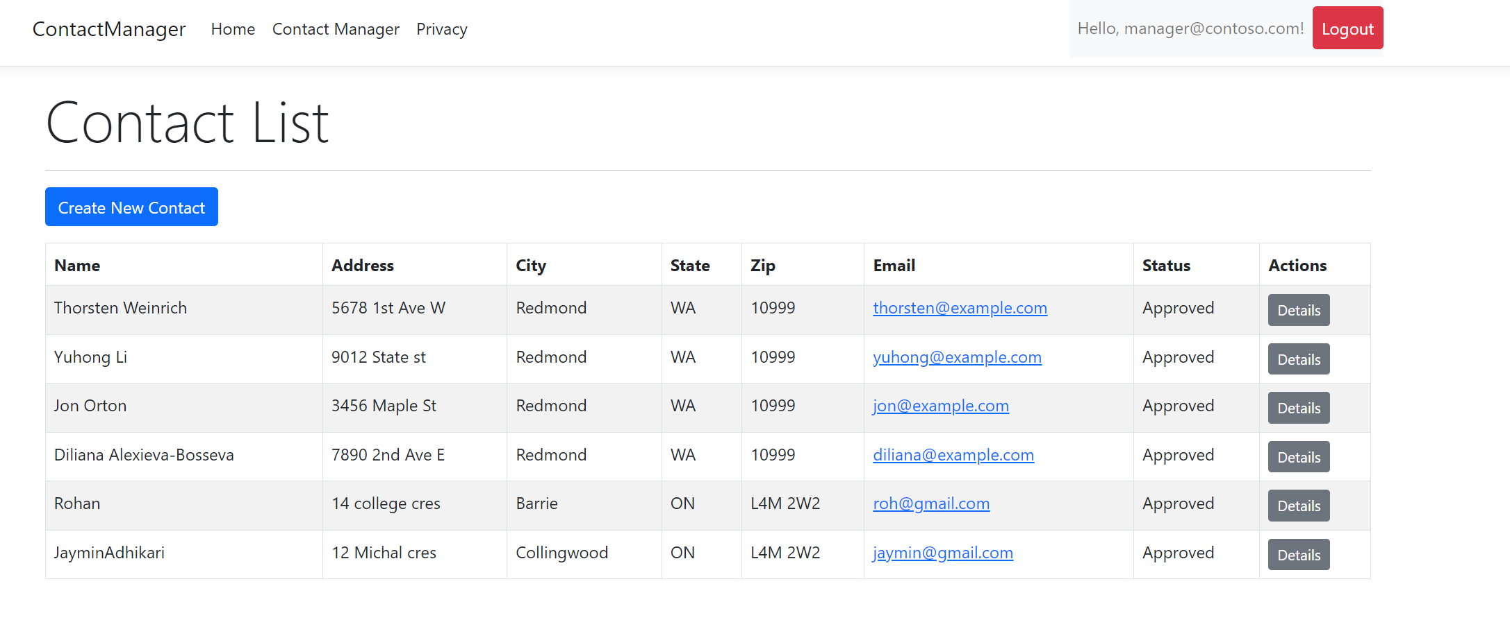
Main screen for the manager

Slide 15
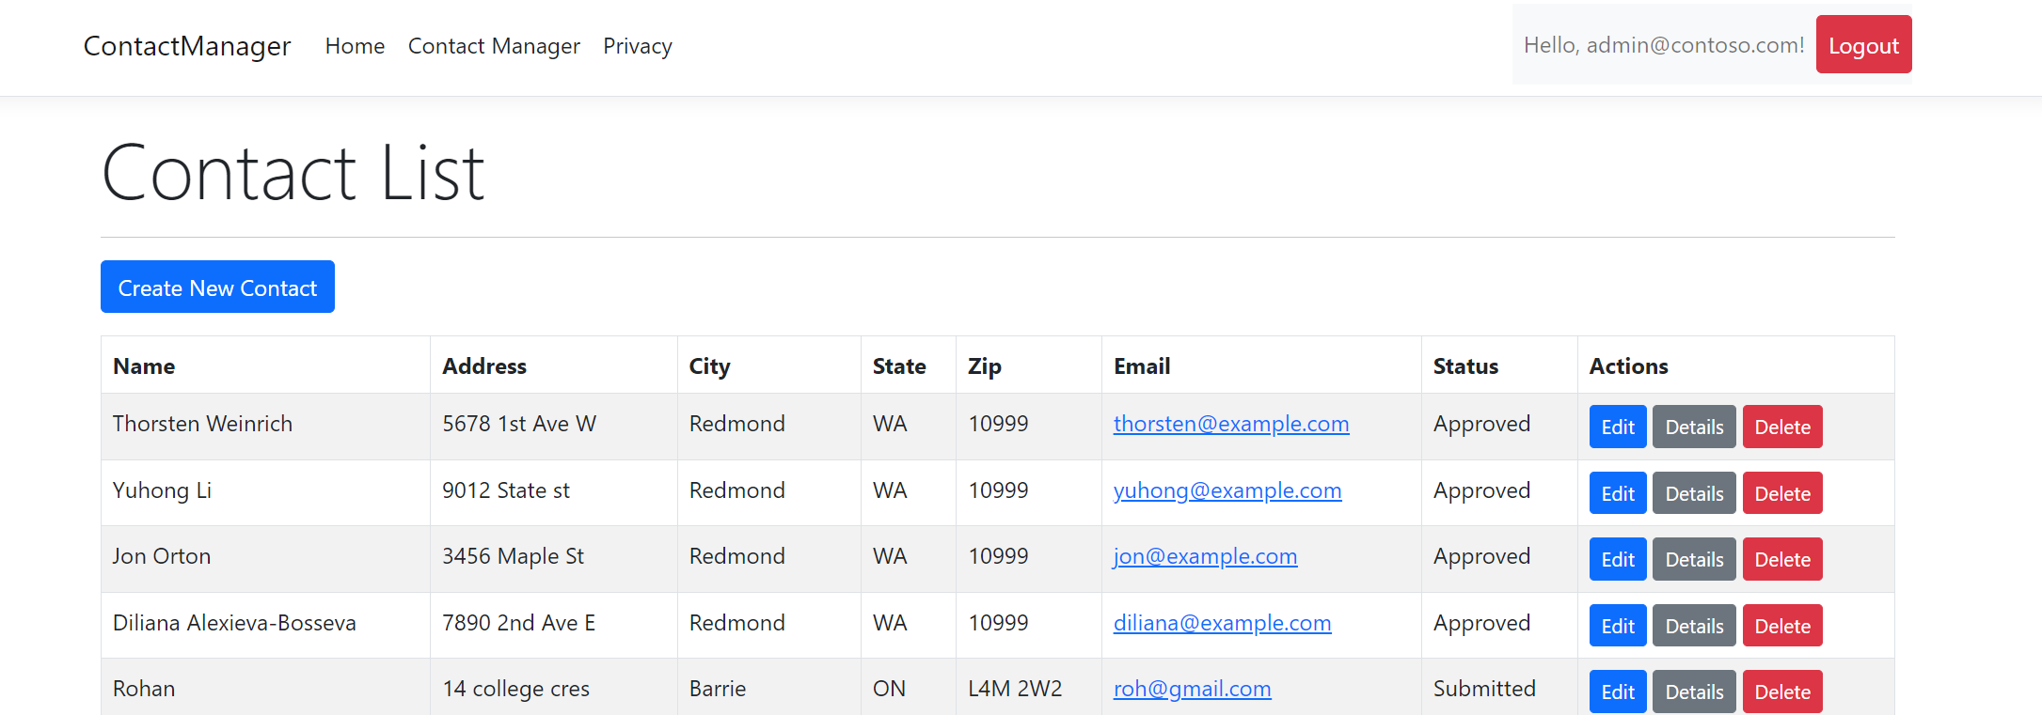
ADMIN SCREEN – CAN UPDATE , DELETE AND EDIT DETAILS

Slide 16
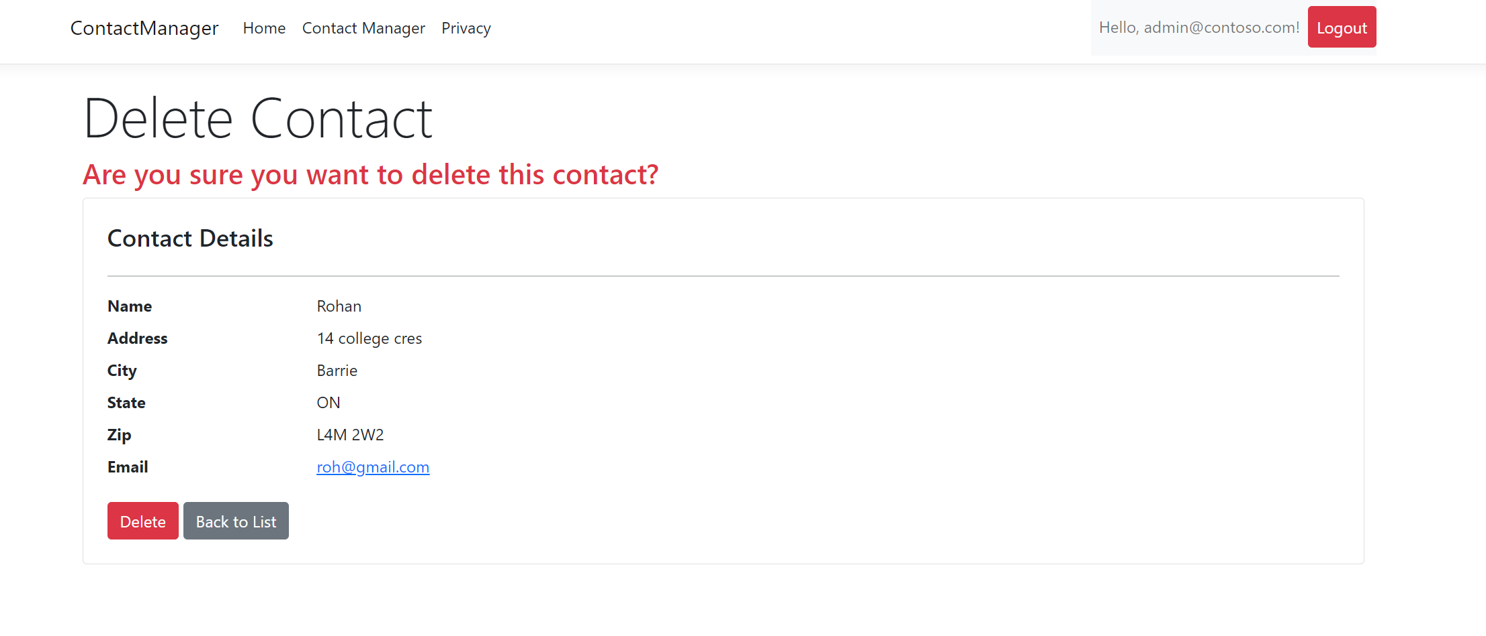
Delete contact screen for the admin

Slide 17
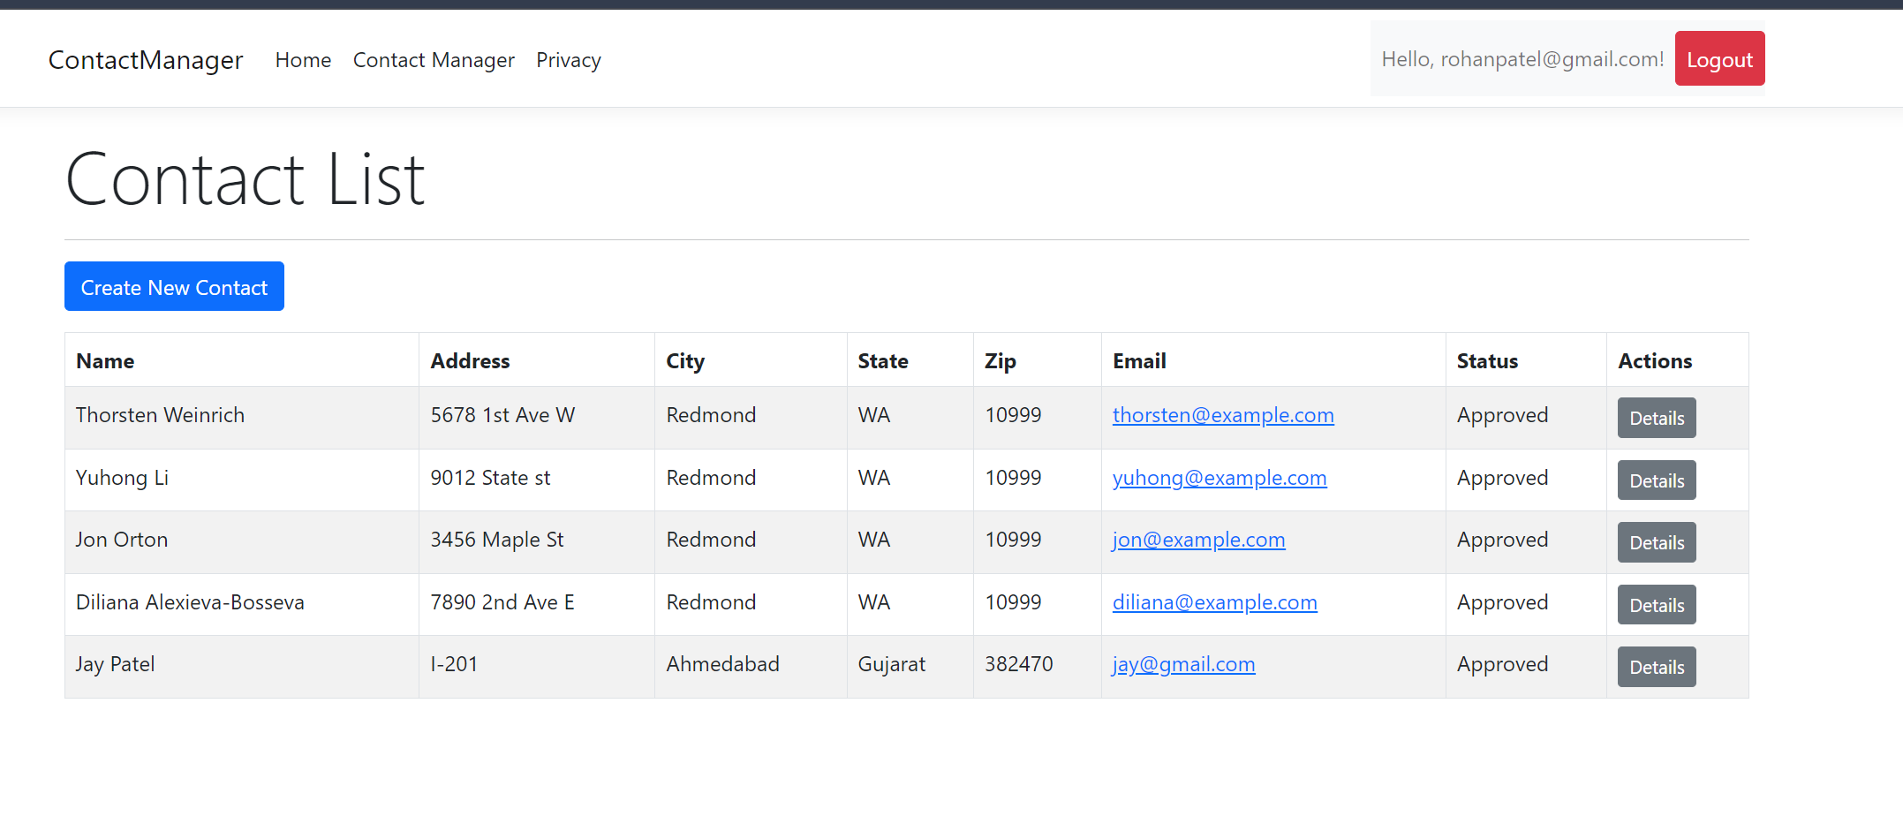
Contact details for the another user who can only see the approved id

Slide 18

Thank you
GROUP 5 IES PROJECT

