Slide 1
Analyzing And Summarizing Amazon Electronic Product Reviews
Done By:
Jaynica Nunna
Lakshmi Prasanna Valdas
Yaswanth Chowdary Venigalla
Chennupati Mahima

Slide 2
Introduction:
Objective: Develop a text classification and summarization system using deep learning techniques.
Motivation: With the increasing volume of text data, automated systems are needed for efficient analysis and summarization.
Approach: Utilize state-of-the-art BERT-based models for text classification and summarization tasks.

Slide 3
Problem Statement
Challenge: Manual processing of large text datasets is time-consuming and prone to errors.
Solution: Develop robust text classification and summarization models to automate text analysis and condensation tasks.
Impact: Improve efficiency and accuracy in analyzing and summarizing large volumes of text data.
In this the main challenge is to analyze the customer reviews of the electronics products in the amazon reviews. The large sea of textual data presents substantial hurdles for both customers and businesses.
For consumers, searching through countless reviews to find meaningful insights can be time-consuming and intimidating, frequently resulting in decision fatigue and doubt. On the other side, businesses must extract actionable knowledge from these reviews to influence product development, marketing tactics, and consumer engagement initiatives.

Slide 4
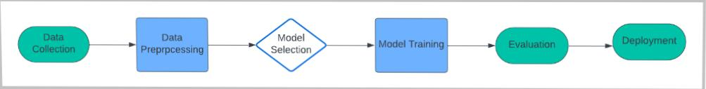
Workflow Diagram:

Slide 5
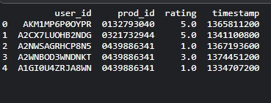
Dataset:
Source: The dataset used in this project is derived from the Amazon Product Reviews dataset, specifically focusing on electronics products.
Content: It includes user ratings and reviews for various electronics products available on the Amazon platform.
Size: The dataset contains a substantial number of entries, totaling over [provide the exact number] reviews.
Format: Data is provided in a structured format, organized into columns such as user ID, product ID, rating, and timestamp.
Usage: The dataset serves as the foundation for training and evaluating the text classification model implemented in this project.

Slide 6
Data Pre - processing
Data Preprocessing: Prior to model training, the dataset underwent preprocessing steps to extract relevant features, clean the text, and prepare it for training the classification model.
To get more detailed quality and usability of the dataset the data is being preprocessed before the model training.
In this dataset, it consists of large number of reviews from amazon of the electronic devices. The training of the reviews are considering by the sentiment analysis and the review summarization.

Slide 7
Implementation:
Data Preprocessing:
To get more accurate accuracy the dataset is being preprocessed in which it is Cleaned and preprocess the dataset to remove noise and prepare text data for model input.
Tokenization and normalization are the two techniques that can be used to preprocesses the data and help to review text in the subsequent analysis.
Model Training:
The selected model architecture is being trained on the preprocessesd dataset. Fine-tune BERT-based models for text classification and summarization tasks using preprocessed data. In this it is being trained to anticipate the user ratings and collects the preferences for the electronic products considering the previous review data.
Model Evaluation:
Assess model performance using standard evaluation metrics and visualization techniques. Metrices like precision, recall, mean absolute are being used to to get the accuracy of the inputed reviews.
Model Deployment:
Deploying trained models as web services using Flask, enabling users to classify and summarize text input.

Slide 8
Results:
Text Classification:
Achieved accuracy of [58%] on the test set.
Confusion matrix analysis reveals model performance across different categories.
Text Summarization:
Generated concise and informative summaries of text documents.
Human evaluation confirms coherence and informativeness of generated summaries.

Slide 9
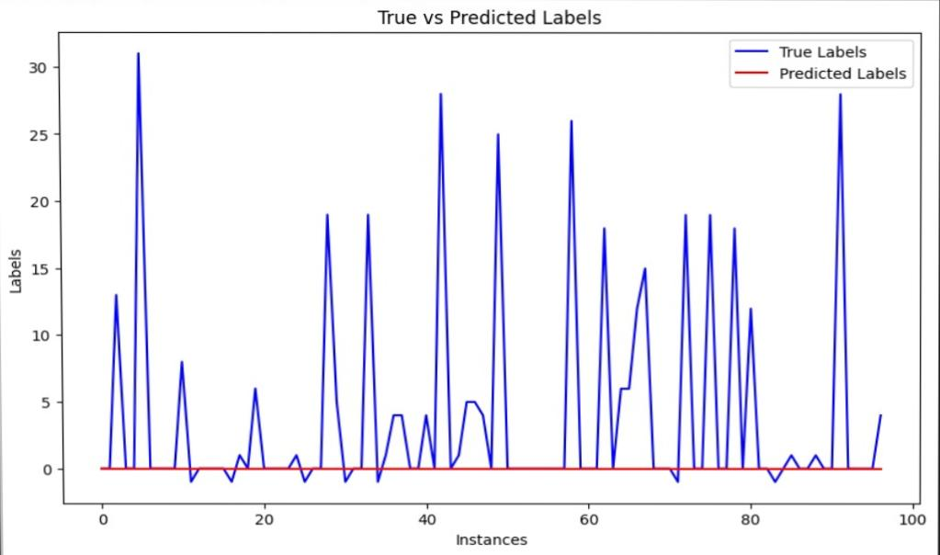
Results:

Slide 10
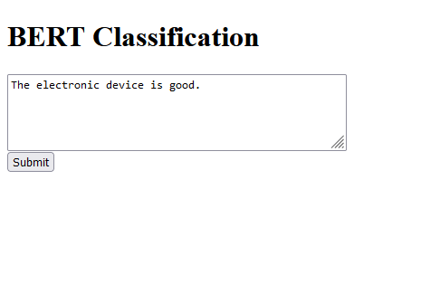
Deployment:
After the model is being trained the model is being sent for deployment in which we can give the sample review. And also checking the review whether the inputed review is good or bad.
Inputed link:
index%5b1%5d
Output link:
result%5b1%5d

Slide 11
Project Management
Team Member | Contributions
Jaynica Nunna (Data Engineer) | Data preprocessing
Lakshmi Prasanna Valdas (ML Engineer) | Model Development
Yeshwanth Chowdary Venigalla (Data Scientist) | Model Evaluation
Mahima Chennupati (Project Manager) | Project oversight and power point
TASK | Person Responsible | Responsibilities`
Data collection and Preprocessing | Jaynica Nunna | Collecting, cleaning, and preprocessing the dataset
Model Development | Lakshmi Prasanna valdas | Developing and Training the model
Model Evaluation | yeshwanth Chowdary | Evaluating the trained model and analyzing performance metrics
Project Management | Mahima chennupati | Overseeuing project progress, coordinating tasks, and managing resources and powerpoint

Slide 12
References
Liu, Chien-Liang., Hsaio, W.., Lee, Chia-Hoang., Lu, Gen-Chi., & Jou, Emery D.. (2012). Movie Rating and Review Summarization in Mobile Environment. IEEE Transactions on Systems, Man, and Cybernetics, Part C (Applications and Reviews) , 42 , 397-407 . http://doi.org/10.1109/TSMCC.2011.2136334
Tsur, Oren., Davidov, D.., & Rappoport, A.. (2010). ICWSM - A Great Catchy Name: Semi-Supervised Recognition of Sarcastic Sentences in Online Product Reviews. Proceedings of the International AAAI Conference on Web and Social Media . http://doi.org/10.1609/icwsm.v4i1.14018
Zhao, Wei., Guan, Ziyu., Chen, Long., He, Xiaofei., Cai, Deng., Wang, Beidou., & Wang, Quan. (2018). Weakly-Supervised Deep Embedding for Product Review Sentiment Analysis. IEEE Transactions on Knowledge and Data Engineering , 30 , 185-197 . http://doi.org/10.1109/TKDE.2017.2756658
https://www.semanticscholar.org/paper/a075b59cb7fda9cd62ab5946a8cdaba94af430d7
Pranckevičius, Tomas., & Marcinkevičius, Virginijus. (2017). Comparison of Naive Bayes, Random Forest, Decision Tree, Support Vector Machines, and Logistic Regression Classifiers for Text Reviews Classification. Balt. J. Mod. Comput. , 5 . http://doi.org/10.22364/BJMC.2017.5.2.05
Chang, Wei-Cheng., Yu, Hsiang-Fu., Zhong, Kai., Yang, Yiming., & Dhillon, I.. (2019). Taming Pretrained Transformers for Extreme Multi-label Text Classification. Proceedings of the 26th ACM SIGKDD International Conference on Knowledge Discovery & Data Mining . http://doi.org/10.1145/3394486.3403368
Brazinskas, Arthur., Lapata, Mirella., & Titov, Ivan. (2019). Unsupervised Opinion Summarization as Copycat-Review Generation. , 5151-5169 . http://doi.org/10.18653/v1/2020.acl-main.461
Keung, Phillip., Lu, Y.., Szarvas, György., & Smith, Noah A.. (2020). The Multilingual Amazon Reviews Corpus. , 4563-4568 . http://doi.org/10.18653/v1/2020.emnlp-main.369
Eichstaedt, J.., Kern, Margaret L.., Yaden, D.., Schwartz, H. A.., Salvatore, ., Giorgi, ., Park, Gregory J.., Hagan, Courtney A.., Tobolsky, Victoria., Smith, Laura K., Anneke, ., Buffone, ., Iwry, J.., Seligman, M.., & Kulkarni, Pallavi V.. (2020). Closed- and open-vocabulary approaches to text analysis: A review, quantitative comparison, and recommendations.. Psychological methods , 26 4 , 398-427 . http://doi.org/10.31234/osf.io/t52c6

Slide 13
Thank you

