Slide 1
GPA1-B
Date : 4/11/2025
Jaynna Marie De Jesus

Slide 2
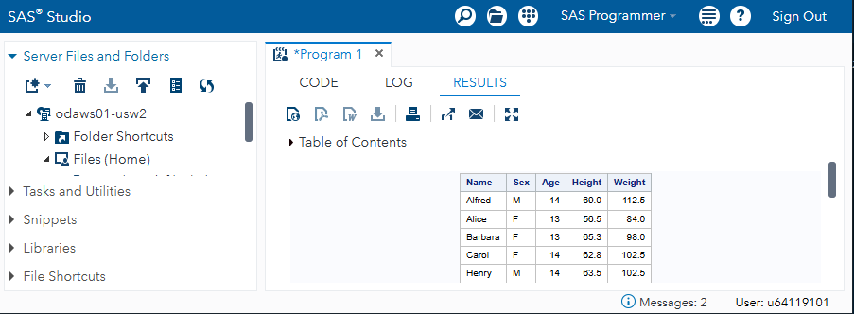

Slide 3
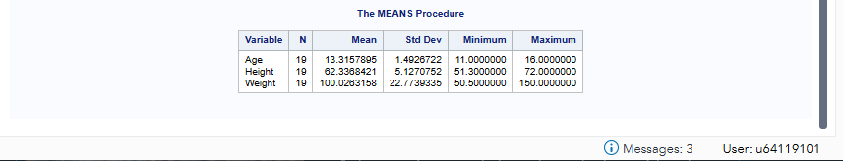

Slide 4


Slide 5
hello
New slide for change

