Slide 1

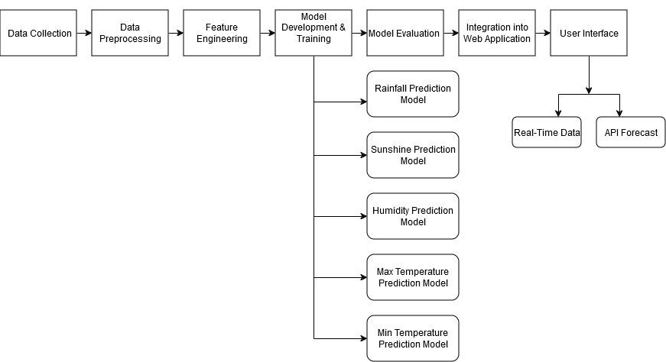
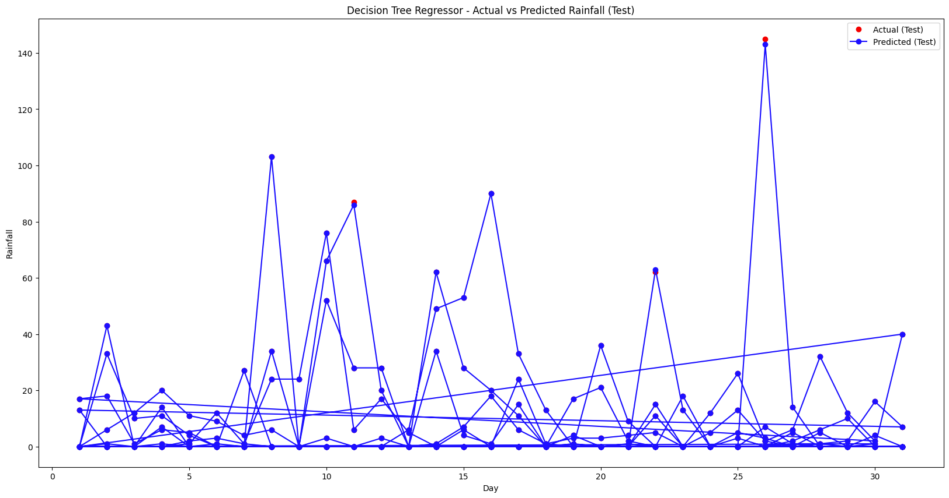
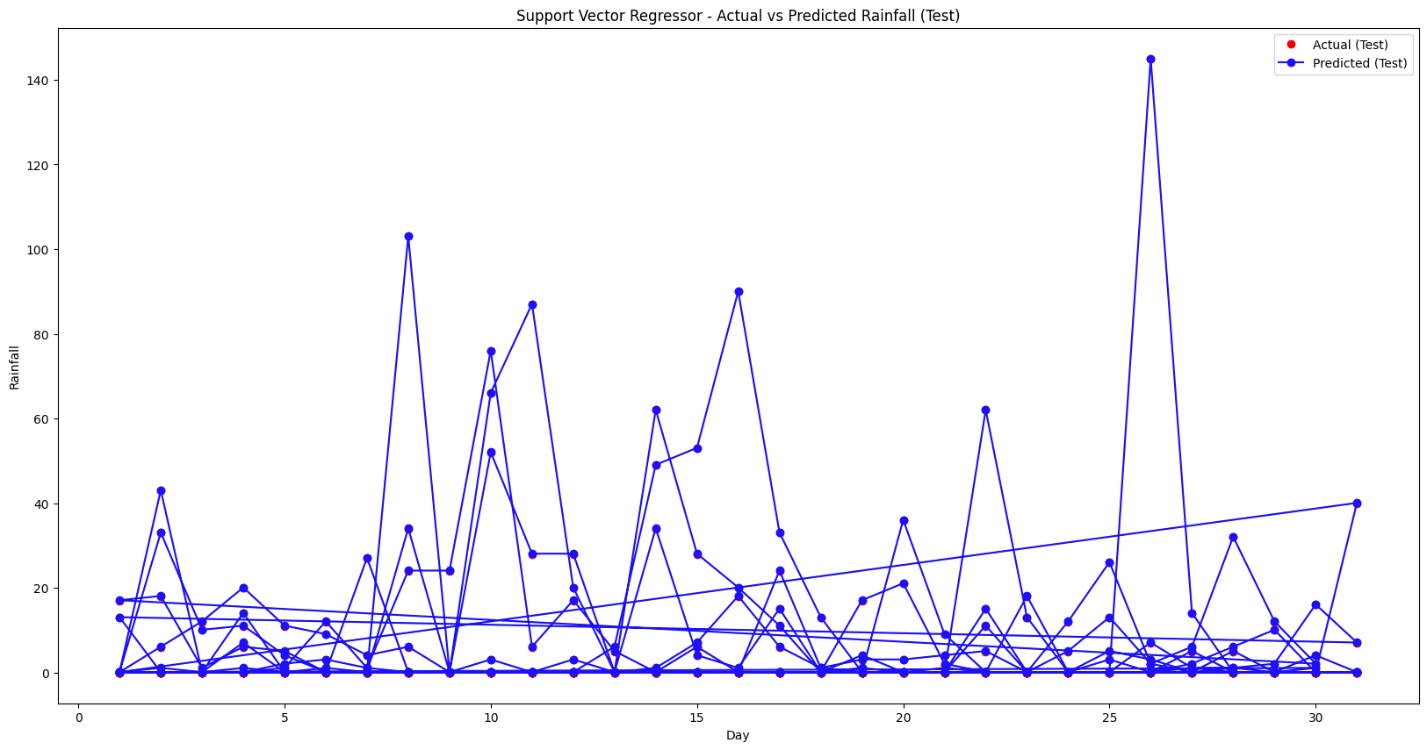



Predictive Climate Insights(PCI) Machine Learning-Driven Weather Insights With API Integration
Jayonti Sarker
Supervised By: Professor MD. Shahriar Hussain
Department of Electrical & Computer Engineering
North South University
Abstract
Methodology
System Diagram
The Predictive Climate Insights is a web-based application that uses machine learning algorithms to predict weather. It can forecast rainfall, temperature, humidity, and sunshine duration for all the districts in Bangladesh. The necessary models were trained based on historical data. Advanced algorithms such as SVM, KNN, MLP and Decision Tree has been used to test the model performances. The integration of weather API in the other part of app can find all the real-time weather information based on a given location specifically.
Data Collection :
Historical weather data (rainfall, sunshine, humidity, temperature) is sourced from trusted meteorological and climate databases.
2. Data Cleaning & Processing :
Invalid or duplicate data entries are filtered, missing values are handled, and the data is converted into a structured format with datetime indices for analysis.
Introduction
3. Feature Engineering:
Features like day, month, and temperature patterns are extracted, with selection methods identifying key predictors.
Bangladesh is highly vulnerable to unpredictable weather patterns, which pose significant risks to agriculture, infrastructure, and disaster management. Accurate weather predictions can provide critical insights to mitigate these impacts. Traditional methods of forecasting often lack precision and accessibility, leaving room for innovative, tech-driven solutions. This project introduces PCI, a web-based weather forecasting system leveraging machine learning models to deliver actionable predictions.
4. Model Development:
Five models are trained and evaluated using MSE and R-squared for rainfall, sunshine, humidity, and temperatures.
5. Evaluation:
Measure model performance using metrics like Mean Squared Error (MSE) and R².
Result & Discussian
Motivation
6. API Development for Future Expansion:
The system includes real-time weather predictions based on the current location and an API forecast providing a 5-day outlook for rainfall, sunshine, humidity, and temperature.
.
Model | Training MSE | Test MSE | Training R² Score | Test R² Score
Decision Tree Regressor | 0.0 | 0.0164 | 1.0 | 0.99993
Support Vector Regressor | 0.0093 | 0.0093 | 0.99997 | 0.99996
KNN Regressor | 0.0 | 0.8552 | 1.0 | 0.99635
KNN Classifier | 0.0 | 0.8552 | 1.0 | 0.99635
MLP Classifier | 10.35 | 5.09 | 0.96148 | 0.97826
Bangladesh frequently experiences unpredictable weather patterns, which pose challenges for agriculture, disaster management, and daily life. Accurate and localized weather forecasting is crucial for informed decision-making and minimizing the impacts of climate change. This project focuses on using machine learning techniques to improve weather predictions, ensuring more reliable and actionable insights to address these critical needs.
Conclusion & Future Goal
This project involved collecting and processing historical weather data to develop and evaluate machine learning models for predicting rainfall, sunshine, humidity, and temperature, with an API feature for real-time updates and 5-day forecasts. Future work will focus on using deep learning to improve accuracy and expanding the dataset with more variables and sources for better model robustness.
Objective
Build an Accurate Weather Prediction System using machine learning.
Evaluate Different Machine Learning Models (SVM, KNN, MLP).
Develop a User-Friendly Web Application for easy access to forecasts.
Optimize Model Accuracy using evaluation metrics like MAE and R².
Integrate Real-Time Weather Data through APIs.
References
E. Subramanian, M. A. Vasanth, and V. A. Suresh, "Solar Power Prediction Using Machine Learning," 2021.
M. M. R. Khan, M. K. Hossain, and R. Ahmmed, "Prediction of Temperature and Rainfall in Bangladesh," 2019.

