Slide 1
Camera Trajectory Recovery and Depth Mapping
University of Delaware

Slide 2
Outline
Project Target
Stereo Vision Model
Pose Graph SLAM and Gtsam
OpenMVG and OpenMVS
Future Work

Slide 3
Project Target
Using Stereo Camera for 3D Reconstruction and Depth Mapping
Be familiar with the following libraries:
libviso2: A small efficient lib for stereo vision odometry
GTSAM: an efficient lib for nonlinear least-squares optimization
Pangolin: an lightweight lib for managing OpenGL displaying
OpenMVG: an lib for Multi-View Structure from Motion
OpenMVS: an lib for computing dense points cloud, surface etc.
KITTI Dataset: A novel challenging real-world computer vision benchmarks suite.

Slide 4
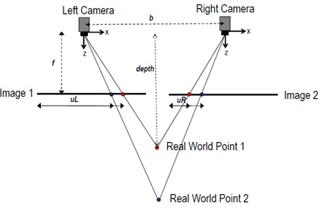
Stereo Vision Model
Using Stereo Camera for 3D Reconstruction and Depth Mapping

Slide 5
Stereo Vision Model
Using Stereo Camera for 3D Reconstruction and Depth Mapping

Slide 6
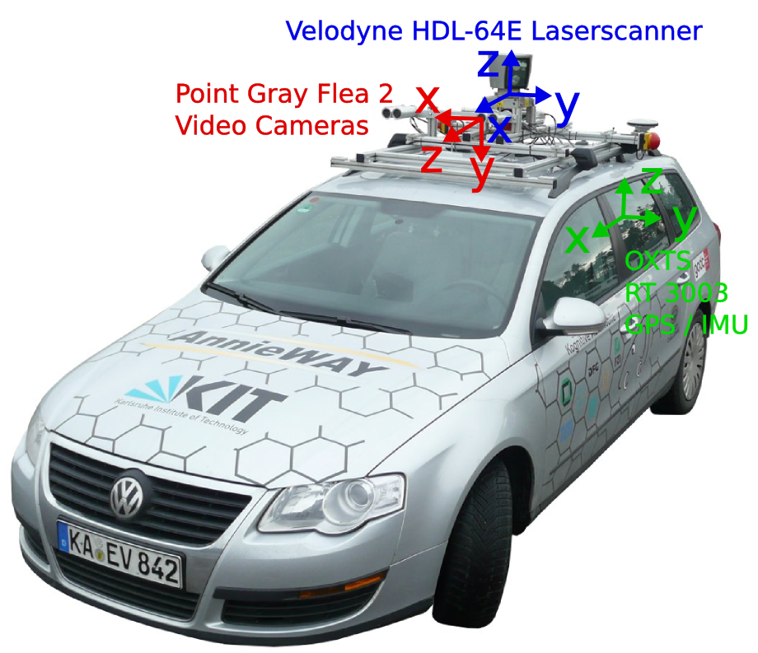
Stereo Vision Odometry Demo

Slide 7
Thanks a lot!
Q&A

