Slide 1
Hotel Booking Analysis

Slide 2
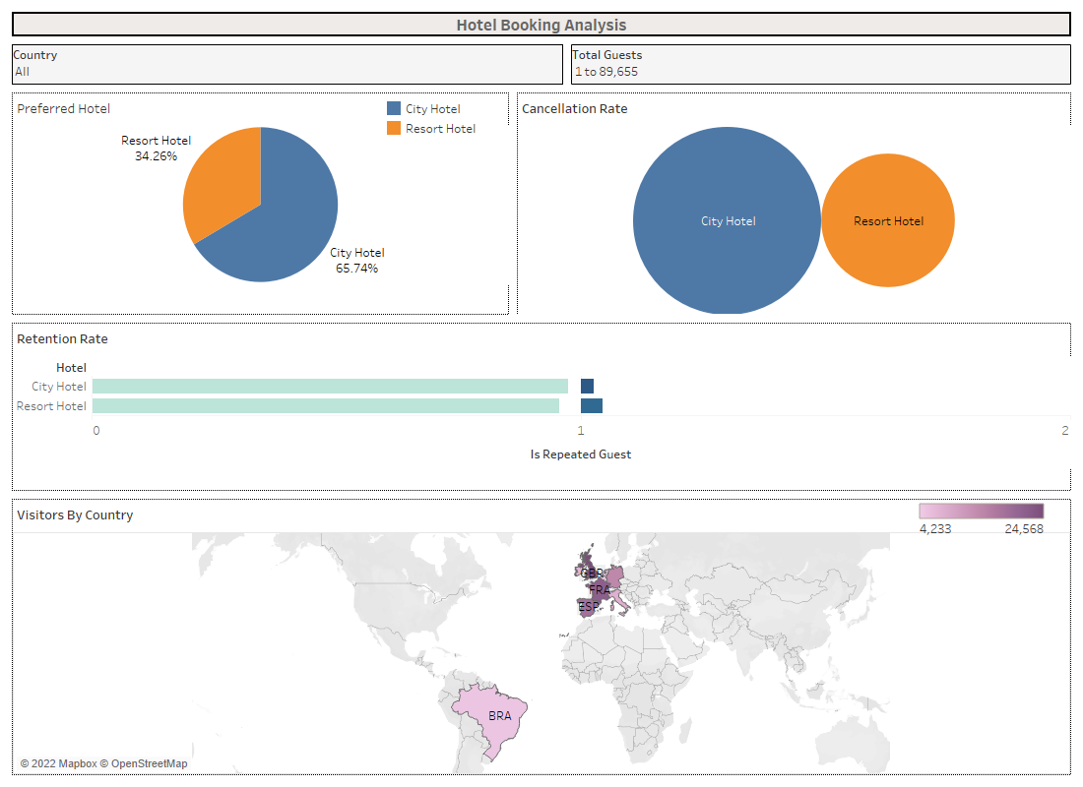

Slide 3
