Slide 1

SMART INDIA HACKATHON 2026
TITLE PAGE
Problem Statement ID – SIH26137
Problem Statement Title - Quantum-Inspired Intelligent Traffic Route Optimization in Transportation Systems Using Metaheuristic Optimization
Theme - Transportation & Logistics
PS Category - Software
Team ID - 165121
Team Name – AlgoNauts_LJIET

Slide 2
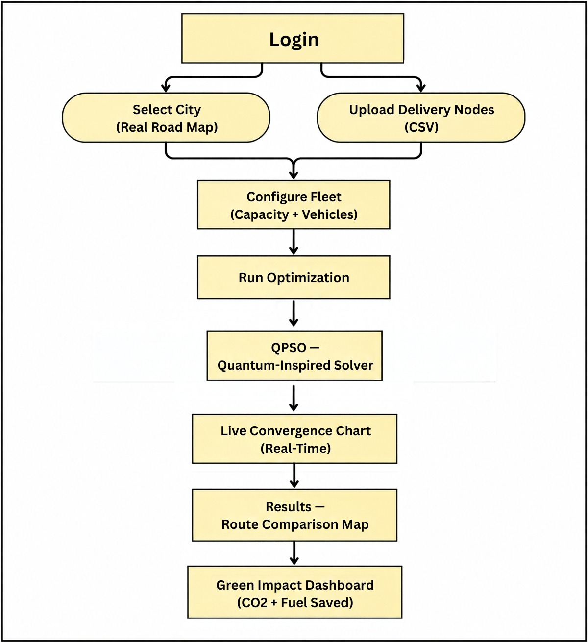
AlgoNauts LJIET
IDEA TITLE
❖ Proposed Solution:
Real Street Maps : Loads real, live road networks for any Indian city, instantly.
Two Brains Compare : A classical planner and our quantum-inspired planner run side by side, so you always see the smarter route.
Live Thinking Chart : Watch the quantum planner explore thousands of options in real time.
Handles Real Accidents : Detects a road disruption and re-routes every affected delivery automatically.
Green Impact Dashboard : Reports the exact fuel and CO2 saved on every single plan.
City-Wide Load Balancing : Spreads many delivery fleets across different roads so no single street gets overloaded.
Secure Multi-Tenant Access : Every company or city team gets its own secure login and fully private data.
Scales With Demand : Runs many optimizations at once, automatically adding more computing power as needed.

Slide 3
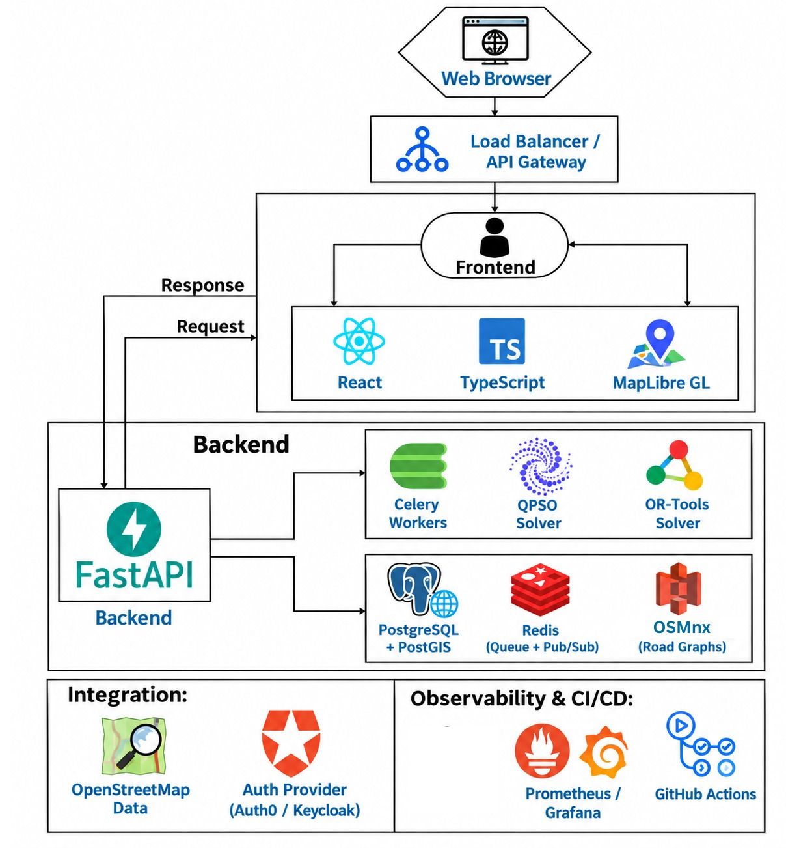
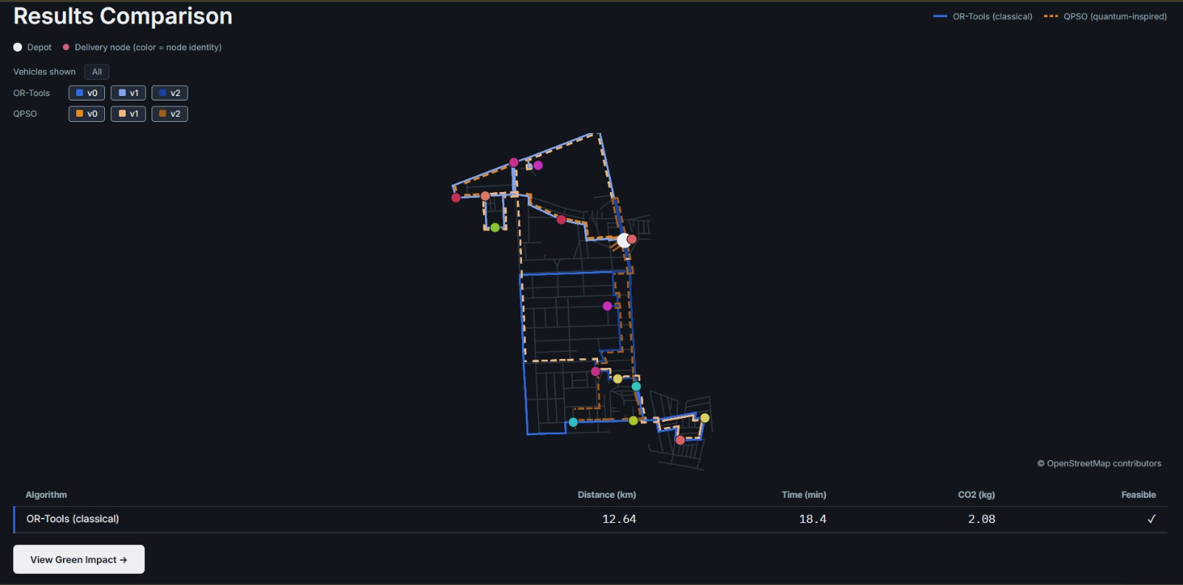
AlgoNauts LJIET
TECHNICAL APPROACH
API & Orchestration: FastAPI (Python, async, Pydantic-validated)
Routing Solvers: Google OR-Tools (classical) + QPSO (in-house, quantum-inspired)
Job Execution: Celery + Redis — horizontally scalable workers
Geospatial Data: PostgreSQL + PostGIS, OSMnx-derived road graphs
Emission Modeling : COPERT (EMEP/EEA formula)
Real-Time Streaming : Server-Sent Events over Redis Pub/Sub
Frontend : React + TypeScript + MapLibre GL
Platform : Auth0 / Keycloak · Docker · GitHub Actions · Grafana

Slide 4
AlgoNauts LJIET
FEASIBILITY AND VIABILITY
❖ Feasibility:
1. Technical
2. Operational
3. Algorithm Core Unchanged
• Deploys on managed services (RDS, Upstash, Auth0) — no infrastructure built from scratch, no Kubernetes required.
• Solver layer (OR-Tools, QPSO, COPERT) is already built and tested — this adds infrastructure, not algorithm risk.
• Every component (FastAPI, Celery, PostgreSQL+PostGIS, Redis) is mature and battle-tested — low technical risk.
• Standard managed tiers exist for every component, so ops overhead stays low as usage grows.
• 99+ automated tests already cover the solver, emissions, and API layers end to end.
• Async-first design keeps solver execution and live streaming responsive under concurrent load.
❖ Risks & Fixes:
Onboarding Load
Risk: Large graph ingestion can bottleneck new cities.
Fix: Async pre-fetch/cache queue ahead of demand.
QPSO Mid-Scale Gap
Risk: Trails classical baseline at ~15 nodes.
Fix: Root-caused, tracked, active fix in progress.
Data Isolation
Risk: Shared infra raises tenant-leak stakes.
Fix: DB row security + managed auth (Auth0).
❖ Viability:
1. Horizontally Scalable by Design
• Celery + Redis workers scale by adding replicas, not by redesigning the job pipeline.
• Multi-city onboarding is a background data job, not a code change, via automated OSMnx ingestion.
2. Cost-Efficient at Every Stage
• Open-source core (Postgres, Redis, Celery) with managed tiers that scale with usage — no proprietary licensing.
• Pay-as-you-grow infrastructure keeps early-stage costs low without a later re-architecture.
3. Proven Differentiator, Now Deployable
• COPERT-based ecological quantification and fair seeded benchmarking carry over unchanged from the validated core.
• Real, measured 7.6% CO2 reduction at city scale — a concrete number, not a projection.

Slide 5
AlgoNauts LJIET
IMPACTS AND BENEFITS
❖ Impacts:
Cleaner Cities:
  Less fuel burned across every fleet, real city-wide change.
  Supports municipal air-quality and sustainability goals.
Smarter Logistics Industry:
  Fewer trucks, less fuel, faster deliveries for any adopter.
  Raises the bar for optimized routing in India.
Systemic Traffic Relief:
  Balances loads across fleets, easing single-road congestion
  Cuts bottlenecks from every operator picking the same route.
Research & Benchmarking Value:
  Our fair-comparison method can test any future algorithm
  Contributes an honest QPSO-vs-classical benchmark to the field.
❖ Benefits:
Economic Benefits:
  Fewer wasted kilometres cut real fuel costs for every fleet.
  Fewer trucks needed for the same delivery volume.
Environmental Benefits:
  Real, formula-sourced reporting on every kg of CO2 avoided.
  Encourages lower-emission logistics practices industry-wide.
Operational Benefits:
  Automatically replans around accidents and road closures.
  Many companies run jobs simultaneously without slowdown.
Trust & Transparency:
  Every number ships with the exact formula behind it
  Fair, seeded benchmarking makes every result reproducible.

Slide 6
AlgoNauts LJIET
RESEARCH AND REFERENCE
1. QPSO Algorithm: Sun, J, et al.
A Quantum-Behaved Particle Swarm Optimization Algorithm, MOPI
mdpi.com/2227-7390/10/22/4168
2. Google OR-Tools : Classical vehicle-routing solver our fair baseline
developers.google.com/optimization/routing/vrp
3. OSMnx : Boeing, G.-real road-network data from OpenStreetMap
osmnx.readthedocs.io
4. COPERT Emissions Model : EMEP/EEA Air Pollutant Emission Inventory Guidebook
copert.emisia.com
5. Server-Sent Events : FastAPI SSE reference the live-chart streaming trick
fastapi.tiangolo.com/reference/sse
6. SVRPBench : NeurIPS 2025 Datasets & Benchmarks, MBZUAI-stochastic traffic modeling
(dataset paper)
OpenStreetMap contributors - required map-data attribution
(openstreetmap.org/copyright)
Demo Video: Link
Source Code: Link

