Slide 1
PAYSTONE EXPLAINABLE AI
Bank Customer Churn Analysis
Understanding, predicting, and preventing customer attrition
Prepared for Executive Leadership Data Science & Analytics Team • August 2026

Slide 2




EXECUTIVE SUMMARY
The State of Customer Churn at PayStone
10,127
1,627
16.1%
92.5%
Total Customers
Customers Lost
Churn Rate
Model Accuracy (ROC-AUC)
KEY FINDINGS
Churn is driven more by customer engagement than demographics: Support contact frequency and inactivity are the strongest predictors of churn.
Churners disengage before they leave: They tend to have fewer products, declining transaction activity, and lower card utilisation.
Certain customer segments show elevated churn: Platinum customers (25.0%) and Doctorate customers (21.1%) churn above the 16.1% overall churn rate.
RECOMMENDED ACTION
Deploy the CatBoost churn model to score the active customer base monthly, routing high-risk customers to a targeted retention programme before they leave.
Full roadmap on slide 10
1 of 11
PayStone | Customer Churn Analysis

Slide 3



SECTION 1: THE CUSTOMER BASE
Who Are PayStone's 10,127 Customers?
52.9% Female & 47.1% Male
Gender distribution is relatively balanced across the customer base.
30.9% hold a Graduate degree
Graduate represents the largest education segment in the customer base.
46.3% Married, 38.9% Single
Married customers represent the largest marital-status group in the customer base.
93.2% hold the Blue card
The product mix is heavily concentrated in the entry-level tier.
2 of 11
PayStone | Customer Churn Analysis

Slide 4
SECTION 1 — THE CUSTOMER BASE
Where Churn Risk Concentrates
Demographic differences in churn are present but relatively modest, with a few segments showing churn rates notably above PayStone’s 16.1% overall rate.
Highest risk
High risk
Elevated
Elevated
Lowest risk
25.0%
21.1%
18.1%
17.8%
13.5%
+8.9 pts
+5.0 pts
+2.0 pts
+1.7 pts
−2.6 pts
Platinum cardholders
Doctorate education
Gold cardholders
Post-Graduate education
$60K–$80K income
Platinum and Doctorate segments are small in size, so results should be validated with qualitative follow-up (e.g., exit surveys) before major strategy changes.
3 of 11
PayStone | Customer Churn Analysis

Slide 5





SECTION 2: WHAT DRIVES CHURN
The Real Warning Signs Are Behavioural
Customers who churn show a consistent pattern of disengagement in the months before they leave.
3.28 vs 3.91
16% vs 30%
0.55 vs 0.74
0.25 vs 0.20
0.22 vs 0.19
Churned vs. Active
Churned vs. Active
Churned vs. Active
Churned vs. Active
Churned vs. Active
Products held
Card utilisation
Transaction count change
Support contact frequency
Inactivity ratio
Churners use fewer PayStone products
Churners use far less of their available credit
Churners' activity drops off more sharply
Churners contact customer service more often
Churners have more inactive months
4 of 11
PayStone | Customer Churn Analysis

Slide 6

SECTION 3: PREDICTING CHURN
Four Models, One Clear Winner
Four machine learning models were trained and evaluated using the same customer dataset. Performance was assessed using ROC-AUC, where 50% represents random guessing and 100% represents perfect discrimination.
RECOMMENDED MODEL
CatBoost
Achieves the highest ROC-AUC (92.5%) and the strongest balance between precision and recall, identifying the most potential churners while minimising false positives.
XGBoost (92.2%) is a strong, validated alternative.
Random Forest (88.3%) trails the others noticeably.
5 of 11
PayStone | Customer Churn Analysis

Slide 7
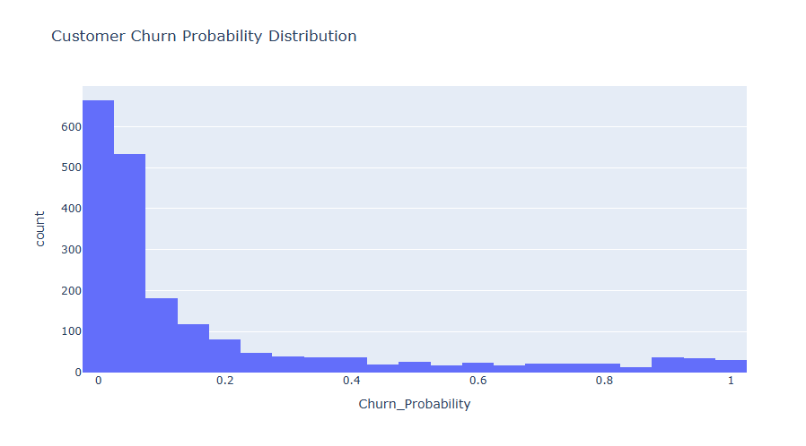

SECTION 3: PREDICTING CHURN
How Well Does It Work In Practice?
Tested on 2,026 previously unseen customers, the CatBoost model reliably distinguishes between high-risk and low-risk customers.
62.8%
Churn catch rate
The model correctly identified 204 of the 325 customers who actually churned in the test set, demonstrating its ability to flag at-risk customers before they left.
97.2% of loyal customers correctly identified as low-risk
Most customers score at very low risk; a distinct high-risk tail is where retention effort should focus.
6 of 11
PayStone | Customer Churn Analysis

Slide 8
SECTION 3: PREDICTING CHURN
What the Model Says Drives Churn
Contact frequency and inactivity are the strongest predictive factors, indicating that customers who become unusually inactive or require increased support attention are the most important groups to monitor.
1
Contact Frequency
Strongest single signal of risk
2
Inactivity Ratio
Time spent disengaged from the account
3
Education Level (Graduate)
Graduate-qualified customers show distinct patterns
4
Total Relationship Count
Number of PayStone products held
5
Transaction Count Change
Recent change in transaction activity
7 of 11
PayStone | Customer Churn Analysis

Slide 9

SECTION 4: WHAT TO DO ABOUT IT
Four Recommended Actions
01
02
03
04
Operationalise the model
Act on early warning signs
Cross-sell to at-risk customers
Investigate high-risk segments
Score the active customer base monthly and route high-risk customers to the retention team.
Flag rising support contact and falling transaction activity for proactive outreach.
Customers with more products tend to be more loyal, highlighting the value of strengthening multi-product relationships.
Run exit interviews with recently churned Platinum and Doctorate-education customers.
8 of 11
PayStone | Customer Churn Analysis

Slide 10

SECTION 4: WHAT TO DO ABOUT IT
Suggested Rollout Timeline
PHASE 1
PHASE 2
PHASE 3
PHASE 4
Deploy monthly scoring pipeline
Build retention outreach workflow
Launch qualitative review of high-risk segments
Review performance & retrain on new data
Data Science
CRM / Retention
Customer Insights
Data Science
0–1 month
1–2 months
1–2 months
Quarterly
With the model in production, PayStone gains a repeatable, data-driven early-warning system that shifts churn management from a lagging indicator to a proactive retention process.
9 of 11
PayStone | Customer Churn Analysis

Slide 11
Thank You
Questions & discussion
Data Science & Analytics Team PayStone Customer Churn Analysis • August 2026

