Slide 1


Touchdown Insights
A Data-Driven NFL Dashboard
Sara Parveen
Lailah Libay
Gus Mendes
Jacob Evans
WEB PROJECT
Multipurpose Template

Slide 2
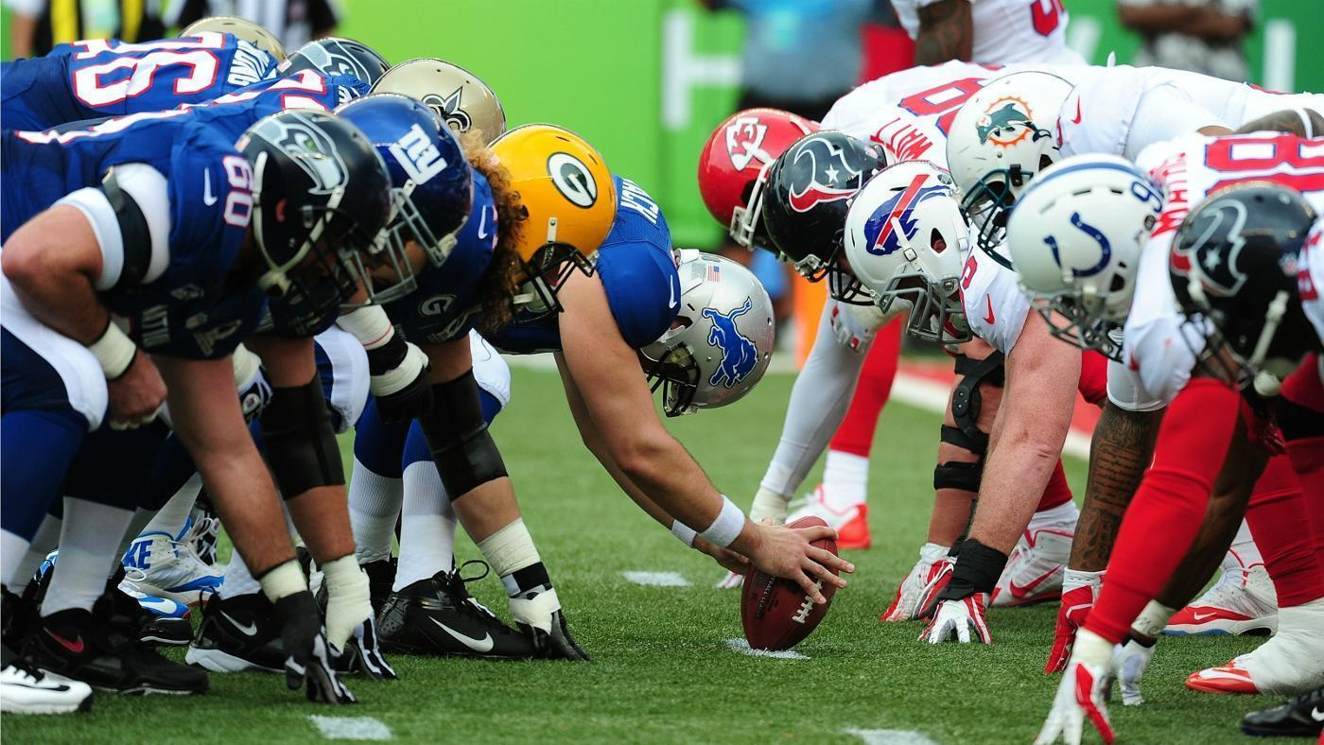

Target Audience
Football enthusiasts
NFL Sports Agents
Sports Analysts
Football coaches

Slide 3
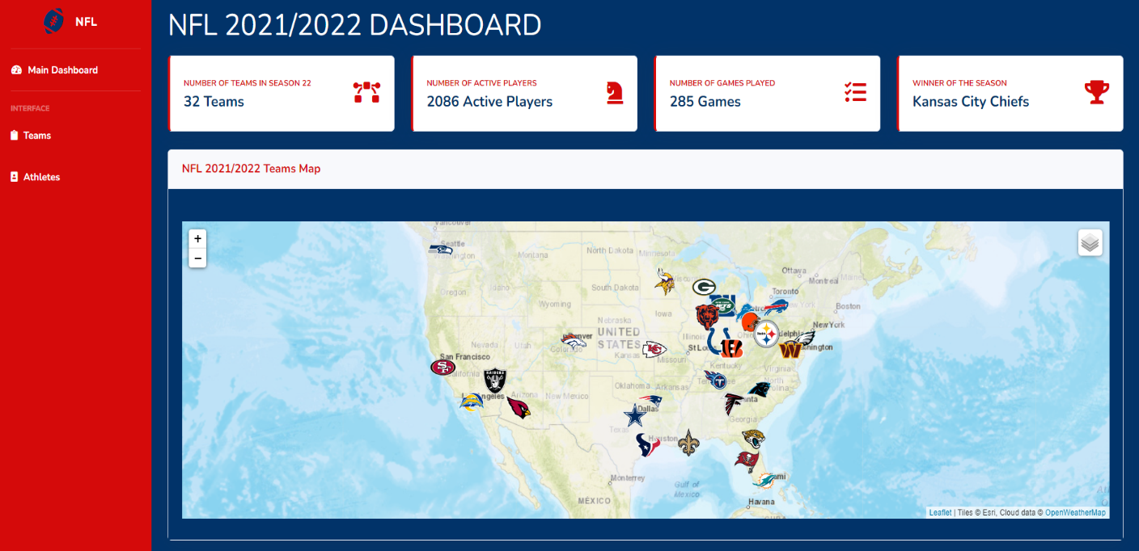
The NFL Dashboard
Main Dashboard
Teams Dashboard
Athletes Dashboard
Overall Statistics
Teams Venue Map
Team Logo
Team Details
Statistic charts
Athlete Headshot
- Athlete Details
- Statistic charts

Slide 4




Data Sources
ESPN API
On GitHub
2021/ 2022 data
Teams and Athletes
Kaggle
Team Statistics
2002 to 2023
GeoPy
- Location coordinates for team venues
Miscellaneous
-ProFootball Reference
- Covers

Slide 5
Project Stages
ETL
Database
Visualizations
Deployment

Slide 6
Extract, Transform & Load (ETL)
- Imported Statistics data from CSV
Create Pandas Dataframes
Converted to JSON and CSV outputs
Scraped data from API
Used embedded loops to extract teams and athletes data

Slide 7
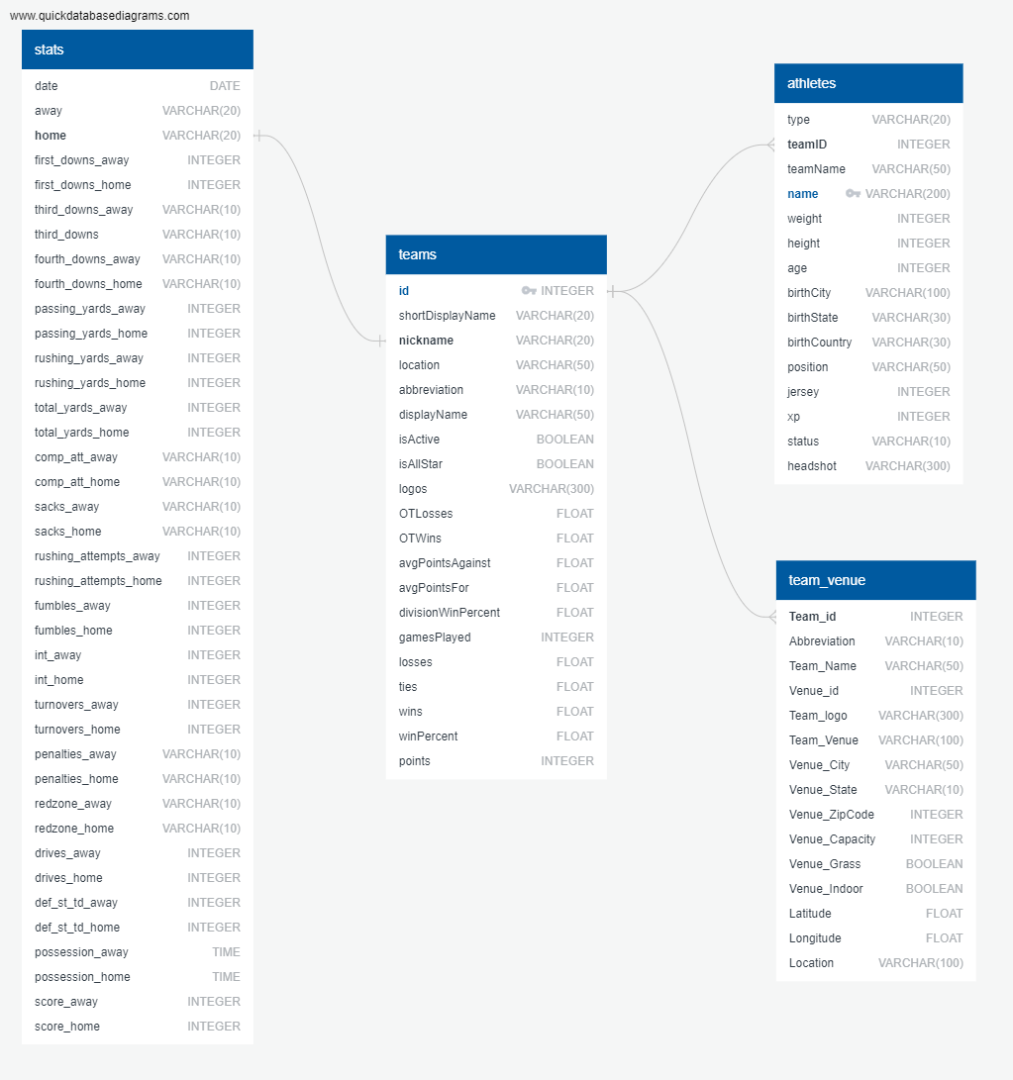
SQL Database
- Imported CSV to tables on PostgreSQL
Developed ERD

Slide 8
Visualizations – HTML/ CSS
Customized HTML to create the three views
Modified to effectively display the visualizations
Personalized CSS
NFL color theme
Template from bootstrap

Slide 9
Visualizations – JavaScript
Libraries used:
D3
Leaflet
Highcharts (new)
Interactive Map
Created dropdowns for Teams and Athletes
Customization by adding labels, legends, tooltips
Three JS files
Teams
Athletes
Teams Venue

Slide 10

Deployment
Deployed to AWS
Deployed to GitHub Pages
AWS:
https://flask-service.ofeg1bv1af188.ca-central-1.cs.amazonlightsail.com/index.html
Created Python Flask app
Added routes
Included debugger
GitHub Pages:
https://gusmendesbh.github.io/project3-group1/index.html

Slide 11

Thank you!
Questions??

