Slide 1
An Accuracy Comparison of Linear and Quadratic Programming Approaches for Classifying Breast Cancer Cells as Malignant or Benign
Jayques Nelson
Natural Science & Mathematics
Advisor: Dr. Wei Wan

Slide 2
Agenda
Abstract
Introduction
Background
Methodology
Results

Slide 3
This study compares two mathematical methods to determine which one more accurately identifies breast cancer tumors as cancerous or non-cancerous.
The goal is to understand which approach makes fewer mistakes and provides more reliable results.

Slide 4
Abstract
Purpose & Approach
Key Findings
Insights & Implications
Systematic comparison of Linear Programming (LP) and Quadratic Programming (QP) approaches for breast cancer classification
Dataset used: Wisconsin Diagnostic Breast Cancer (WDBC) dataset
Binary classification task: malignant vs. benign tumors
Evaluation across four discriminative feature pairs:
  concave_points3 vs perimeter3
  concave_points1 vs radius1
  perimeter1 vs area1
  texture1 vs smoothness1
Both methods achieved peak accuracy of 93.85% on the most discriminative feature pair (concave_points3 vs perimeter3)
LP slightly outperformed QP on less separable feature pairs
Average error rate:
  LP: 12.00%
  QP: 12.87% (performance varies with regularization parameter)
QP margin widths ranged from 0.11 to 14.22, reflecting varying separability and regularization effects
LP offers computational simplicity and direct error minimization
QP provides explicit margin optimization and stronger theoretical generalization guarantees
Demonstrates practical trade-offs between error minimization and margin maximization
Provides evidence-based guidance for selecting LP or QP based on feature discriminability and clinical priorities

Slide 5

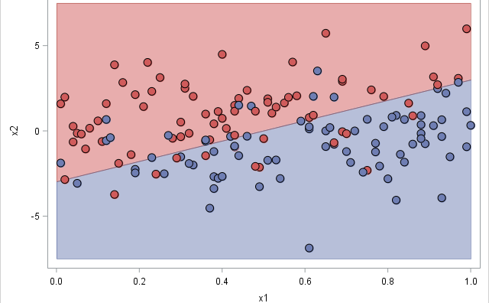
Introduction
Breast cancer diagnosis represents a critical application of machine learning in medical decision-making. Accurate classification of malignant versus benign tumors enables early detection and appropriate treatment planning, directly influencing patient outcomes and survival rates. Mathematical programming approaches, particularly Linear Programming (LP) and Quadratic Programming (QP), provide structured and interpretable frameworks for binary classification problems.

Slide 6
introduction
LP has been successfully applied to classification by minimizing misclassification errors through slack variables, offering computational efficiency and clarity in formulation.
In contrast, QP, implemented through Support Vector Machines (SVM), maximizes the margin between classes, providing strong theoretical generalization guarantees grounded in statistical learning theory.
Despite extensive research on both methods individually, systematic comparative studies examining their relative performance, error behavior, and regularization effects in breast cancer classification remain limited.
This study addresses that gap by:
  Conducting a direct comparison of LP and QP formulations
  Evaluating performance on the Wisconsin Diagnostic Breast Cancer (WDBC) dataset
  Analyzing accuracy, error ratios, and regularization impact across multiple feature pairs

Slide 7
Background research
What do the experts say?

Slide 8
Background research
The application of mathematical programming to classification problems has a rich history in operations research and machine learning. Early work by Mangasarian (1965) demonstrated that linear programming could be used for pattern separation by minimizing misclassification errors through slack variables. This formulation provided a computationally efficient alternative to statistical classifiers, particularly in medical diagnostics where interpretability and speed are valued (Bennett & Mangasarian, 1992).
In parallel, Vapnik (1995) introduced Support Vector Machines (SVMs), framing classification as a quadratic optimization problem aimed at maximizing the margin between classes. This approach is grounded in statistical learning theory and offers strong generalization guarantees.

Slide 9
Background research
Linear Programming in Medical Classification
LP approaches have been successfully applied in breast cancer diagnosis by separating malignant and benign samples using cytological features extracted from fine needle aspirates (Wolberg & Mangasarian, 1990). These methods emphasize:
  Direct error minimization
  Simplicity and transparency
  Computational efficiency
  No explicit regularization
Such properties make LP particularly suitable for clinical environments prioritizing interpretability and speed.
Quadratic Programming and SVM
QP formulations, implemented through SVMs, identify the hyperplane that maximizes the distance between the nearest points of opposing classes (support vectors). Studies have demonstrated strong performance of SVMs in distinguishing malignant from benign tumors (Bennett & Campbell, 2000).
The introduction of the regularization parameter 𝐶 in soft-margin SVMs allows practitioners to balance:
  Classification accuracy
  Margin size
  Overfitting control (Cortes & Vapnik, 1995)

Slide 10
Background research
Wisconsin Diagnostic Breast Cancer (WDBC) Dataset
The WDBC dataset, introduced by Wolberg & Mangasarian (1990), contains 569 samples with 30 features derived from digitized images of breast mass aspirates. It has served as a benchmark dataset for evaluating classification algorithms (Street et al., 1993).
Despite extensive study of the dataset using various machine learning methods, systematic comparisons between LP and QP formulations remain underexplored—particularly regarding:
  Error distribution analysis
  Regularization effects
  Feature-pair performance
  Margin behavior
Research Gap & Study Contribution
Prior studies validated LP and SVM independently but did not:
  Contrast them under controlled, feature-wise experimental conditions
  Examine regularization sensitivity alongside a parameter-free LP baseline
  Provide detailed error-ratio and margin-width comparisons
This study addresses these gaps by providing:
  A systematic feature-pair-wise comparison of LP and QP classifiers
  Explicit error-ratio analysis
  Margin-width evaluation
  Regularization sensitivity testing
  Practical guidelines for method selection in medical classification tasks

Slide 11
methodology
What are the steps?

Slide 12
Methodology: Data Preparation & Feature Selection
This study employs a controlled experimental framework to ensure a fair comparison between Linear Programming (LP) and Quadratic Programming (QP) classifiers. The publicly available Wisconsin Diagnostic Breast Cancer (WDBC) dataset (Wolberg & Mangasarian, 1990) was used.
569 samples: 212 malignant (37.3%), 357 benign (62.7%)
30 real-valued features derived from digitized images of breast mass aspirates
Two-dimensional feature-pair classification strategy
Top four feature pairs selected using a separability score:
  concave_points3 vs perimeter3
  concave_points1 vs radius1
  perimeter1 vs area1
  texture1 vs smoothness1

Slide 13

Methodology: Binary Classification Setup
Let:
A = set of malignant samples
B = set of benign samples
= feature vector
= class label
= weight vector
b = bias term
The goal is to determine the separating hyperplane:

Slide 14
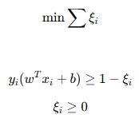
Linear Programming (LP) Formulation
The LP classifier directly minimizes classification errors using slack variables.
Objective Function:
Subject to:
Key Characteristics
Minimizes total margin violations
No explicit margin maximization
Parameter-free formulation
Deterministic solution
Focused solely on empirical error minimization

Slide 15
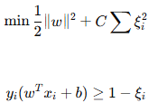

Quadratic Programming (QP) / SVM Formulation
The QP classifier is implemented as an L2-regularized soft-margin SVM (Cortes & Vapnik, 1995).
Primal Optimization
Problem:
Subject to:
Key Components
Margin maximization
Penalized misclassification
controls error-margin trade-off
Tested values:
For QP models, geometric margin:

Slide 16
Results
Which is better?

Slide 17
table

Slide 18
Graphs

Slide 19
Graphs

Slide 20
table

Slide 21
Discussion & Conclusion

Slide 22
references

