Slide 1
Sudoku Solver Using Constraint Satisfaction
Backtracking, MRV, Degree, Forward Checking and AC-3 (MAC)
Problem: complete a partial 9x9 grid (rows, columns, boxes hold 1-9 once) or report it invalid / unsolvable.
Motivation: the same all-different structure drives timetabling and crew rostering; naive search explodes (up to 9^57 assignments).
Jayraj Chauhan (2410111015) | Om Patel (2410111112) | Parth Prajapati (2410111138)
Supervisor: Ms. Alpa Rupala | Adani University, FEST, CSE (AI-ML)

Slide 2
PEAS model
Component | Sudoku AI solver
Performance | Correct solution; minimal nodes, backtracks, runtime; safe handling of bad input; clear trace
Environment | 9x9 (and 16x16) grid; fully observable, deterministic, static, discrete, single-agent, known
Actuators | Assign digit, prune domains, backtrack, output solution and trace
Sensors | Grid, cell domains, peers, user puzzle
Track: Applied AI (Optimization & Scheduling, Unit 2)
ECSCT24301 Foundation of AI | Sudoku CSP | 2

Slide 3
State space and operators
Element | Definition
State | Partial assignment of digits with no violated constraint
Initial state | Validated user puzzle (invalid input rejected first)
Actions | Choose cell, assign value, propagate, backtrack on empty domain
Goal test | All cells assigned; all 27 units contain each digit once
Path cost | 1 per assignment (every solution costs E = number of empty cells)
Depth = E, branching <= 9, unpruned space <= 9^E (about 10^54 for 24 givens)
ECSCT24301 Foundation of AI | Sudoku CSP | 3

Slide 4
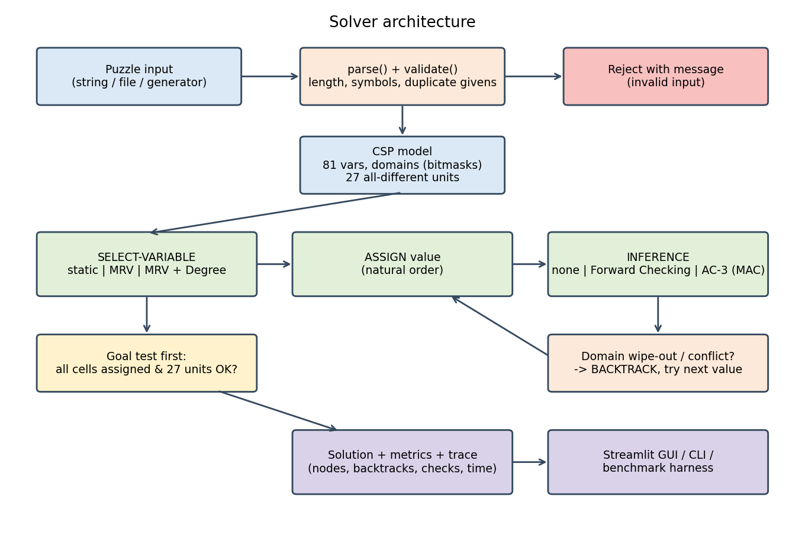
Knowledge representation and architecture
81 variables; domains as integer bitmasks (bit v-1 = digit v)
27 all-different units; 20 peers per cell (39 for 16x16)
FC/MAC: trail of domain changes, no state copying
Validation: length, symbols, duplicate givens
ECSCT24301 Foundation of AI | Sudoku CSP | 4

Slide 5
Core algorithms
Solver | Variable order | Inference | Role
BT | row-major | none | baseline
BT+MRV | smallest domain | none | advanced
BT+MRV+DEG | MRV, ties: max degree | none | improved
FC | MRV + degree | forward checking | optimized
MAC | MRV + degree | AC-3 after each assignment | optimized
All five are complete; identical metrics: nodes, backtracks, checks, prunes, time
ECSCT24301 Foundation of AI | Sudoku CSP | 5

Slide 6
Heuristic design and theory
Heuristic | Admissible | Consistent | Evidence (10,751 edges)
h_u = unassigned cells | yes (= h*) | yes | 0 violations
h_2 = 2 h_u | no | no | 10,751 overestimates
h_s = cells with |D|>1 | yes | no | 3,030 violations
BT time O(9^E), space O(E); AC-3 O(e d^3) per call, trail <= N^3
MRV / degree only reorder search: completeness unaffected
AC-3 sound: 0 of 16,200 solution values removed; FC accepts 19.5% of assignments AC-3 refutes
ECSCT24301 Foundation of AI | Sudoku CSP | 6

Slide 7
Experimental setup
Python 3.12, bitmask CSP, single CPU core; seed 2026
Limits: 5 s per 9x9 run, 15 s per 16x16 run; time-outs reported, never as results
Every solution verified against givens and goal test: 0 wrong in 545 runs
Metrics: nodes, backtracks, checks, prunes, depth, time
ECSCT24301 Foundation of AI | Sudoku CSP | 7

Slide 8
Benchmark instances
Family | Count | Givens | Class
9x9 sweep (unique solutions) | 90 | 40 ... 24 | small / medium
Named hard puzzles | 4 | 17-22 | medium
16x16 generated | 15 | 107-140 | large
Invalid inputs | 6 | - | edge
Unsolvable inputs | 7 | - | edge
Norvig and Kaggle sets plug in via --extra (see README)
ECSCT24301 Foundation of AI | Sudoku CSP | 8

Slide 9
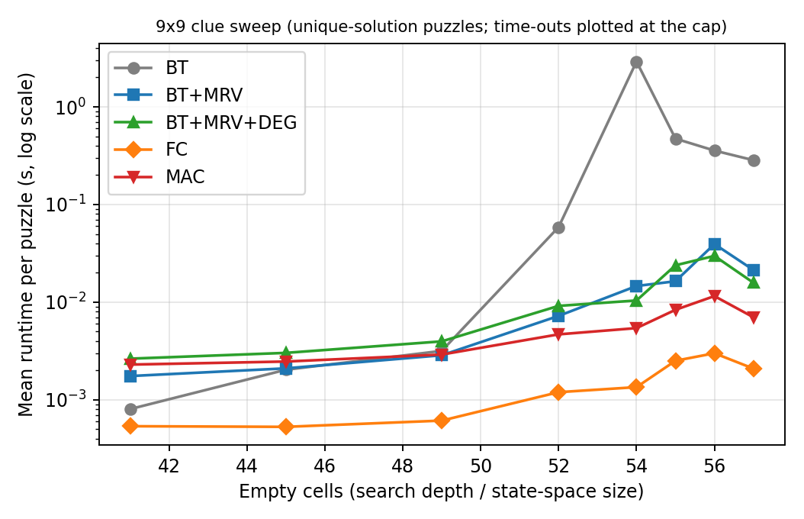
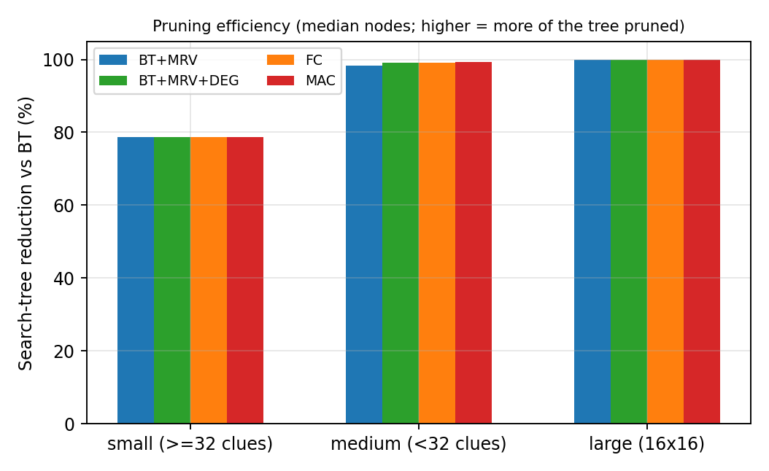
Results: depth, time and pruning
Baseline time explodes beyond ~50 empty cells; MRV removes 98.4% and MAC 99.4% of nodes on medium puzzles.
ECSCT24301 Foundation of AI | Sudoku CSP | 9

Slide 10
Results: comparison table (means)
Class / solver | Solved | Time (s) | Nodes | Backtracks
medium BT | 47/49 | 0.572 | 95,046 | 94,993
medium BT+MRV | 49/49 | 0.044 | 624 | 569
medium FC | 49/49 | 0.009 | 642 | 587
medium MAC | 49/49 | 0.027 | 289 | 234
large BT | 6/15 | 9.385 | 650,268 | 650,187
large BT+MRV | 14/15 | 2.126 | 6,134 | 6,007
large FC | 12/15 | 3.640 | 149,505 | 149,390
large MAC | 12/15 | 4.759 | 25,448 | 25,334
ECSCT24301 Foundation of AI | Sudoku CSP | 10

Slide 11
Error analysis and scalability limits
23 of 545 runs timed out: 11 BT, 5 BT+MRV+DEG, 3 FC, 3 MAC, 1 BT+MRV
Heavy tails on 16x16: one early wrong choice costs thousands of nodes (chronological backtracking, fixed value order)
Degree tie-break not always better (hard1: 2,090 vs 481 nodes)
AC-3 on binary != is weaker than all-different filtering
Memory is not the bottleneck; per-node cost in Python is (MAC about 6x FC)
Unsolvable: 4 solvers prove it at the root; BT timed out on 6 of 7
ECSCT24301 Foundation of AI | Sudoku CSP | 11

Slide 12
Conclusion, ethics and future scope
Heuristics + propagation cut search by 2-3 orders of magnitude; FC fastest overall
Fewer nodes do not guarantee less time
Future: Norvig/Kaggle sets, hidden singles / Regin all-different filtering, LCV, backjumping, restarts, compiled implementation
Ethics: no privacy issues here; scheduling use cases encode human preferences and need review
ECSCT24301 Foundation of AI | Sudoku CSP | 12

Slide 13
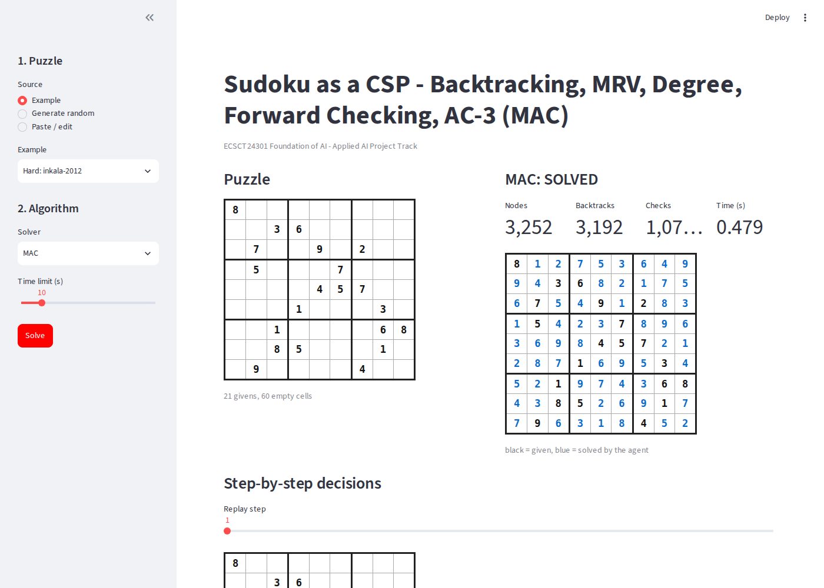
Live demonstration
streamlit run app.py
Pick, paste or generate a puzzle (9x9 / 16x16)
Run any solver; replay decisions step by step
Compare all five; invalid input is rejected with a message
ECSCT24301 Foundation of AI | Sudoku CSP | 13

