Slide 1
Capstone Project
Group 12
April 17, 2023

Slide 2





Our team
Amit Sharma
Rajvi Mehta
Jayraj Radadiya
Harshil Patel
Suhail

Slide 3
Agenda
01. Life of a Student
02. Problem statement
03. Solutioning
04. Technologies - Data flow
05. Demo
06. Wins, Struggles and Way-outs
07. What’s Next

Slide 4

Life of a Student
Achieving an optimal academic experience is a common goal among all college students. There are certain factors (with varying degrees of impact) that contribute to a desirable college experience such as:
Personal and professional background, Residential life experience, living flexibility & other academic factors
Factors, such as socioeconomic status, race, and ethnicity, may also play a significant role in shaping one's college experience.
The overall college experience can also be influenced by campus culture, extracurricular events, services provided and social opportunities.

Slide 5
Problem Statement
The purpose of this study is to examine the relationship between various factors and the academic experience of students. Specifically, the study will focus on
Demographics
work history
living conditions
to determine their impact on academic experience and overall quality of life. By identifying patterns and correlations, the study results will provide insights that could be used to improve the academic experience.
Target population:
DAB program Students
Hypothesis
Students who have stable work histories, relatable educational backgrounds, and better living situations are more likely to have a positive academic experience

Slide 6
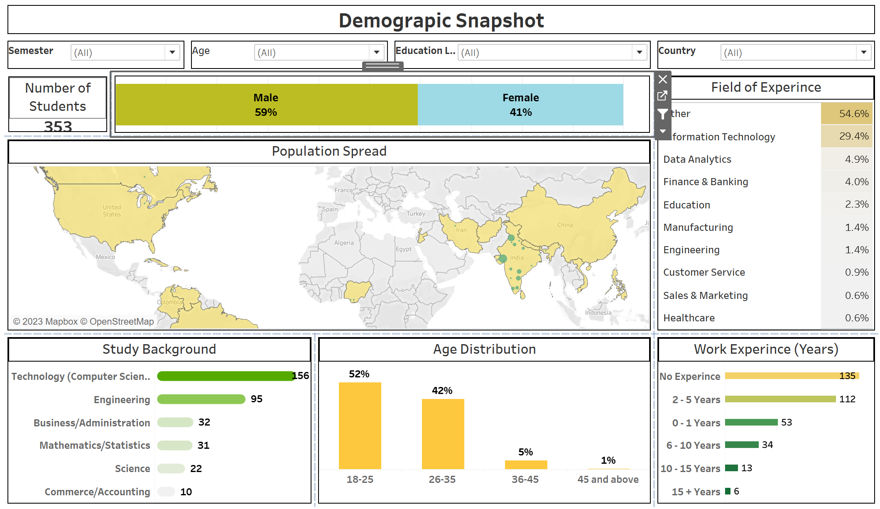
Solution
Central objective: To devise an automated and self-sufficient system that can proficiently showcase the correlations between diverse factors and a student's academic experience, while also forecasting the influence and potency of these factors on the same.
The solution's scope extends beyond providing insights solely on academic experience, as it also aims to illuminate Student-College relationship. The implementation of this solution will ultimately enhance the academic experience for students.
Solution in Nutshell: Series of interactive Tableau dashboards that provide a detailed overview of the data journey, from initial background information to academic outcomes and predictive analysis

Slide 7
Technologies - Data flow
collection -- pre processing -- transformation -- prediction - outcomes
Technologies used
Architecture
Story board explanation of the dashboard
to use all phadses fo a data journey (collection -- pre processing -- transformation -- prediction - outcomes)

Slide 8
Demo
Part 1 - Dashboard
Part 2- Pipeline

Slide 9
Wins, Struggles and Way-outs
Wins
Struggles
Way-Outs
Increase customer satisfaction by 2%
Maintain growth
Decrease the number of rotations by at least 2
Ensure the cost of development stays below budget
Interns begin
Indoor rec leagues
Chess tournaments
Big Game watching party
Food drive

Slide 10
What’s Next
Business/Domain
Technical
Expansion to more courses
Course wise customization of survey and data
Central DB for DAB program
Entry and Exit Survey
Technical cloud pipelines
File arrive automation with email

Slide 11

Thank you
Students - Data, Mentors - guidance and All college professors – For all the 4 sems of learnings
Contoso

