Slide 1
Sound Wave Scribe : Bridging Spoken language and Written text
Presented by
Mohammed Shaik, Samadarshini Pinninti, Achyuthreddy Kethireddy, Vasanth Kathare, Sanjay Nerella and Pavan Pitta
Presenter: Achyuthreddy
School of computer science & Artificial Intelligence
SR University
Date:02-04 August,2024
Paper ID:441
:

Slide 2
Presentation Outline
Abstract
Introduction
Literature Survey
Proposed System
Capturing Audio
Automatic Speech Recognition (ASR)
Natural Language Processing (NLP)
Natural Language Understanding (NLU)
Dialog Management
Knowledge Graphs and Structured Data
Natural Language Generation and Text-to-Speech
Test Results
Conclusion
Future Scope
References

Slide 3
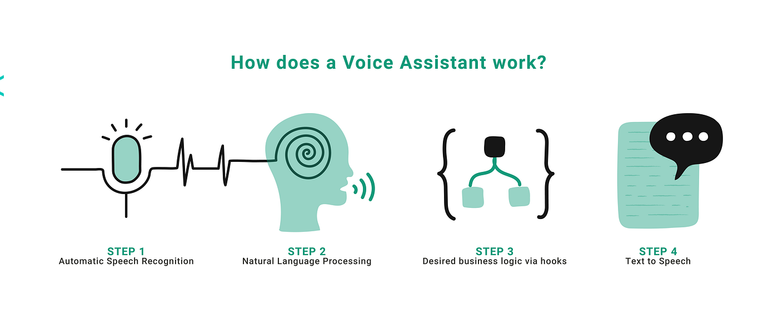
Introduction
Sound Wave Scribe aims to develop a voice assistant that translates spoken language into written text using advanced NLP and ML techniques.
This technology improves accessibility and efficiency, benefiting fields like education, healthcare, and professional environments.
To create a user-friendly voice assistant that accurately transcribes spoken language, enhancing human-machine interaction.

Slide 4
Literature
Key Contributions:
Tirthajyoti Nag, Jayasree Ghosh, Sanjay Chakraborty:
Project: Python-based virtual assistant
Technologies: NLP, Google's speech recognition
Raj Kumar Jain, Vikas Sharma, Mangilal, Rakesh Kardam, Mamta Rani:
Project: Python virtual assistant
Technologies: Speech Recognition, Pyttsx3, additional modules
Dr. Ranjeet Kumar, Muhammad Faisal, Mohd Faisal, Owaish Ahmad:
Project: Virtual assistant system
Technologies: Speech recognition, Python backend, API calls
Ahmed J. Abougarair:
Project: COBRA voice assistant model
Application: Desktop assistant projects
Common Challenges:
ASR & NLP Limitations:
Accuracy in noisy environments
Difficulty with accents and dialects
Dependency on External Services:
Reliability issues if services are unavailable
Sound Wave Scribe Voice:
Advanced NLP & ML for better understanding
Effective handling of context and multi-turn conversations
Precise responses with sophisticated algorithms and knowledge graphs
Setting reminders, web scraping
Seamless integration with external services
Natural language generation and text-to-speech for engaging user experience

Slide 5
Methodology
The proposed system, Sound Wave Scribe, aims to revolutionize the way we interact with technology by seamlessly converting spoken language into written text. The system leverages advanced Natural Language Processing (NLP) and Machine Learning (ML) techniques to achieve this goal. Below are the key components and functionalities of the proposed system
Audio Capture
Preprocessing
Automatic Speech Recognition (ASR)
Natural Language Processing (NLP)
Natural Language Understanding (NLU)
Dialogue Management
Knowledge Graphs and Structured Data
Natural Language Generation (NLG)
Text-to-Speech (TTS)

Slide 6
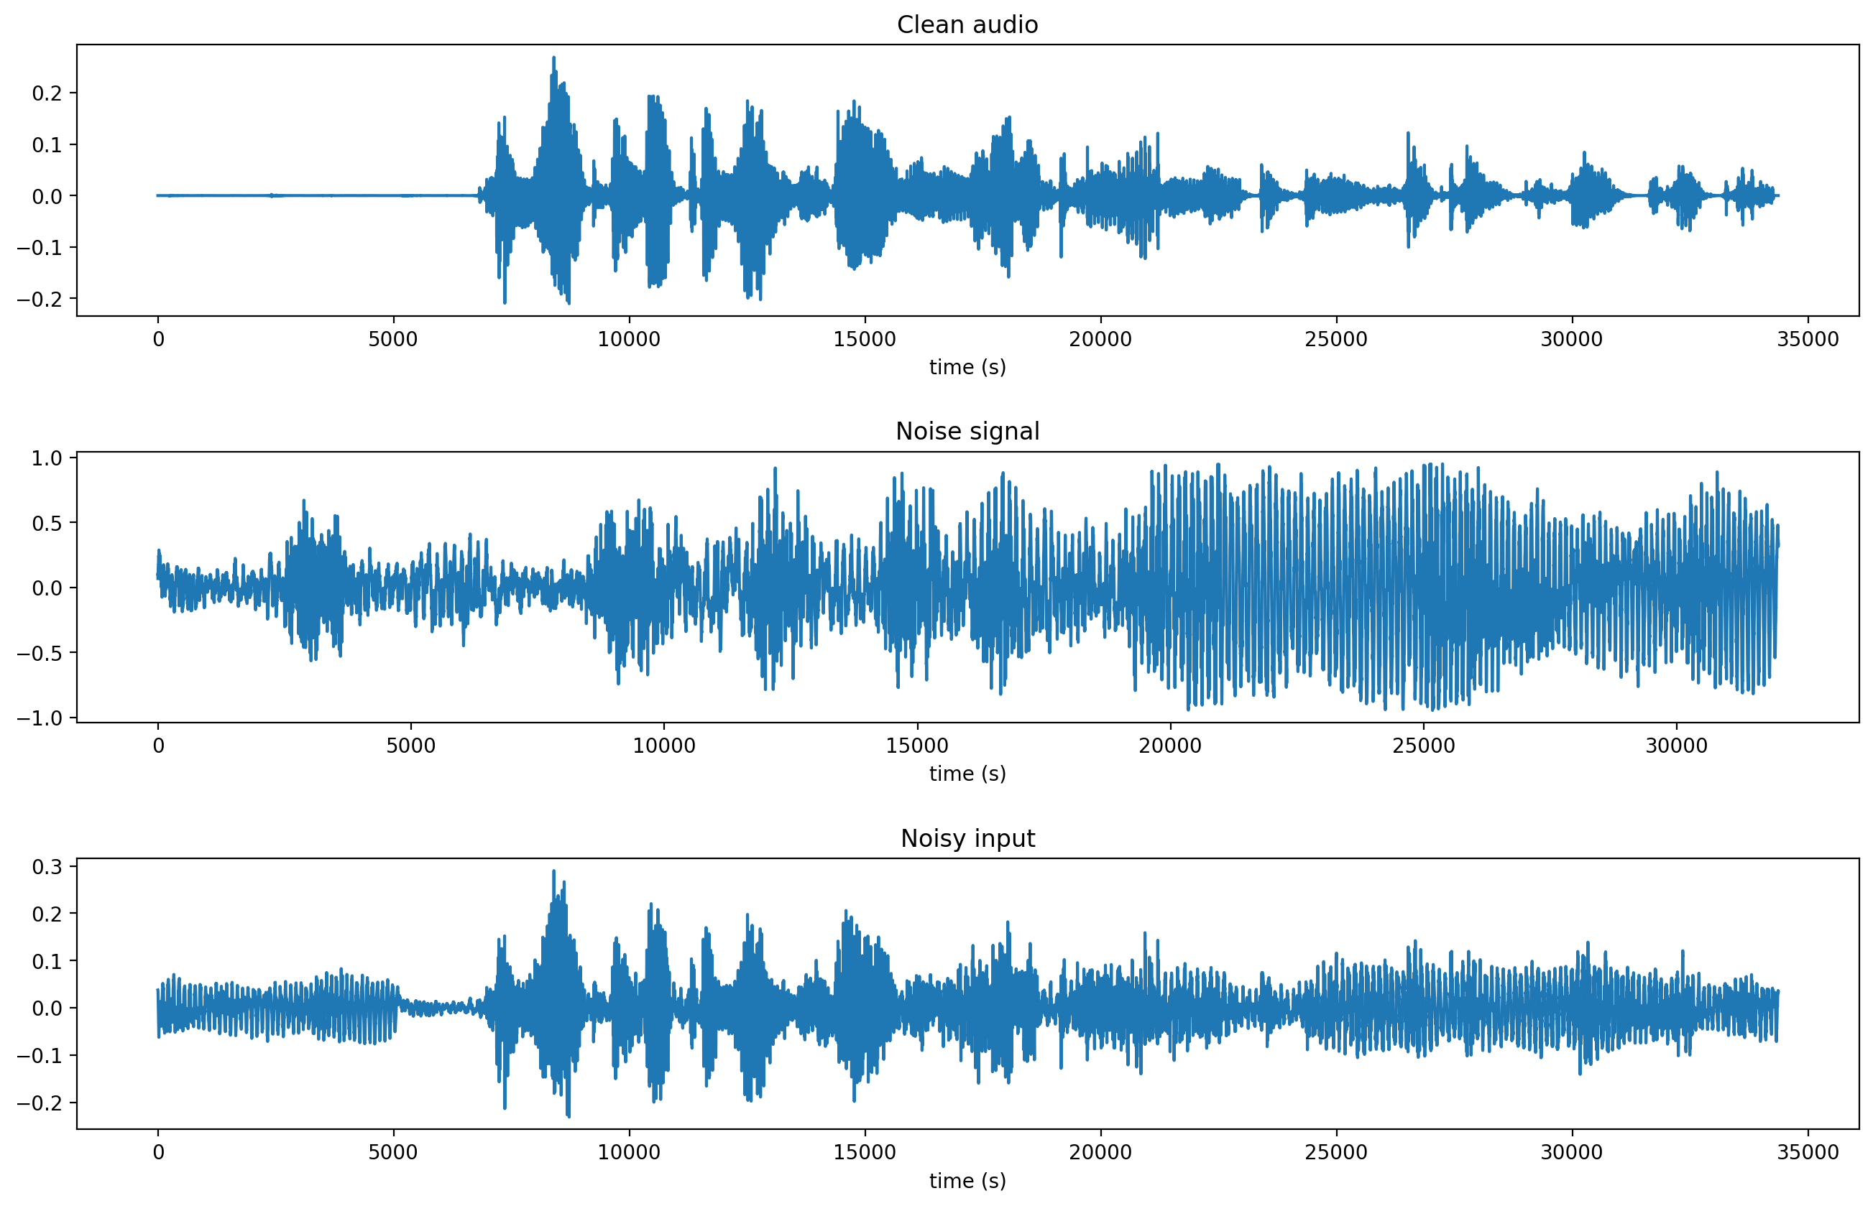
Capturing Audio
The first step in the Sound Wave Scribe system is capturing audio. This process involves the following key aspects:
Audio Input :
Noise Reduction:for this we used python Noisereduce library
🗣〰️

Slide 7
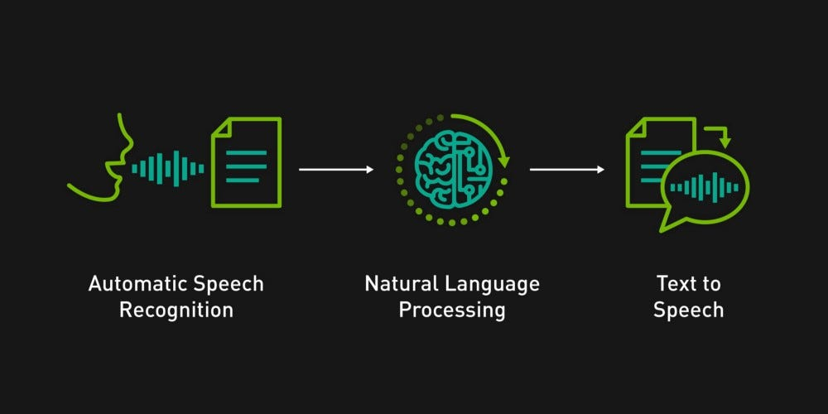
Automatic Speech Recognition (ASR)
Automatic Speech Recognition (ASR) is a technology that enables a machine to convert spoken language into written text.
Objective: To transcribe audio input into text accurately, enabling further processing in natural language applications.

Slide 8
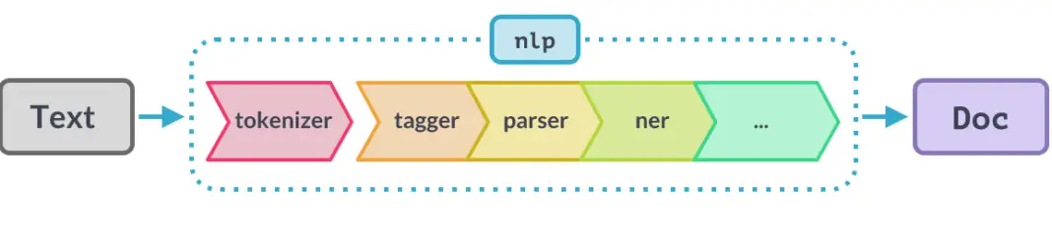
Natural Language Processing (NLP)
Overview of NLP
Natural Language Processing (NLP) involves the use of algorithms and models to process and understand human language in a way that is meaningful and useful.
Objective: To enable machines to interpret, understand, and generate human language in a way that facilitates effective human-computer interaction.
spaCy is a powerful Python library specifically designed for industrial-strength NLP. It provides a comprehensive set of tools for processing and understanding human language.

Slide 9
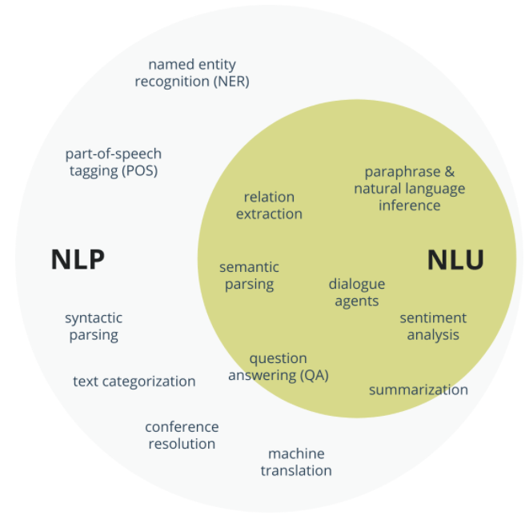
Natural Language Understanding (NLU)
Overview of NLU
Definition: Natural Language Understanding (NLU) is a subfield of NLP focused on comprehending and interpreting the meaning behind text or spoken language. It aims to extract semantic meaning and intent from user input.
Objective: To bridge the gap between human language and machine understanding by processing and interpreting the intent and context of user interactions.

Slide 10
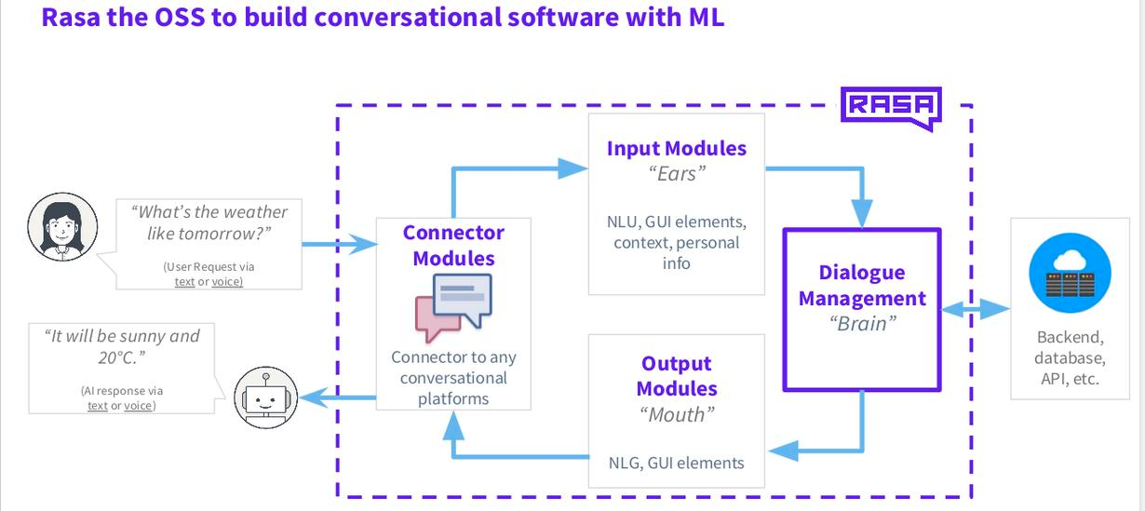
Dialog Management
Overview of Dialogue Management
Definition: Dialogue Management is a component of conversational systems that manages and controls the flow of interactions between users and the system. It ensures that the conversation progresses smoothly and logically.
Objective: To maintain context, handle multi-turn interactions, and provide coherent and relevant responses throughout the conversation.

Slide 11
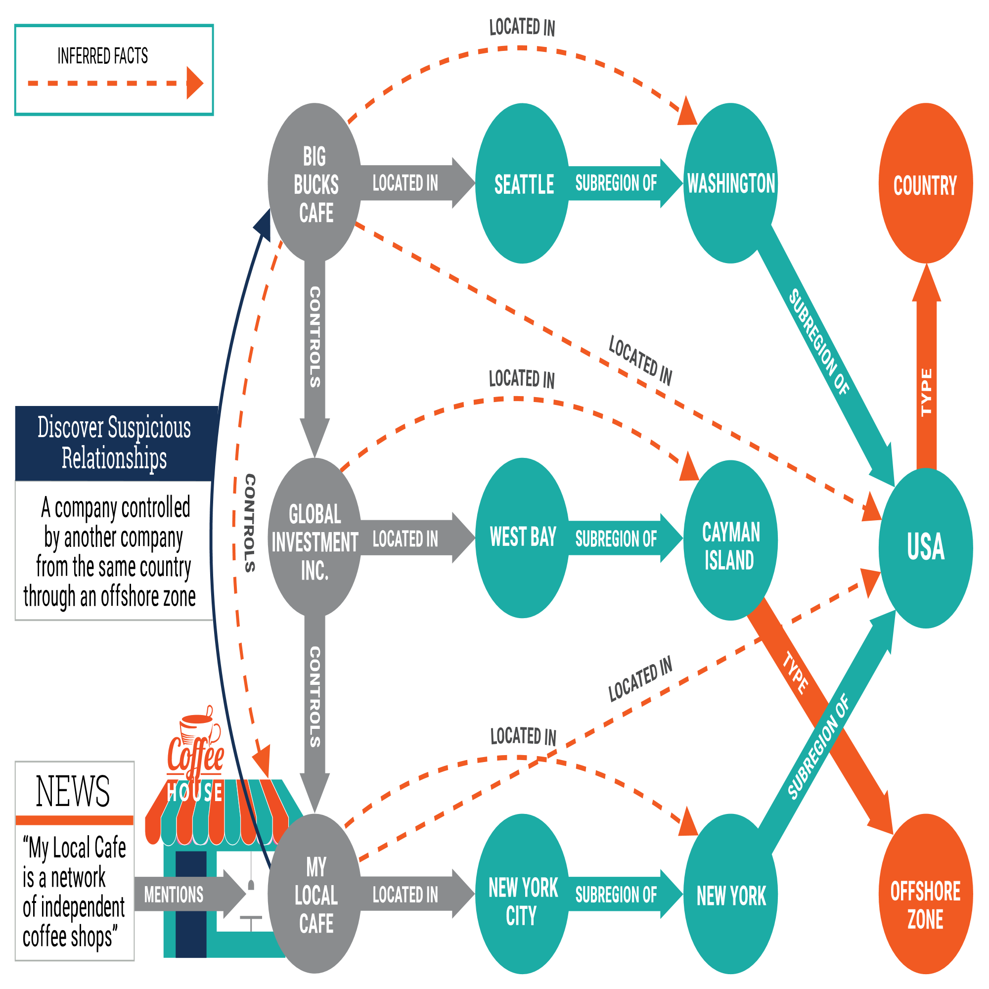
Knowledge Graphs and Structured Data
Overview of Knowledge Graphs
Definition: A Knowledge Graph is a structured representation of knowledge that connects entities and their relationships in a graph format. It organizes and integrates information from various sources to provide a comprehensive view.
Objective: To enhance the system’s ability to understand and reason about information by providing context and relationships between entities.

Slide 12
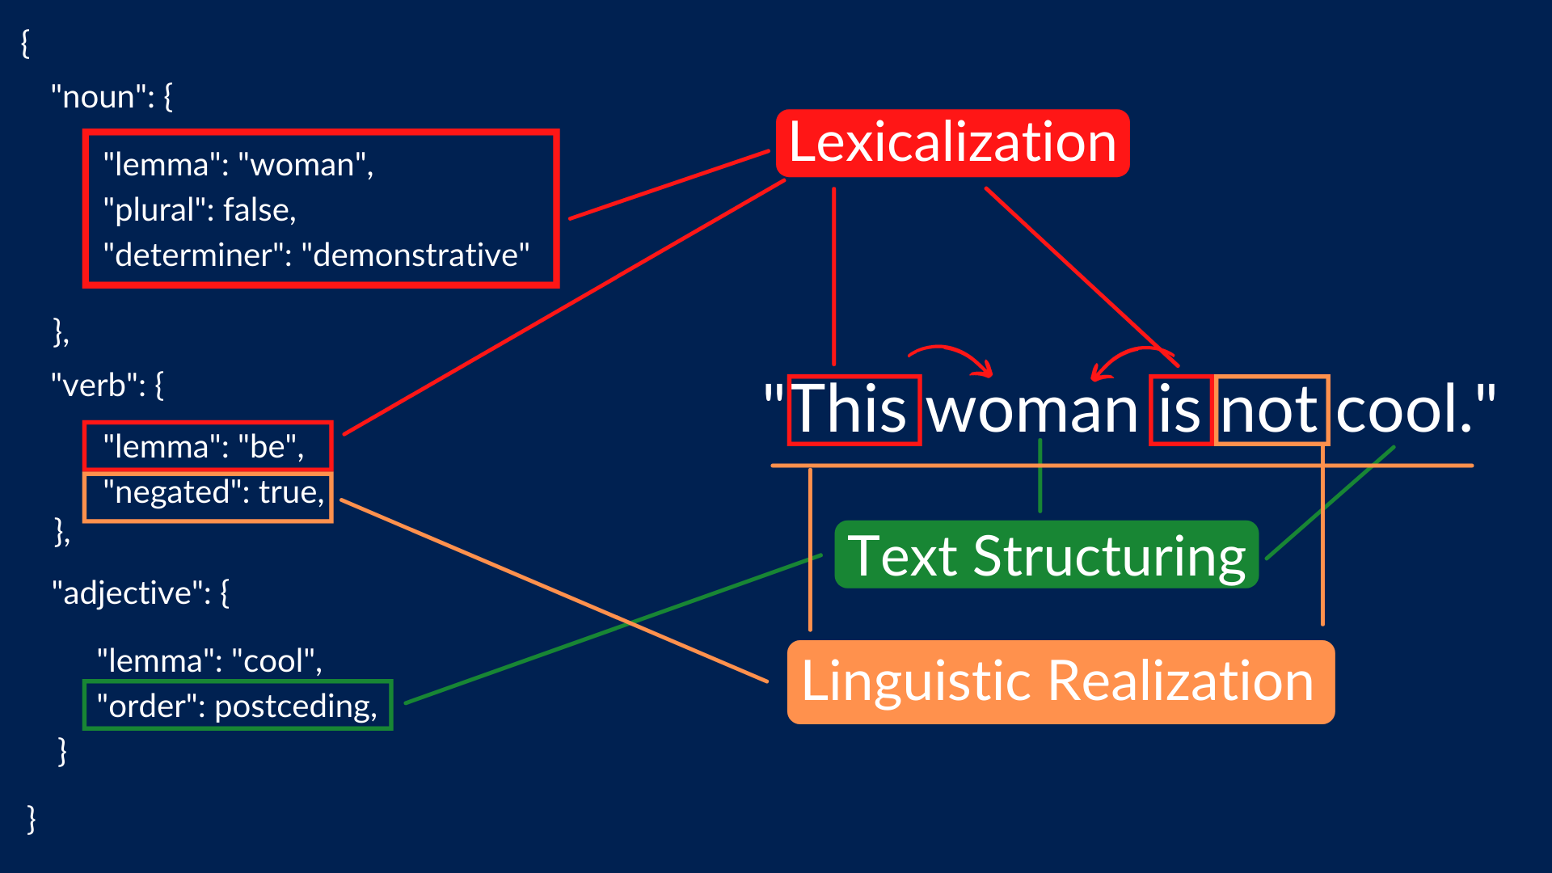
Natural Language Generation and Text-to-Speech
Overview of Natural Language Generation (NLG)
Definition: Natural Language Generation (NLG) is the process of converting structured data or information into coherent and contextually appropriate text. It involves generating human-like language that is understandable and relevant.
Objective: To produce natural and engaging textual responses based on the processed information, enhancing the interaction experience.

Slide 13
Results & Discussion
Compares performance in listening, recognizing, and generating responses across different virtual assistants, highlighting efficiency and speed.
Speech Recognition: High accuracy in transcribing speech into text, despite various accents and speech patterns.
Functionality: Successfully performs operations like web browsing, weather monitoring, time checking, emailing, and calculating.
Error Handling: Efficiently addresses issues from mispronunciations, unclear instructions, or unsupported capabilities. Provides brief explanations and solutions to the user.
Input Validation: Responds appropriately to unsupported or poorly structured utterances, preventing system crashes or unexpected behavior.
Integration:Features work seamlessly together, ensuring smooth user experience without hitches or unexpected performance issues.

Slide 14
Conclusion
Advanced Voice Interaction:Offers a voice-activated interface with advanced machine learning and natural language processing to understand orders, differentiate intents, and provide appropriate replies..
Comprehensive Functionality:Capable of browsing the internet, managing calendars, computing current time, and handling sub-processes beyond executing plain commands.
User-Centered Design:Personalized voice, language, and autonomy levels adapt to user mood, suitable for all ages and skill levels.
Data Privacy Commitment:Ensures strong data privacy measures to protect user information.
Challenges:Struggles with context in multi-turn dialogues, complex questions, and relies on external platforms and APIs, leading to security concerns and the need for improvements in offline ability, platform compatibility, and language support.

Slide 15
References
[1]Nag, Tirthajyoti, Jayasree Ghosh, and Sanjay Chakraborty. "A Study on Python-Based Virtual Assistant Using Natural Language Processing." Journal of Artificial Intelligence and Soft Computing Research, vol. 10, no. 3, 2023, pp. 235-250.
[2]Kumar Jain, Raj, Vikas Sharma, Mangilal, Rakesh Kardam, and Mamta Rani. "Development of a Python-Based Virtual Assistant for Task Automation." International Journal of Computer Applications, vol. 182, no. 35, 2021, pp. 1-8.
[3]Kumar, Dr. Ranjeet, Muhammad Faisal, Mohd Faisal, and Owaish Ahmad. "Virtual Assistant System Design Using Python and Speech Recognition." International Journal of Scientific Research in Computer Science, Engineering and Information Technology, vol. 6, no. 3, 2022, pp. 13-19.
[4]Abougarair, Sarah. "Exploring the Use of Virtual Assistants for Desktop Automation." Proceedings of the International Conference on Advances in Computer Science, Engineering & Applications, 2023, pp. 145-158.
[5]Chinchane, Prathamesh, et al. "Enhancing Virtual Assistant Capabilities through Natural Language Processing and Machine
[6]Learning." Proceedings of the IEEE International Conference on Artificial Intelligence and Machine Learning, 2022, pp. 78-92.

Slide 16


