Slide 1
PingPong Ball vs. Tennis Ball

Slide 2
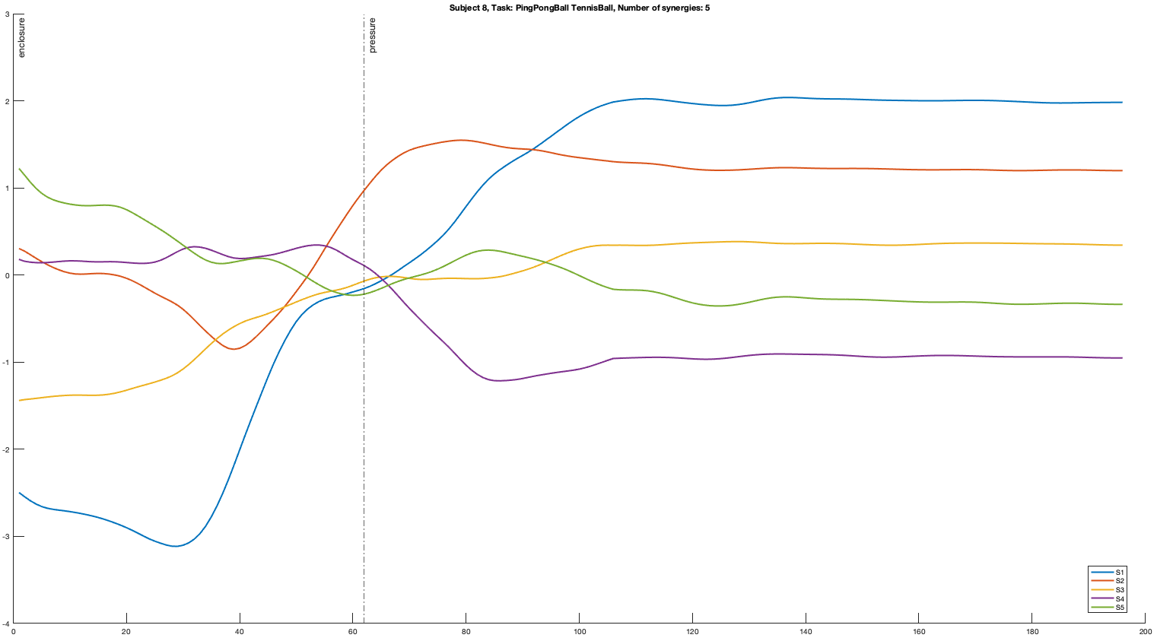

Slide 3
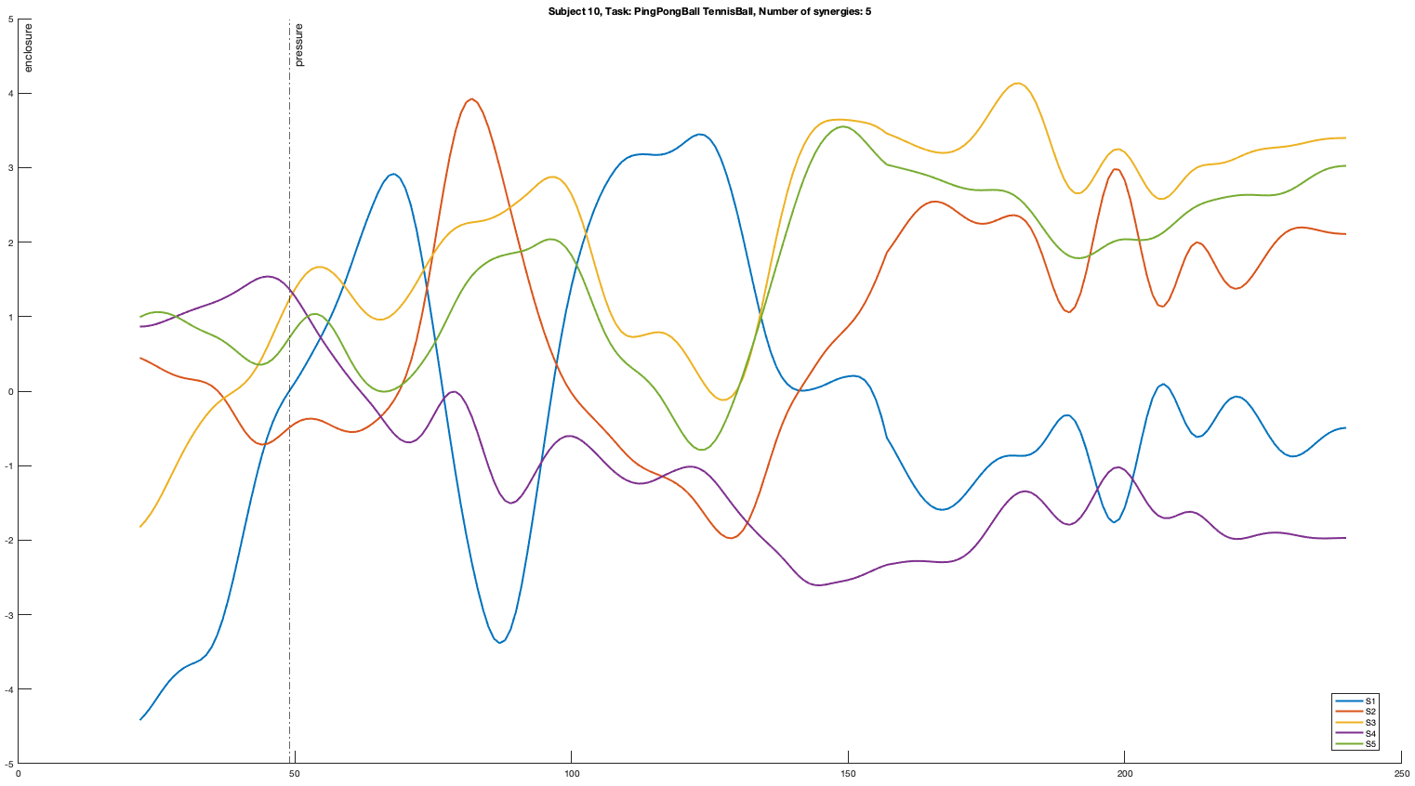

Slide 4
Subject 8
Subject 10

Slide 5
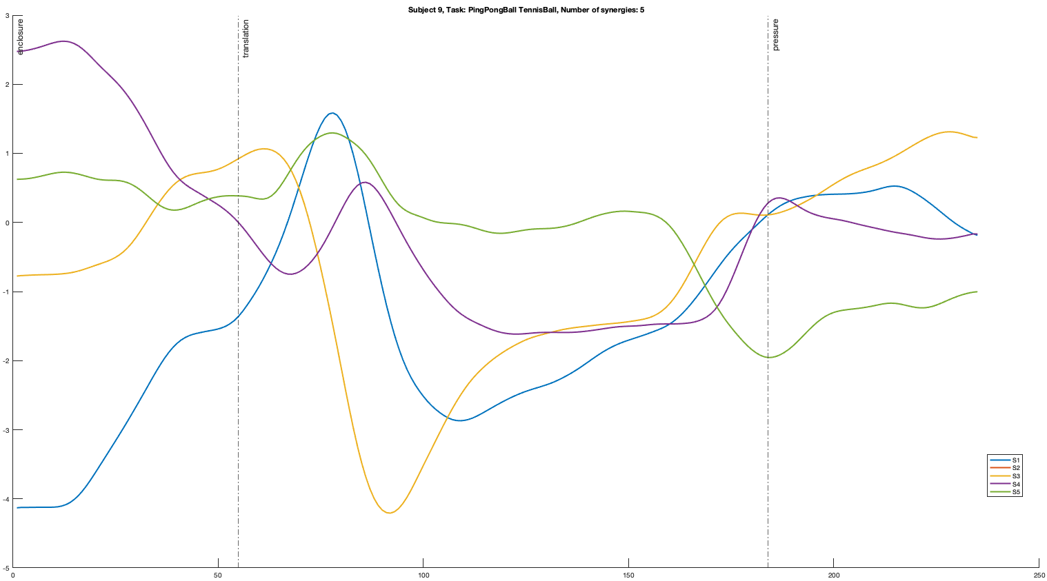

Slide 6
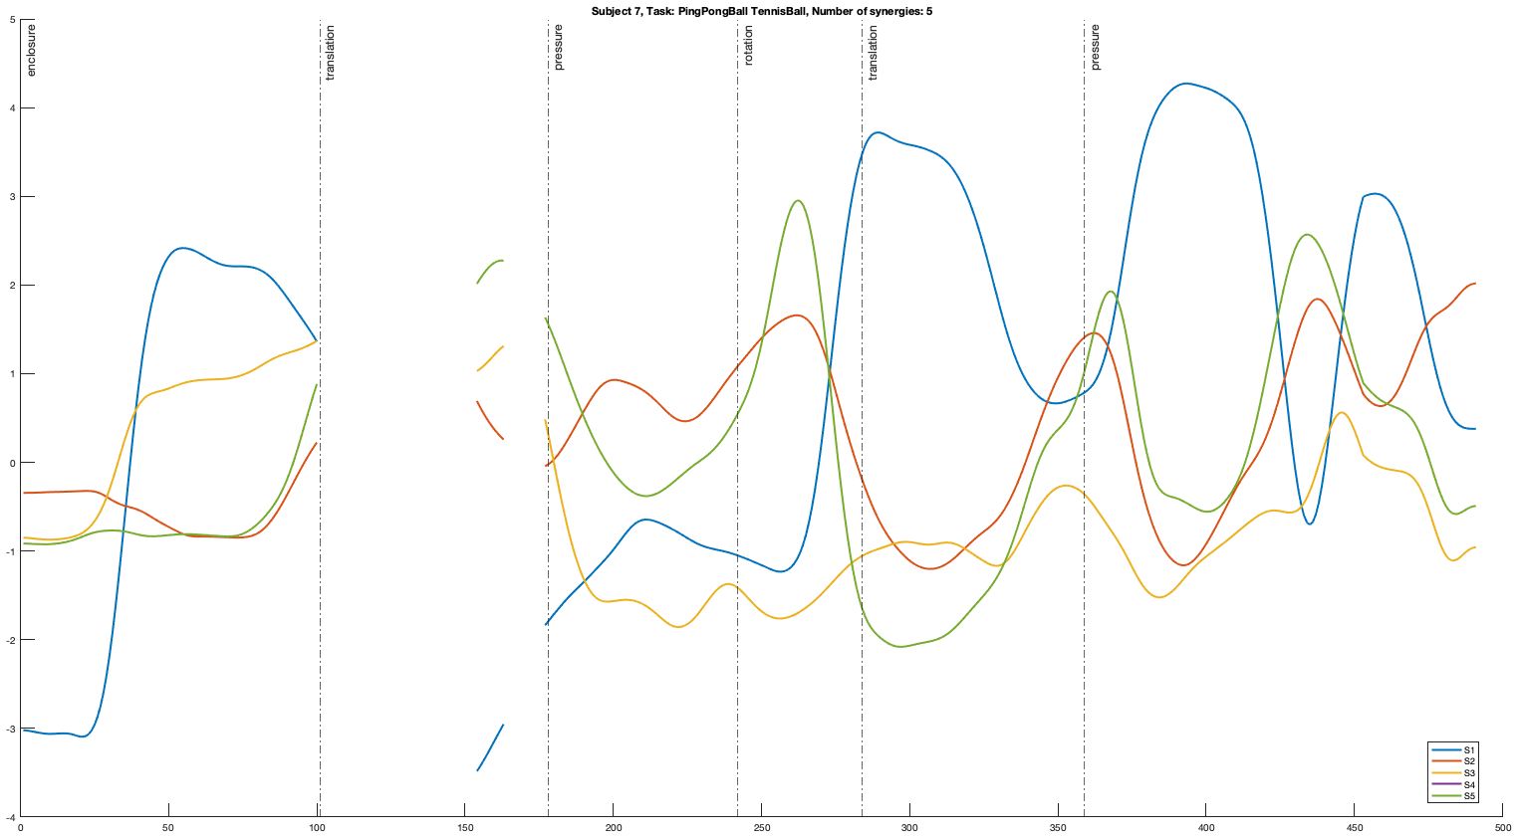

Slide 7
Ceramic Mug vs. Ceramic Mug

Slide 8
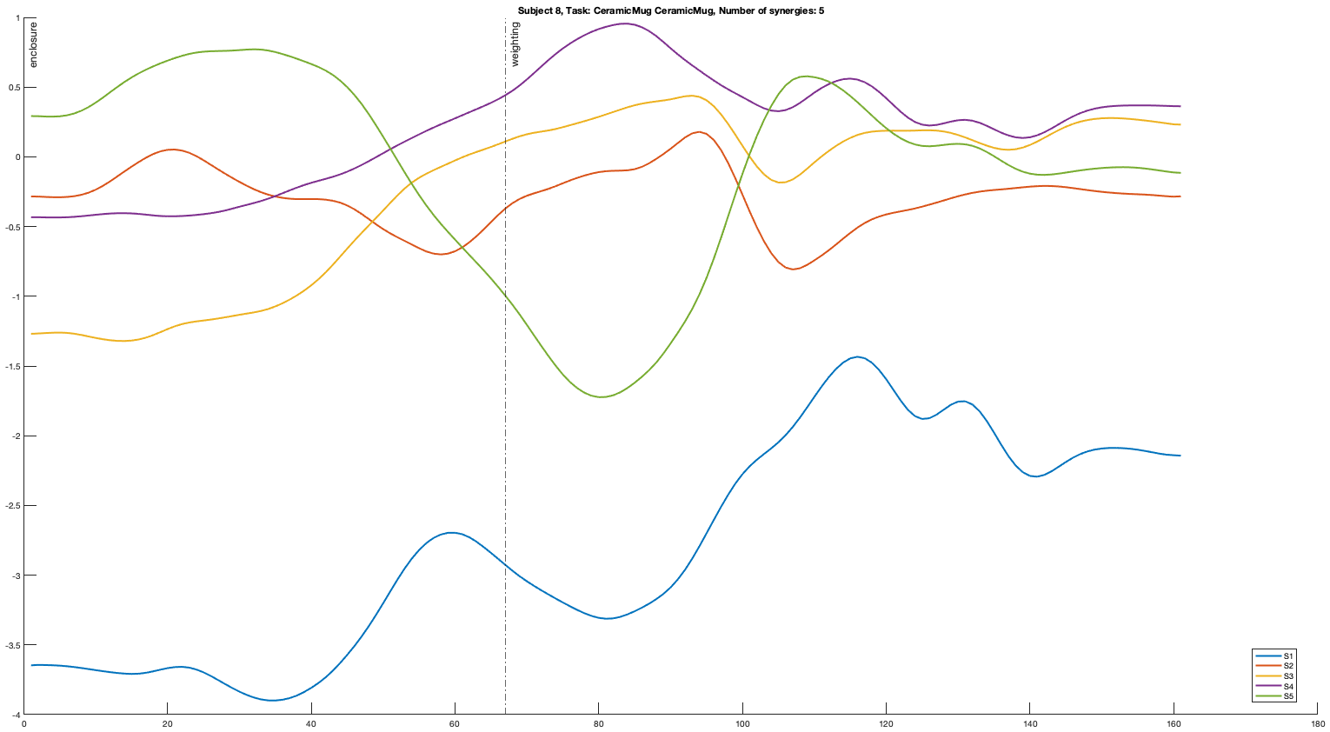

Slide 9
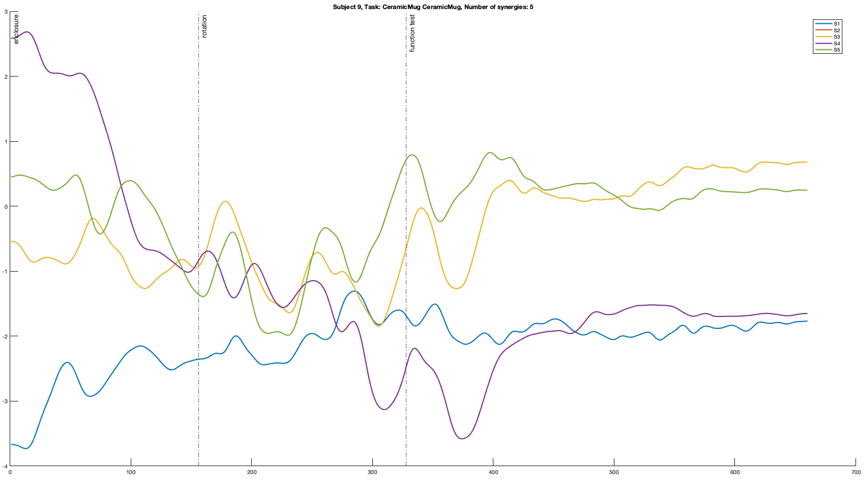
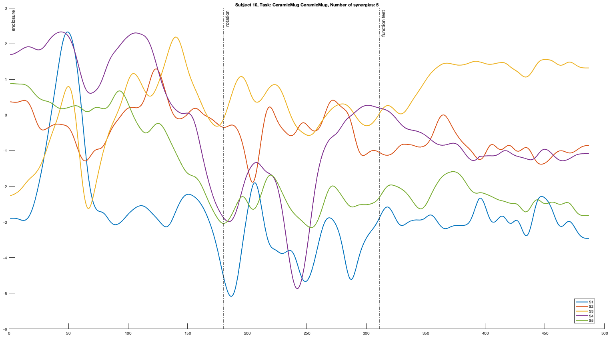
Subject 9
Subject 10

Slide 10
Cube vs. Cylinder

Slide 11
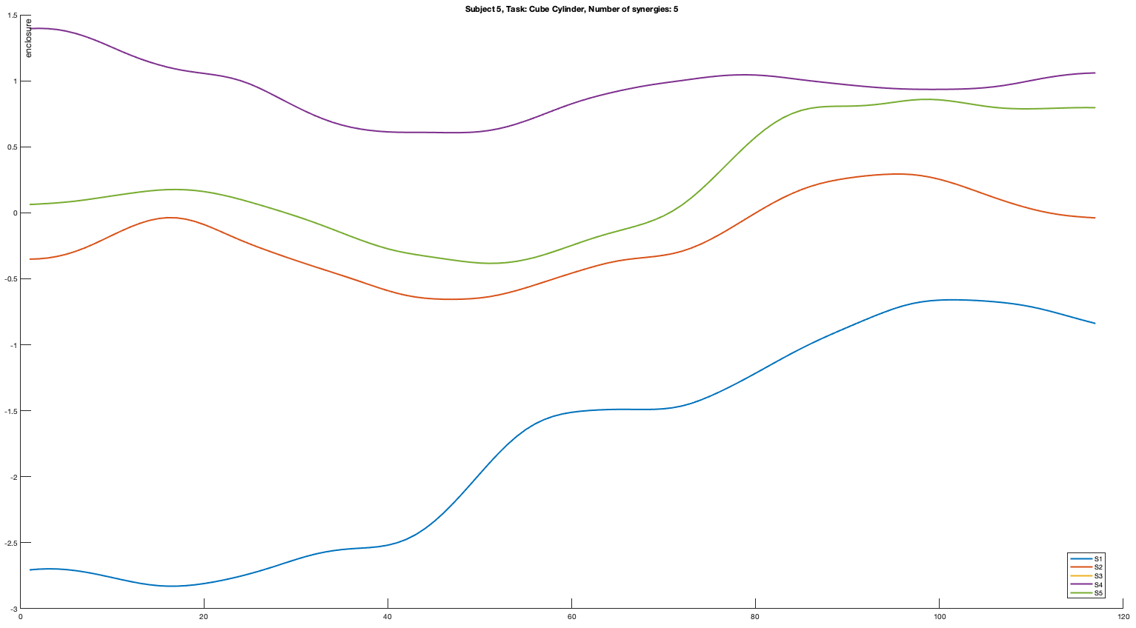
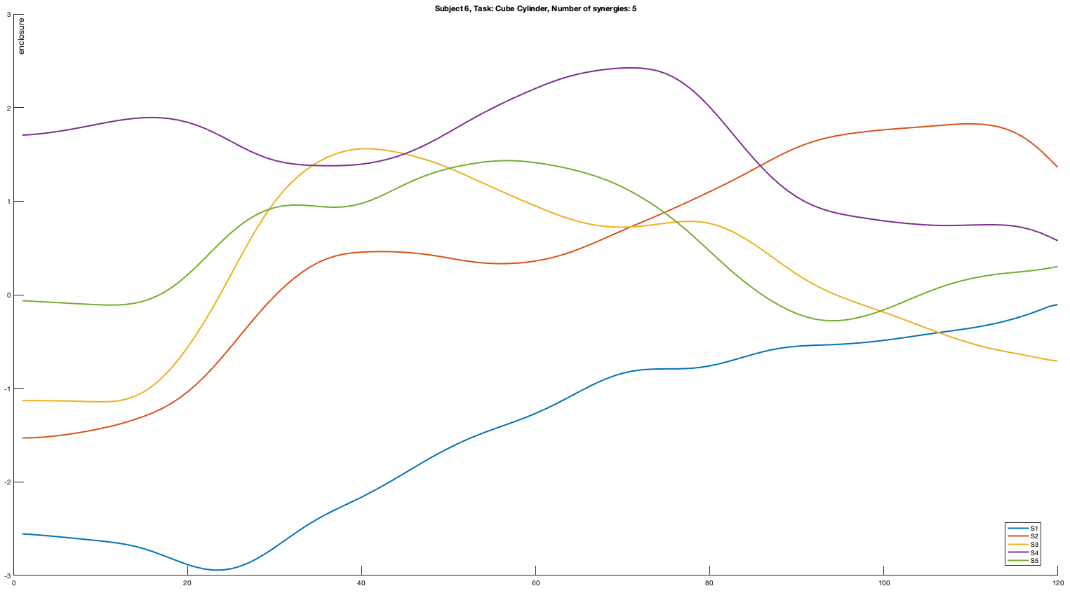
Subject 5
Subject 6

Slide 12
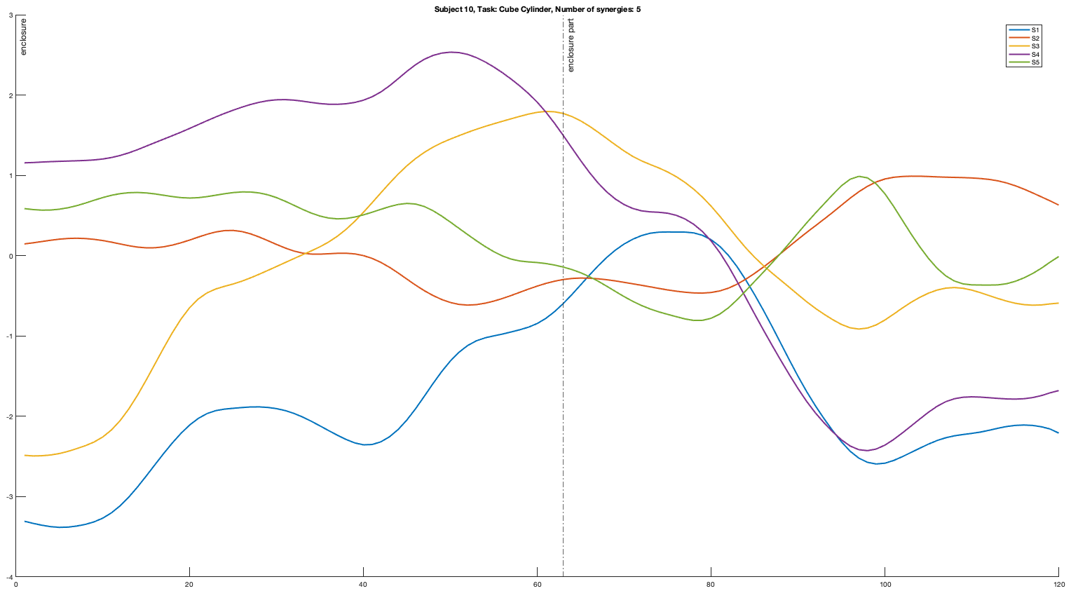
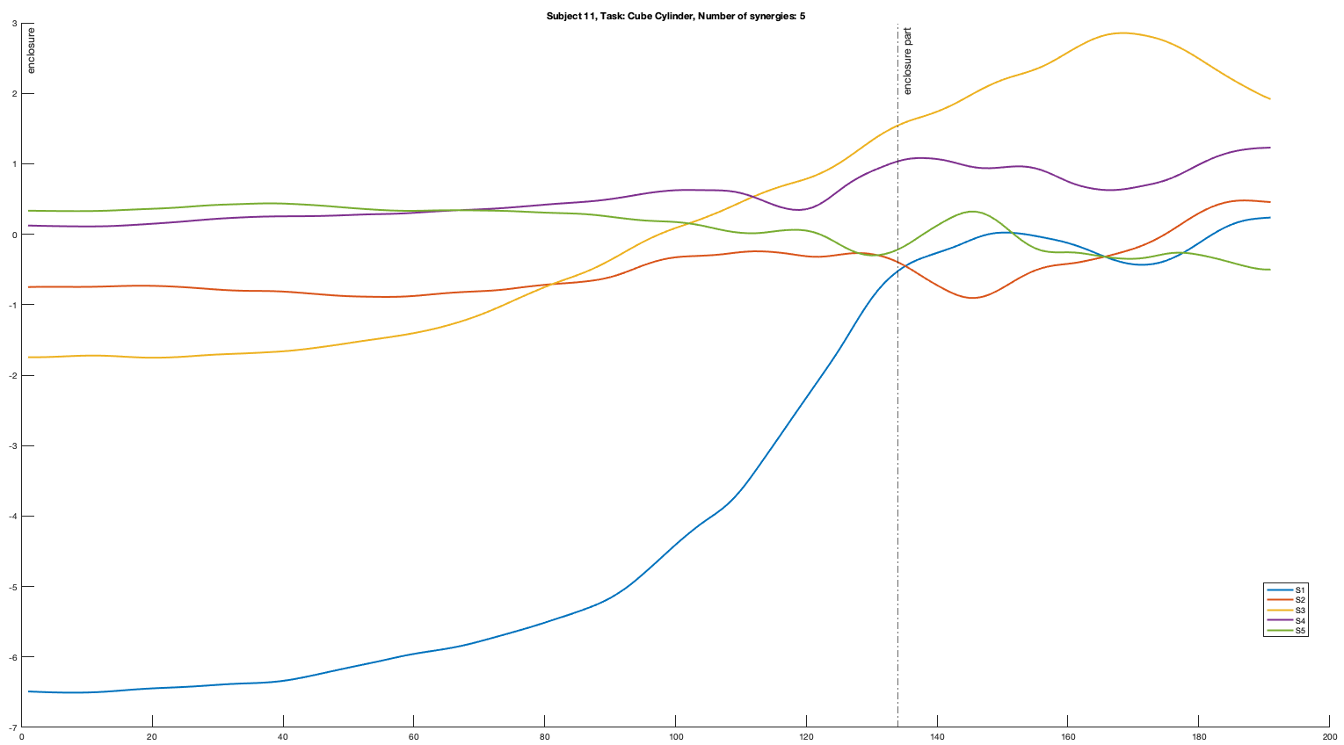
Subject 10
Subject 11

Slide 13
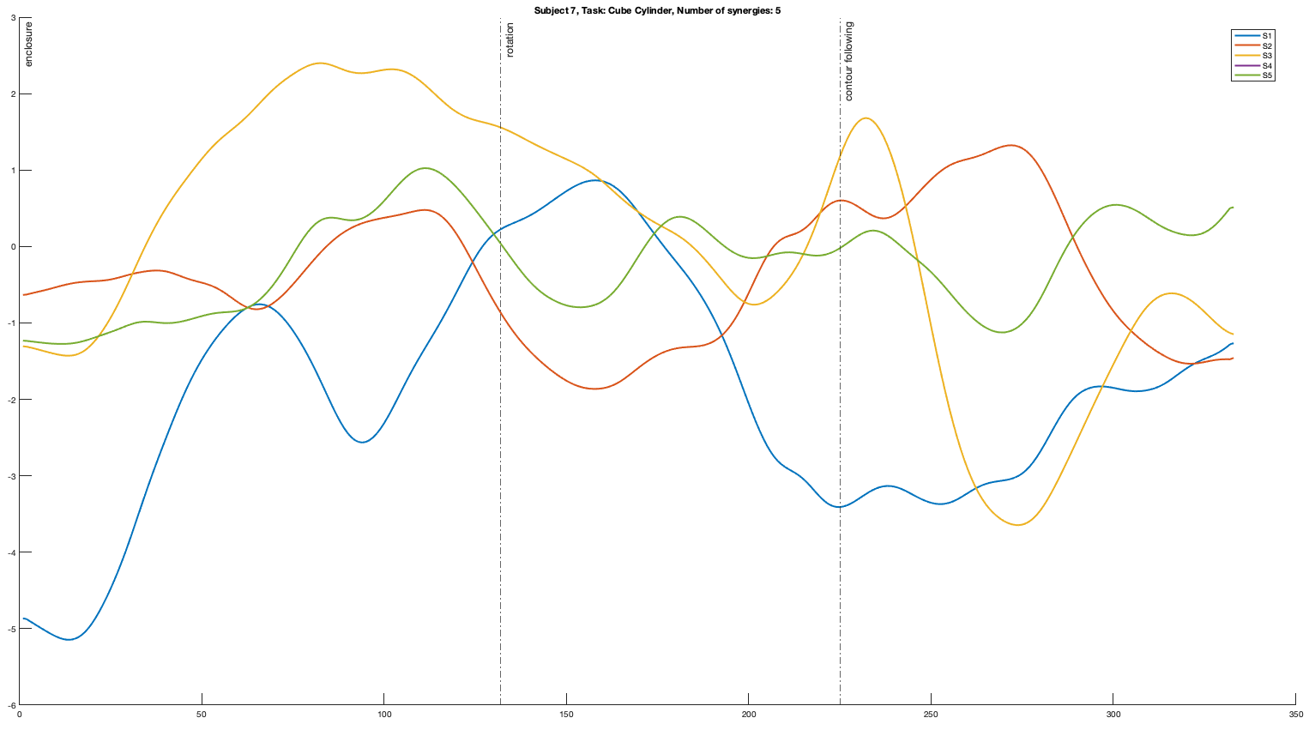

Slide 14
PingPong Ball vs. Tennis Ball & Pressure

Slide 15
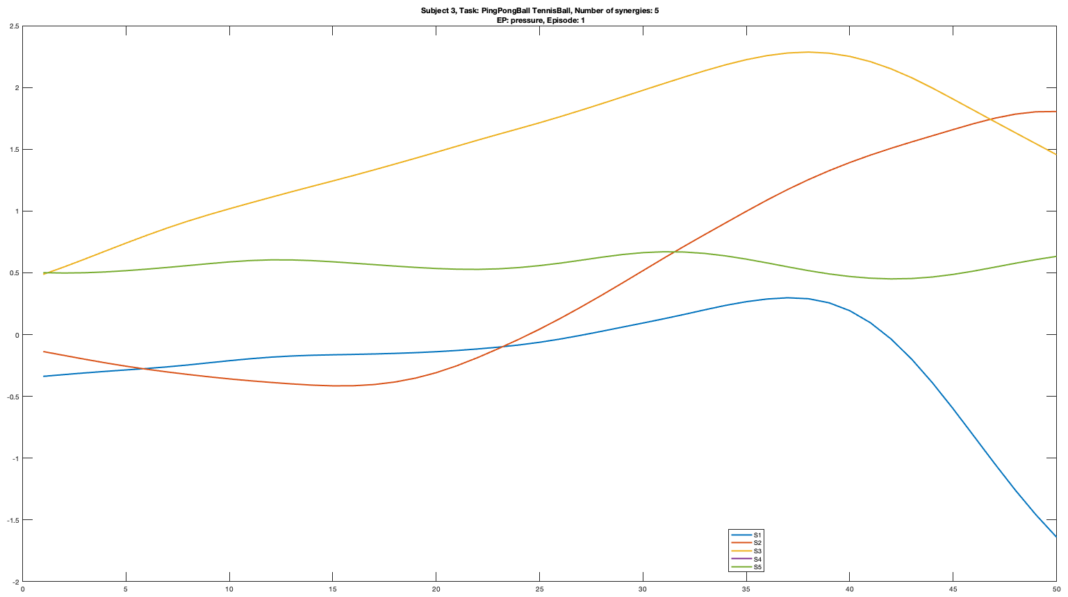
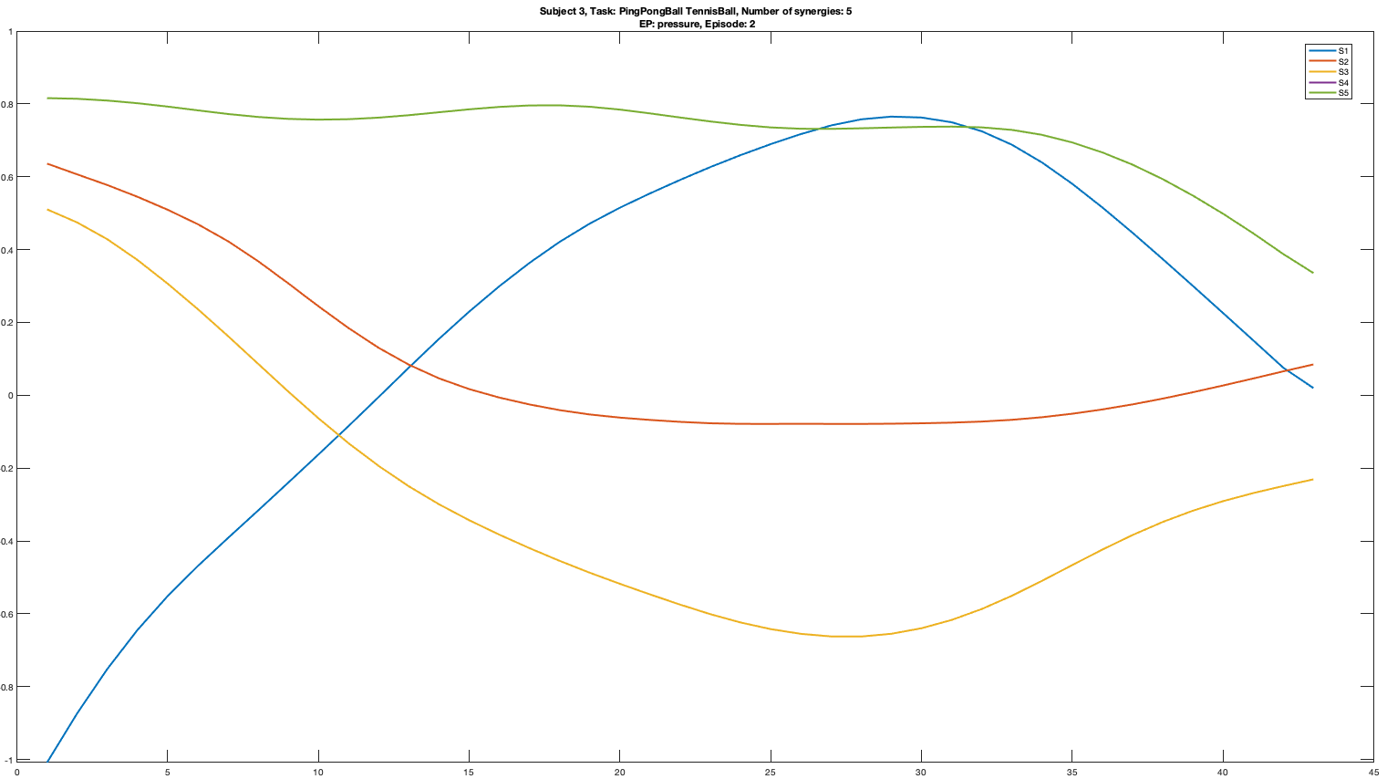
Subject 3

Slide 16
