Slide 1
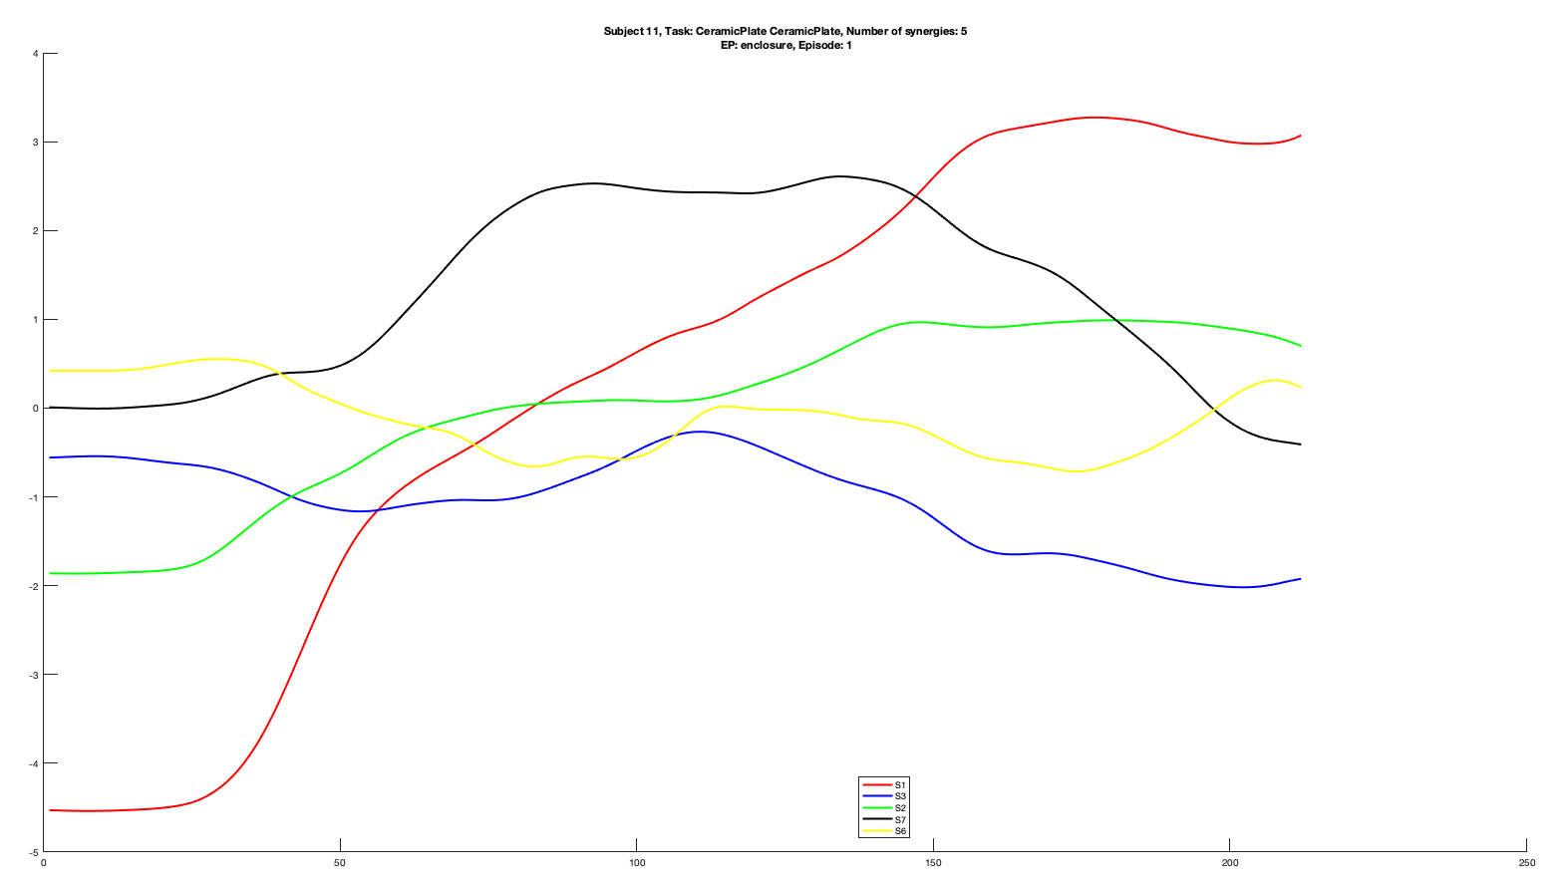
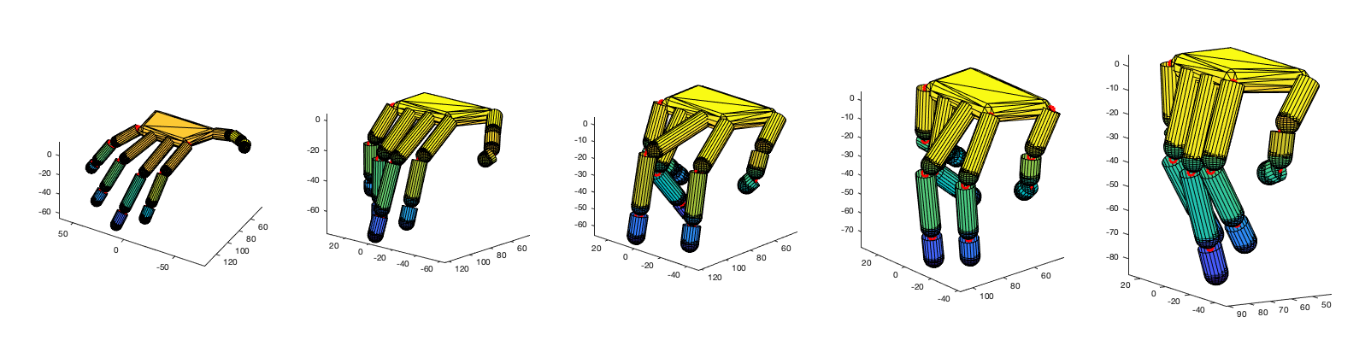
Subject 11
Ceramic Plate vs. Ceramic Plate
Enclosure
Episode 1
5 synergies

Slide 2
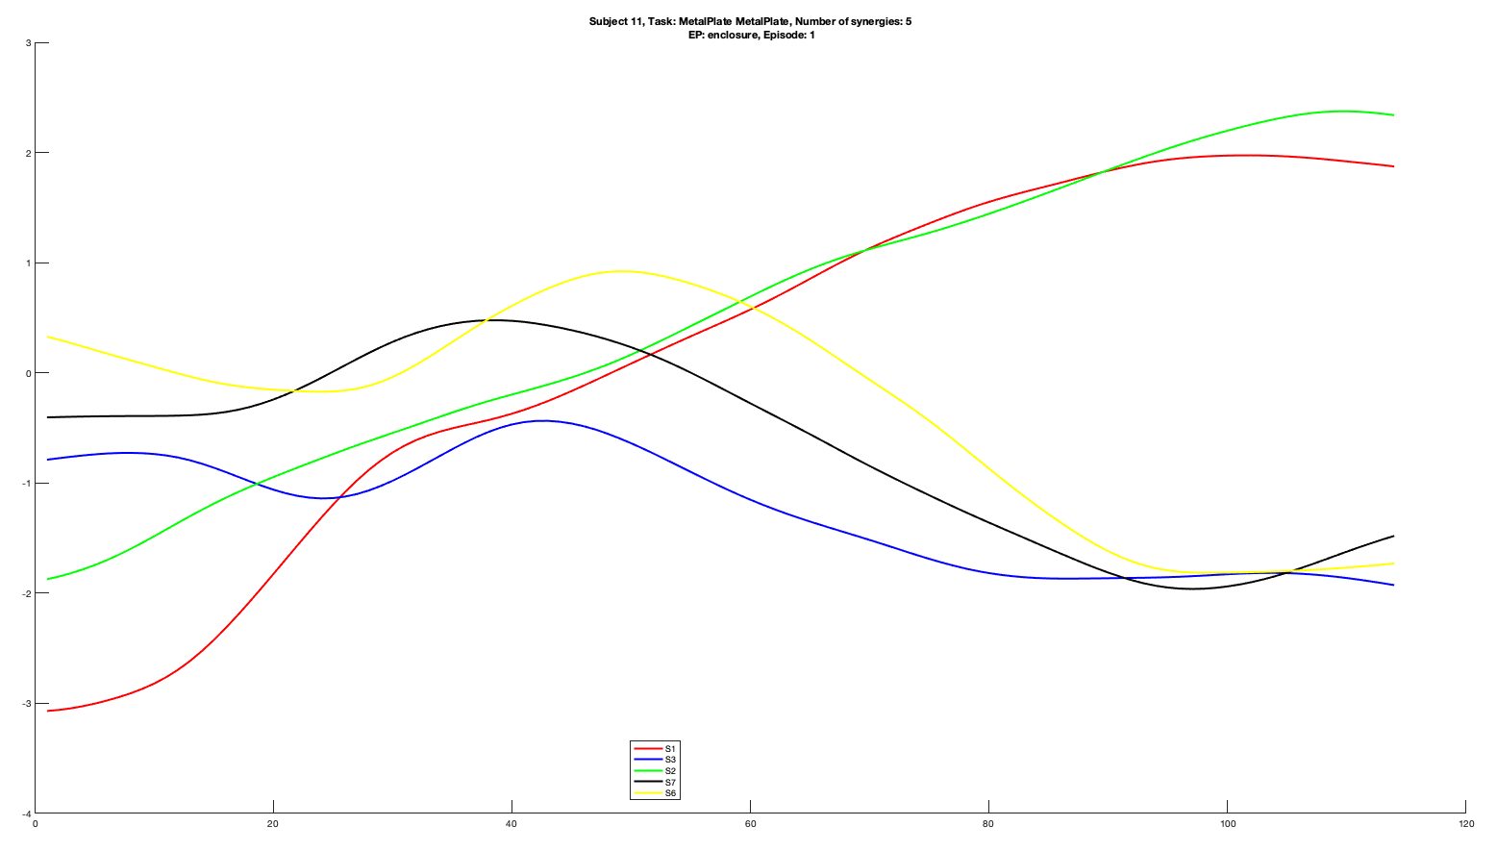
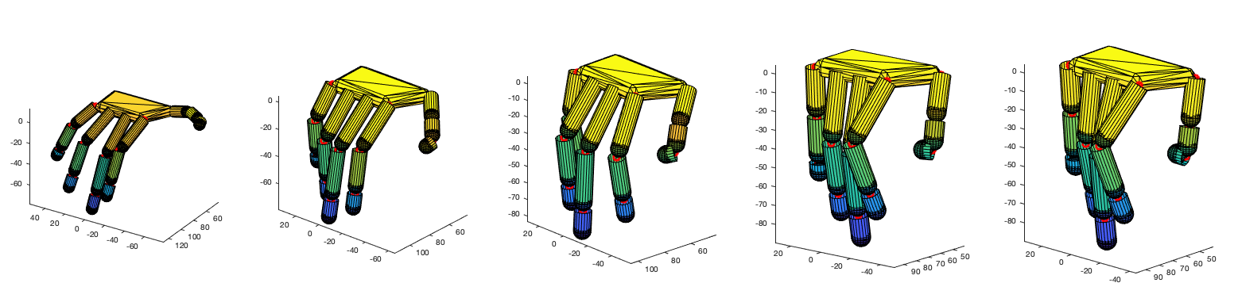
Subject 11
Metal Plate vs. Metal Plate
Enclosure
Episode 1
5 synergies

Slide 3
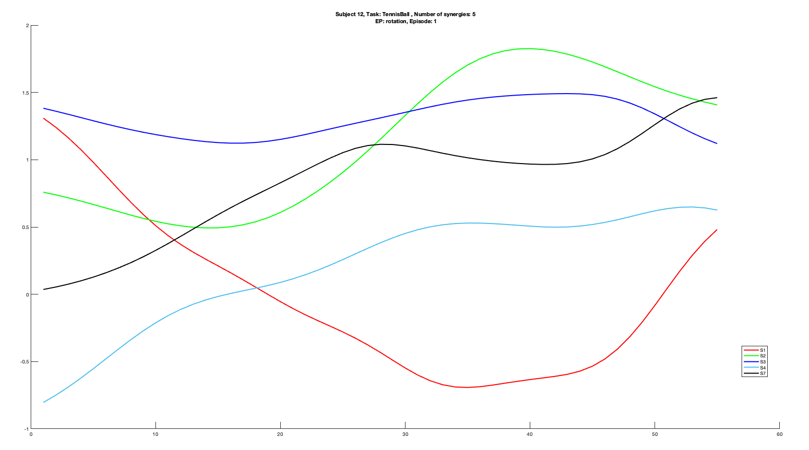
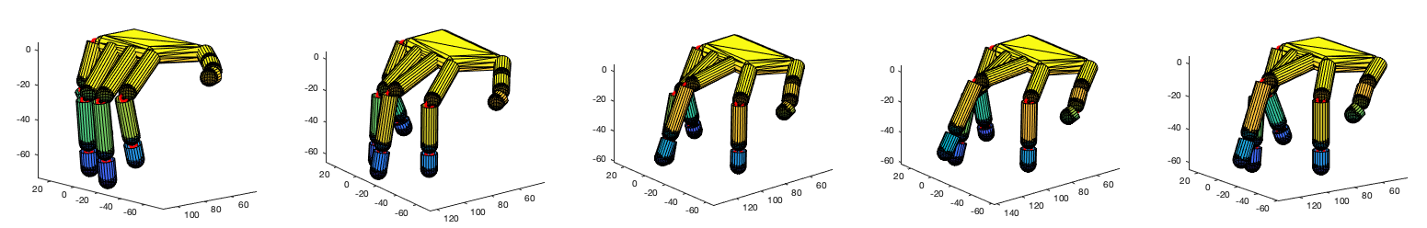
Subject 12
Tennis Ball
Rotation
Episode 1
5 synergies

Slide 4
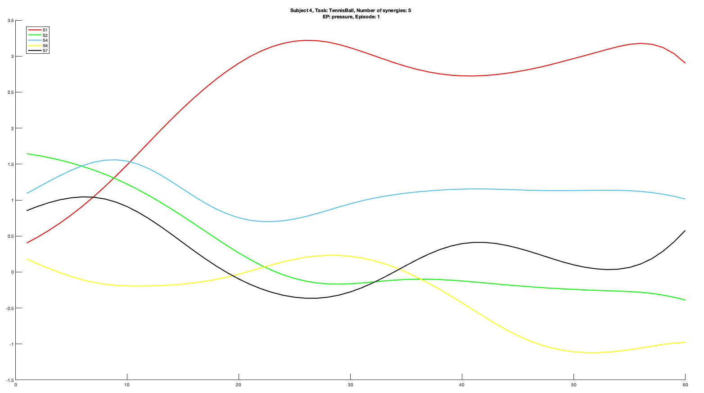
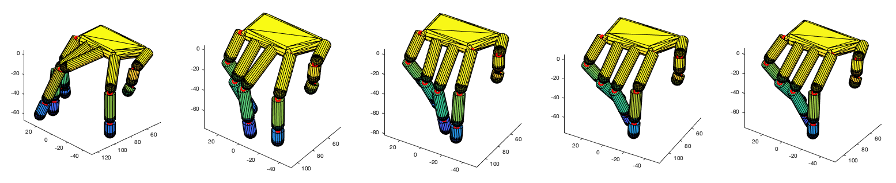
Subject 4
Tennis Ball
Pressure
Episode 1
5 synergies

