Slide 1
Synergy Matching
09/07/2021

Slide 2
Correspondence between PCs and clusters
Principal Component | Subject 3 | Subject 4
PC 1 | 9 | 9
PC 2 | 2 | 1
PC 3 | 1 | 2
PC 4 | 16 | 10
PC 5 | 7 | 7
PC 6 | 6 | 6
PC 7 | 3 | 16
PC 8 | 15 | 17
PC 9 | 4 | 18
PC 10 | 18 | 3
PC 11 | 17 | 12
PC 12 | 13 | 4
PC 13 | 11 | 15
PC 14 | 10 | 13
PC 15 | 14 | 11
PC 16 | 12 | 14
PC 17 | 8 | 5
PC 18 | 8 | 8

Slide 3
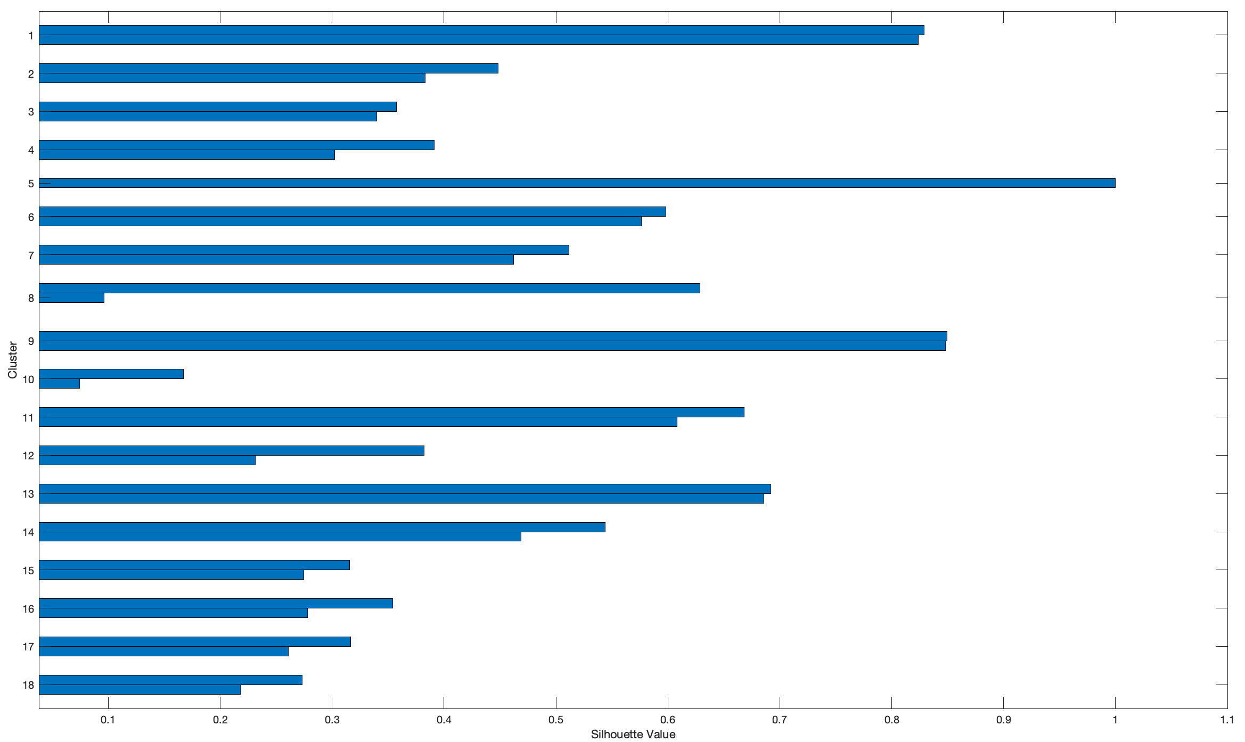
Silhouette values for clusters
A silhouette value measures how similar a point is to points in its own cluster, when compared to points in other clusters. Values range from –1 to 1. A high silhouette value indicates that a point is well matched to its own cluster, and poorly matched to other clusters.
Although it cannot be perceived, Cluster 8 has three elements.

Slide 4
Synergies construction
Principal Component | Subject 3 | Subject 4
PC 1 | 9 | 9
PC 2 | 2 | 1
PC 3 | 1 | 2
PC 4 | 16 | 10
PC 5 | 7 | 7
PC 6 | 6 | 6
PC 7 | 3 | 16
PC 8 | 15 | 17
PC 9 | 4 | 18
PC 10 | 18 | 3
PC 11 | 17 | 12
PC 12 | 13 | 4
PC 13 | 11 | 15
PC 14 | 10 | 13
PC 15 | 14 | 11
PC 16 | 12 | 14
PC 17 | 8 | 5
PC 18 | 8 | 8
Synergy 1

Slide 5
Synergies construction
Principal Component | Subject 3 | Subject 4
PC 1 | 9 | 9
PC 2 | 2 | 1
PC 3 | 1 | 2
PC 4 | 16 | 10
PC 5 | 7 | 7
PC 6 | 6 | 6
PC 7 | 3 | 16
PC 8 | 15 | 17
PC 9 | 4 | 18
PC 10 | 18 | 3
PC 11 | 17 | 12
PC 12 | 13 | 4
PC 13 | 11 | 15
PC 14 | 10 | 13
PC 15 | 14 | 11
PC 16 | 12 | 14
PC 17 | 8 | 5
PC 18 | 8 | 8
Synergy 2

Slide 6
Synergies construction
Principal Component | Subject 3 | Subject 4
PC 1 | 9 | 9
PC 2 | 2 | 1
PC 3 | 1 | 2
PC 4 | 16 | 10
PC 5 | 7 | 7
PC 6 | 6 | 6
PC 7 | 3 | 16
PC 8 | 15 | 17
PC 9 | 4 | 18
PC 10 | 18 | 3
PC 11 | 17 | 12
PC 12 | 13 | 4
PC 13 | 11 | 15
PC 14 | 10 | 13
PC 15 | 14 | 11
PC 16 | 12 | 14
PC 17 | 8 | 5
PC 18 | 8 | 8
Synergy 3

Slide 7
Synergies construction
Principal Component | Subject 3 | Subject 4
PC 1 | 9 | 9
PC 2 | 2 | 1
PC 3 | 1 | 2
PC 4 | 16 | 10
PC 5 | 7 | 7
PC 6 | 6 | 6
PC 7 | 3 | 16
PC 8 | 15 | 17
PC 9 | 4 | 18
PC 10 | 18 | 3
PC 11 | 17 | 12
PC 12 | 13 | 4
PC 13 | 11 | 15
PC 14 | 10 | 13
PC 15 | 14 | 11
PC 16 | 12 | 14
PC 17 | 8 | 5
PC 18 | 8 | 8
Synergy 14
Synergy 16
Synergy 8

Slide 8
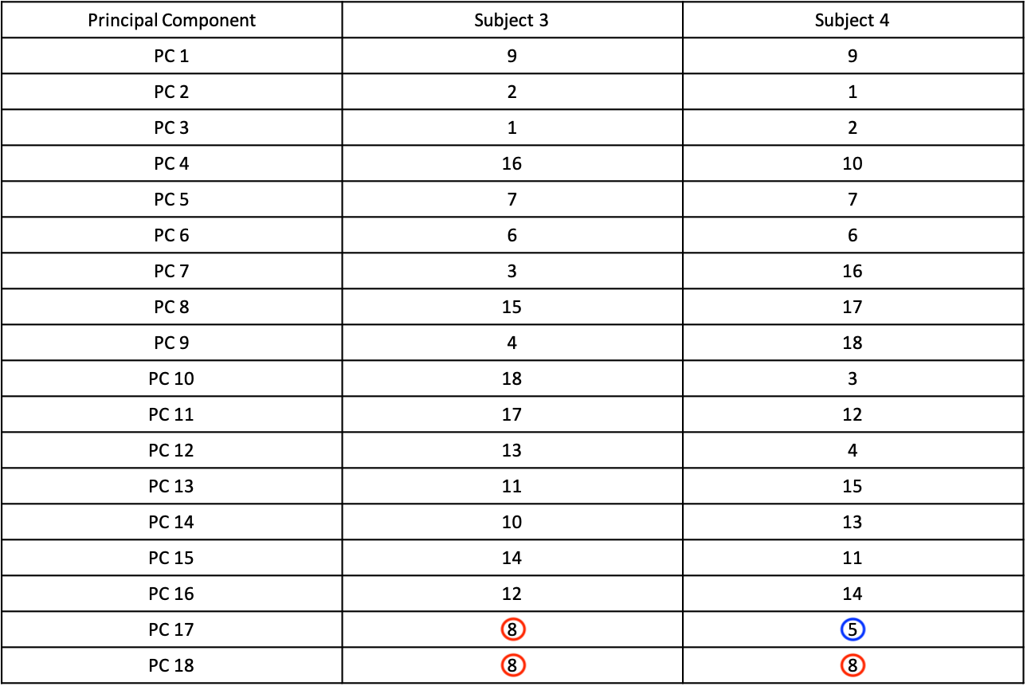
Synergies construction
Cluster 8 has 3 elements, but one of them (Subject 3 PC 18) has a silhouette score close to 0.
Cluster 5 has only one element (subject 4 PC 17).

Slide 9
Synergies construction
Synergy 18
Synergy 17

Slide 10
Correspondence between synergies and PCs
Synergies | Subject 3 PCs | Subject 4 PCs
Synergy 1 | PC 1 | PC 1
Synergy 2 | PC 2 | PC 3
Synergy 3 | PC 3 | PC 2
Synergy 4 | PC 4 | PC 7
Synergy 5 | PC 5 | PC 5
Synergy 6 | PC 6 | PC 6
Synergy 7 | PC 7 | PC 10
Synergy 8 | PC 8 | PC 13
Synergy 9 | PC 9 | PC 12
Synergy 10 | PC 10 | PC 9
Synergy 11 | PC 11 | PC 8
Synergy 12 | PC 12 | PC 14
Synergy 13 | PC 13 | PC 15
Synergy 14 | PC 14 | PC 4
Synergy 15 | PC 15 | PC 16
Synergy 16 | PC 16 | PC 11
Synergy 17 | PC 17 | PC 18
Synergy 18 | PC 18 | PC 17

Slide 11
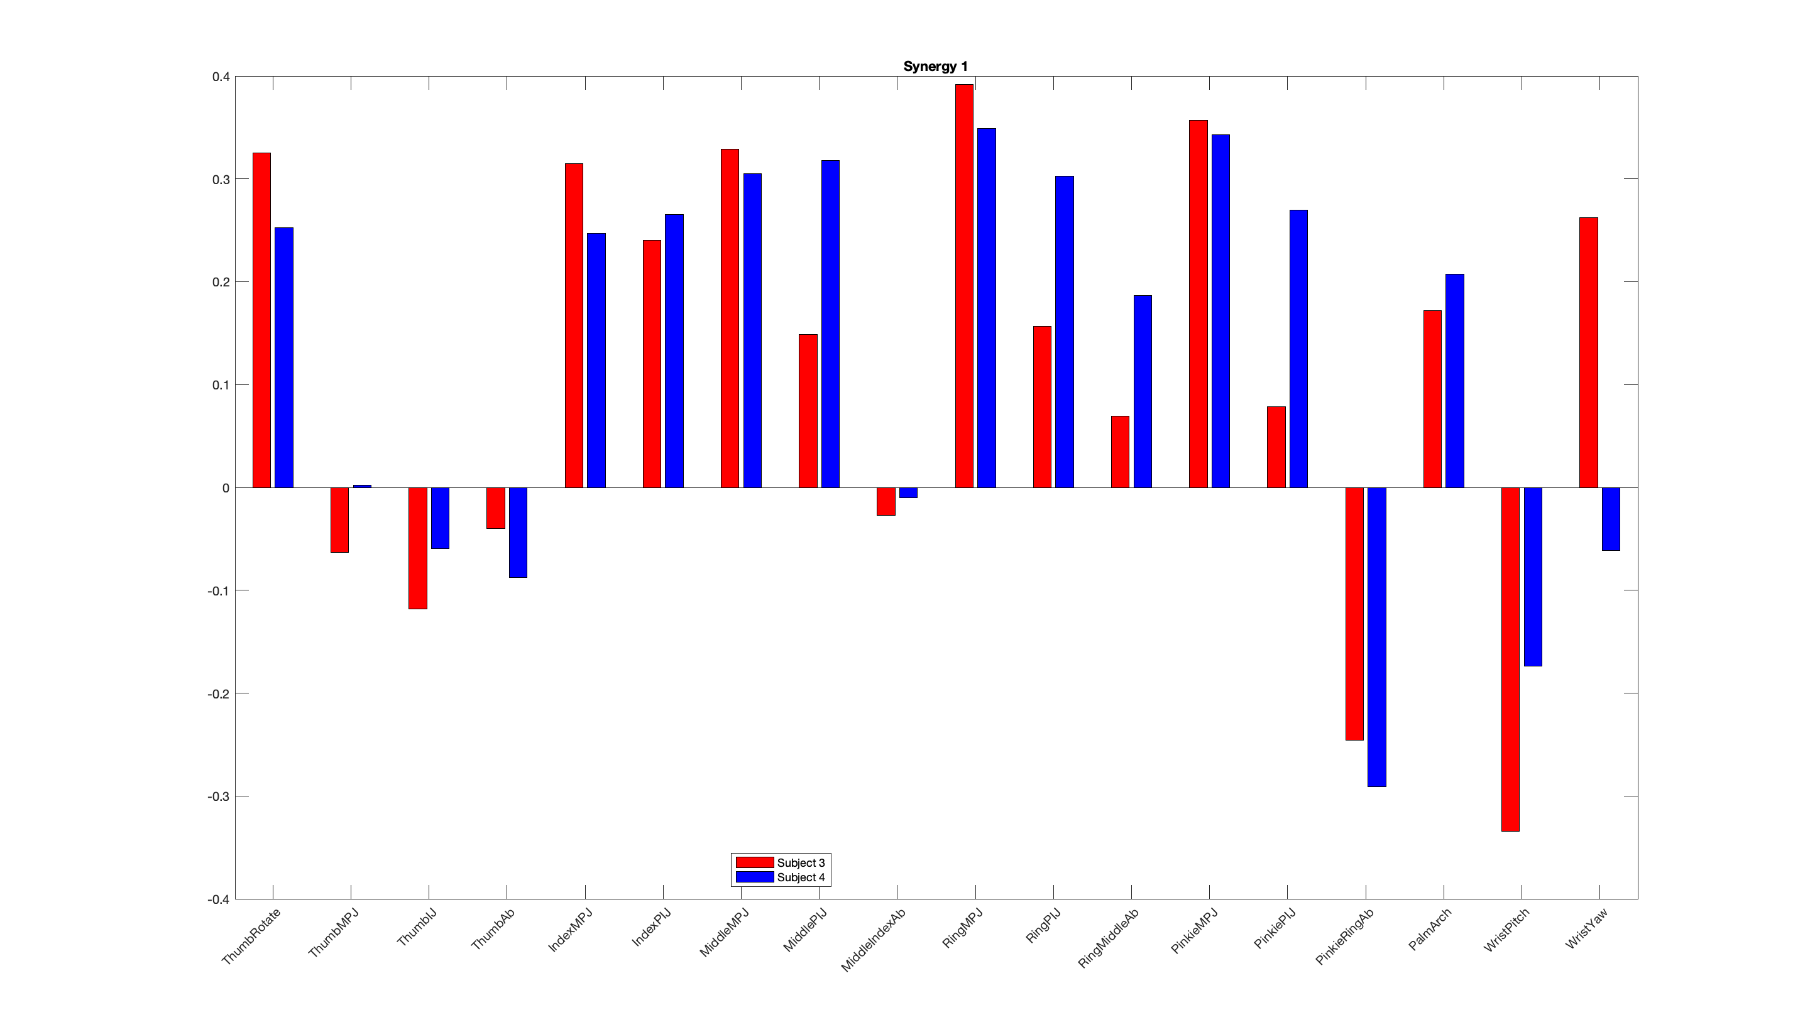
Synergies representations

Slide 12
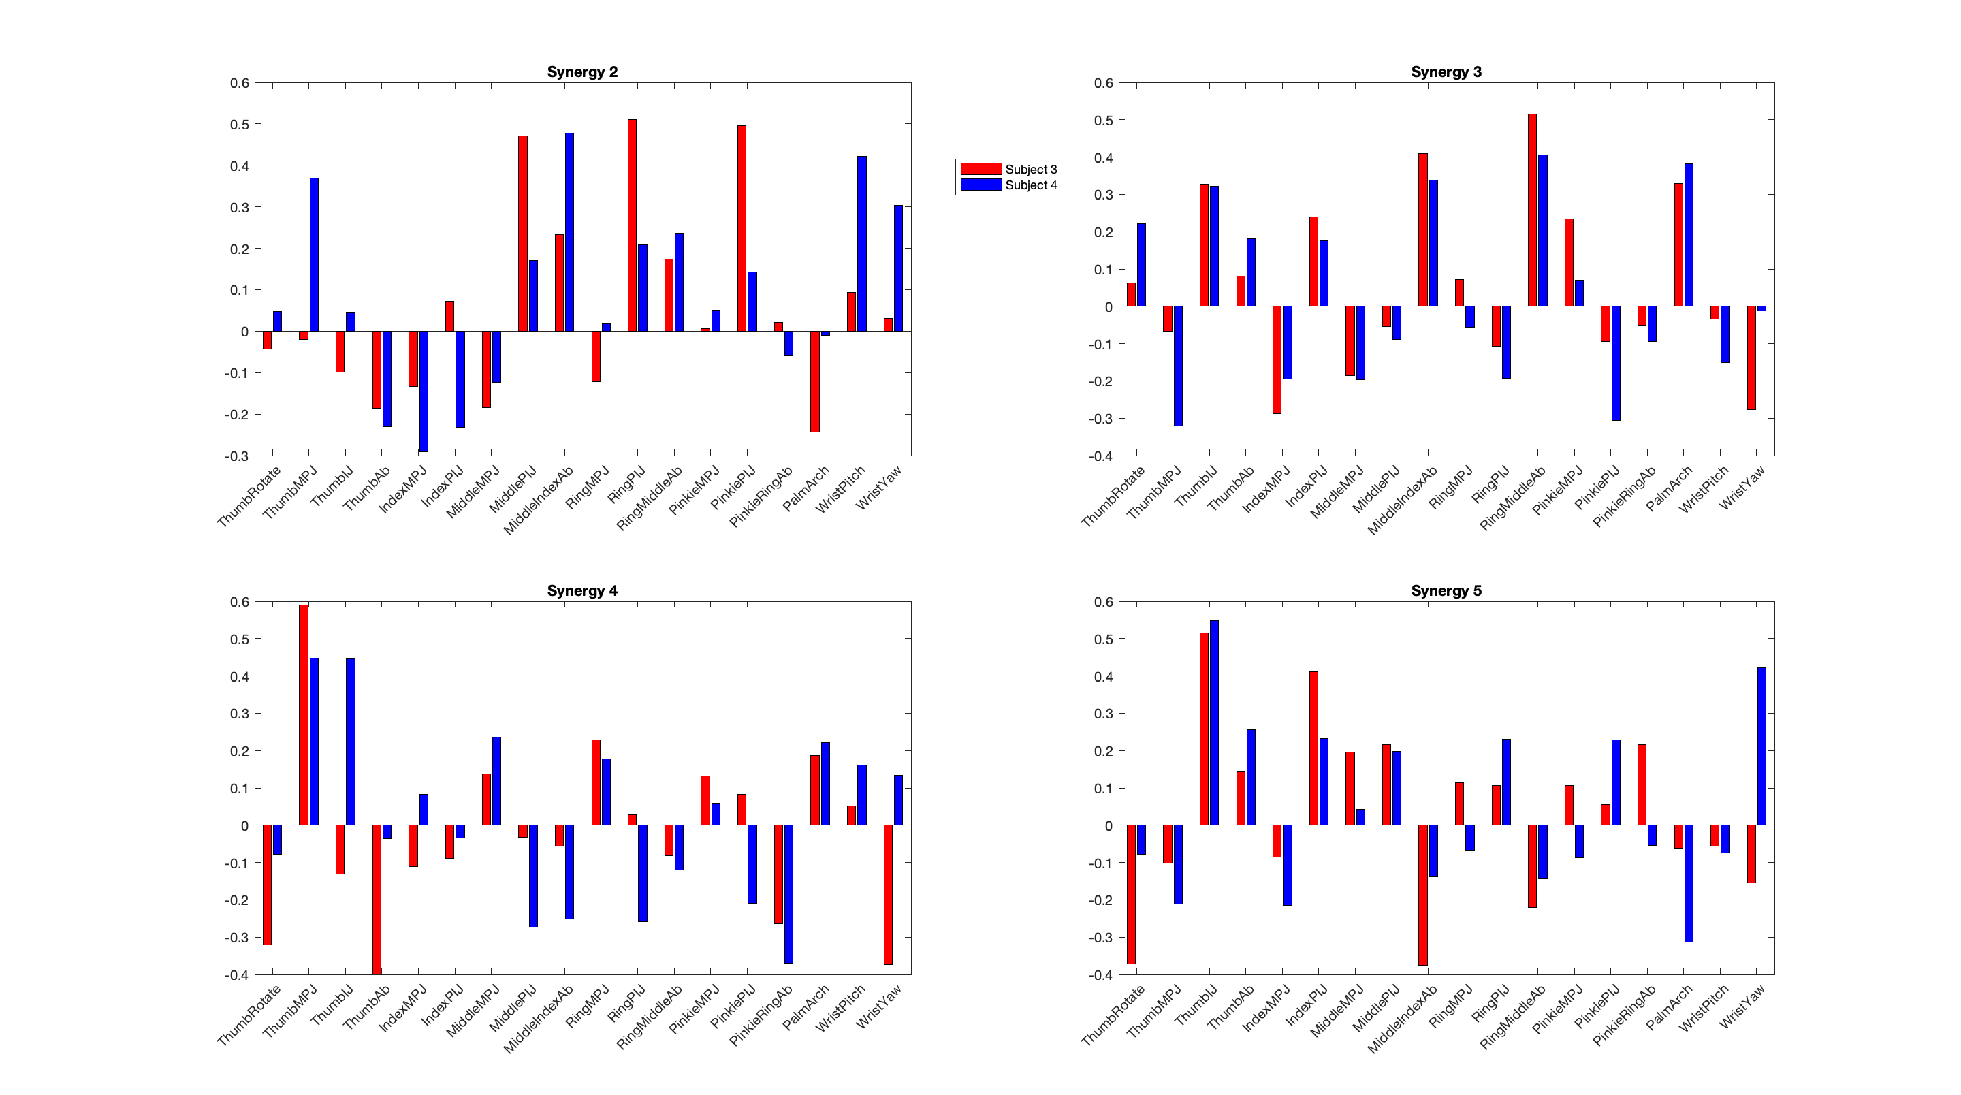
Synergies representations

Slide 13
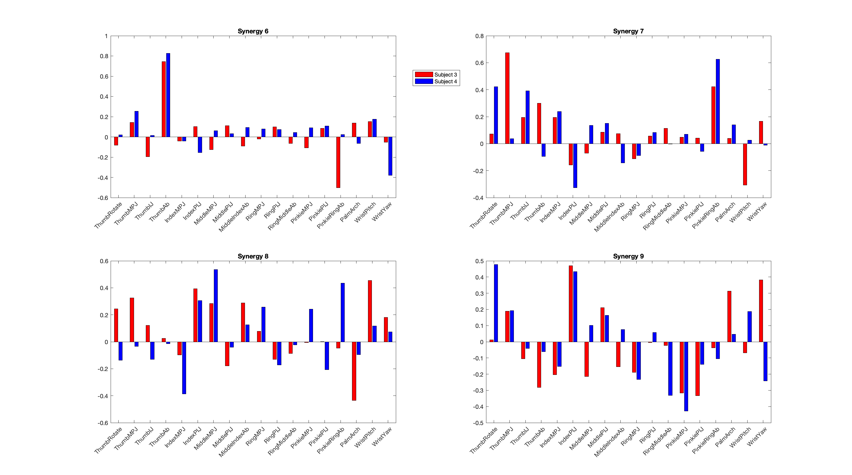
Synergies representations

Slide 14
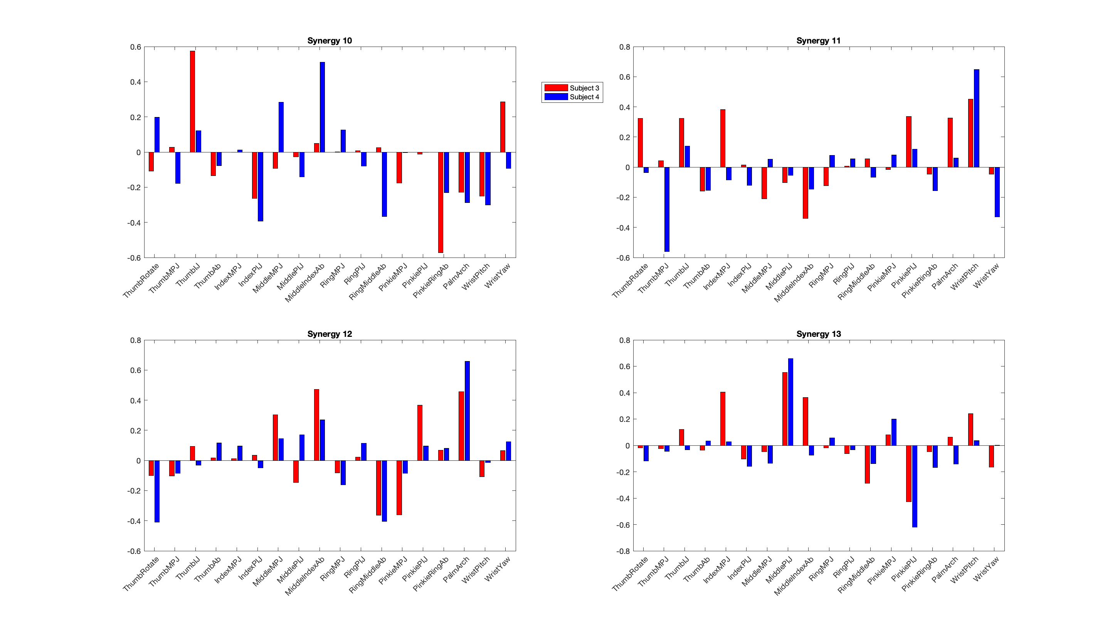
Synergies representations

Slide 15
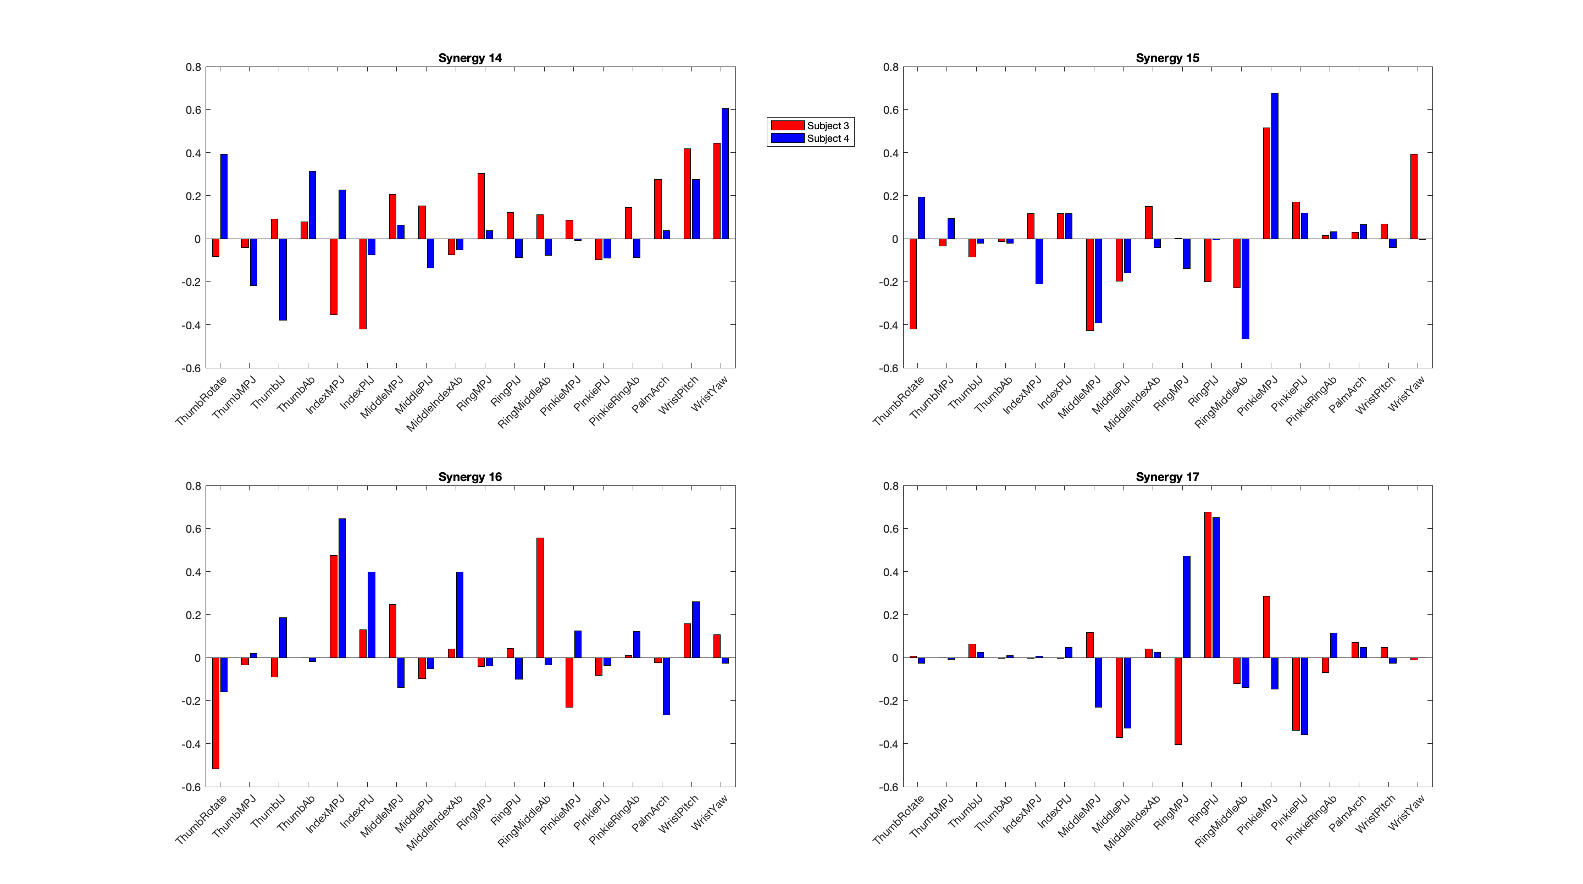
Synergies representations

Slide 16
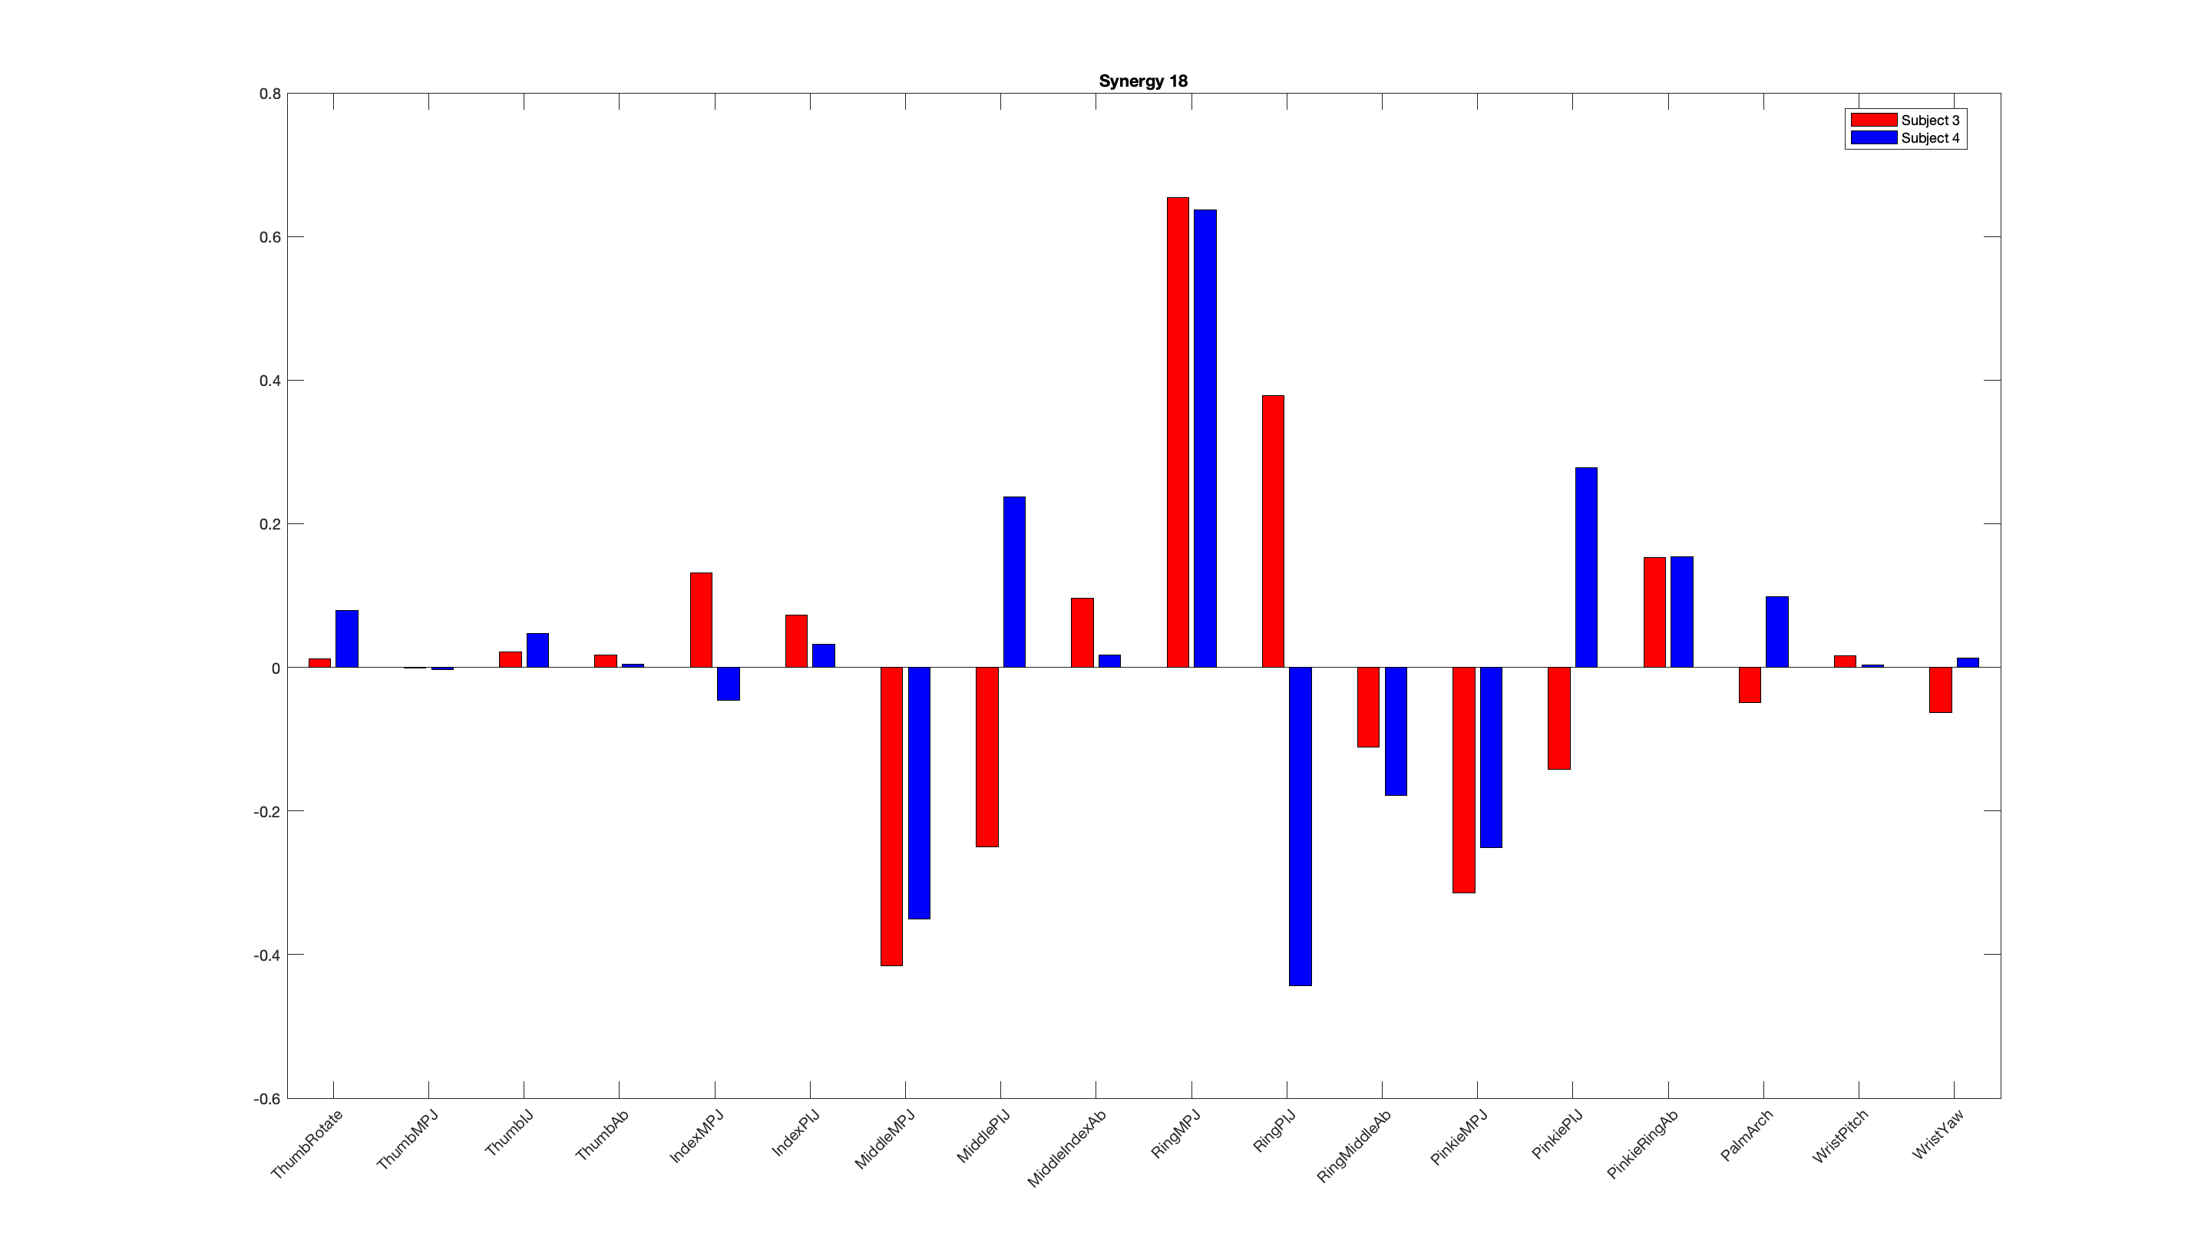
Synergies representations

Slide 17
Synergies construction including All Subjects data
PCs | Subject 3 | Subject 4 | All Subjects
PC 1 | 7 | 7 | 7
PC 2 | 18 | 4 | 16
PC 3 | 4 | 18 | 18
PC 4 | 15 | 16 | 18
PC 5 | 15 | 5 | 15
PC 6 | 2 | 2 | 2
PC 7 | 1 | 15 | 10
PC 8 | 6 | 13 | 17
PC 9 | 17 | 5 | 1
PC 10 | 5 | 1 | 5
PC 11 | 13 | 9 | 13
PC 12 | 12 | 6 | 6
PC 13 | 11 | 10 | 9
PC 14 | 16 | 12 | 12
PC 15 | 8 | 11 | 10
PC 16 | 9 | 8 | 8
PC 17 | 14 | 3 | 14
PC 18 | 3 | 3 | 3

Slide 18
Synergies construction including All Subjects data
PCs | Subject 3 | Subject 4 | All Subjects
PC 1 | 7 | 7 | 7
PC 2 | 18 | 4 | 16
PC 3 | 4 | 18 | 18
PC 4 | 15 | 16 | 18
PC 5 | 15 | 5 | 15
PC 6 | 2 | 2 | 2
PC 7 | 1 | 15 | 10
PC 8 | 6 | 13 | 17
PC 9 | 17 | 5 | 1
PC 10 | 5 | 1 | 5
PC 11 | 13 | 9 | 13
PC 12 | 12 | 6 | 6
PC 13 | 11 | 10 | 9
PC 14 | 16 | 12 | 12
PC 15 | 8 | 11 | 10
PC 16 | 9 | 8 | 8
PC 17 | 14 | 3 | 14
PC 18 | 3 | 3 | 3

Slide 19
Synergies construction including All Subjects data
PCs | Subject 3 | Subject 4 | All Subjects
PC 1 | 7 | 7 | 7
PC 2 | 18 | 4 | 16
PC 3 | 4 | 18 | 18
PC 4 | 15 | 16 | 18
PC 5 | 15 | 5 | 15
PC 6 | 2 | 2 | 2
PC 7 | 1 | 15 | 10
PC 8 | 6 | 13 | 17
PC 9 | 17 | 5 | 1
PC 10 | 5 | 1 | 5
PC 11 | 13 | 9 | 13
PC 12 | 12 | 6 | 6
PC 13 | 11 | 10 | 9
PC 14 | 16 | 12 | 12
PC 15 | 8 | 11 | 10
PC 16 | 9 | 8 | 8
PC 17 | 14 | 3 | 14
PC 18 | 3 | 3 | 3

Slide 20
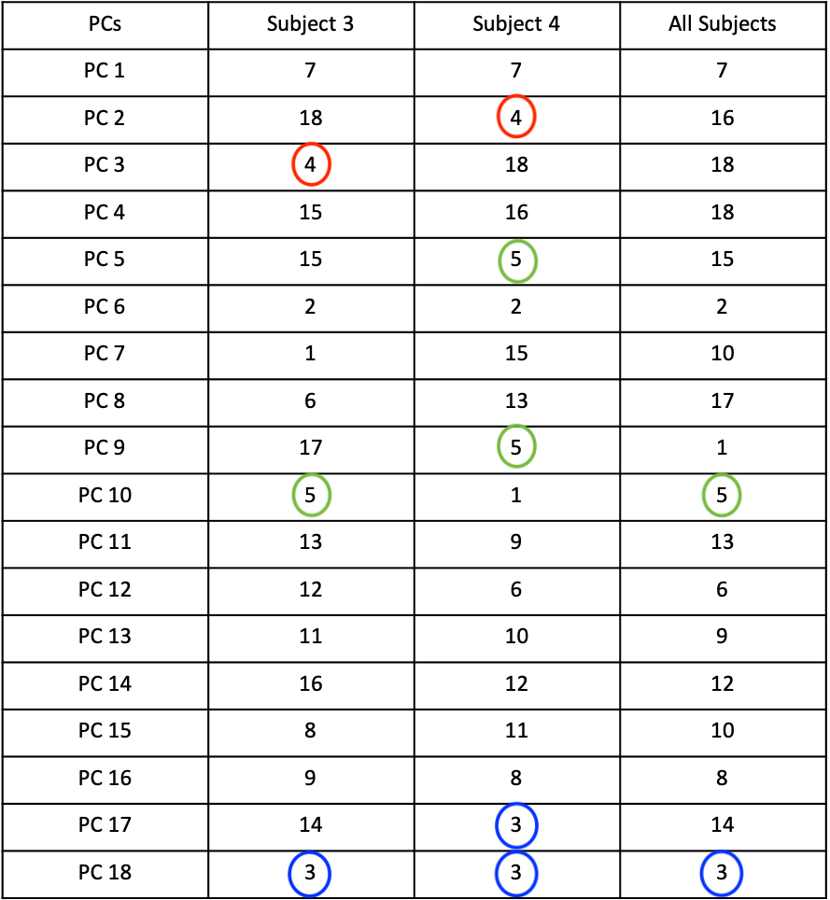
Synergies construction including All Subjects data

Slide 21
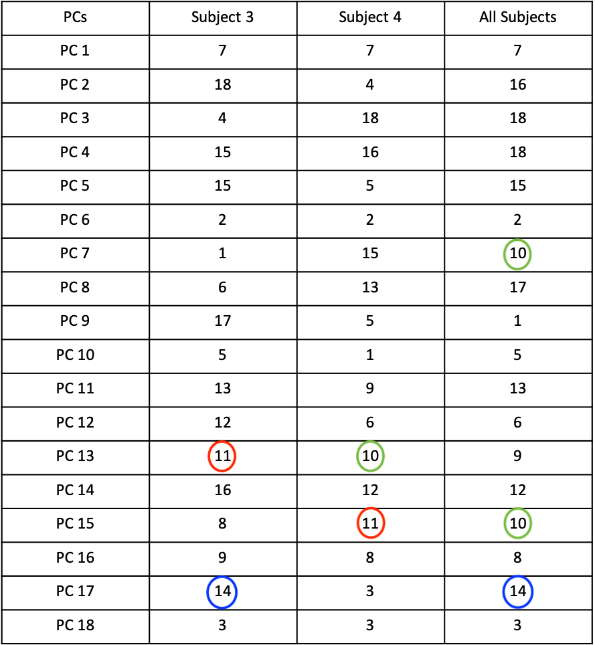
Synergies construction including All Subjects data

Slide 22
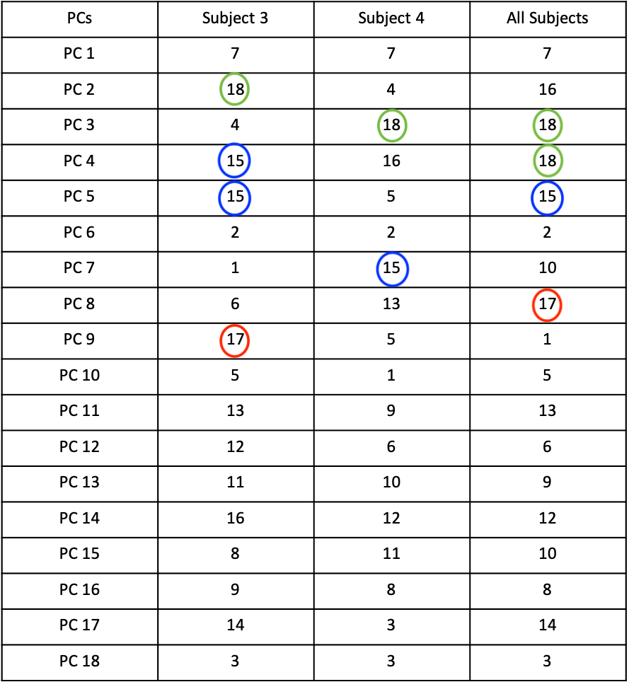
Synergies construction including All Subjects data

Slide 23
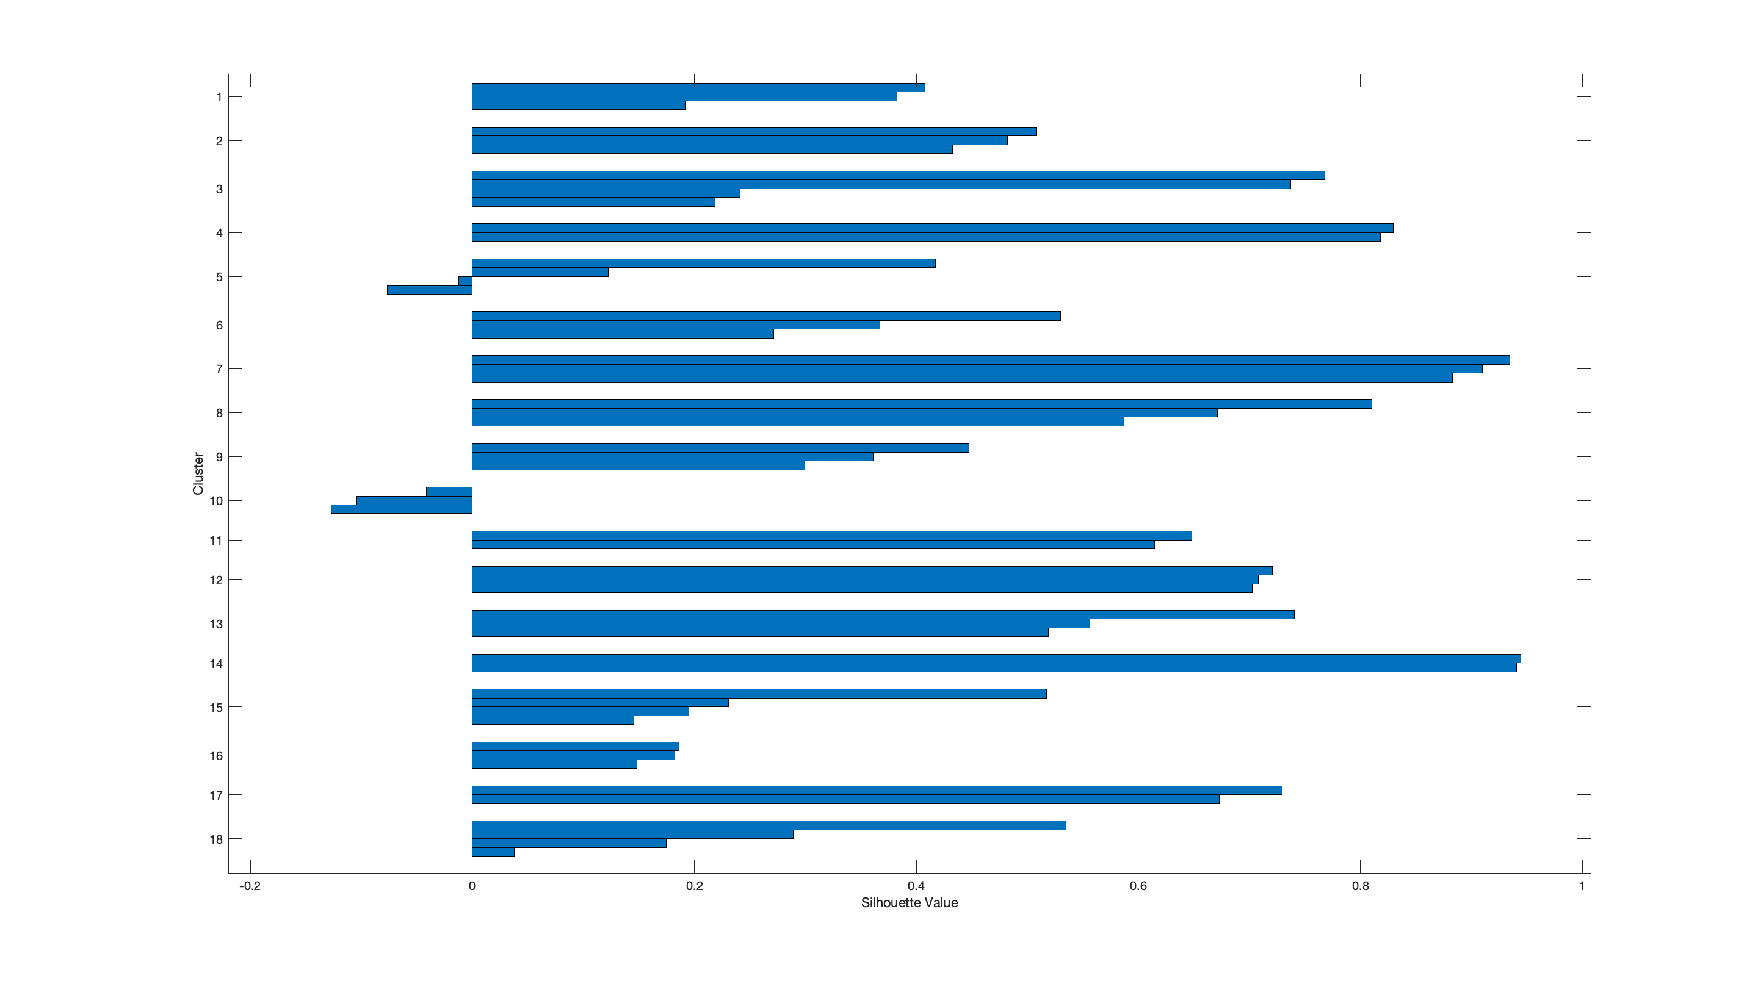
Silhouette values for clusters including All Subjects data

Slide 24
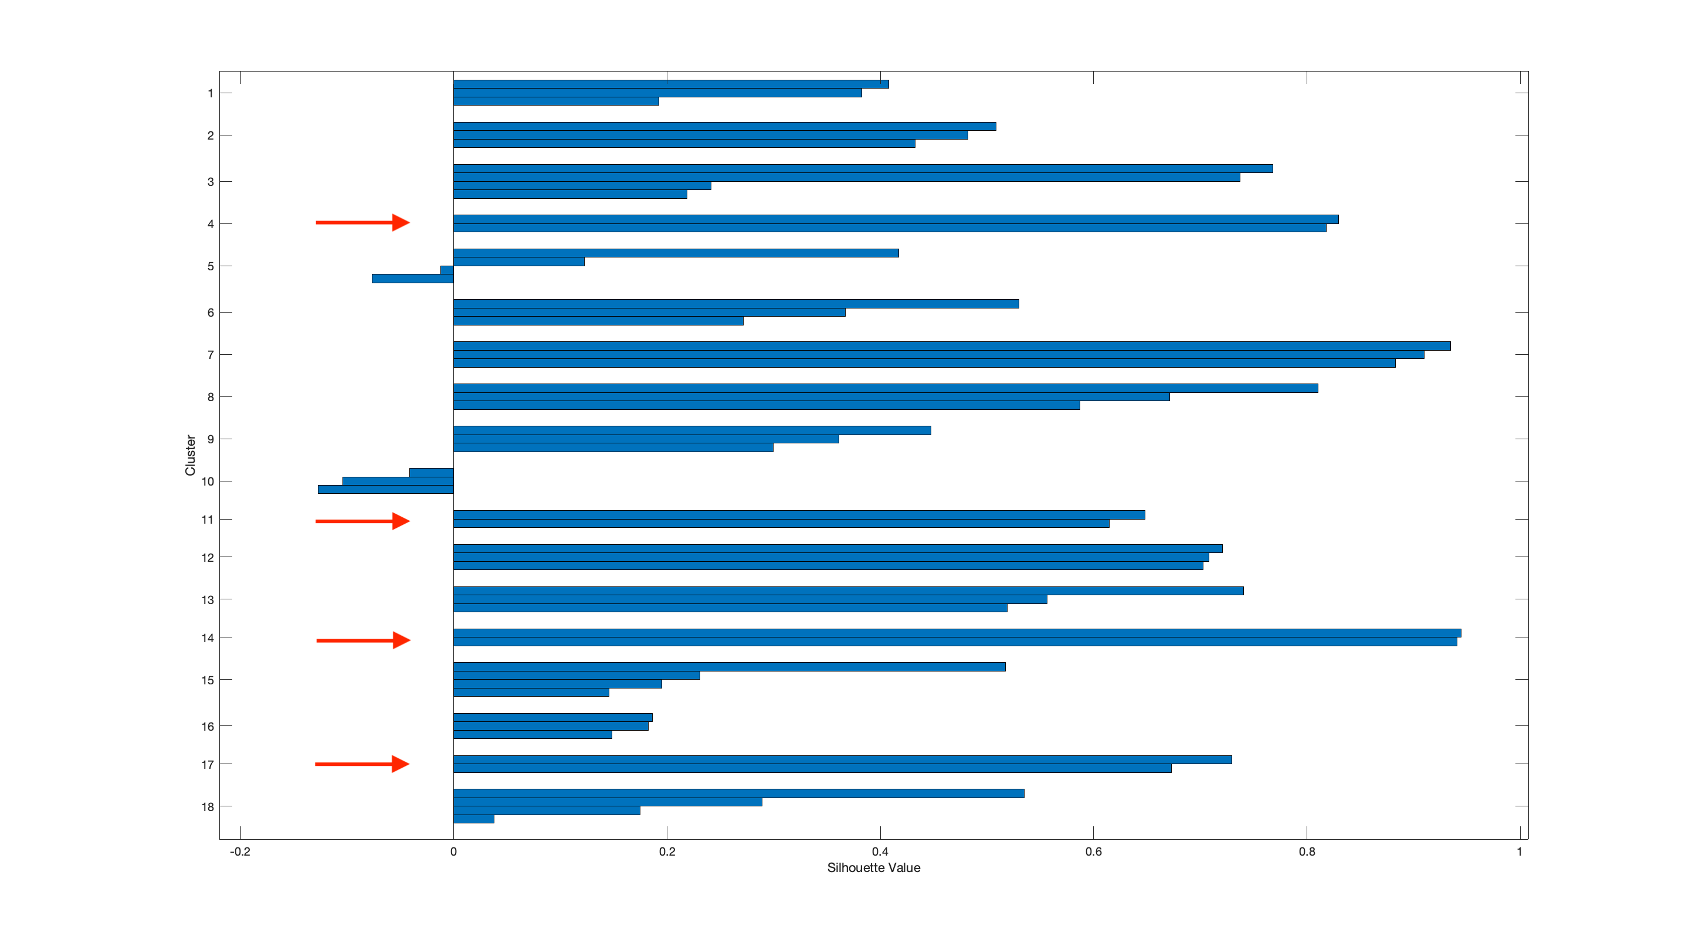
Silhouette values for clusters including All Subjects data

Slide 25

Silhouette values for clusters including All Subjects data

Slide 26
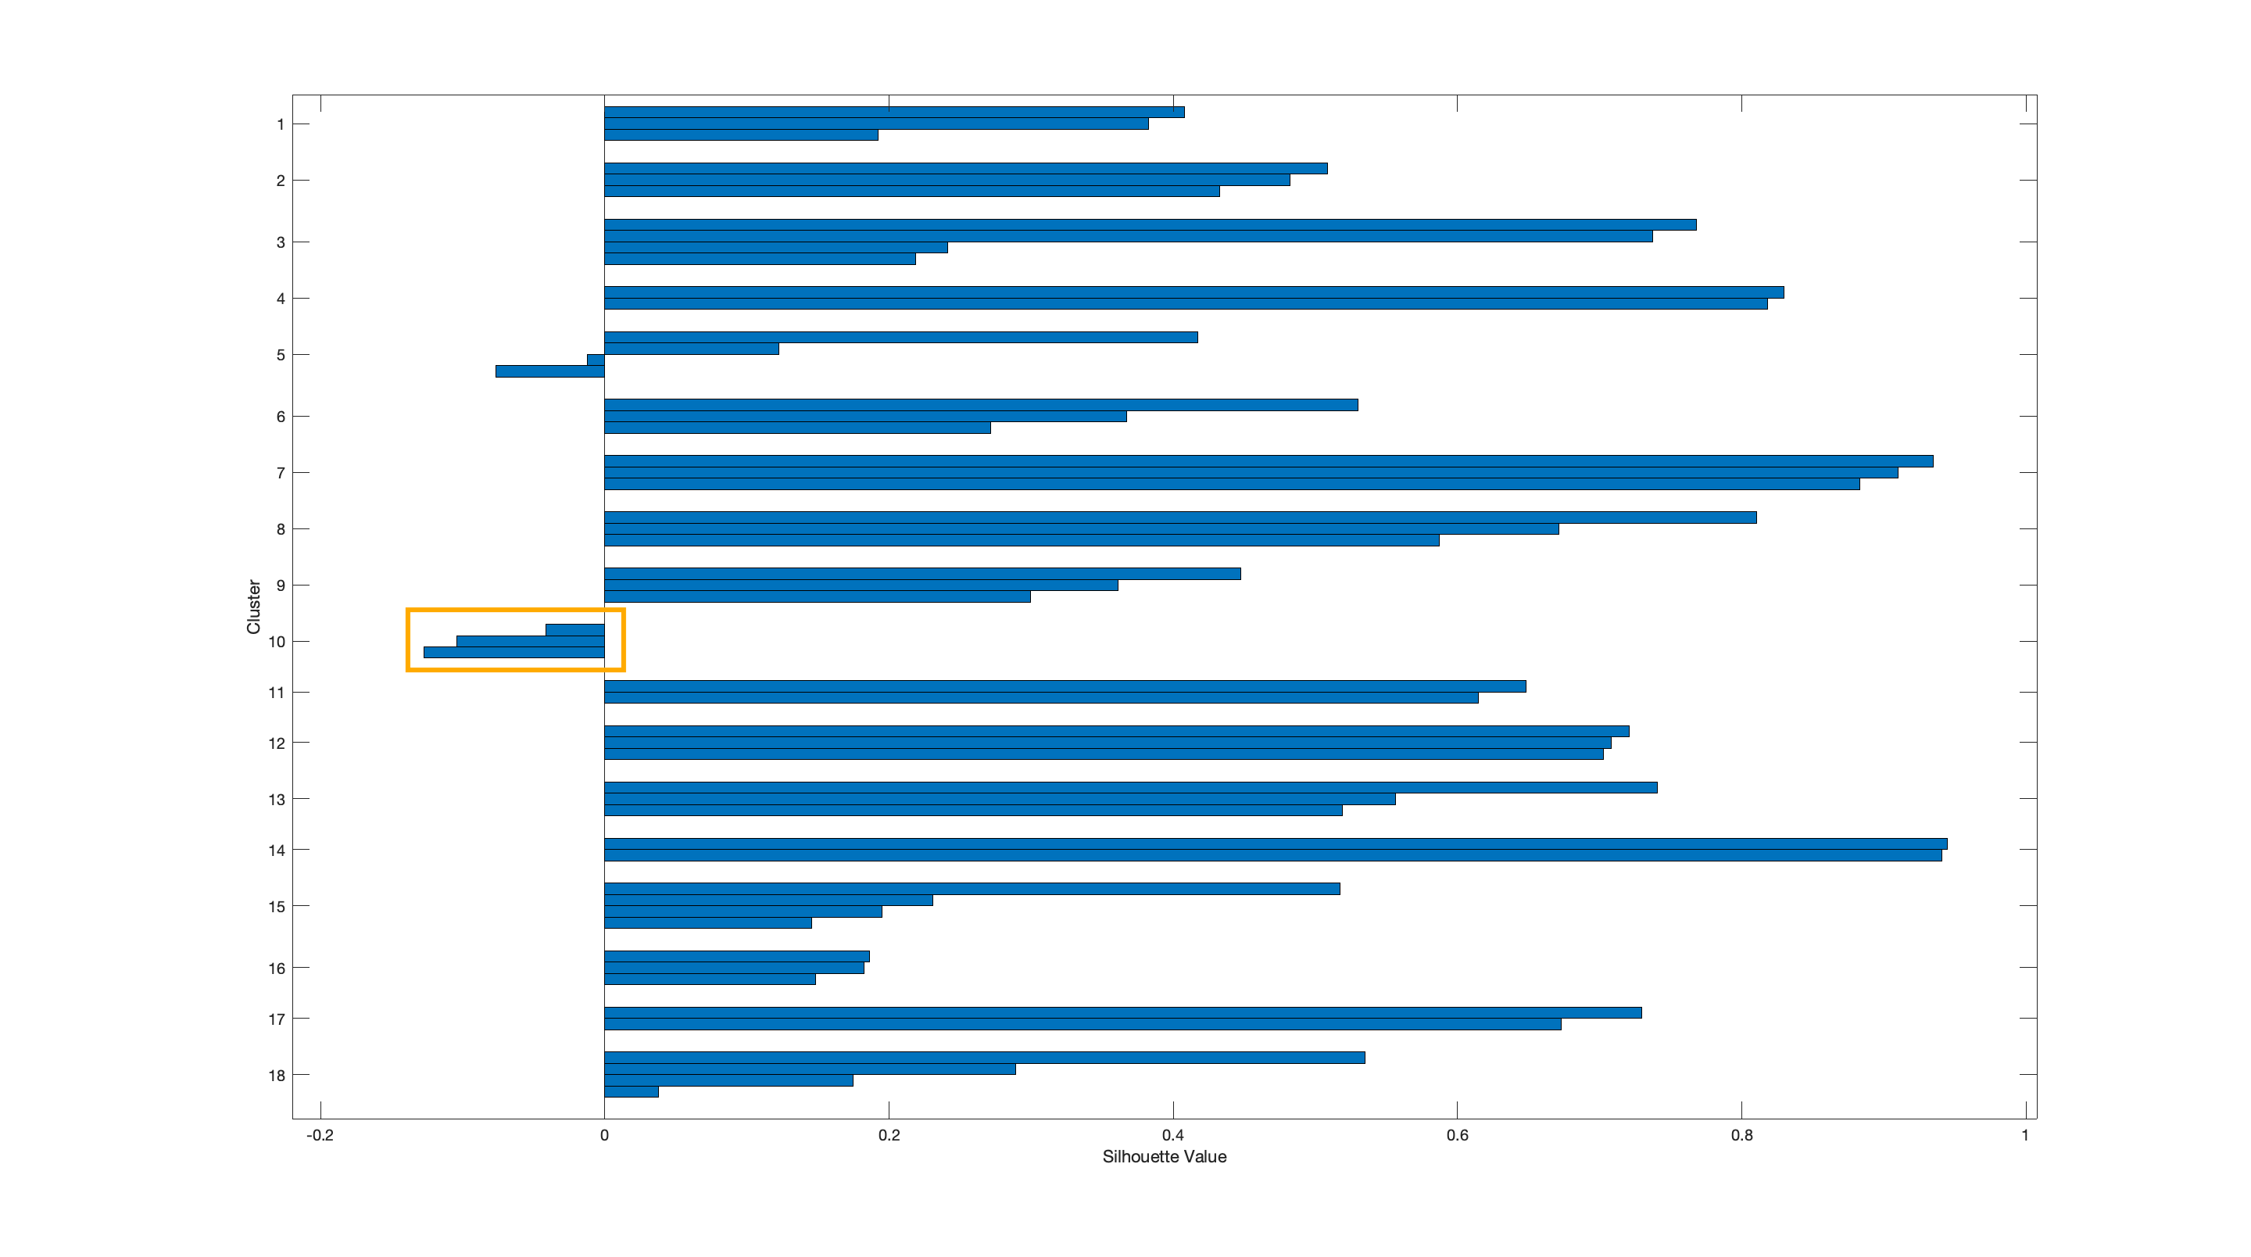
Silhouette values for clusters including All Subjects data

Slide 27
Next steps
Iterative clustering.
Calculate dynamic synergies (how synergies evolve during time).
Synergies representations.
Items to comment
Mendeley.

