Slide 1
Synergy Matching
06/08/2021

Slide 2
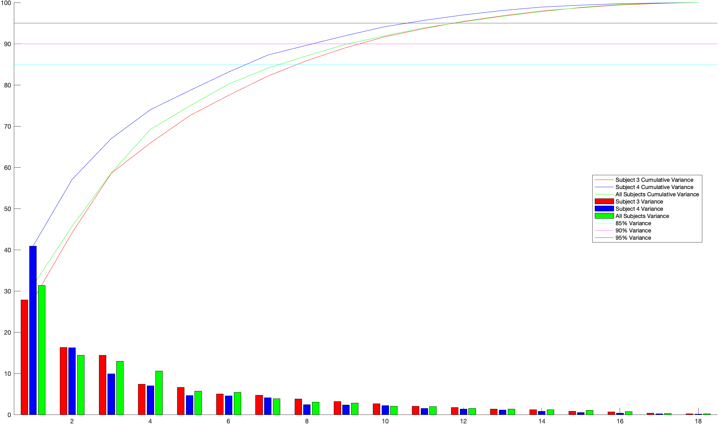
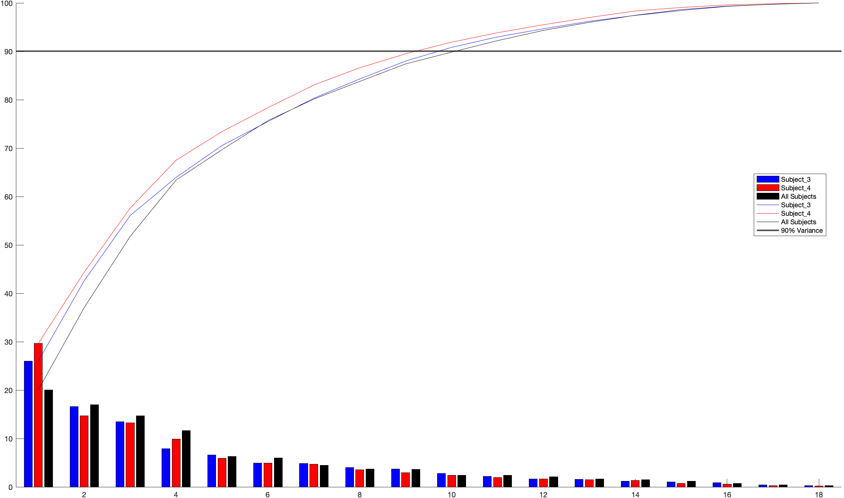
Variance comparison
Old Data
New Data
Even when the new data accomplishes for less variance in the first PC (particularly for Subject 4 and All Subjects), both datasets achieves more than 90% of the variance after 10 PCs.

Slide 3
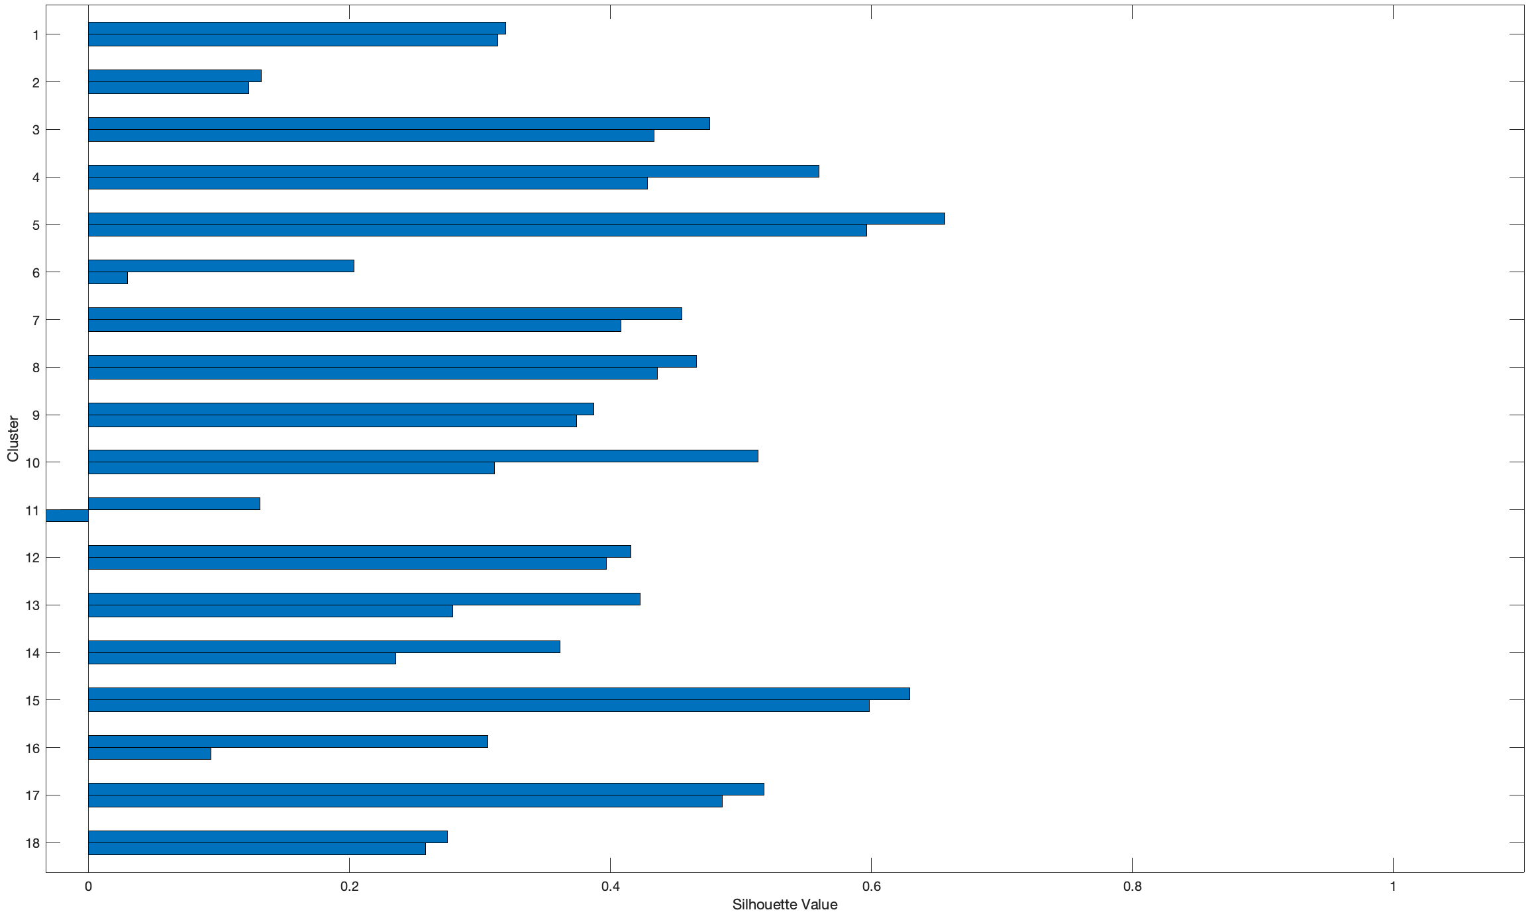
Silhouette values for clusters with two subjects
A silhouette value measures how similar a point is to points in its own cluster, when compared to points in other clusters. Values range from –1 to 1. A high silhouette value indicates that a point is well matched to its own cluster, and poorly matched to other clusters.

Slide 4
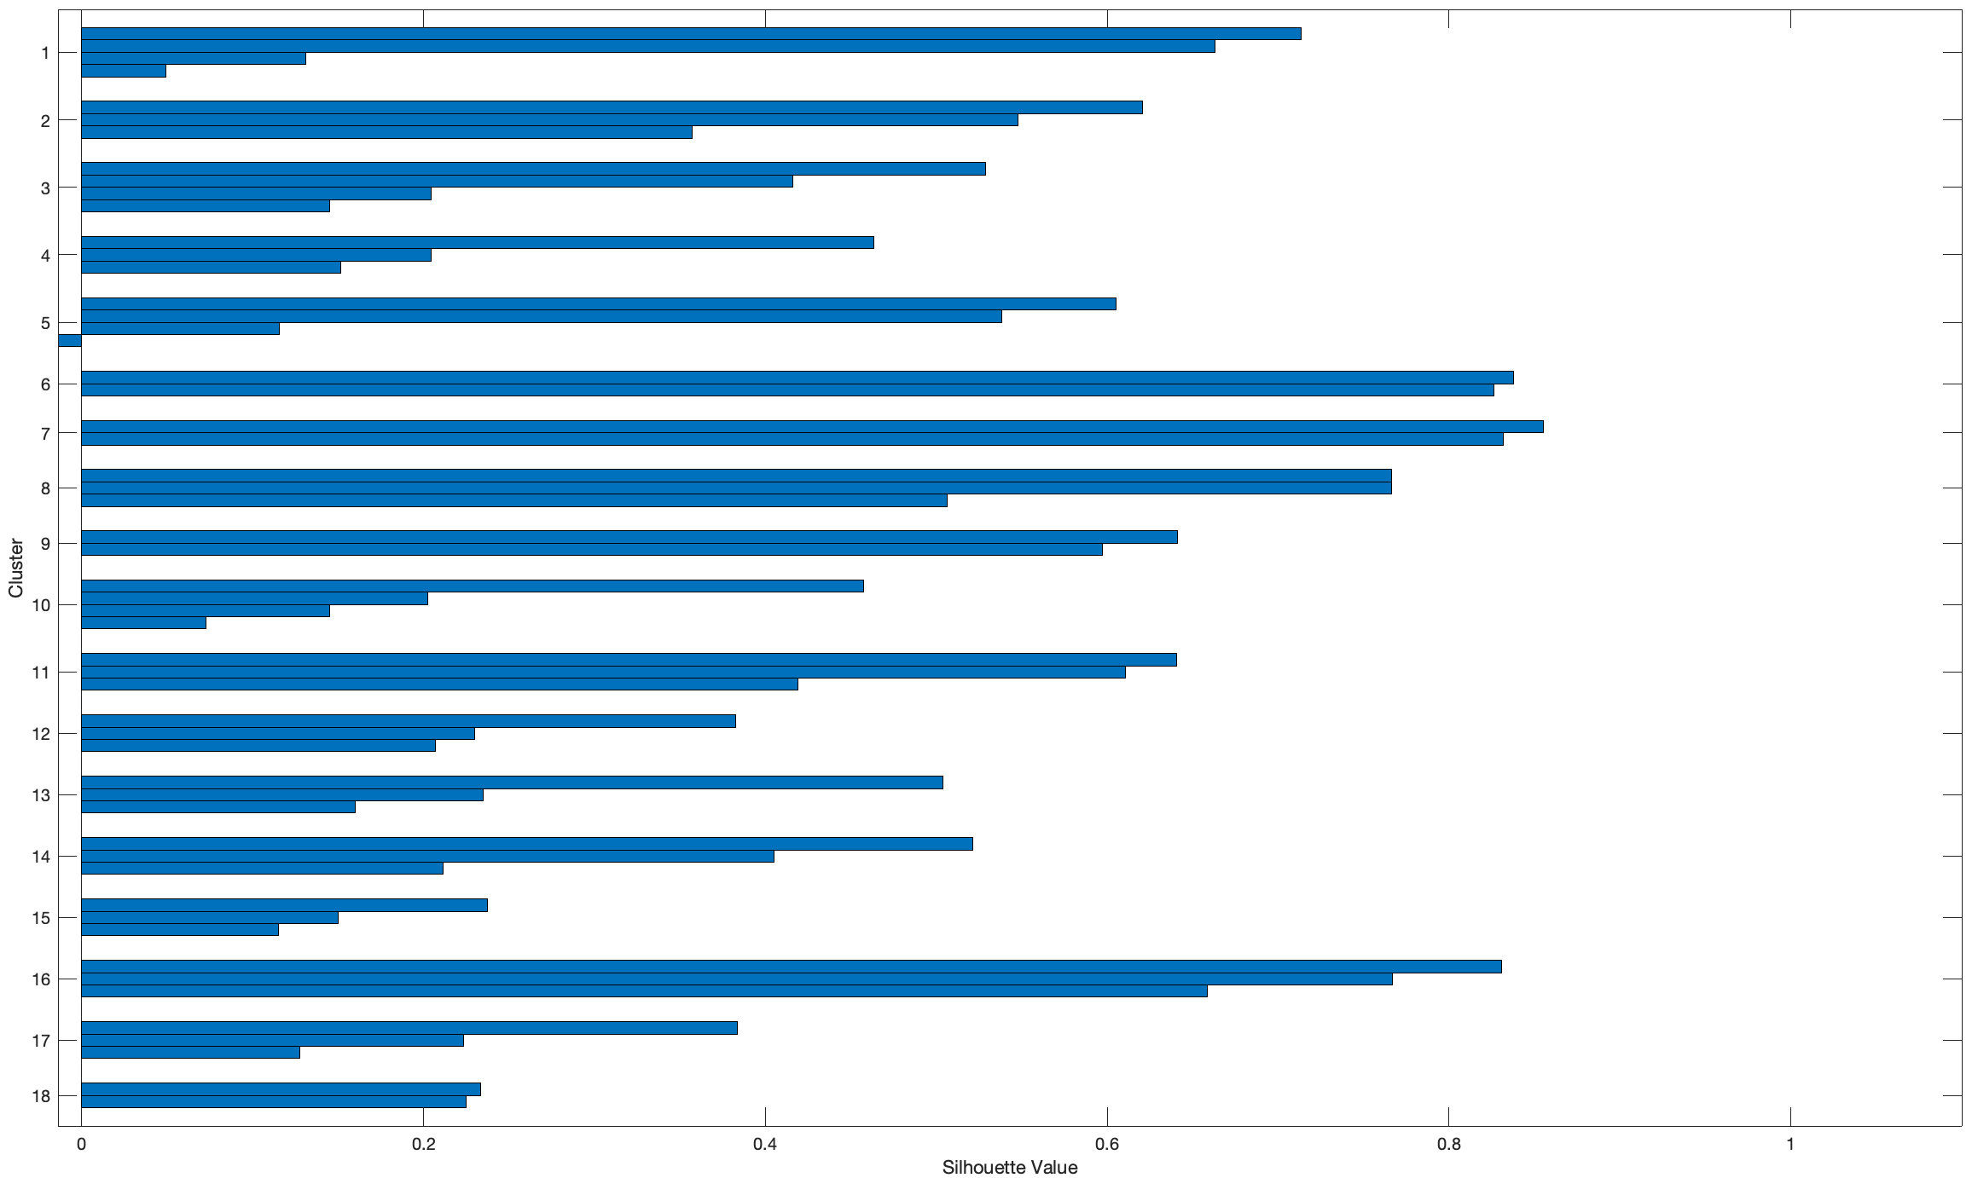
Silhouette values for clusters including All subjects
If we include the data corresponding to both subjects together the results are not so good. Some clusters include only 2 PCs (like 6 and 7) while some other clusters (like 1, 3 or 10) include 4 PCs.

Slide 5
Two different approaches to solve this
Modified Traditional Clustering:
If we find a cluster with more that one PC per subject we select the PC with the higher silhouette value and discard the other(s).
That discarded PC will not appear in any other synergy.
The clustering algorithm is executed only once.
Recursive Clustering:
First we find the cluster with higher score using the Matlab function ‘evalclusters’. If that cluster has more that one PC per subject we select the PC with the higher silhouette value.
We replace the selected PCs with NaNs.
We call again to the clustering function with one cluster less.
In this case, those PCs discarded from one synergy could be matched with the remaining PCs in another synergy.
The clustering algorith is executed until we only have 2 clusters (base case).

Slide 6
Synergies for two subjects
Synergy | PC Subject 3 | PC Subject 4
1 | PC 2 | PC 1
2 | PC 1 | PC 4
3 | PC 3 | PC 2
4 | PC 4 | PC 3
5 | PC 7 | PC 5
6 | PC 5 | PC 8
7 | PC 6 | PC 6
8 | PC 8 | PC 7
9 | PC 9 | PC 12
10 | PC 11 | PC 10
11 | PC 10 | PC 13
12 | PC 15 | PC 9
13 | PC 13 | PC 11
14 | PC 14 | PC 14
15 | PC 12 | PC 15
16 | PC 16 | PC 16
17 | PC 17 | PC 18
18 | PC 18 | PC 17
Synergy | PC Subject 3 | PC Subject 4
1 | PC 2 | PC 1
2 | PC 1 | PC 4
3 | PC 3 | PC 2
4 | PC 4 | PC 3
5 | PC 7 | PC 5
6 | PC 5 | PC 8
7 | PC 6 | PC 6
8 | PC 8 | PC 7
9 | PC 9 | PC 12
10 | PC 11 | PC 10
11 | PC 10 | PC 13
12 | PC 15 | PC 9
13 | PC 13 | PC 11
14 | PC 14 | PC 14
15 | PC 12 | PC 15
16 | PC 16 | PC 16
17 | PC 17 | PC 18
18 | PC 18 | PC 17
Traditional Clustering
Recursive Clustering

Slide 7
Synergies with All subjects
Synergy | PC Subject 3 | PC Subject 4 | PC All Subjects
1 | PC 3 | PC 1 | PC 1
2 | PC 2 |  | PC 3
3 | PC 1 | PC 4 | PC 5
4 | PC 14 | PC 3 | PC 4
5 |  | PC 5 | PC 6
6 | PC 4 | PC 12
7 | PC 7 | PC 6 | PC 7
8 | PC 5 | PC 8 | PC 8
9 | PC 6 | PC 7 | PC 9
10 | PC 8 | PC 11 | PC 12
11 | PC 11 | PC 10 | PC 11
12 | PC 15 | PC 9 | PC 10
13 | PC 10 | PC 13 | PC 13
14 | PC 13 | PC 14 | PC 14
15 | PC 12 | PC 15 | PC 15
16 | PC 16 | PC 16 | PC 16
17 | PC 17 |  | PC 17
18 | PC 18 | PC 18 | PC 18
Synergy | PC Subject 3 | PC Subject 4 | PC All Subjects
1 | PC 3 | PC 1 | PC 2
2 | PC 1 | PC 4 | PC 1
3 | PC 2 |  | PC 3
4 | PC 14 | PC 3 | PC 4
5 |  | PC 5 | PC 6
6 | PC 7 | PC 6 | PC 7
7 | PC 5 | PC 8 | PC 8
8 | PC 6 | PC 7 | PC 9
9 | PC 9 | PC 12 | PC 5
10 | PC 8 | PC 11 | PC 12
11 | PC 11 | PC 10 | PC 11
12 | PC 15 | PC 9 | PC 10
13 | PC 10 | PC 13 | PC 13
14 | PC 13 | PC 14 | PC 14
15 | PC 12 | PC 15 | PC 15
16 | PC 16 | PC 16 | PC 16
17 | PC 17 |  | PC 17
18 | PC 18 | PC 18 | PC 18
Traditional Clustering
Recursive Clustering

Slide 8
Synergies with All subjects
Synergy | PC Subject 3 | PC Subject 4 | PC All Subjects
1 | PC 3 | PC 1 | PC 1
2 | PC 2 |  | PC 3
3 | PC 1 | PC 4 | PC 5
4 | PC 14 | PC 3 | PC 4
5 |  | PC 5 | PC 6
6 | PC 4 | PC 12
7 | PC 7 | PC 6 | PC 7
8 | PC 5 | PC 8 | PC 8
9 | PC 6 | PC 7 | PC 9
10 | PC 8 | PC 11 | PC 12
11 | PC 11 | PC 10 | PC 11
12 | PC 15 | PC 9 | PC 10
13 | PC 10 | PC 13 | PC 13
14 | PC 13 | PC 14 | PC 14
15 | PC 12 | PC 15 | PC 15
16 | PC 16 | PC 16 | PC 16
17 | PC 17 |  | PC 17
18 | PC 18 | PC 18 | PC 18
Synergy | PC Subject 3 | PC Subject 4 | PC All Subjects
1 | PC 3 | PC 1 | PC 2
2 | PC 1 | PC 4 | PC 1
3 | PC 2 |  | PC 3
4 | PC 14 | PC 3 | PC 4
5 |  | PC 5 | PC 6
6 | PC 7 | PC 6 | PC 7
7 | PC 5 | PC 8 | PC 8
8 | PC 6 | PC 7 | PC 9
9 | PC 9 | PC 12 | PC 5
10 | PC 8 | PC 11 | PC 12
11 | PC 11 | PC 10 | PC 11
12 | PC 15 | PC 9 | PC 10
13 | PC 10 | PC 13 | PC 13
14 | PC 13 | PC 14 | PC 14
15 | PC 12 | PC 15 | PC 15
16 | PC 16 | PC 16 | PC 16
17 | PC 17 |  | PC 17
18 | PC 18 | PC 18 | PC 18
Modified Traditional Clustering
Recursive Clustering

Slide 9
Synergies with All subjects
Synergy | PC Subject 3 | PC Subject 4 | PC All Subjects
1 | PC 3 | PC 1 | PC 1
2 | PC 2 |  | PC 3
3 | PC 1 | PC 4 | PC 5
4 | PC 14 | PC 3 | PC 4
5 |  | PC 5 | PC 6
6 | PC 4 | PC 12
7 | PC 7 | PC 6 | PC 7
8 | PC 5 | PC 8 | PC 8
9 | PC 6 | PC 7 | PC 9
10 | PC 8 | PC 11 | PC 12
11 | PC 11 | PC 10 | PC 11
12 | PC 15 | PC 9 | PC 10
13 | PC 10 | PC 13 | PC 13
14 | PC 13 | PC 14 | PC 14
15 | PC 12 | PC 15 | PC 15
16 | PC 16 | PC 16 | PC 16
17 | PC 17 |  | PC 17
18 | PC 18 | PC 18 | PC 18
Synergy | PC Subject 3 | PC Subject 4 | PC All Subjects
1 | PC 3 | PC 1 | PC 2
2 | PC 1 | PC 4 | PC 1
3 | PC 2 |  | PC 3
4 | PC 14 | PC 3 | PC 4
5 |  | PC 5 | PC 6
6 | PC 7 | PC 6 | PC 7
7 | PC 5 | PC 8 | PC 8
8 | PC 6 | PC 7 | PC 9
9 | PC 9 | PC 12 | PC 5
10 | PC 8 | PC 11 | PC 12
11 | PC 11 | PC 10 | PC 11
12 | PC 15 | PC 9 | PC 10
13 | PC 10 | PC 13 | PC 13
14 | PC 13 | PC 14 | PC 14
15 | PC 12 | PC 15 | PC 15
16 | PC 16 | PC 16 | PC 16
17 | PC 17 |  | PC 17
18 | PC 18 | PC 18 | PC 18
Traditional Clustering
Recursive Clustering

Slide 10
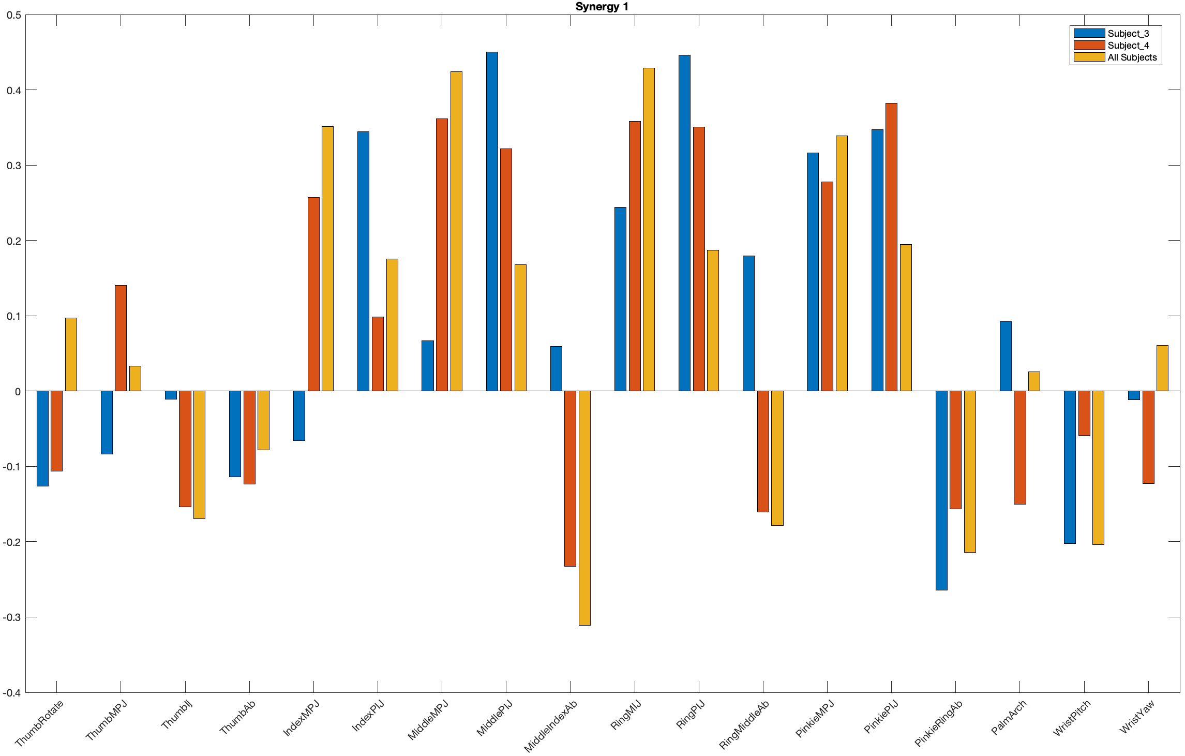
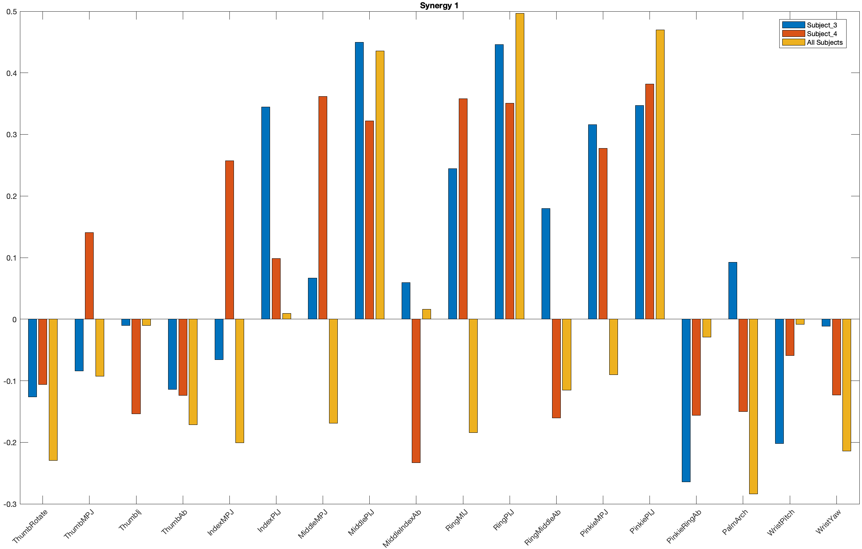
Synergies comparison
Modified Traditional Clustering
Recursive Clustering

Slide 11
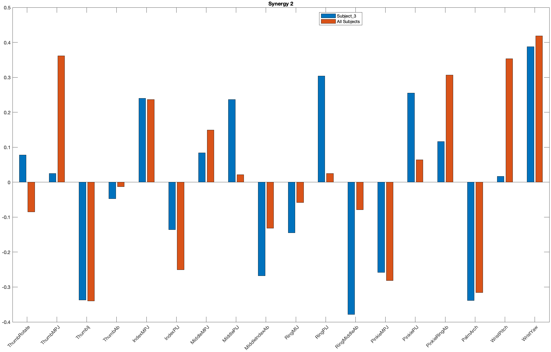
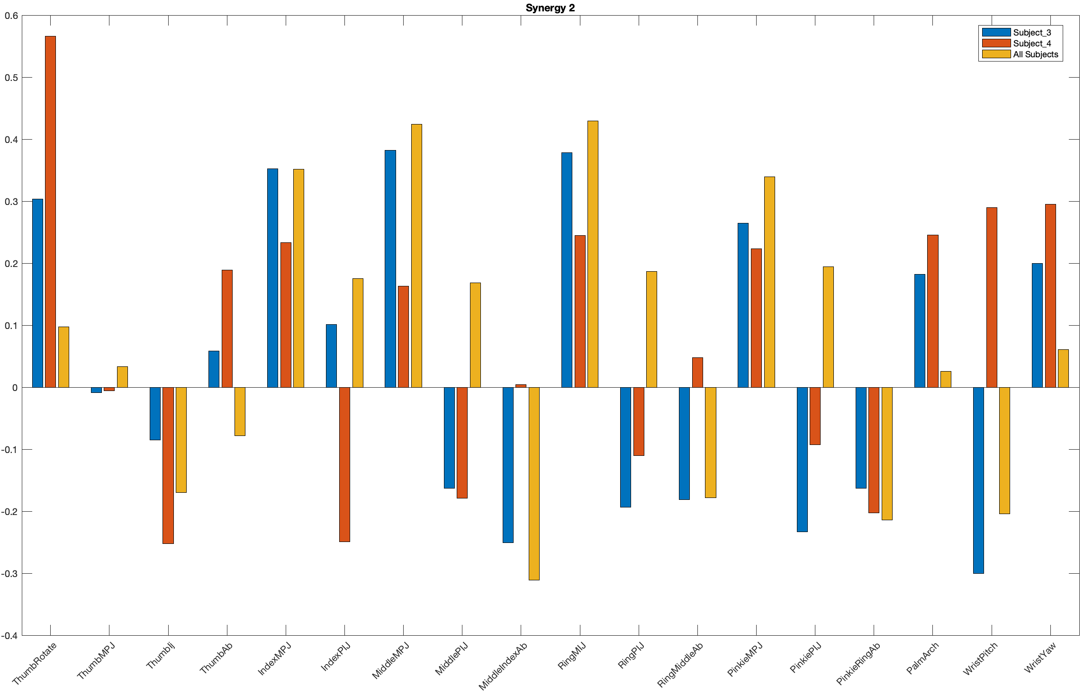
Synergies comparison
Modified Traditional Clustering
Recursive Clustering

Slide 12
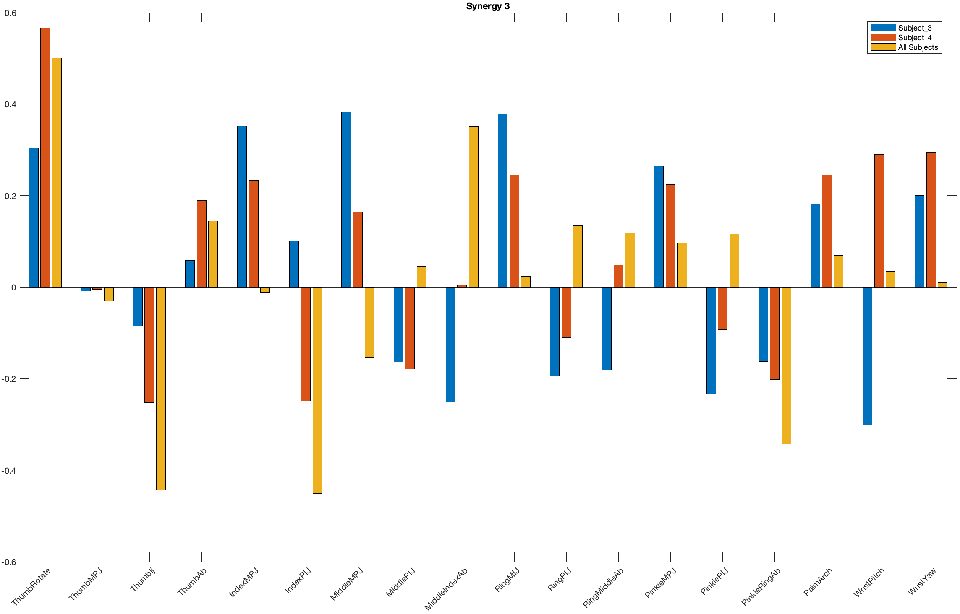
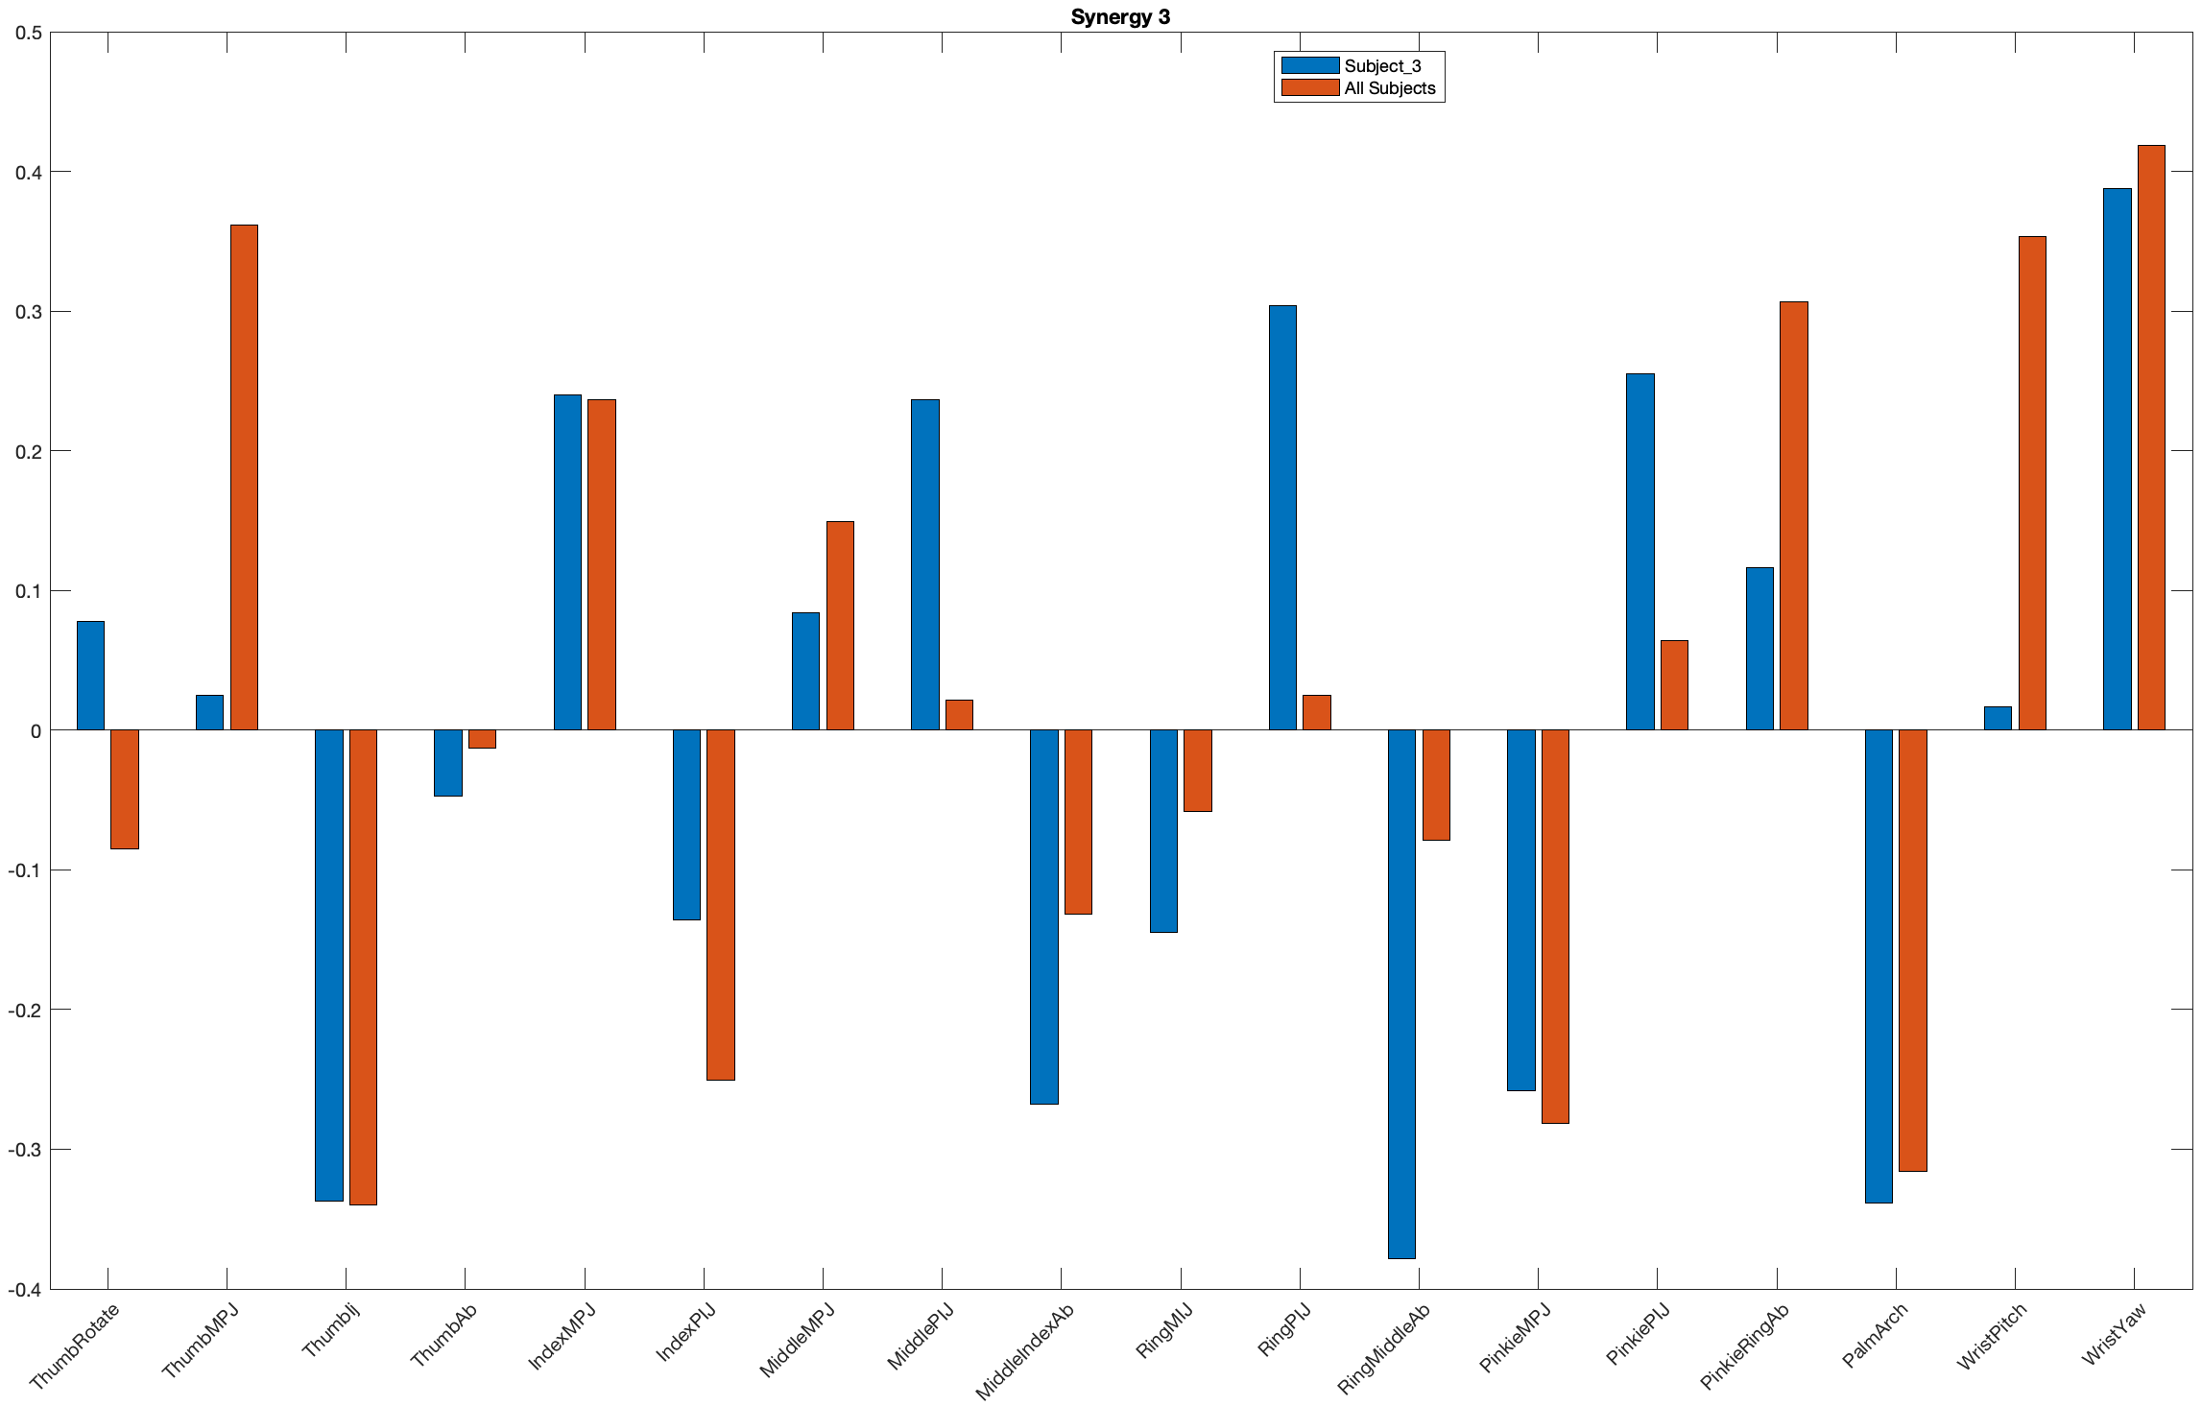
Synergies comparison
Modified Traditional Clustering
Recursive Clustering

Slide 13
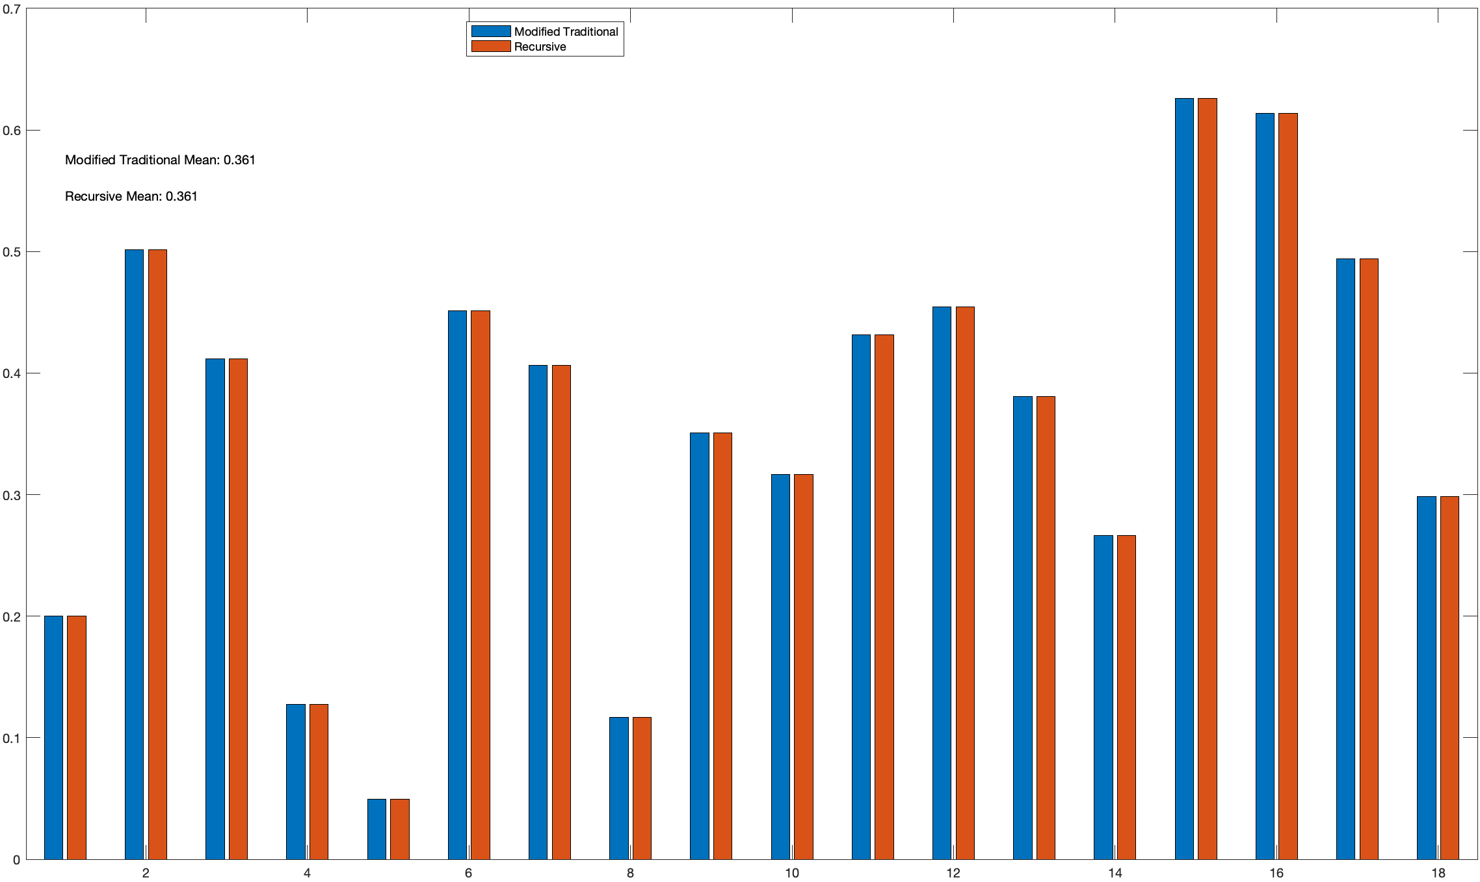
Cluster evaluation
Two subjects

Slide 14
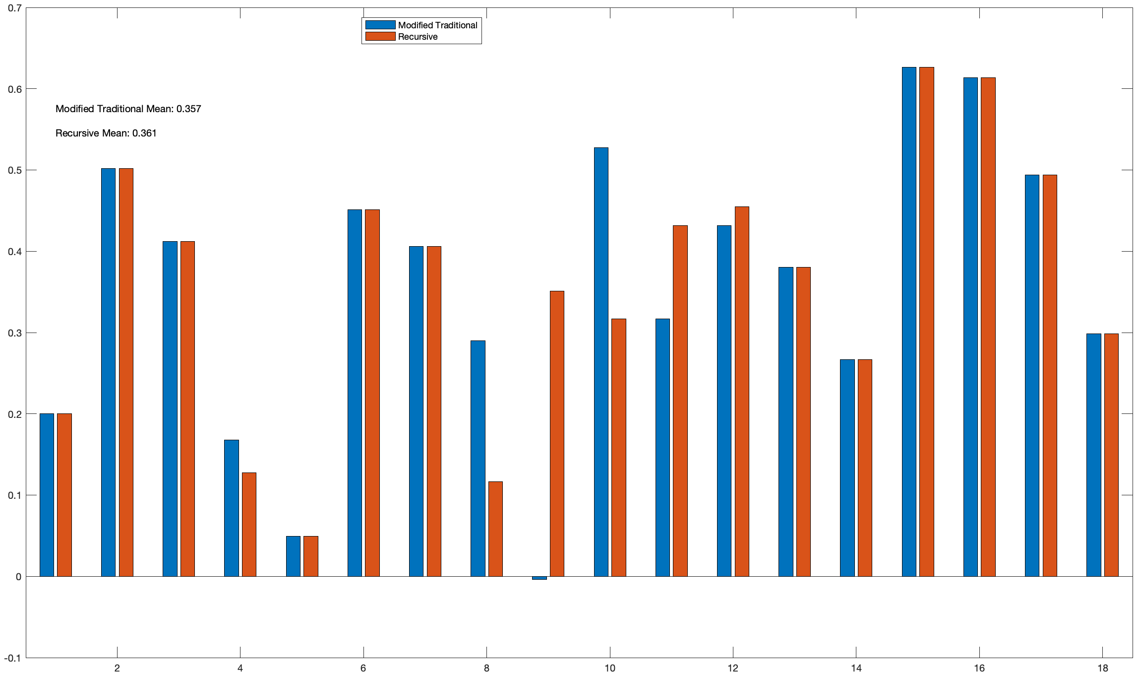
Cluster evaluation
Two subjects

Slide 15
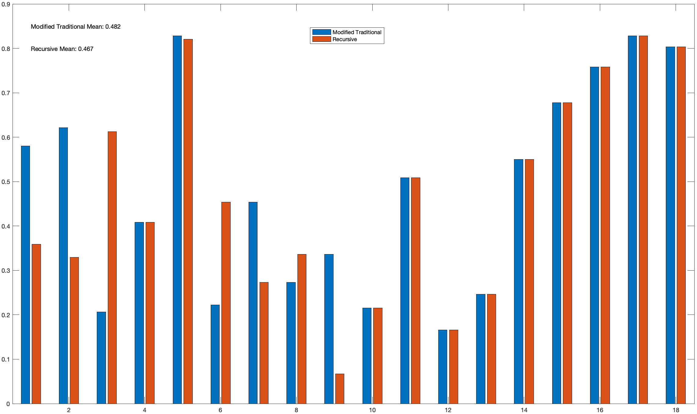
Cluster evaluation
Including All subjects

Slide 16
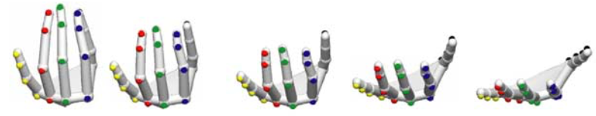
Next steps
Check synergy differences using the same algorithm.
Calculate dynamic synergies (how synergies evolve during time).
Synergies representations.
Items to comment
Mendeley.

