Slide 1
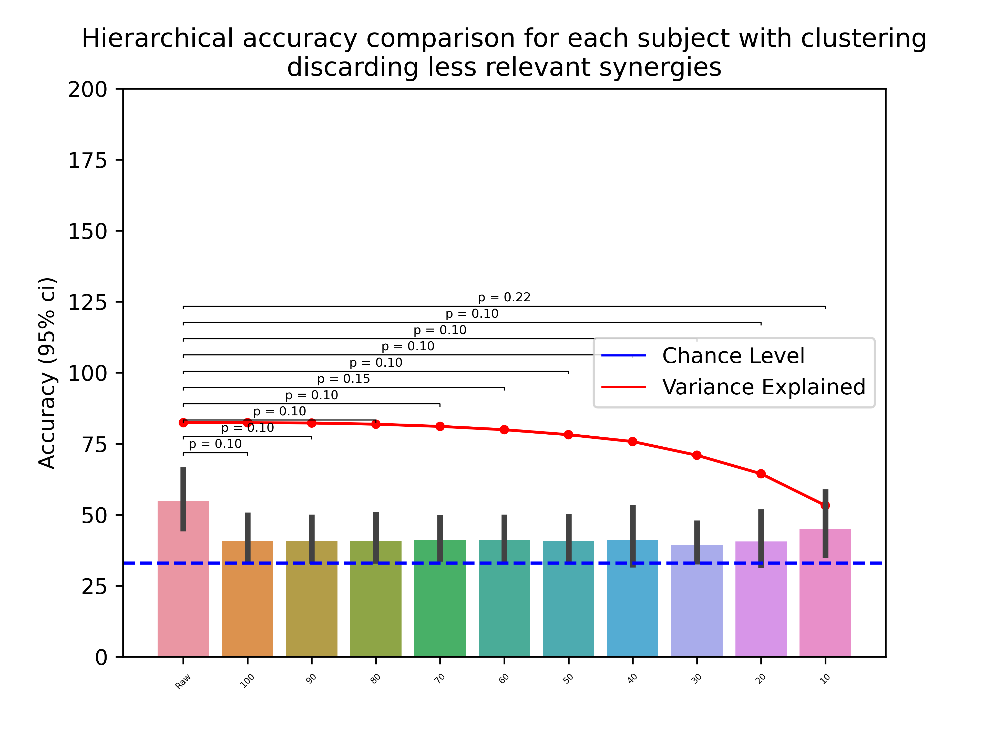
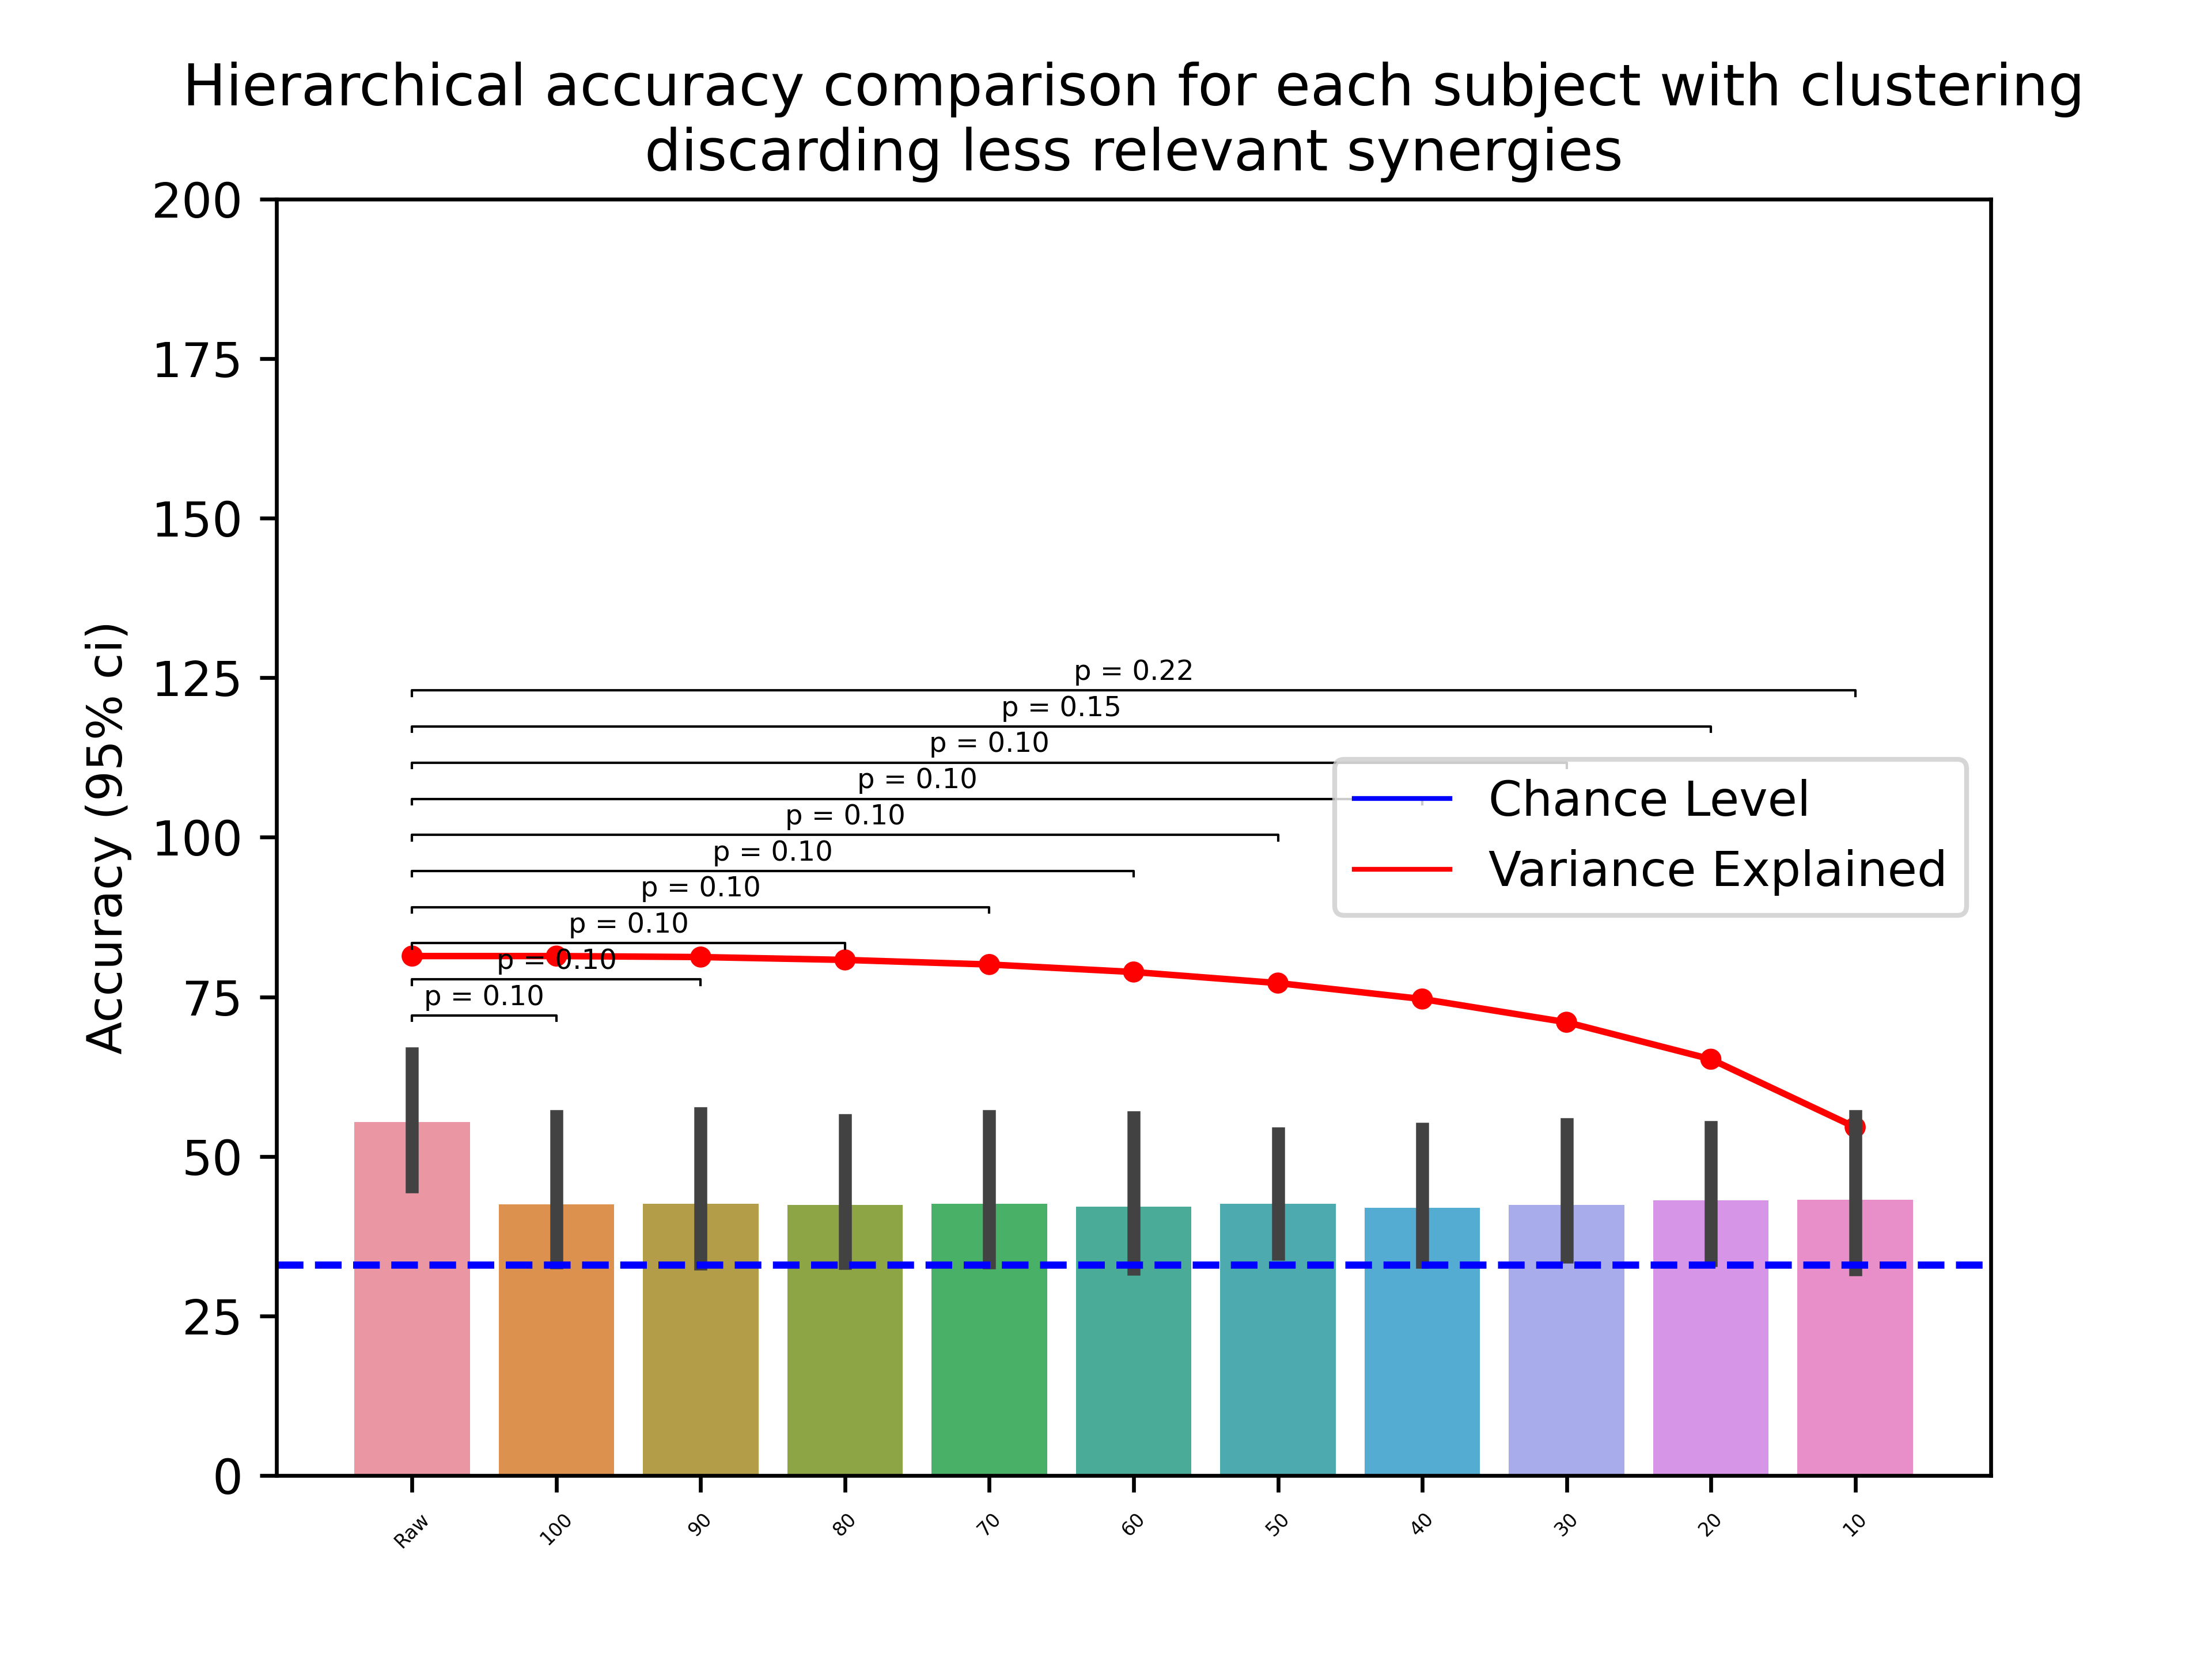
All subjects vs. discarding 7-9

Slide 2
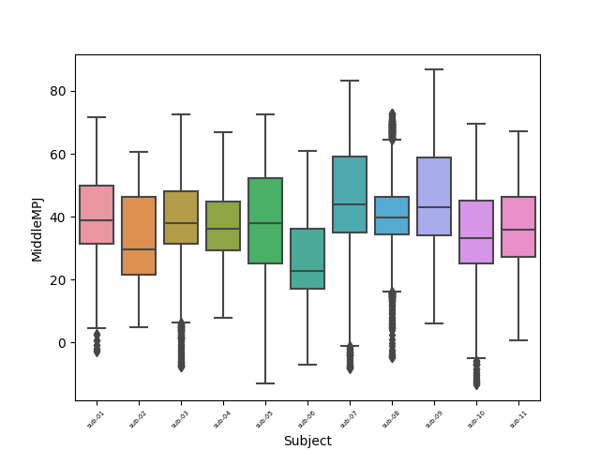
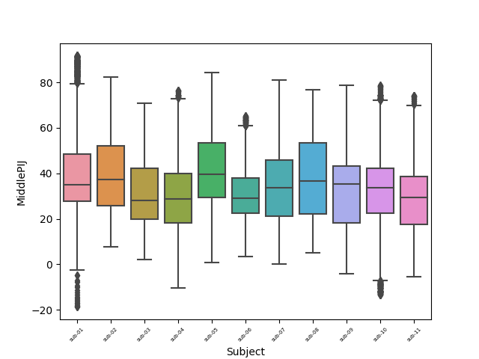
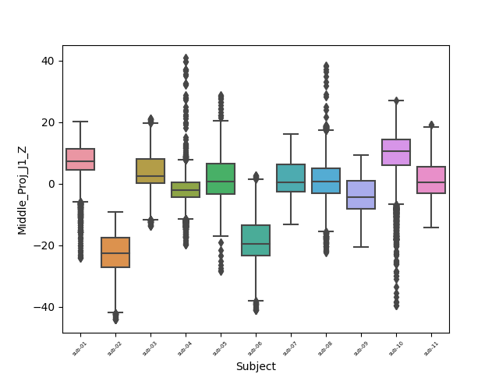

Slide 3
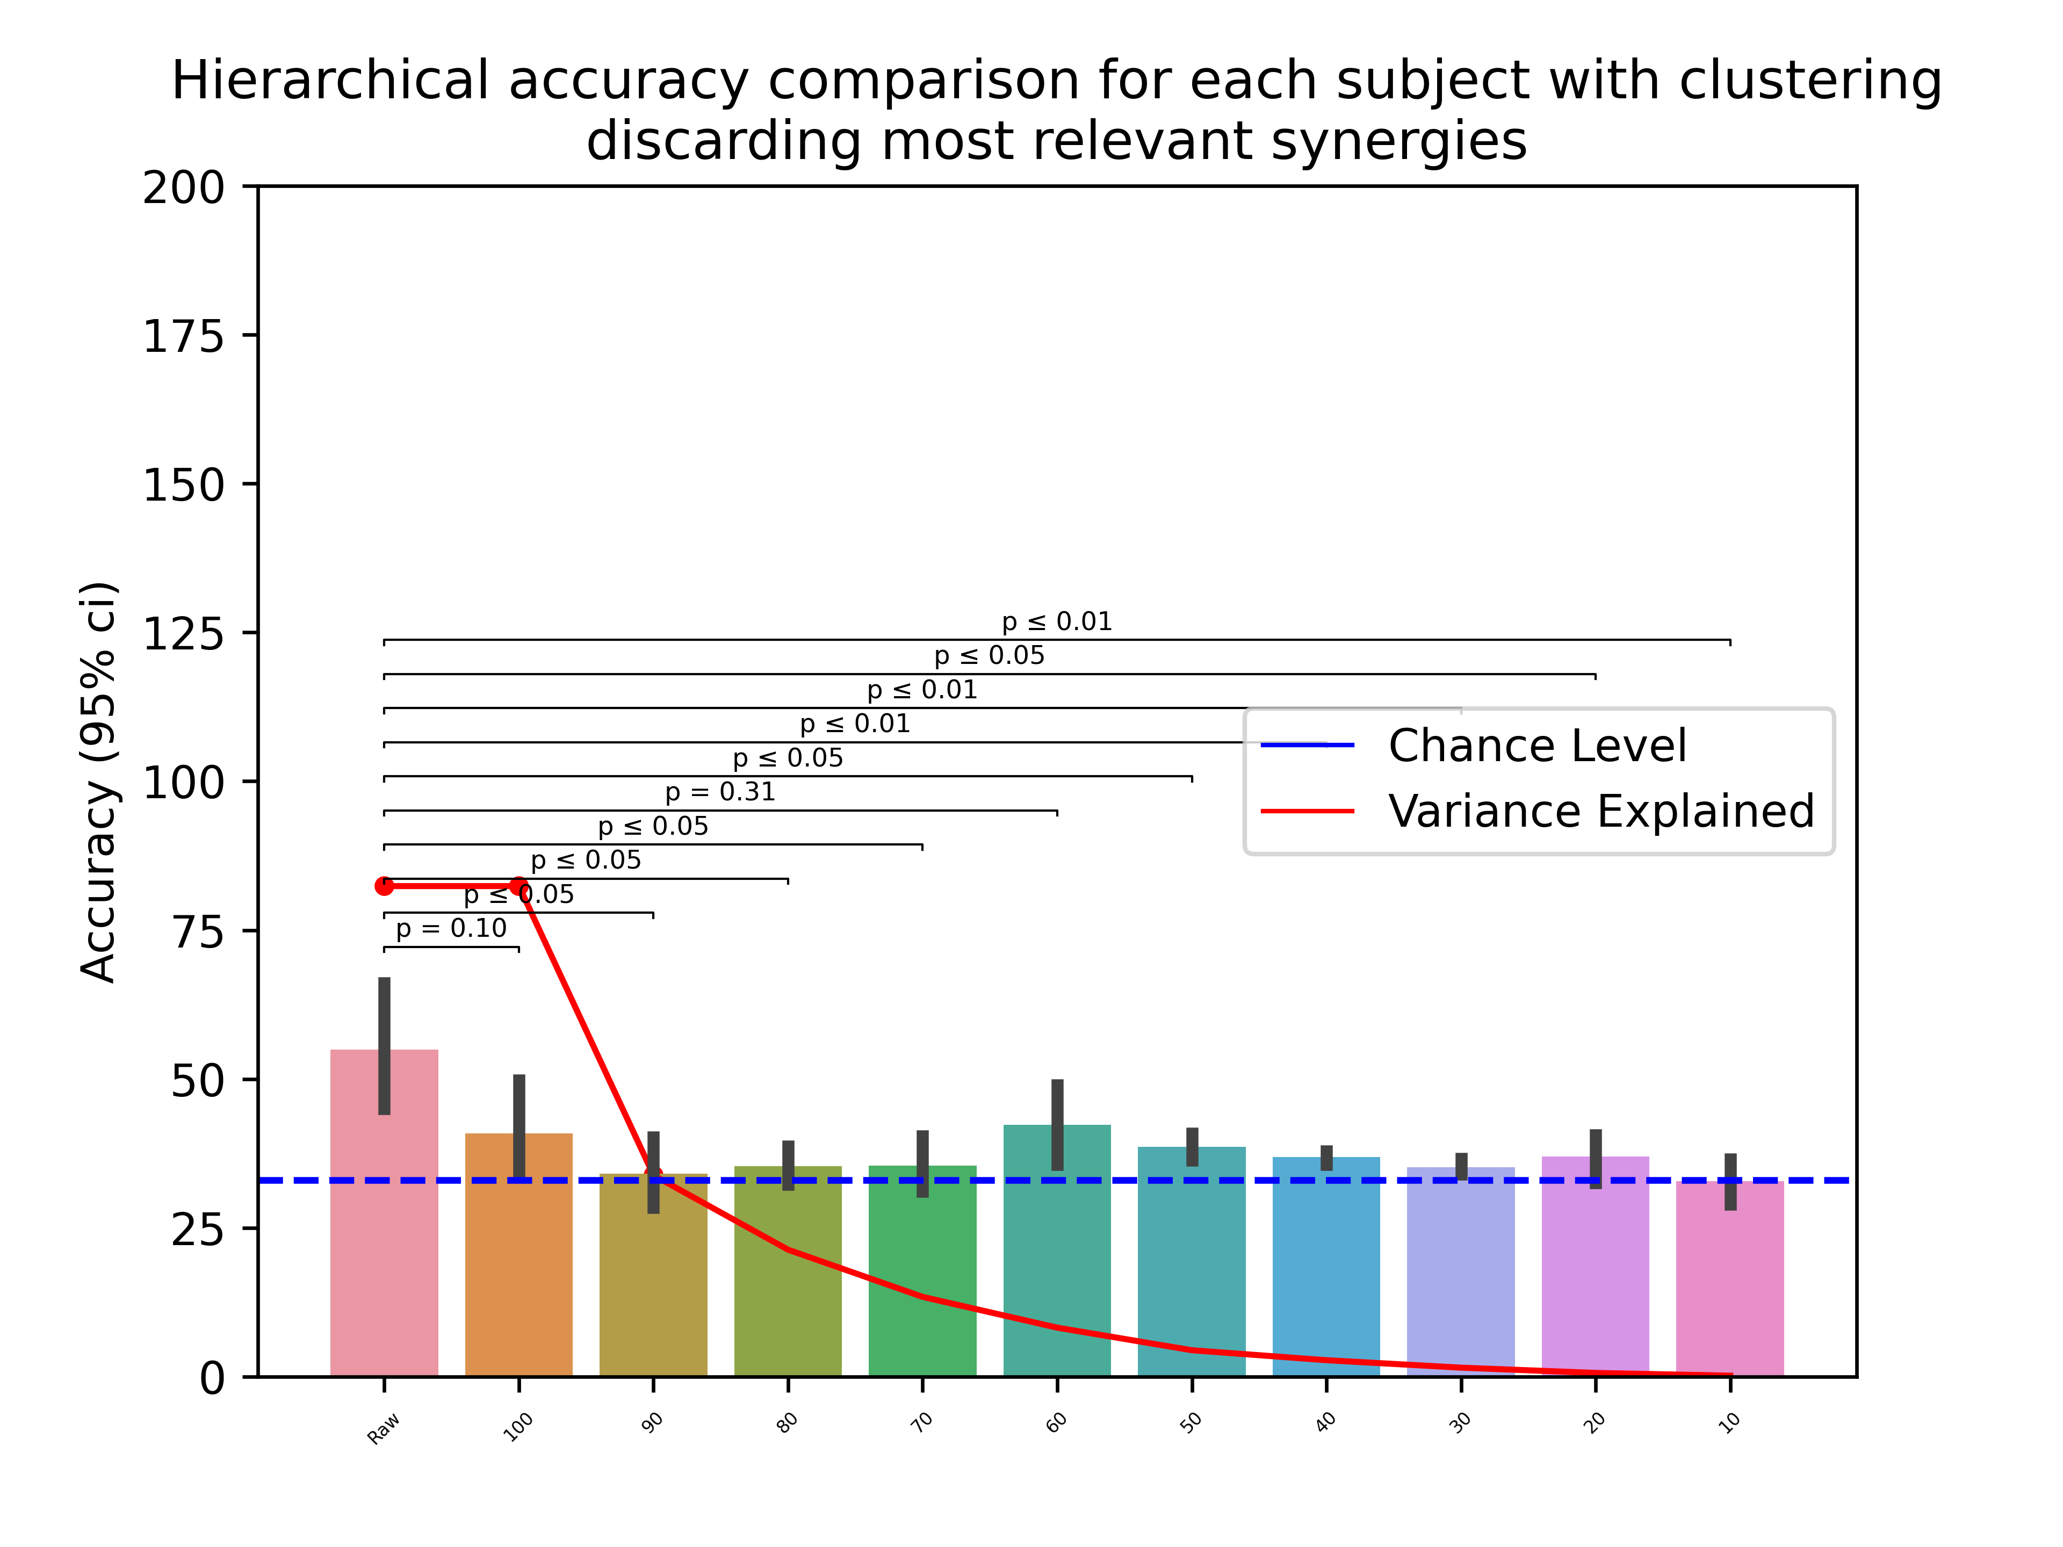
Discarding less relevant vs. discarding most relevant

Slide 4
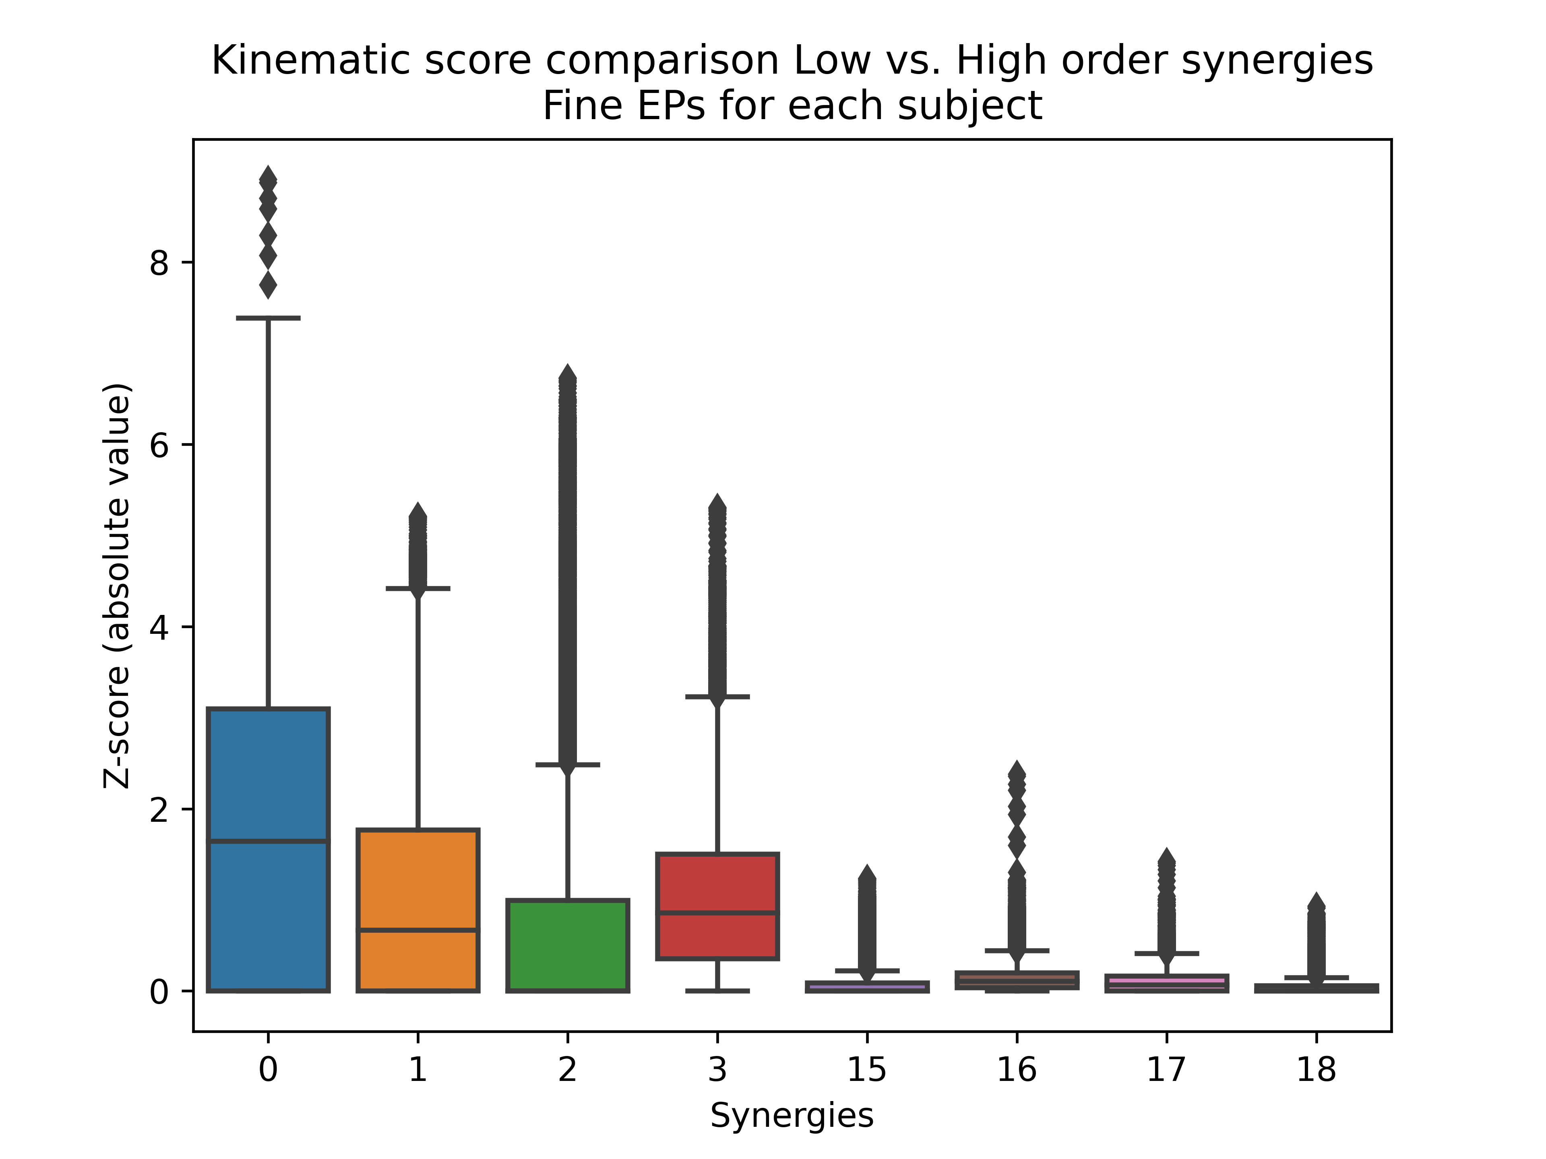
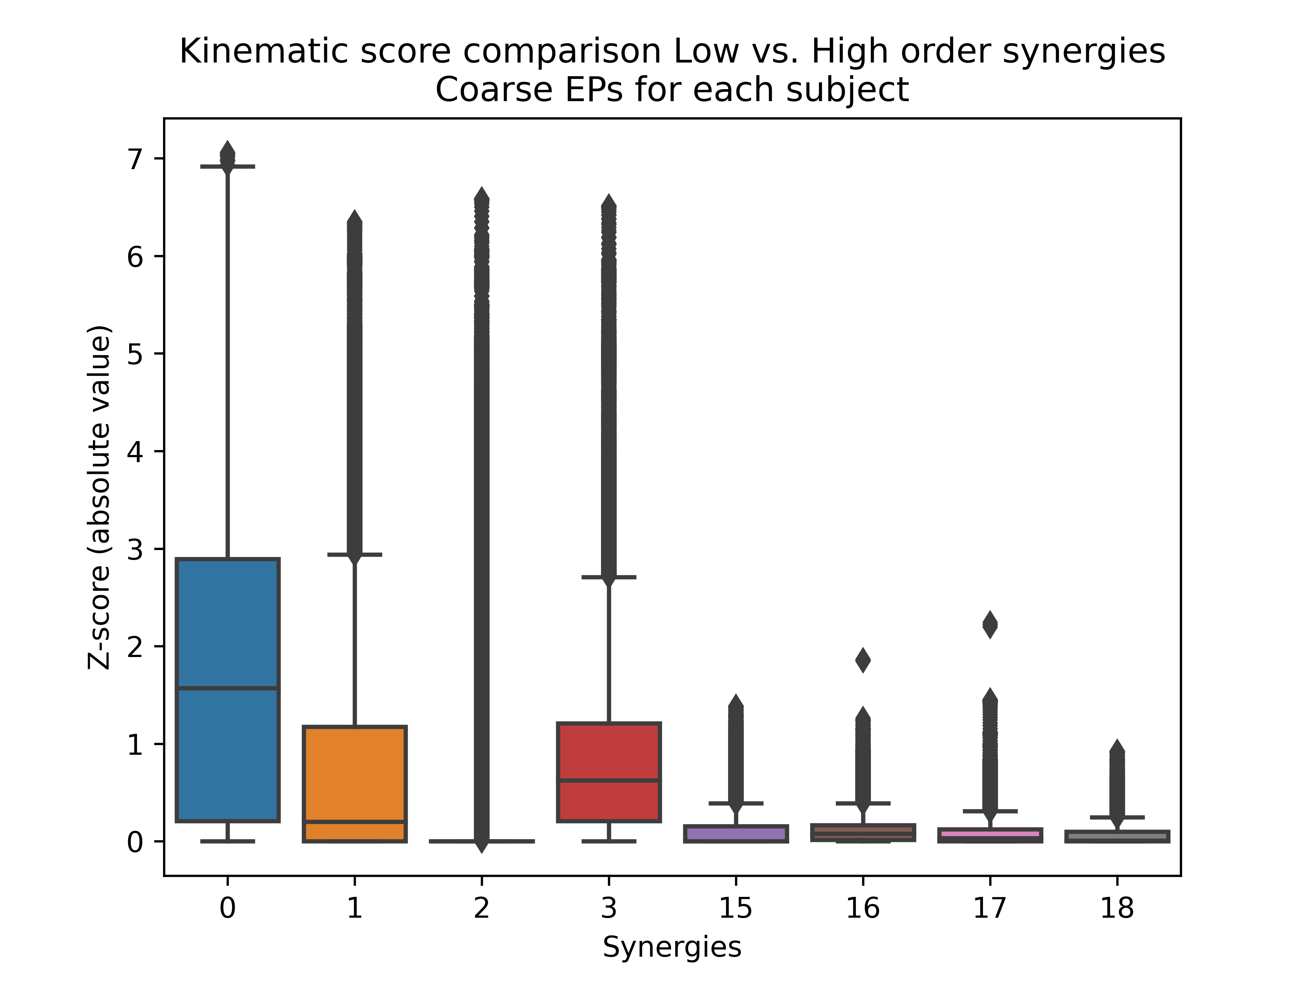
Fine = {'edge following', 'function test', 'enclosure part'}
Coarse = {'enclosure', 'weighting', 'pressure'}

Slide 5
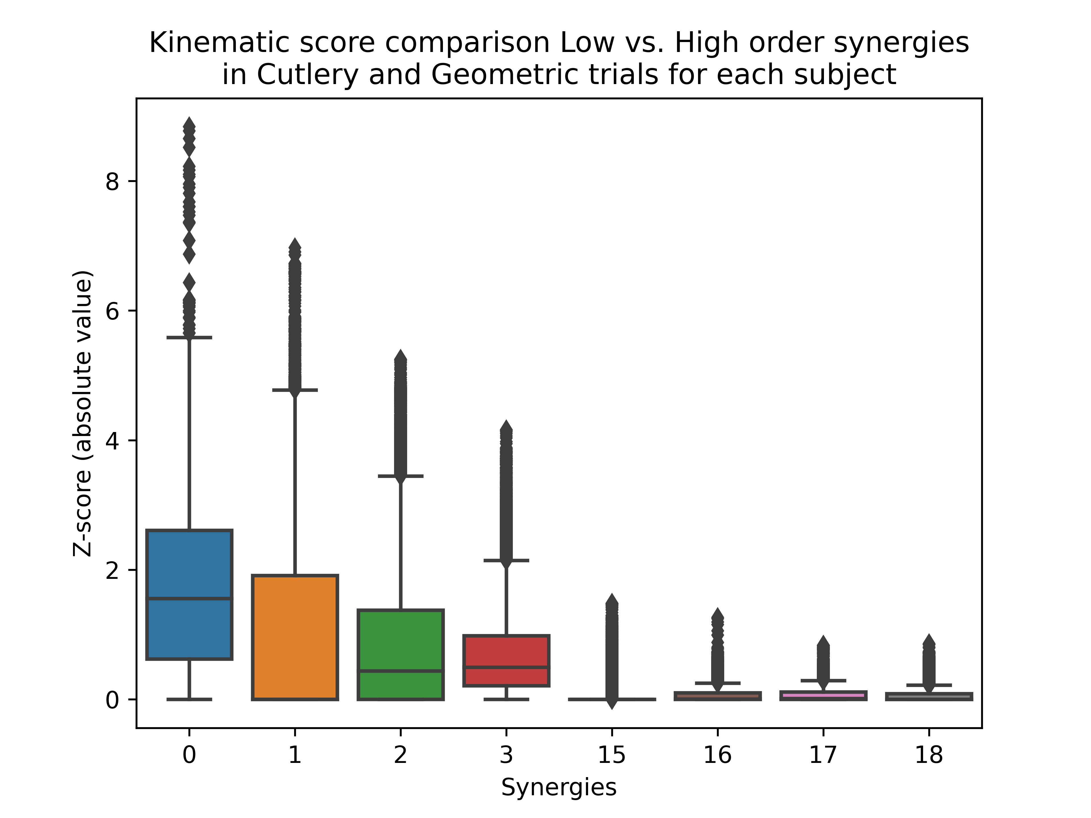
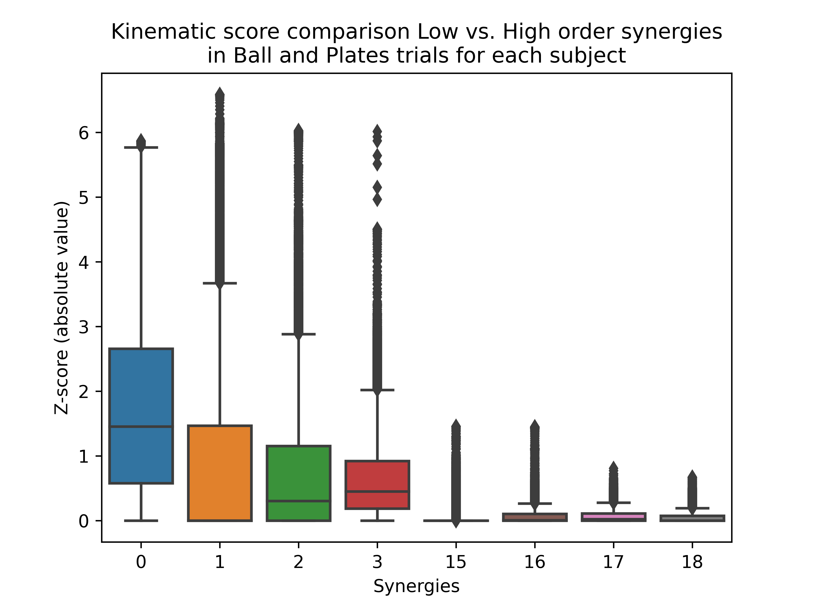
Fine = {'Cutlery', 'Geometric'}
Coarse = {'Ball', 'Plates'}
MUGS??

Slide 6
Now running classifiers not targeting ‘Given Object’ but ‘Family’
Early results on raw data show better results:
EMG with similar results (~46%)
Tactile from 50% to +60%
Kinematics from 55% to +75%

