Slide 1
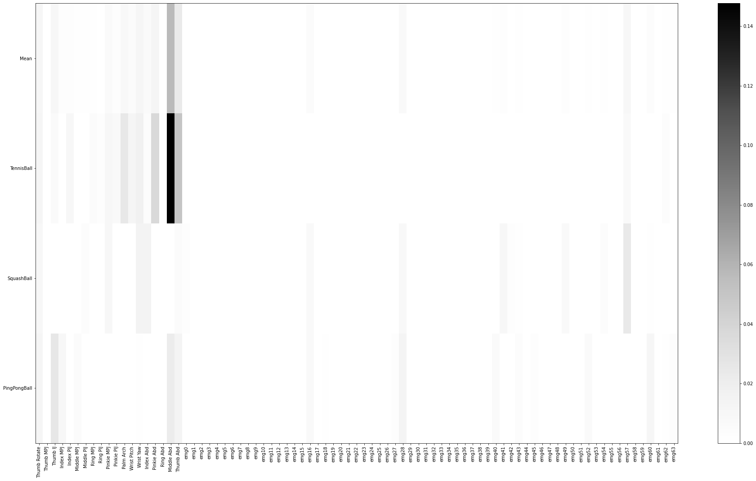

Slide 3
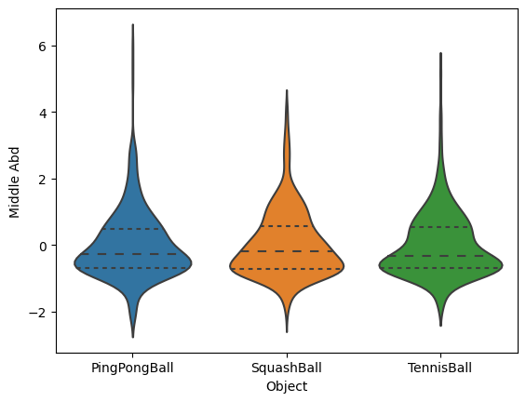
ANOVA p-val: 0.842
Tukey Pairwise p-val:
PingPongBall – SquashBall: 0.865 PingPongBall - TennisBall: 0.999
SquashBall - TennisBall: 0.87
Bonferroni t-test p-val:
PingPongBall - SquashBall :1.0 PingPongBall - TennisBall: 1.0
SquashBall - TennisBall: 1.0

Slide 4
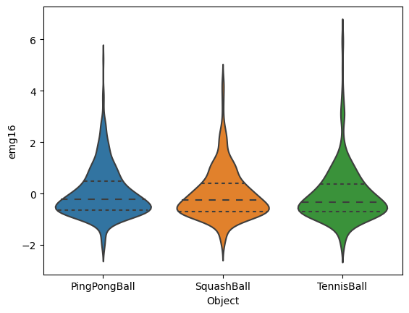
ANOVA p-val: 0.732
Tukey Pairwise p-val:
PingPongBall – SquashBall: 0.846 PingPongBall - TennisBall: 0.738 SquashBall - TennisBall: 0.974
Bonferroni t-test p-val:
PingPongBall - SquashBall :1.0 PingPongBall - TennisBall: 1.0 SquashBall - TennisBall: 1.0

Slide 5
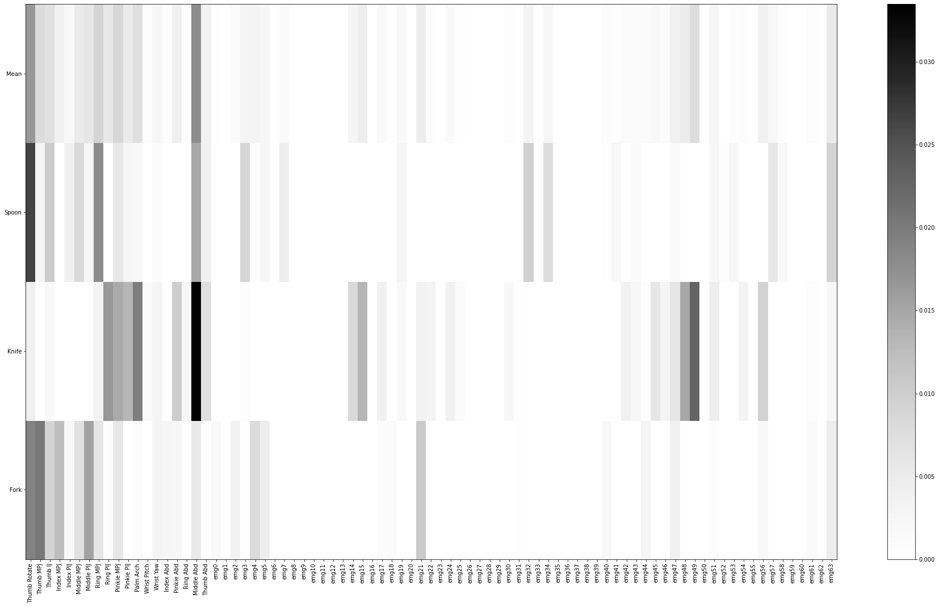

Slide 7
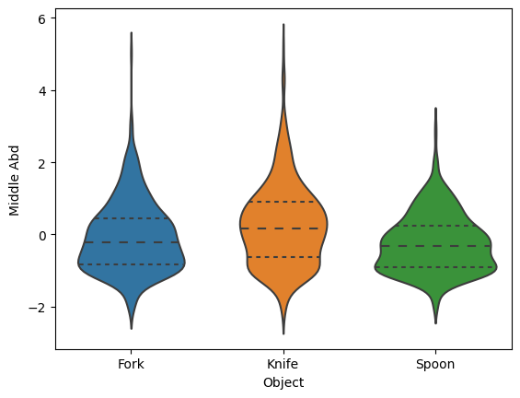
ANOVA p-val: 0.0
Tukey Pairwise p-val:
Fork – Knife: 0.0
Fork - Spoon: 0.035
Knife - Spoon: 0.0
Bonferroni t-test p-val:
Fork – Knife: 0.0
Fork - Spoon: 0.019
Knife - Spoon: 0.0

Slide 8
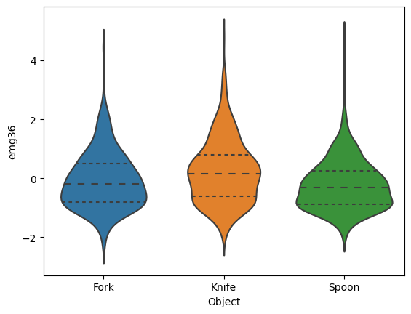
ANOVA p-val: 0.0
Tukey Pairwise p-val:
Fork – Knife: 0.0
Fork - Spoon: 0.077
Knife - Spoon: 0.0
Bonferroni t-test p-val:
Fork – Knife: 0.0
Fork - Spoon: 0.063
Knife - Spoon: 0.0

Slide 9
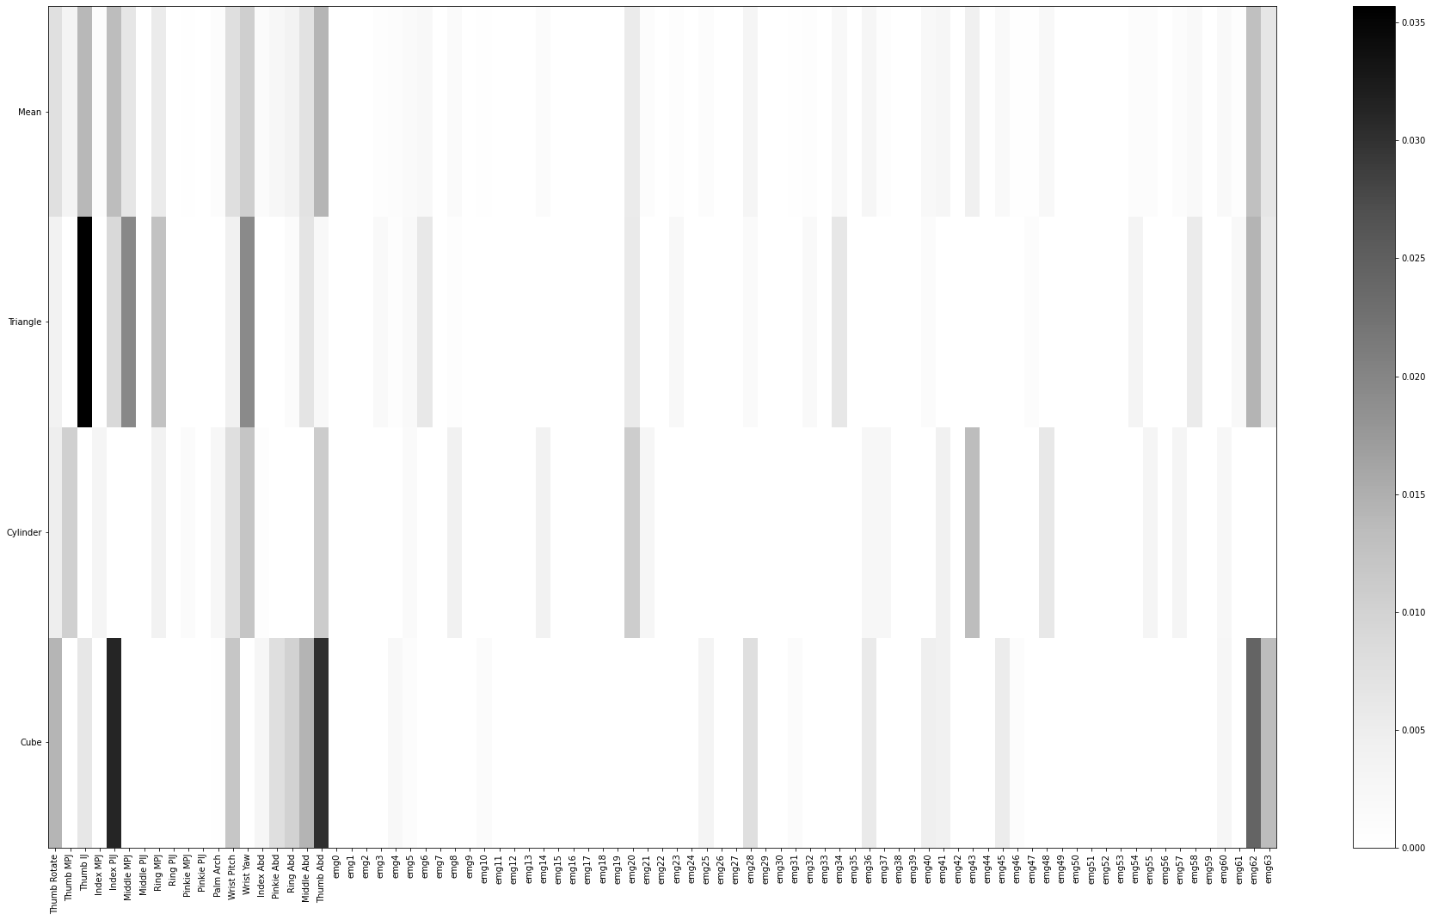

Slide 11
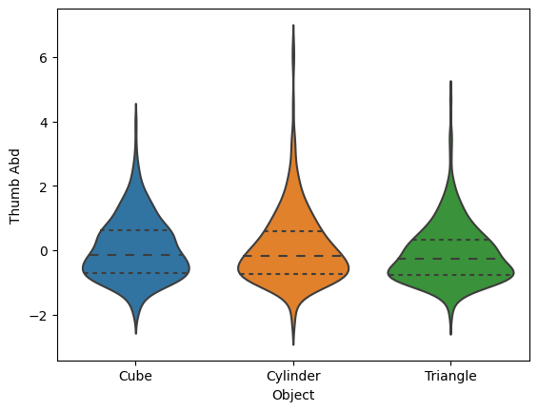
ANOVA p-val: 0.065
Tukey Pairwise p-val:
Cube – Cylinder: 0.938
Cube – Triangle: 0.163
Cylinder – Triangle: 0.074
Bonferroni t-test p-val:
Cube – Cylinder: 1.0
Cube – Triangle: 0.149
Cylinder – Triangle: 0.097

Slide 12
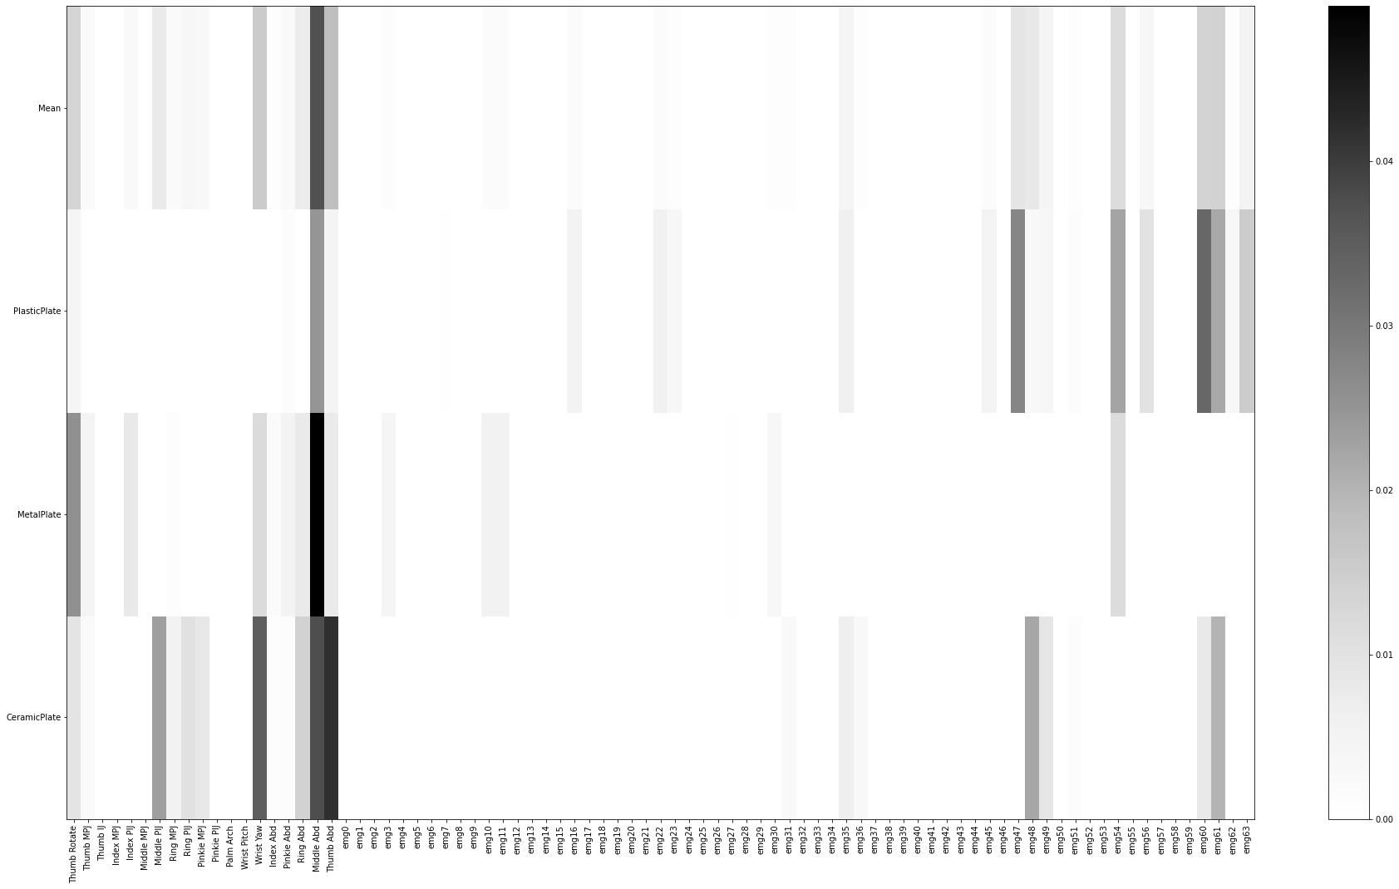

Slide 14
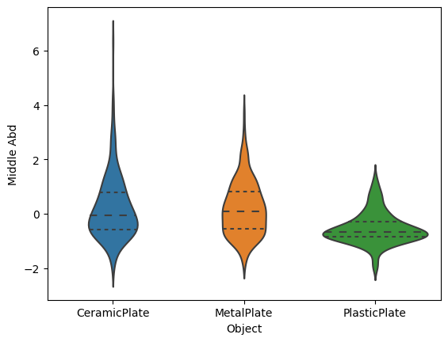
ANOVA p-val: 0.0
Tukey Pairwise p-val:
CeramicPlate – MetalPlate: 0.942
CeramicPlate - PlasticPlate: 0.0
MetalPlate – PlasticPlate: 0.0
Bonferroni t-test p-val:
CeramicPlate – MetalPlate: 1.0
CeramicPlate - PlasticPlate: 0.0
MetalPlate – PlasticPlate: 0.0

