Slide 1
 | Presence / Absence | Duration | Count
Object | 51.11 % | 52.06 % | 52.19 %
Family | 71.18 % | 67 % | 70.44 %

Slide 2
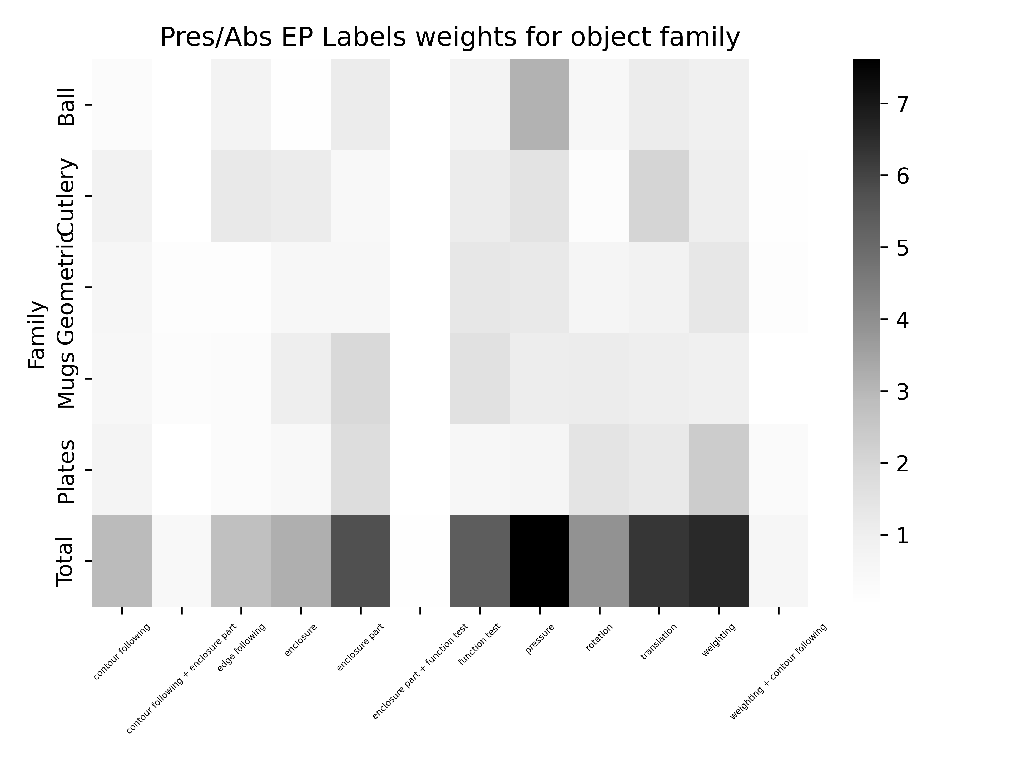

Slide 3
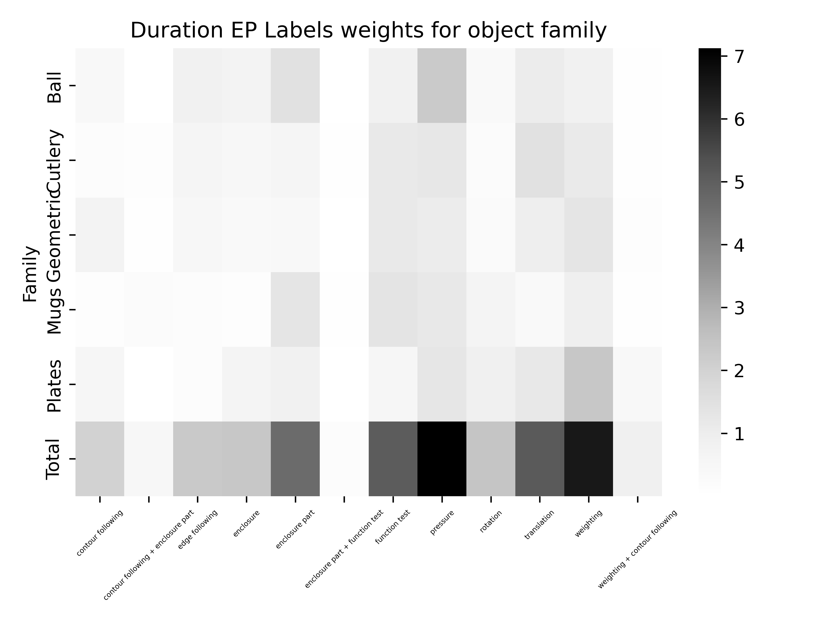

Slide 4
