Slide 1
Preliminary Results
02/07/2021

Slide 2
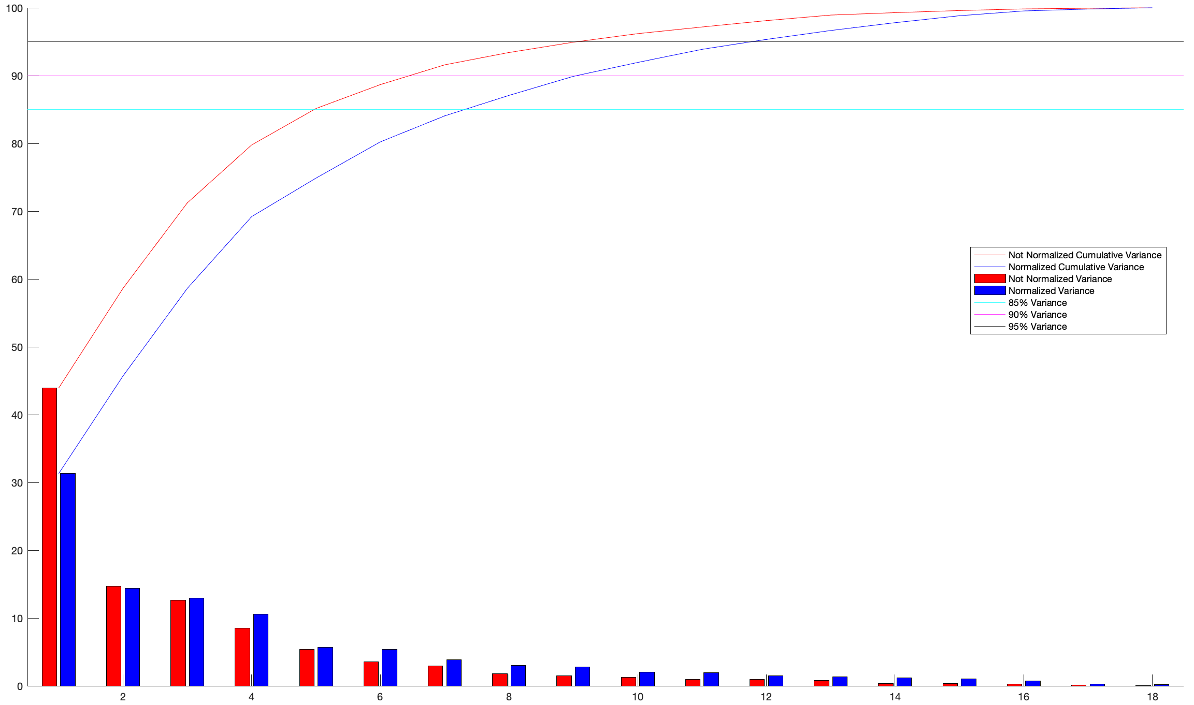
Variance difference between normalized and not normalized data
 | Not Norm | Norm
85% | 5 | 8
90% | 7 | 10 (9)
95% | 10 (9) | 12

Slide 3
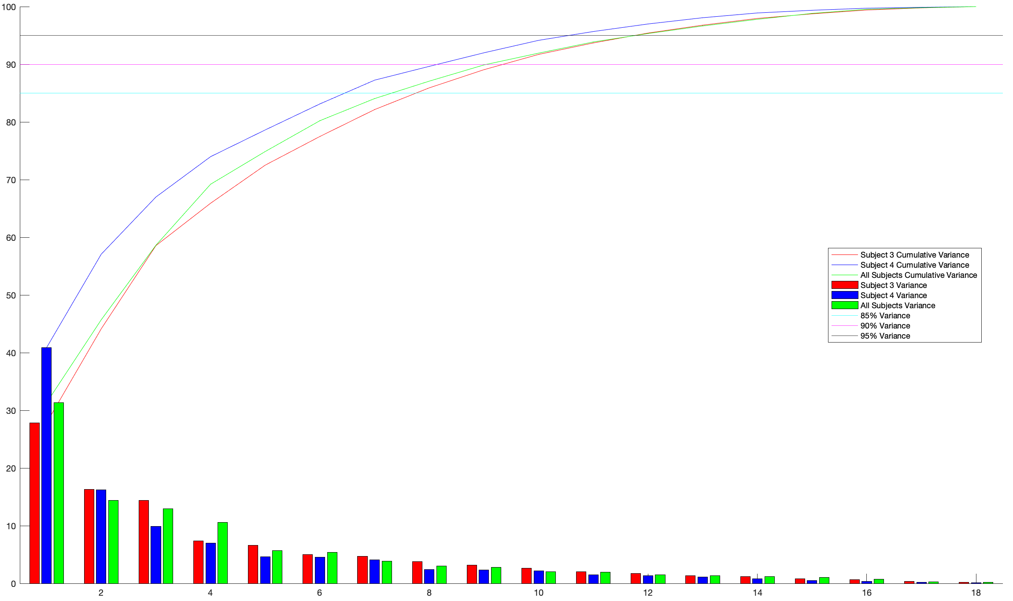
Variance difference between subjects
 | S3 | S4 | All
85% | 8 | 7 | 8
90% | 10 | 9 | 10
95% | 12 | 11 | 12
In general, variance explained is lower than in other studies.
This could be due to our experimental task.

Slide 4
Synergy considerations
”Lower-order principal components […] are mainly responsible for coarse hand opening and closing – and higher-order principal components corresponding to finer hand shape adjustments”. [Santello et al. 2016].
“Although there are striking similarities in synergy vectors across subjects, there are subtle differences as well. […] Such differences are in general larger in the synergies with lower eigenvalues”. [Thakur et al. 2008].
“This suggests that the finer or more precise synergies are subject-dependent”. [Jarque-Bou et al. 2019].
“The exact order of the principal components across subjects differed”. [Thakur et al. 2008].
Here, synergies are not matched. The idea is to apply hierarchical clustering as in Jarque-Bou et al. 2019.

Slide 5
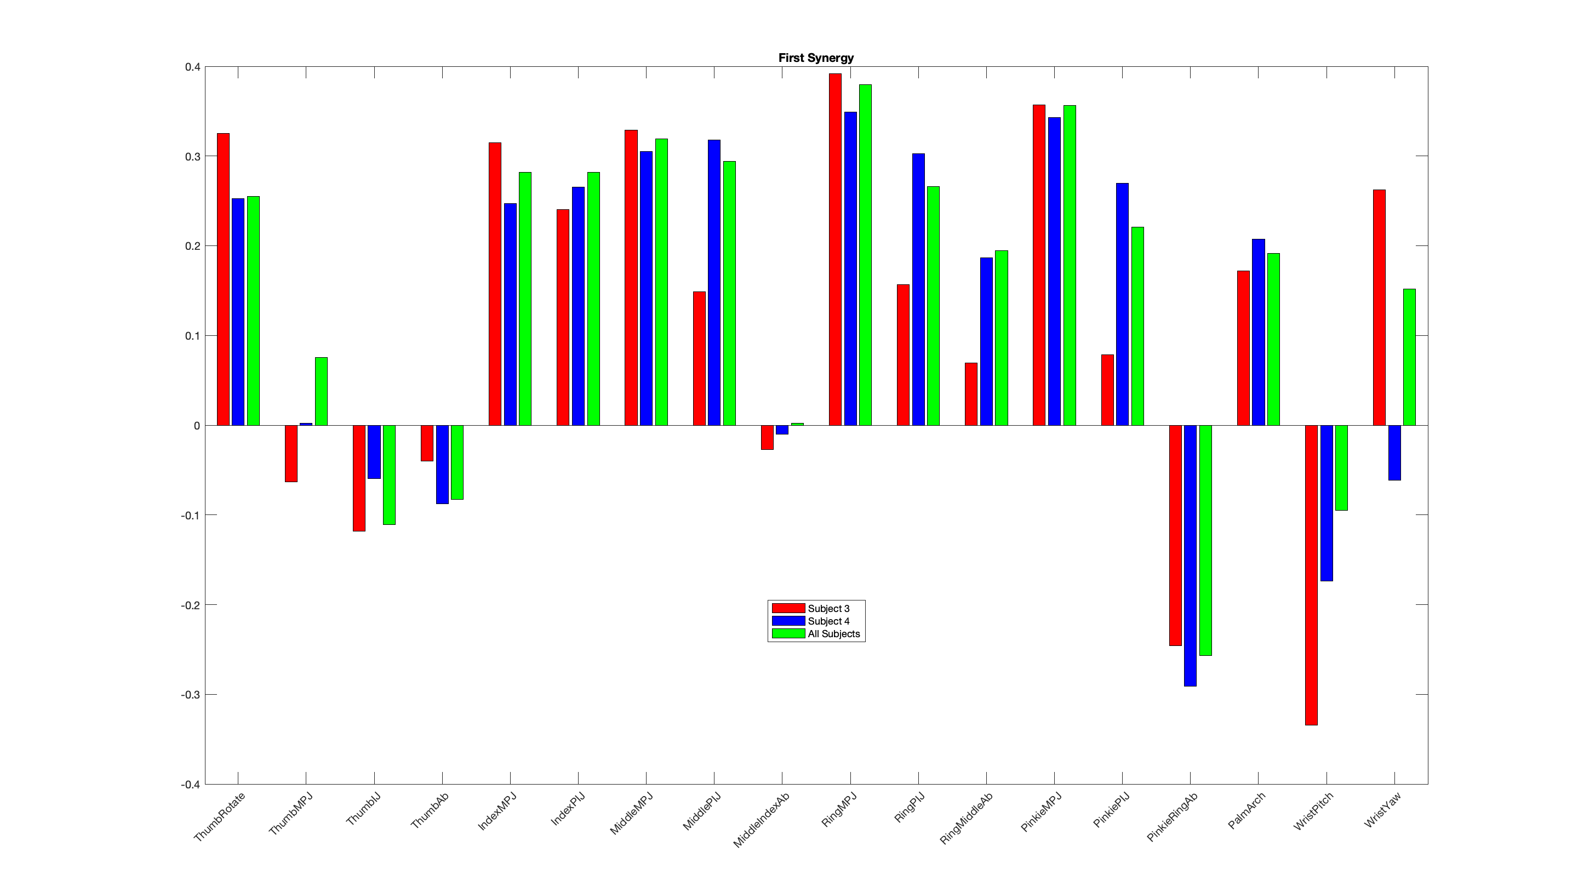
First Synergy

Slide 6
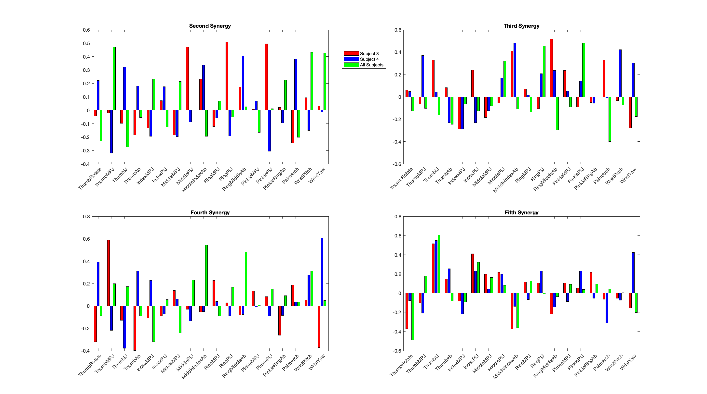
Second to Fifth Synergies

Slide 7
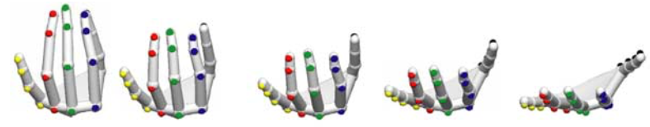
Next steps
Hierarchical clustering.
Calculate dynamic synergies (how synergies evolve during time).
Synergies representations.
Items to comment
Vicon Nexus.
Mendeley.

