Slide 1
Joint 2
…
Trial
Joint 1
Joint 3
Joint m
Timepoint 1
Timepoint 2
Timepoint 3
Timepoint 4
…
Timepoint n

Slide 2
Joint 2
…
Trial
Joint 1
Joint 3
Joint m
Timepoint 1
EP
Timepoint 2
Timepoint 3
EP 1
Timepoint 4
…
EP 2
EP 3
Timepoint n

Slide 3
Joint 2
…
EP
Joint 1
Joint 3
Joint m
Timepoint 1
Timepoint 2
Timepoint 3
Timepoint 4
…
Timepoint n

Slide 4
Joint 2
…
EP
Joint 1
Joint 3
Joint m
Timepoint 1
Bins
Timepoint 2
Bin 1
Timepoint 3
Timepoint 4
…
Bin 2
Bin 3
Bin 4
Bin 5
Timepoint n

Slide 5
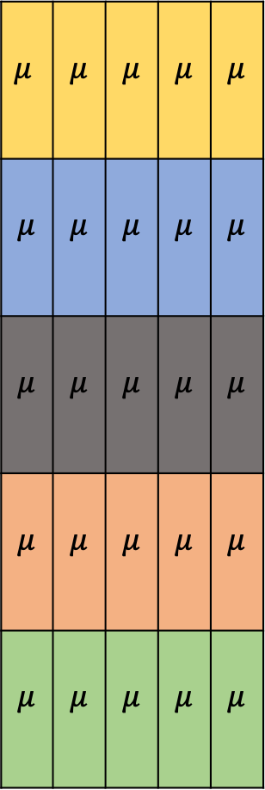
Joint 2
…
EP
Joint 1
Joint 3
Joint m
Timepoint 1
$$μ$$ | $$μ$$ | $$μ$$ | $$μ$$ | $$μ$$
$$μ$$ | $$μ$$ | $$μ$$ | $$μ$$ | $$μ$$
$$μ$$ | $$μ$$ | $$μ$$ | $$μ$$ | $$μ$$
$$μ$$ | $$μ$$ | $$μ$$ | $$μ$$ | $$μ$$
$$μ$$ | $$μ$$ | $$μ$$ | $$μ$$ | $$μ$$
Bins
Timepoint 2
Bin 1
Timepoint 3
Timepoint 4
…
Bin 2
Bin 3
Bin 4
Bin 5
Timepoint n

Slide 6
EP
Bins
Bin 1
Bin 2
Bin 3
Bin 4
Bin 5
EP 1
EP 2
EP 3
Joint 1
Joint 2
Joint 1
Joint 2
Each input to the classifier has a size of [number of bins X number of joints]

Slide 7
Logistic Regression
Elastic Net Regularization (avoids overfitting)

Slide 8
Logistic Regression
Elastic Net Regularization (avoids overfitting)
Multinomial (predicts probability for each class)

Slide 9




Logistic Regression
Elastic Net Regularization (avoids overfitting)
Multinomial (predicts probability for each class)
p(Class) = $\frac{1}{1+e^{−(β_{0}+β_{1}x_{1}+β_{2}x_{2}+…+β_{n}x_{n})}}$
$β_{0}$ = Intercept
$x_{1…n}$ = Variables
$β_{1…n}$ = Coefficients

Slide 10
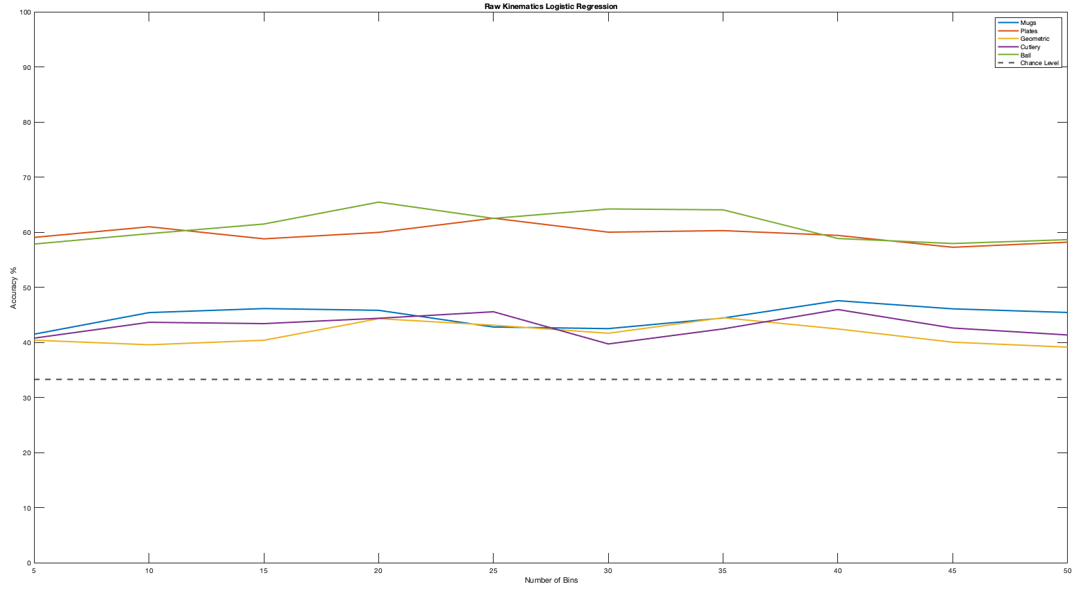
Raw Kinematics

Slide 11
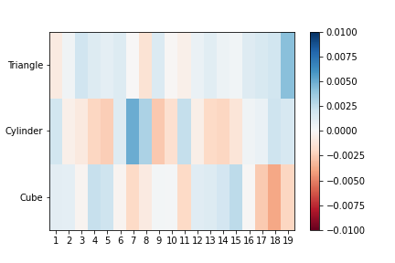
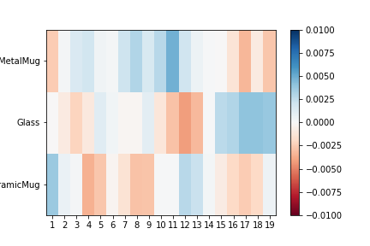
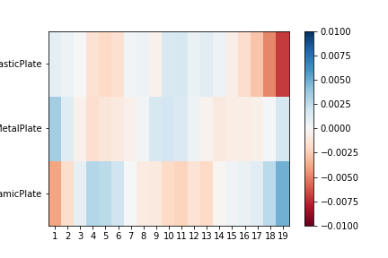
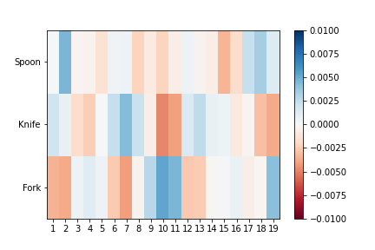
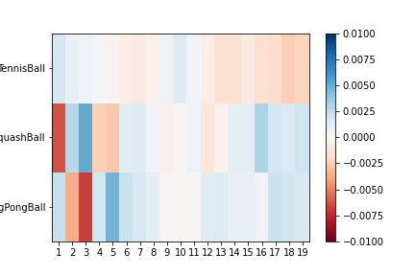
Raw Kinematics

Slide 12
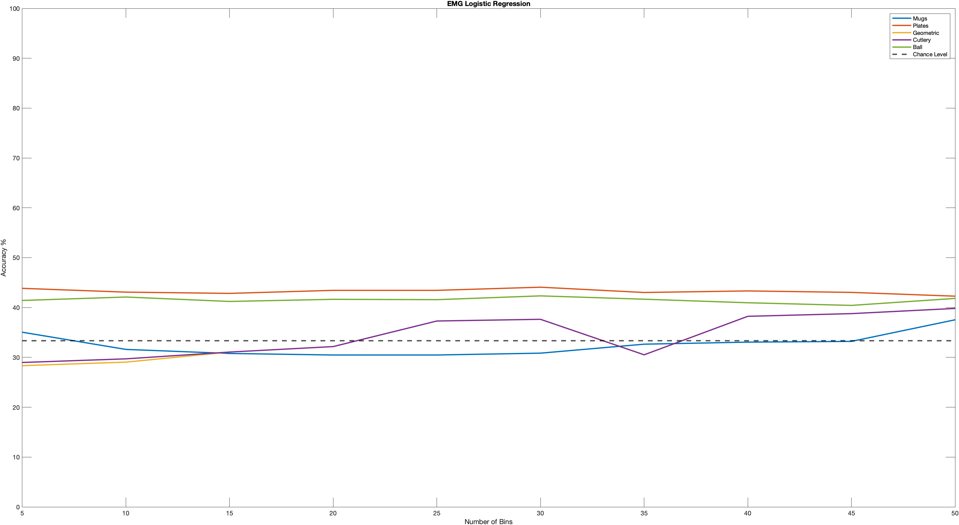
EMG

Slide 13
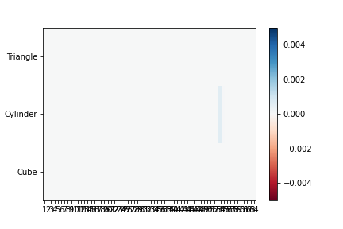
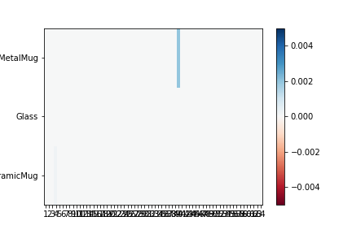
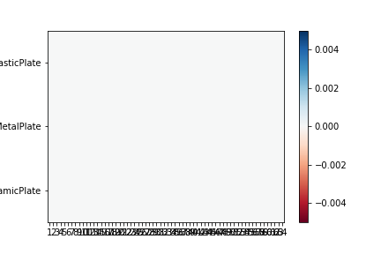
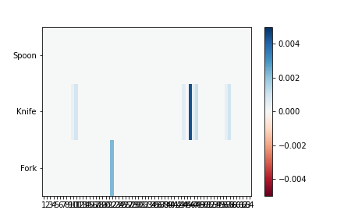
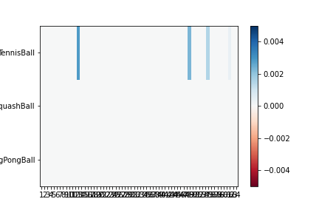
EMG

Slide 14
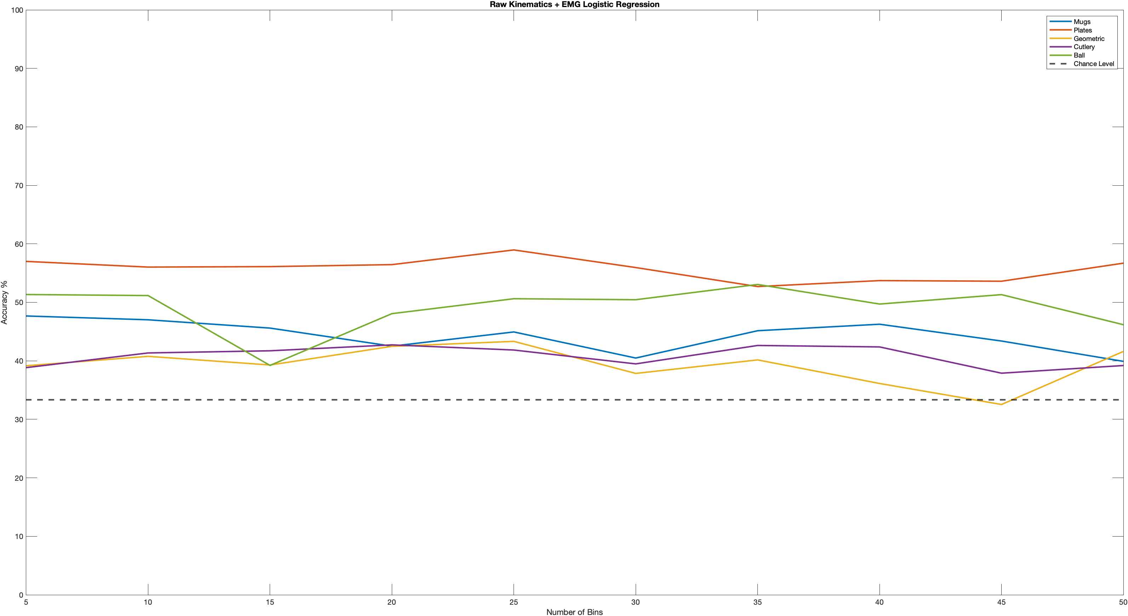
Raw Kinematics + EMG

Slide 15
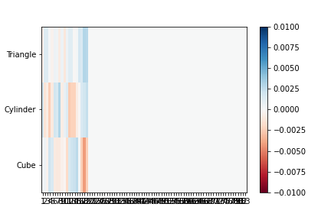
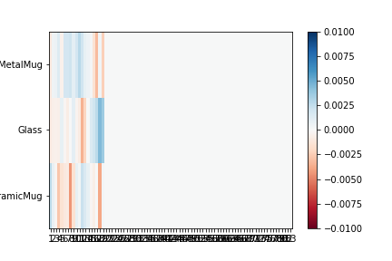
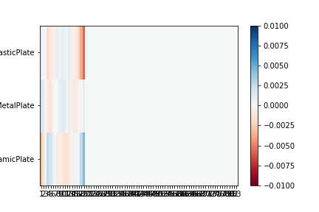
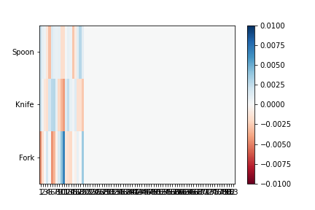
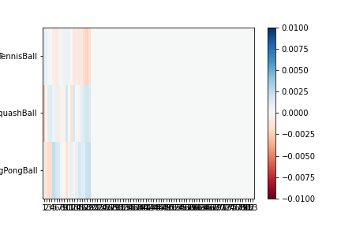
Raw Kinematics + EMG

Slide 16
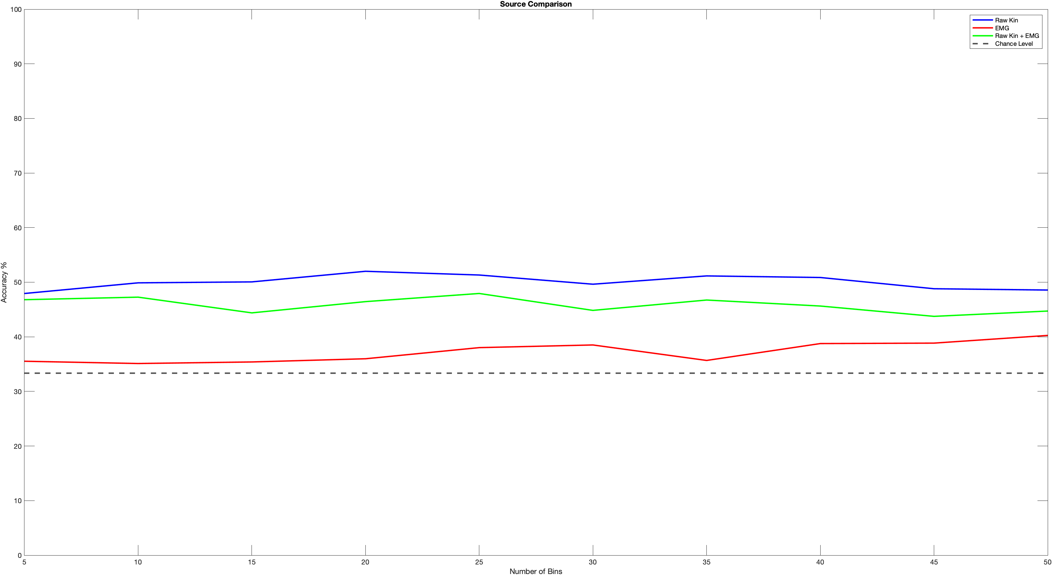
Comparison

Slide 17
Next Steps
Extract synergies from EMG
Study correlation with kinematic synergies
Build classifier with muscular and kinematic synergies
Build classifier with tactile data
Time evolution of model coefficients

