Slide 1
Family | Ep presence/absence | Ep duration
Ball | 39.39 % | 53.54 %
Cutlery | 54.55 % | 43.43 %
Geometric | 38.38 % | 34.34 %
Mugs | 50.05 % | 51.51 %
Plates | 58.59 % | 74.74 %
MEAN | 48.26 % | 51.51 %

Slide 2
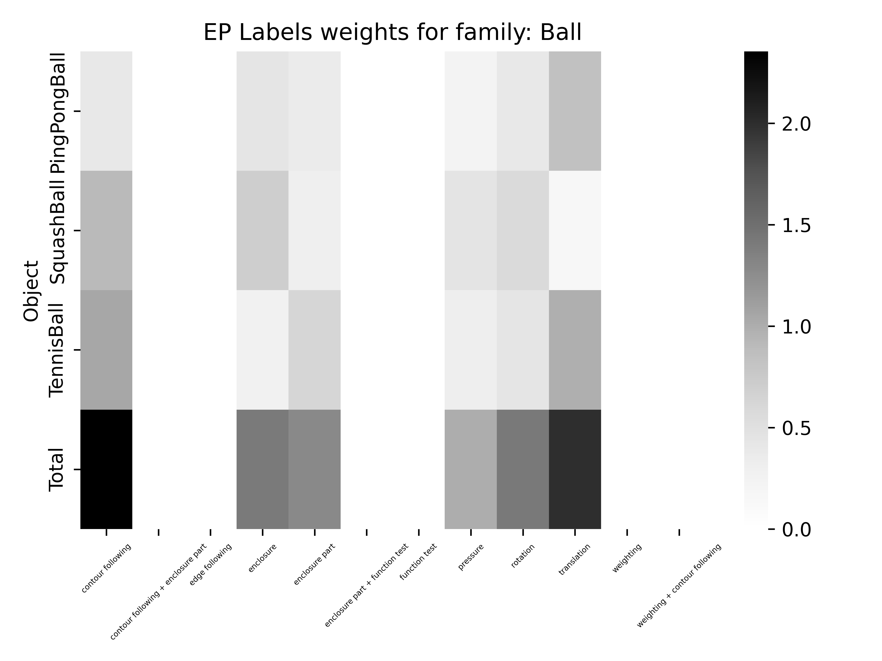
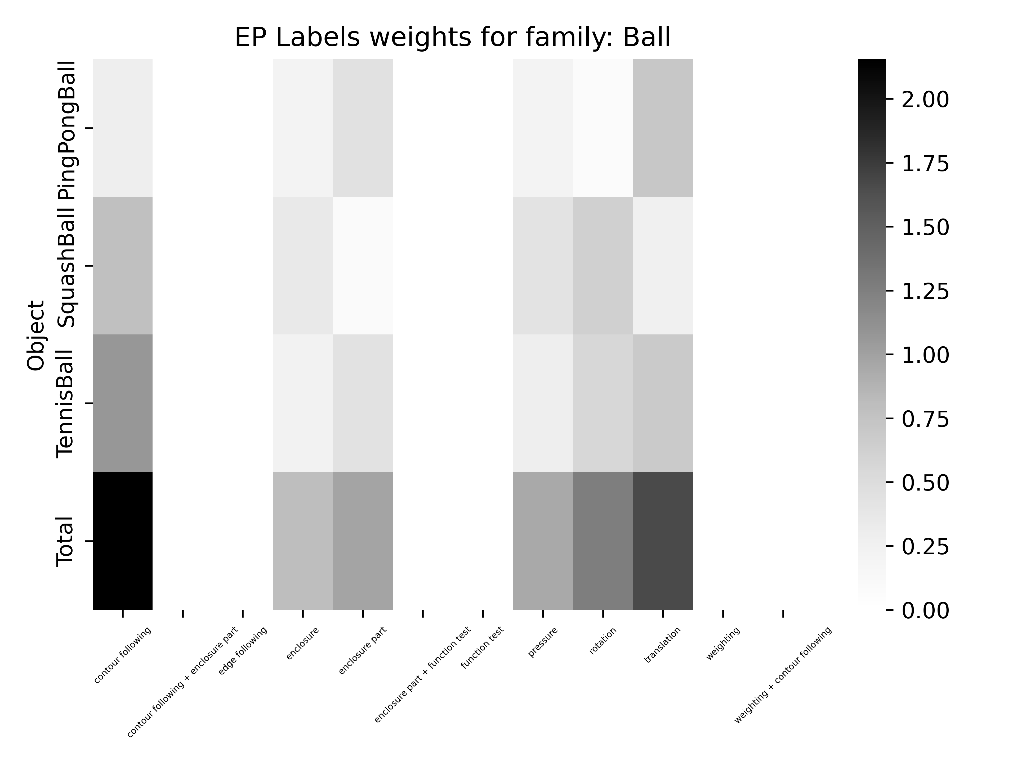
Acc: 39.39 %
Acc: 53.54 %

Slide 3
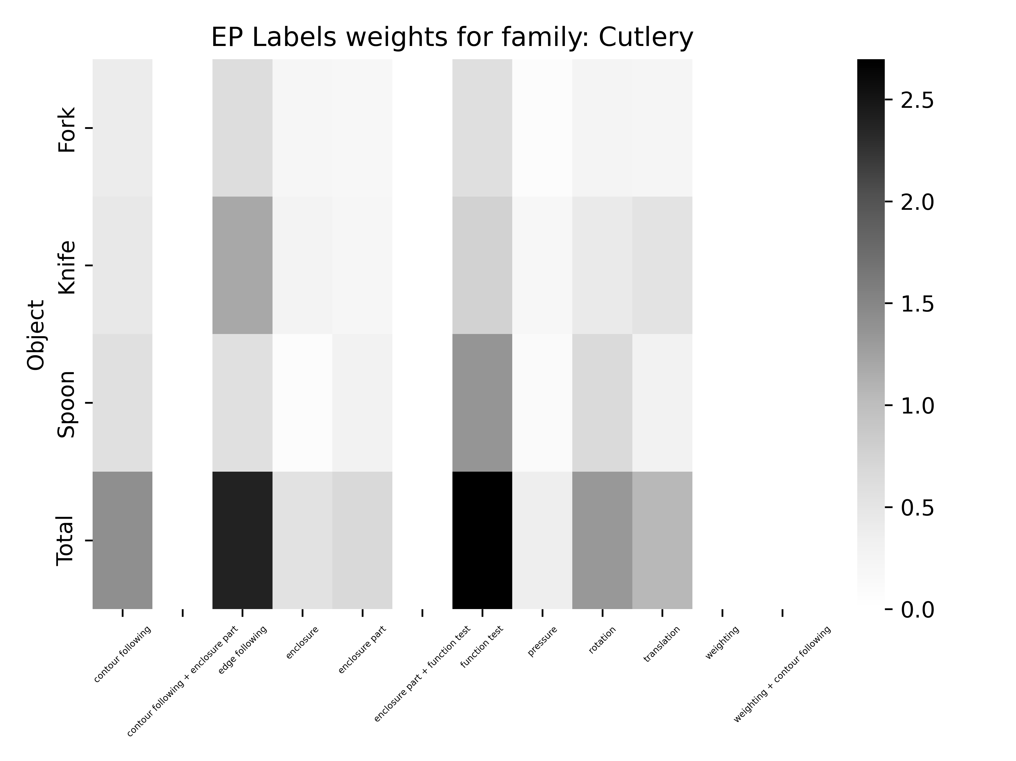
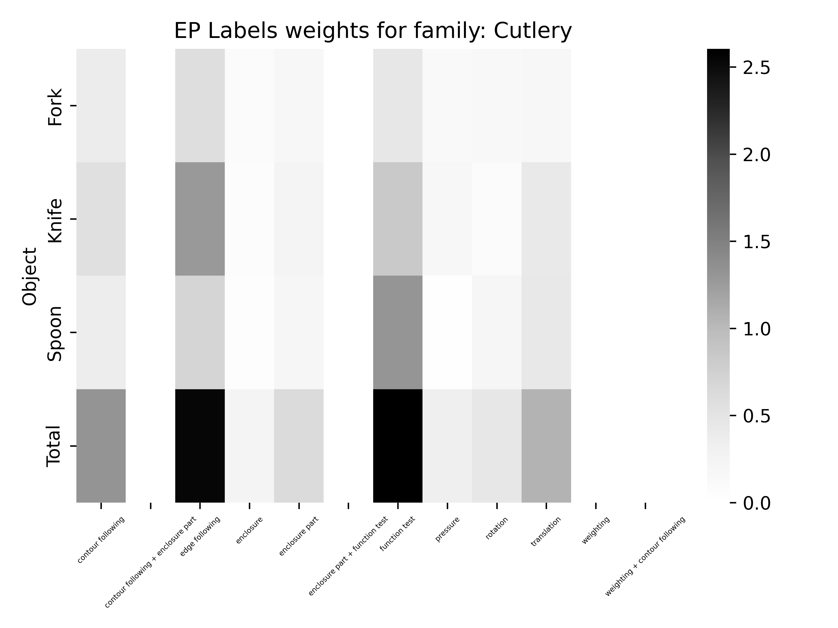
Acc: 54.55 %
Acc: 43.43 %

Slide 4
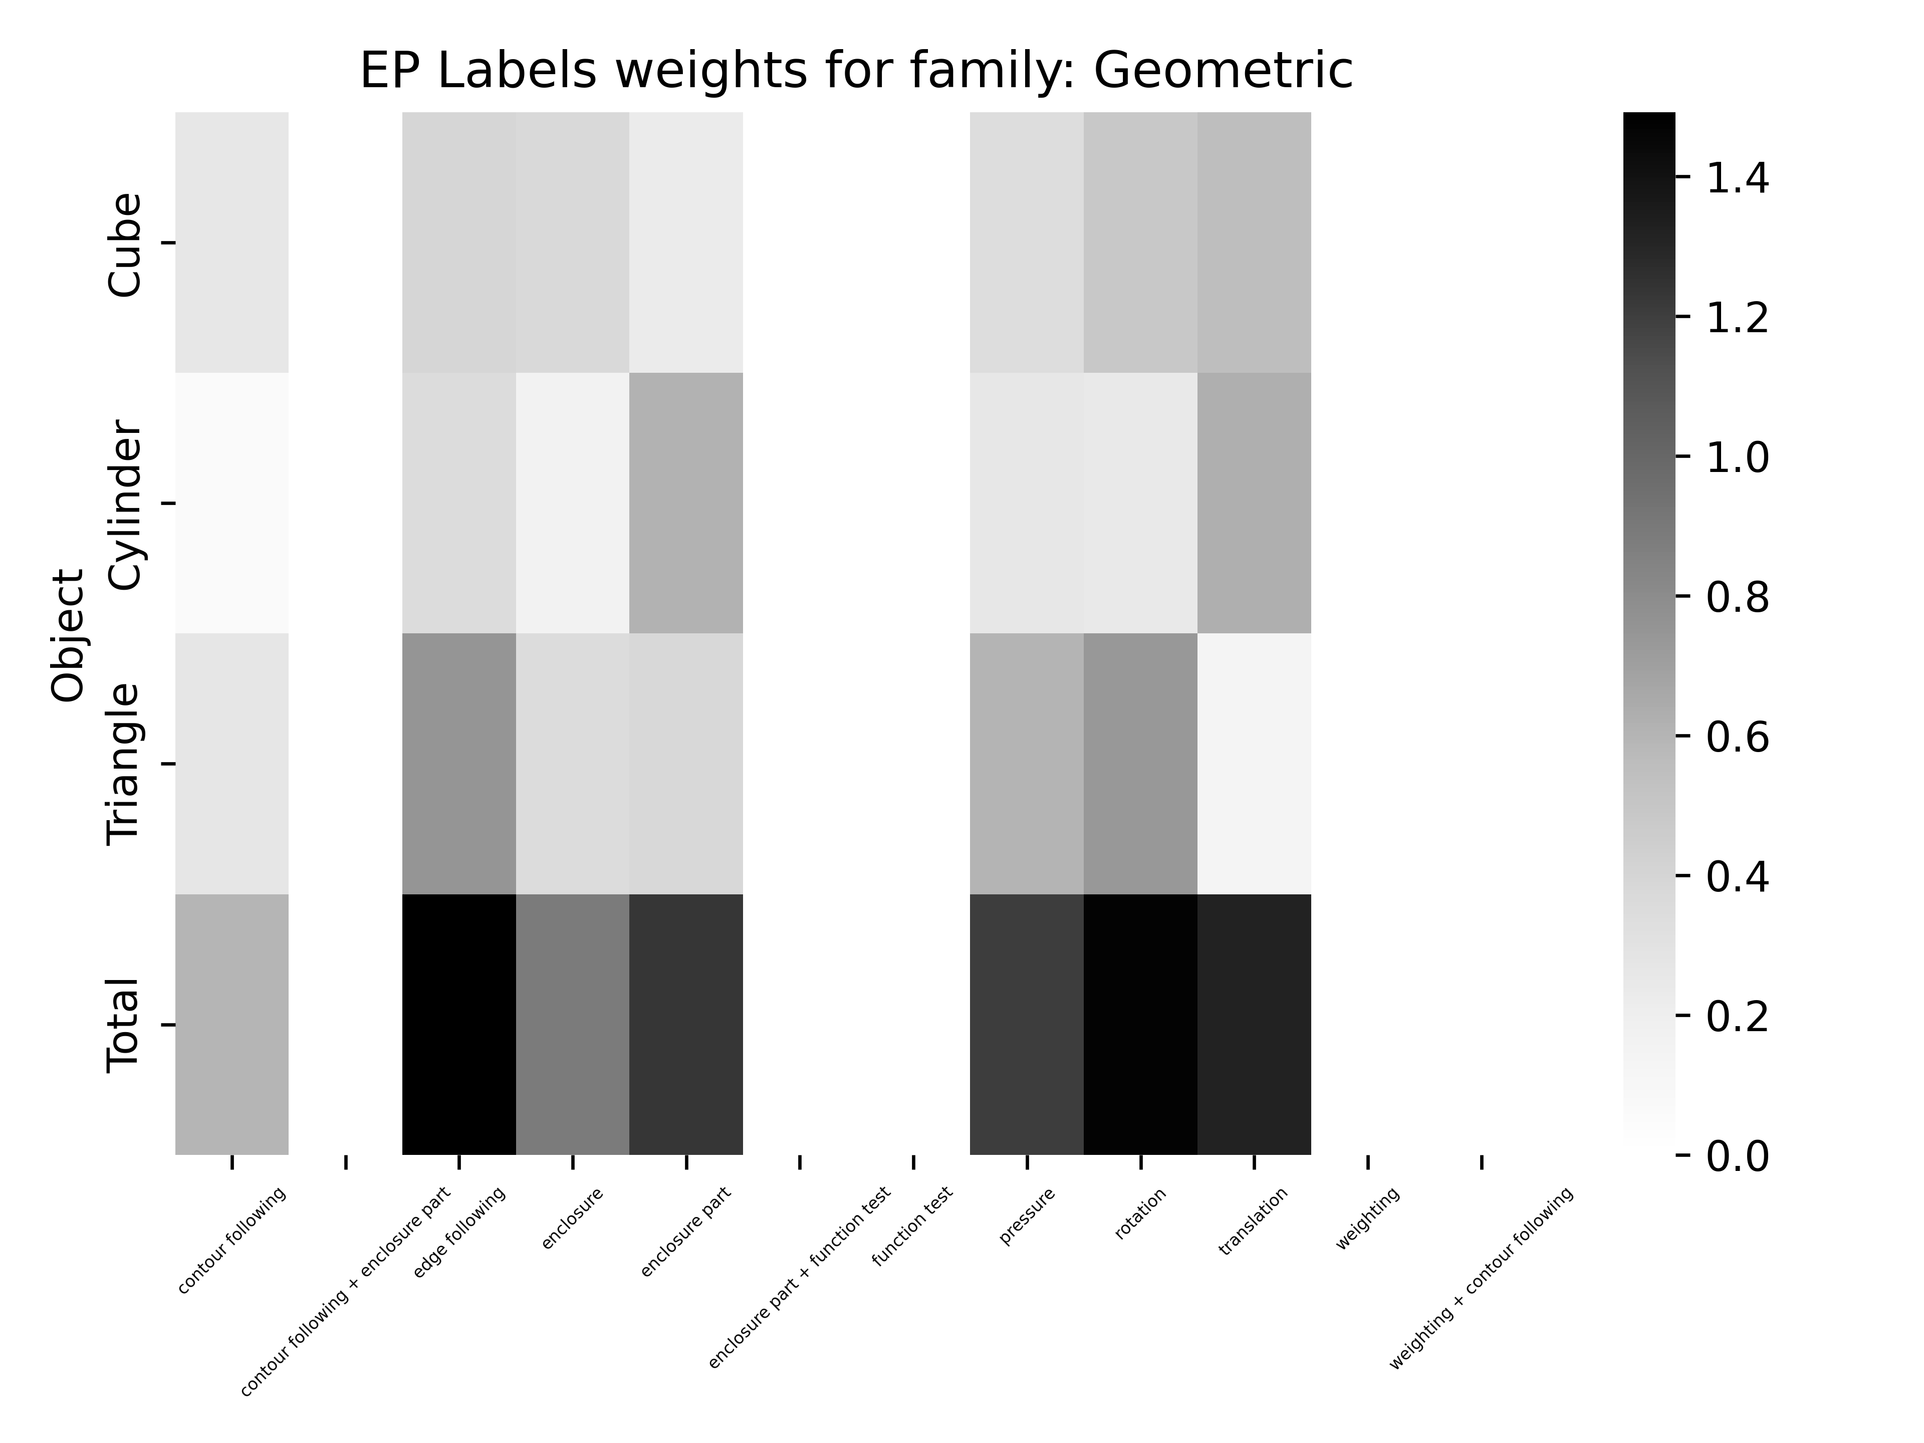
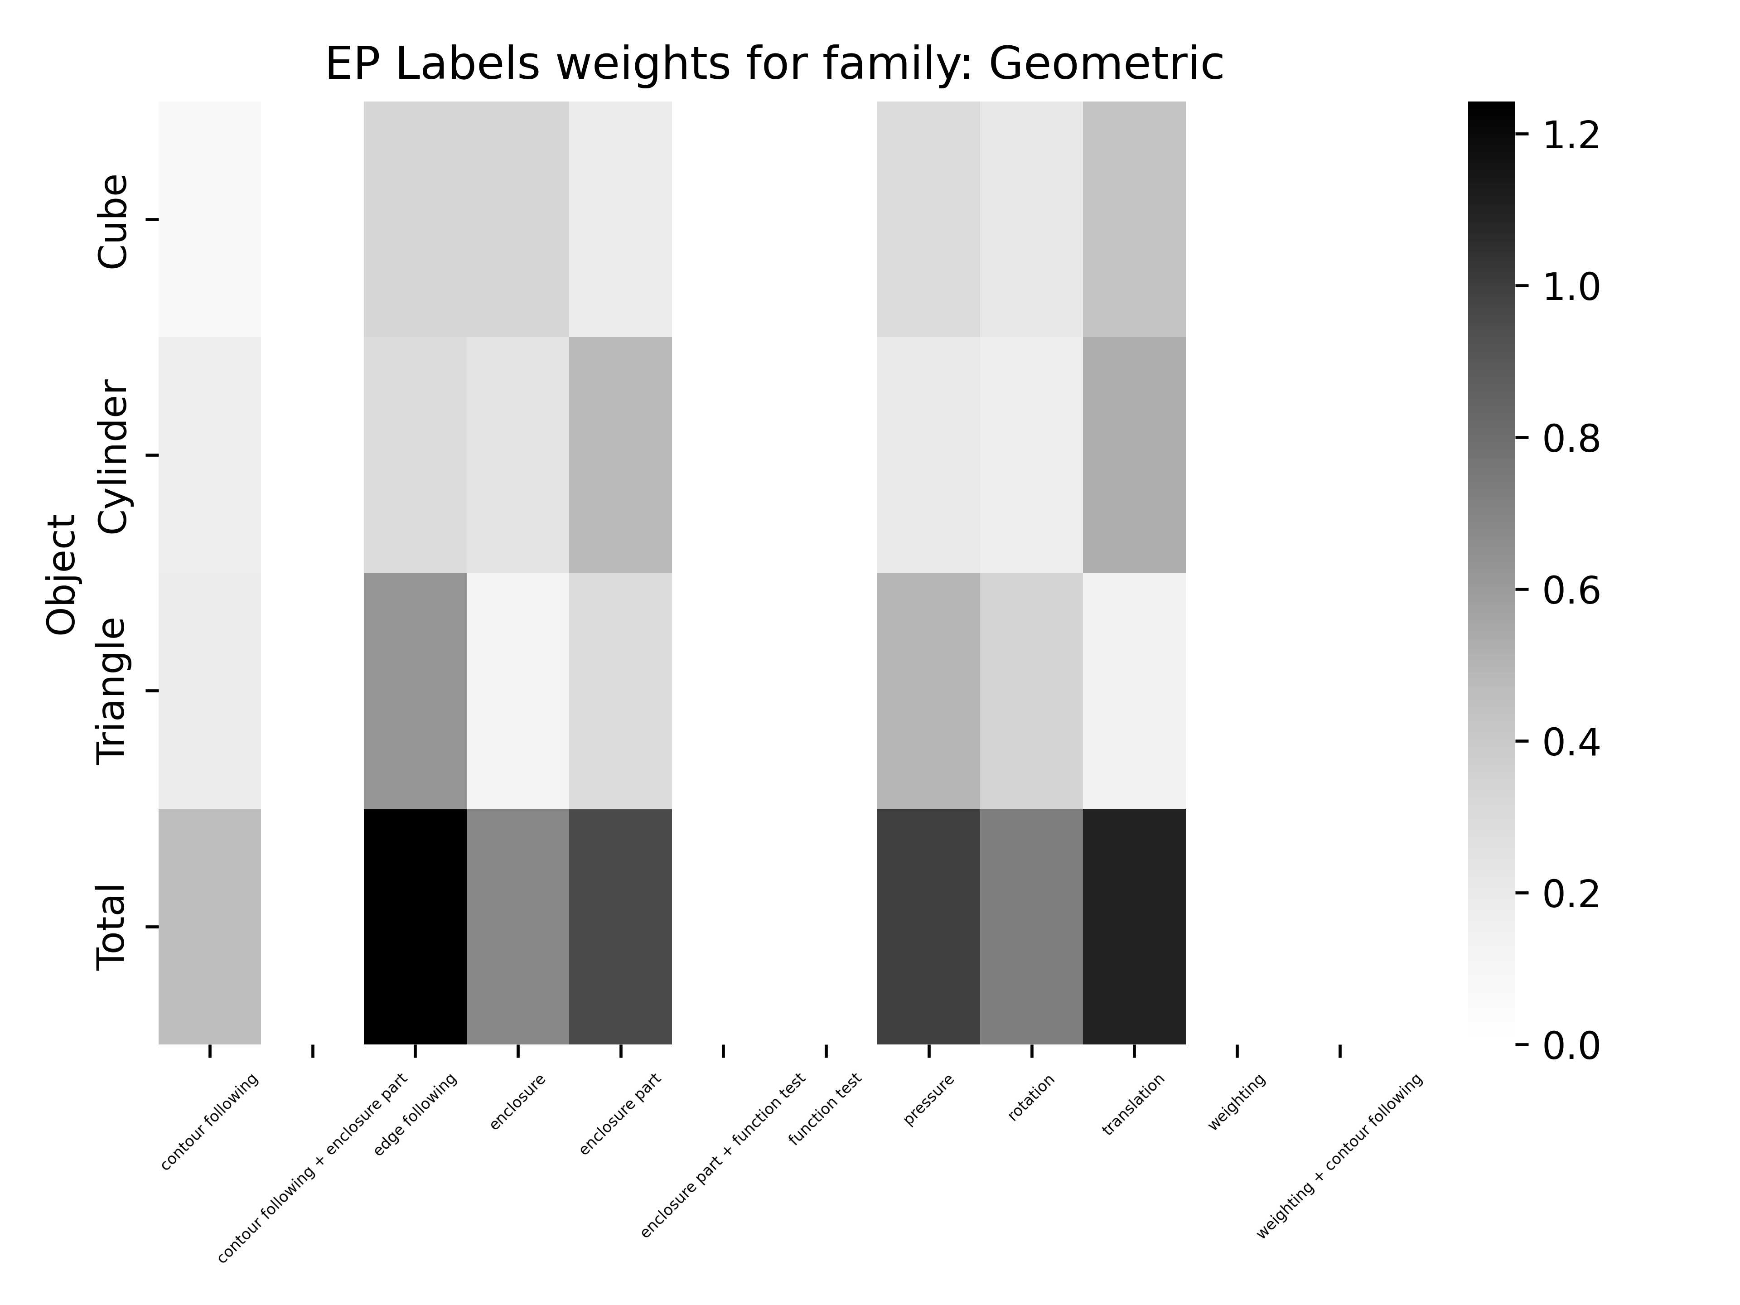
Acc: 38.38 %
Acc: 34.34 %

Slide 5
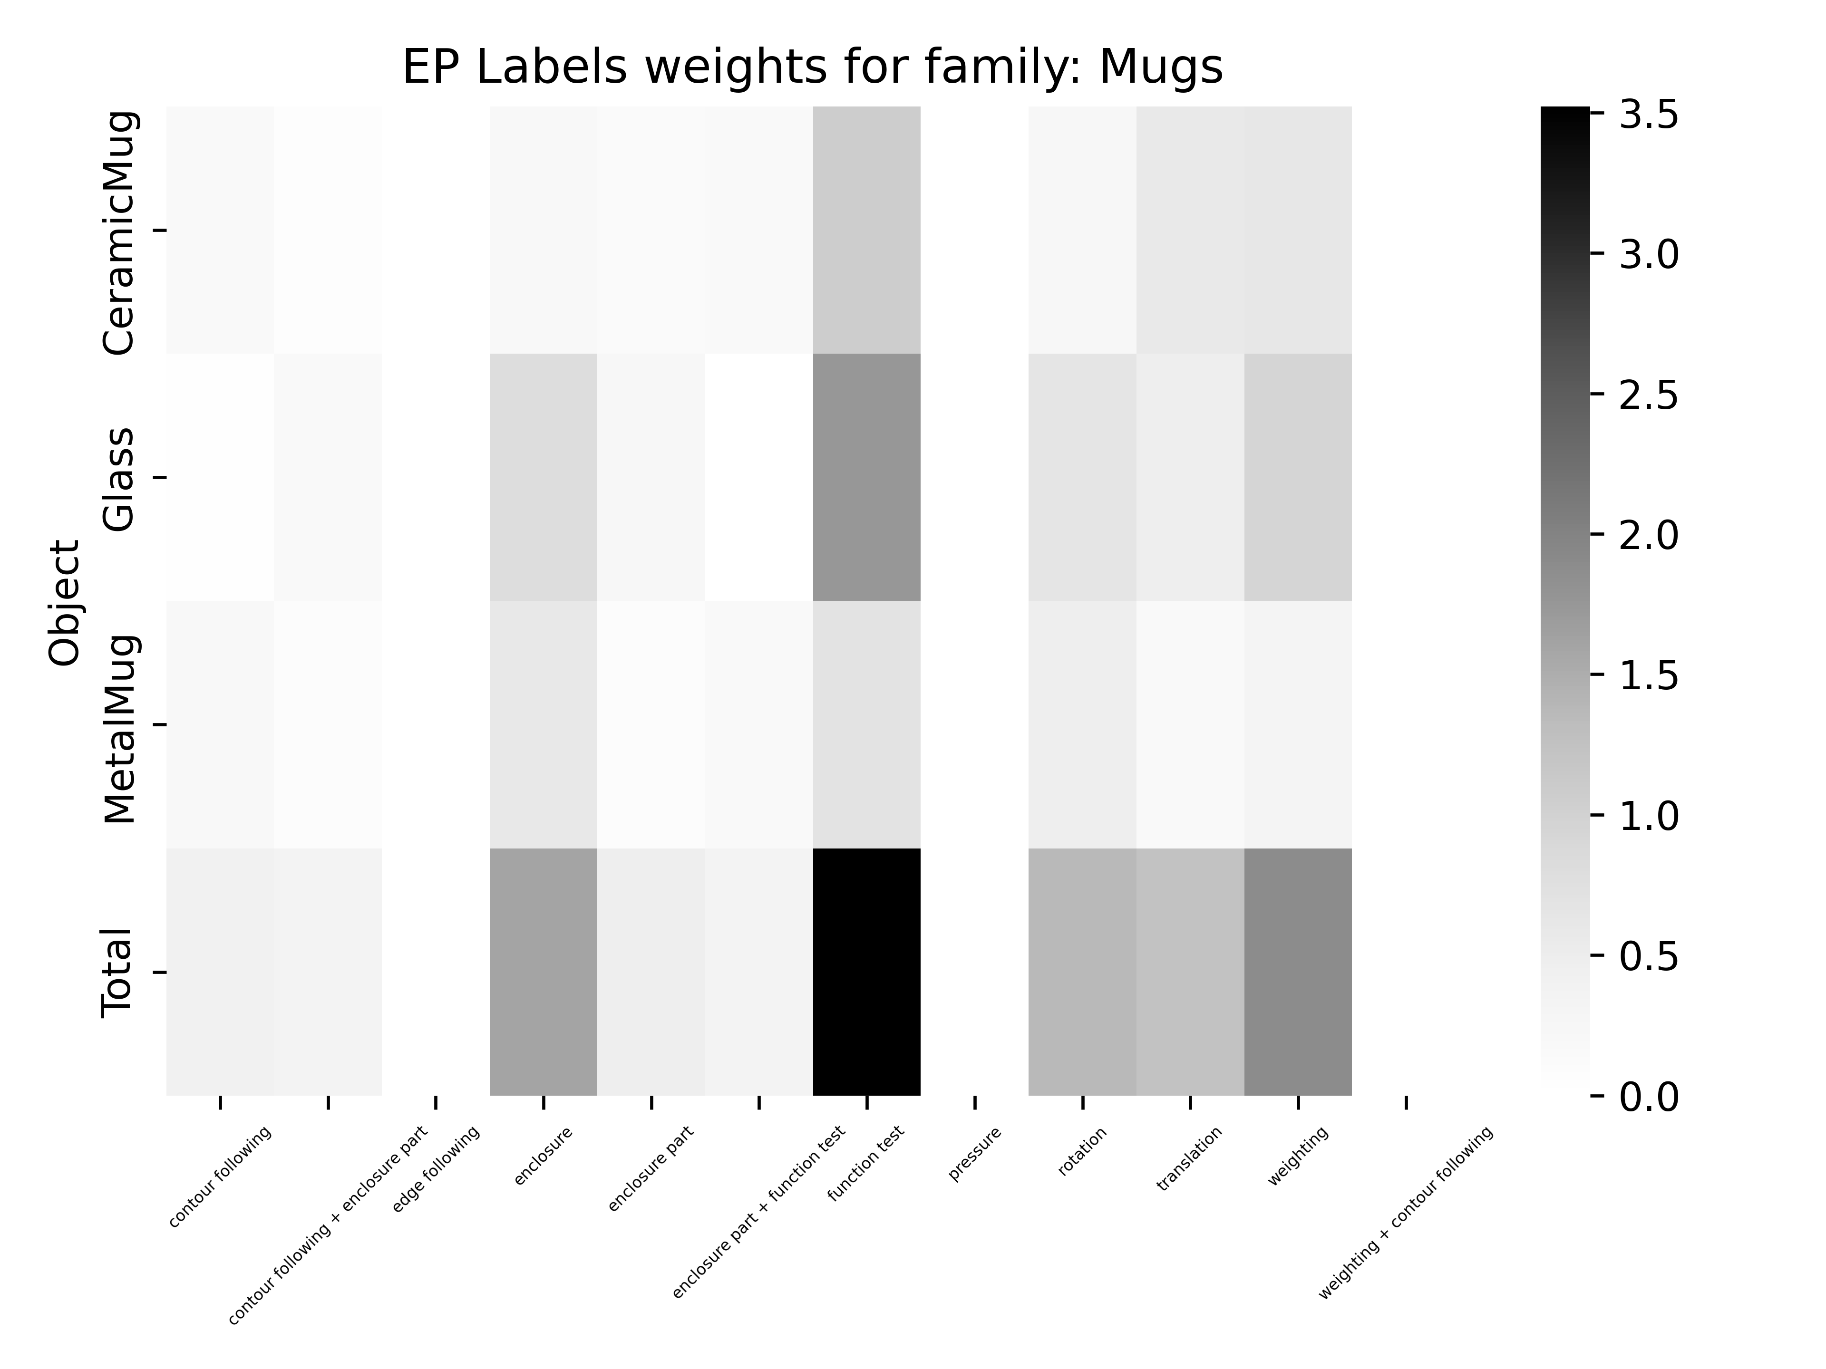
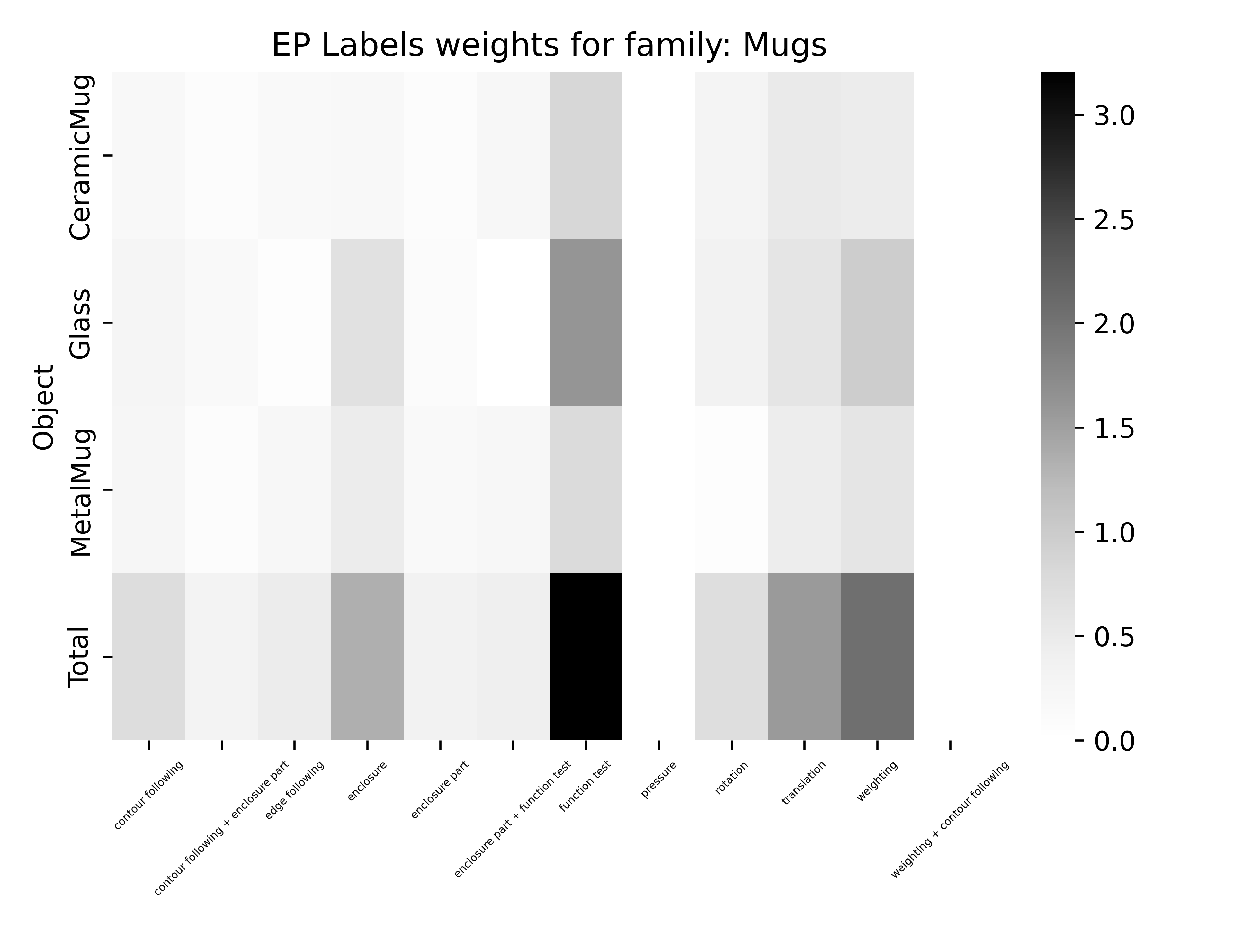
Acc: 50.5 %
Acc: 51.51 %

Slide 6
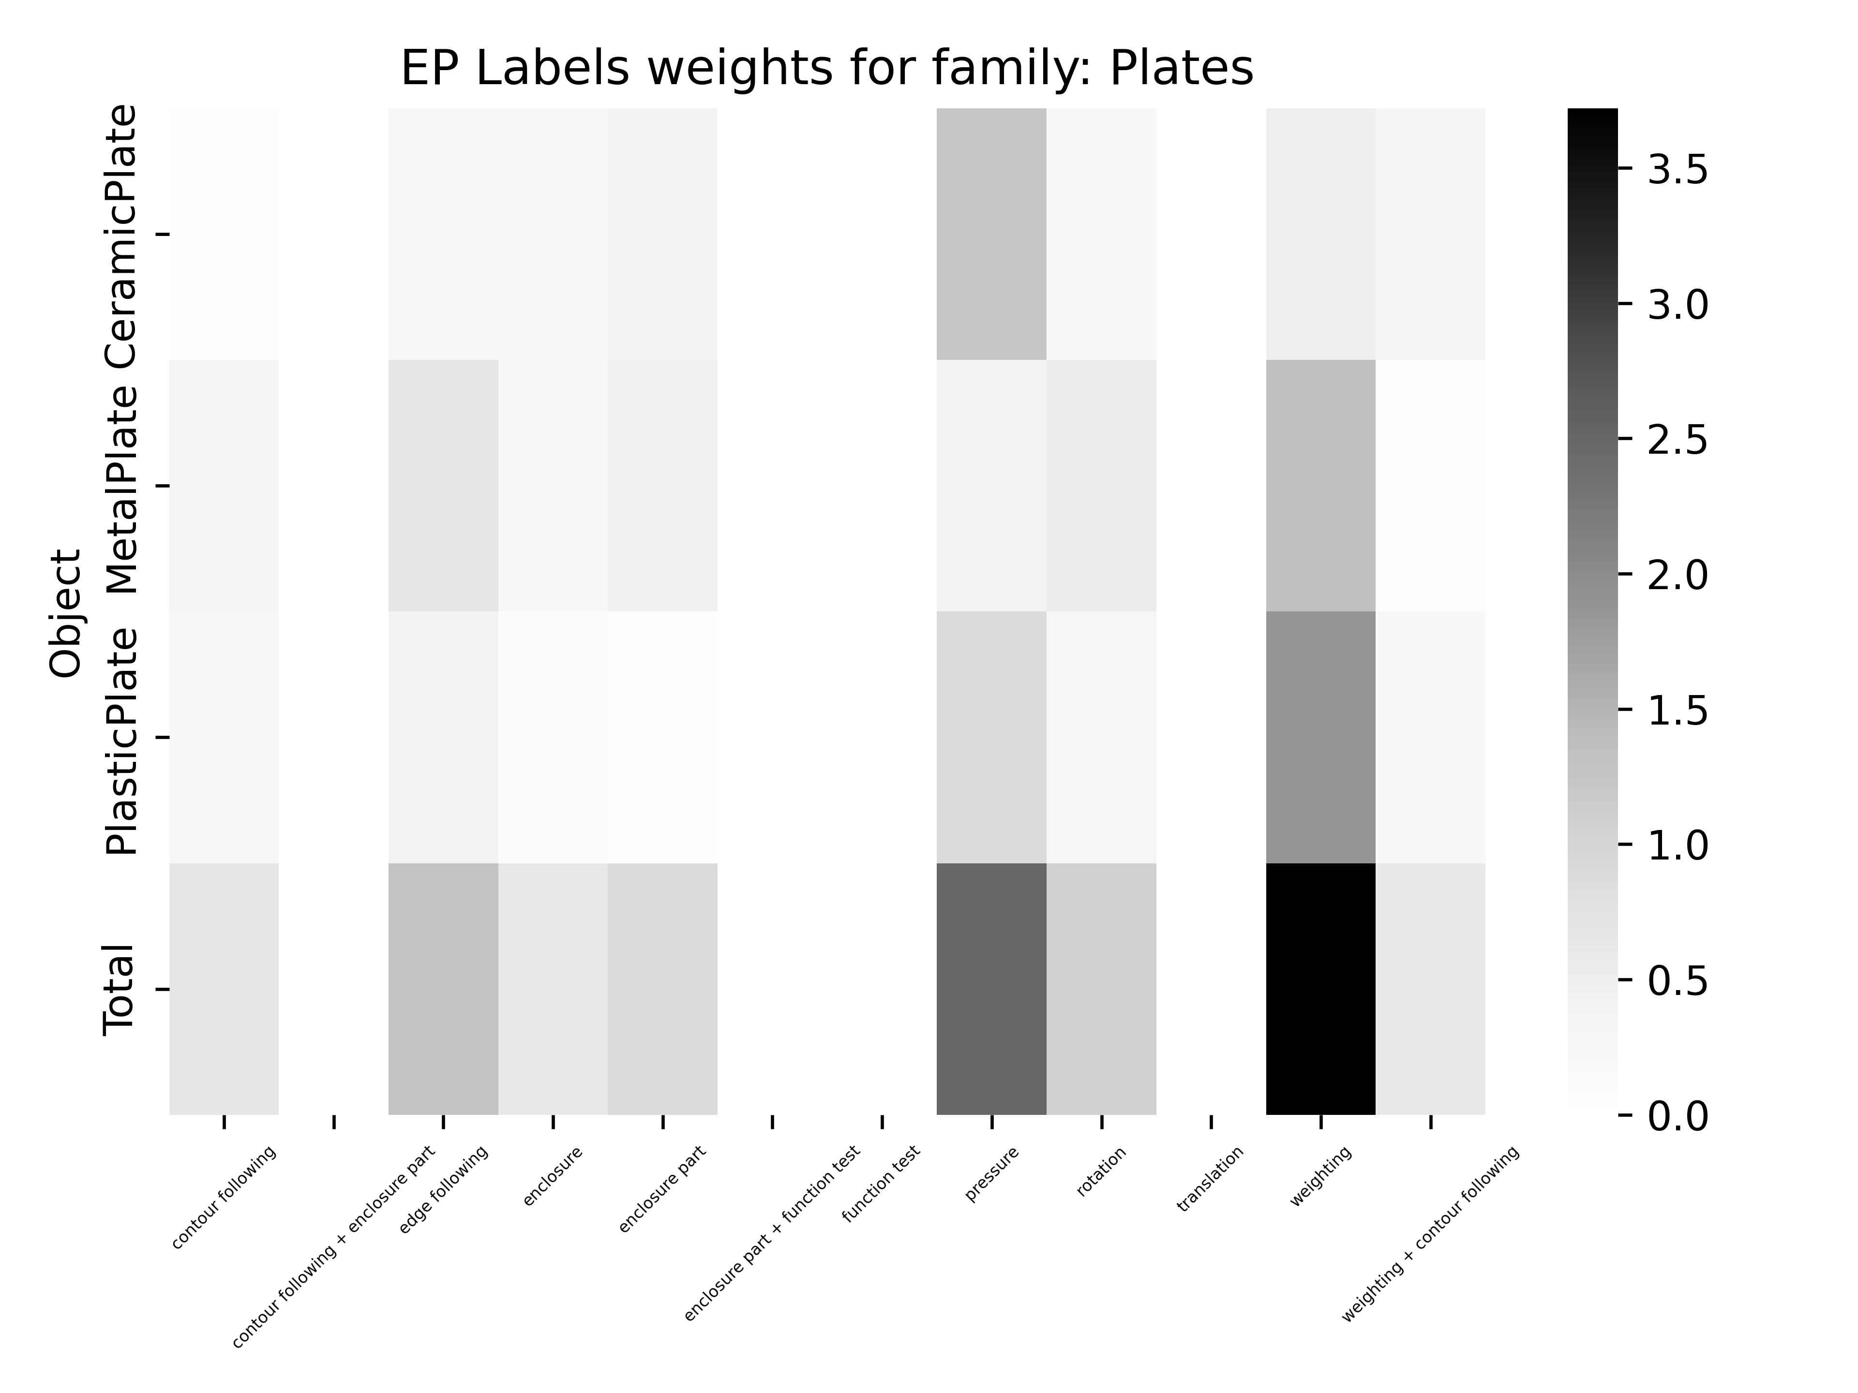
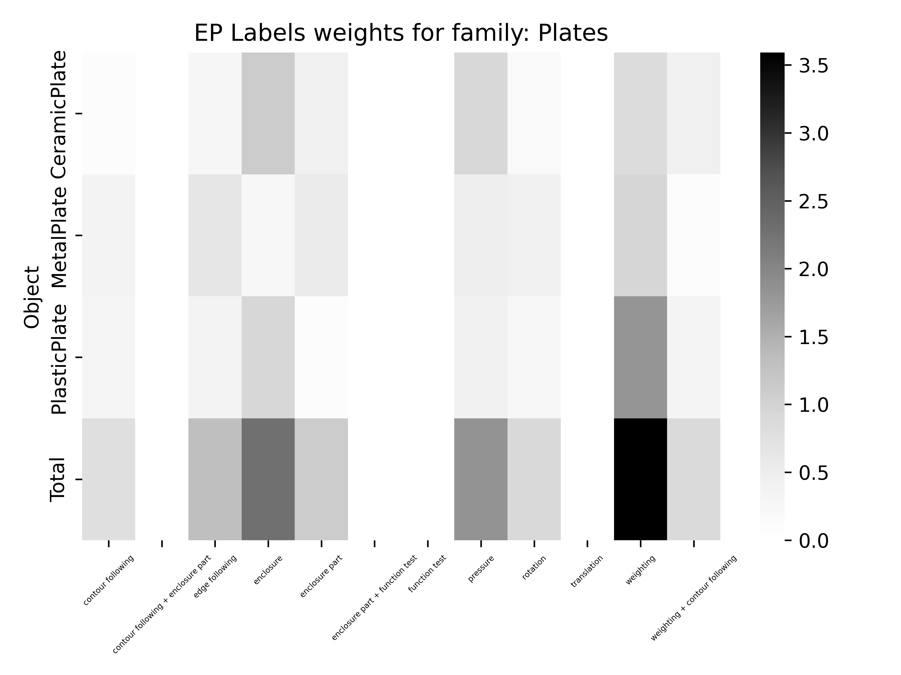
Acc: 58.59 %
Acc: 74.75 %

