Slide 1
Market Research Recommendations
March 23rd, 2023

Slide 2
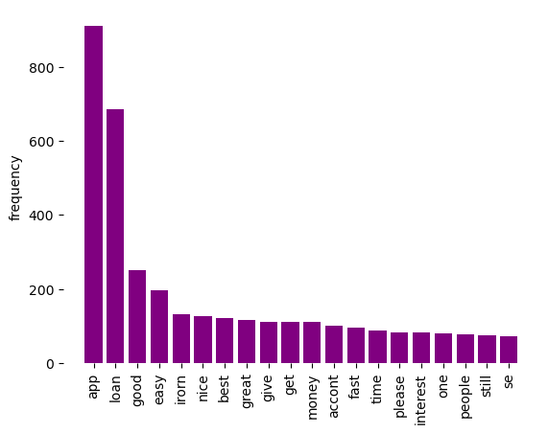
Irorun
key topics;
The chart shows that the frequent key topics discussed within the reviews are: “app", “loan”, “good”, “easy”, “best”, which reflect positive sentiments, indicating that customers find the app user-friendly, appreciate the ease of borrowing, and consider Irorun to be a top choice in the market.

Slide 3
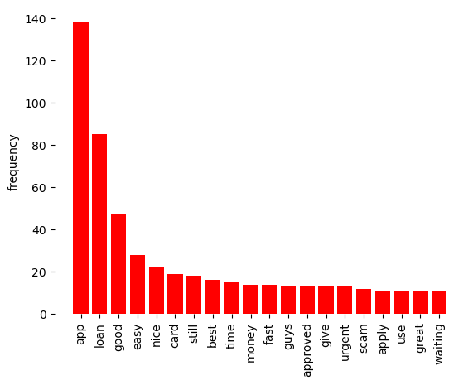
Urgent10K
Key topics;
The frequency chart shows some of the key topics discussed within the customers’ reviews are: “nice”, “great”, “best” and “scam”, which suggest that customers are expressing overall satisfaction with the lending app, but also have concerns about its trustworthiness.

Slide 4
Recommendations
Increase Transparency: As "scam" is in the top 20 frequent words, it suggests that some customers may feel that they are being deceived by the lending apps. Both Irorun and Urgent10k should ensure that all terms and conditions are clear and transparent, and that customers are aware of all fees and charges associated with their loans. In addition, assure the customers that their personal data and card details are secured.
Enhance Customer Service: customers value good customer service. Irorun and Urgent10k should prioritize responding promptly to customer inquiries and complaints and provide excellent service to improve customer satisfaction.
Improve the App: As "app" is the most frequent word, it indicates that most customers are interacting with the app frequently. To ensure customer satisfaction, Irorun and Urgent10k should prioritize improving the user interface, fixing bugs, and adding new features.

