Slide 1
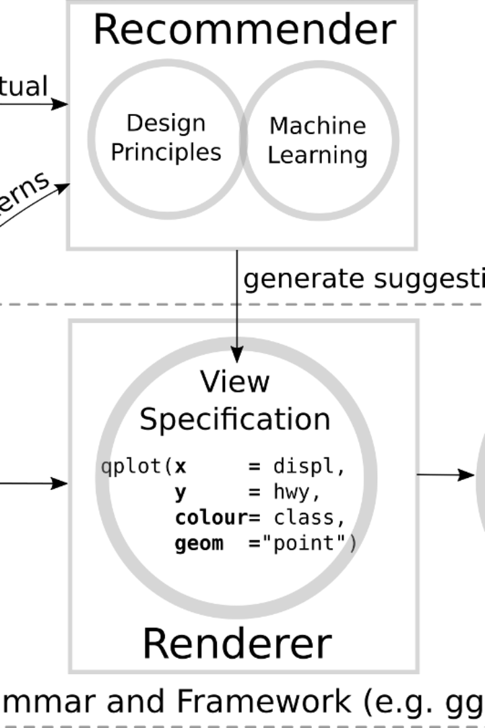
Introduction to Course Recommendation System
A course recommendation system provides personalized suggestions for online courses, leveraging user interests and interactions to enhance learning experiences and improve outcomes.
Presented By
Tanaya Patil
Jaydeep Shinde
Sagar Adling

Slide 2

Problem Statement
1
Lack of Personalization
2
Information Overload
3
Relevance
Users often face challenges in navigating through a vast array of course options, resulting in decision fatigue and reduced engagement.
Difficulty in finding courses that align with users' specific interests and learning objectives.
In traditional e-learning platforms, there is a lack of personalized course recommendations, leading to a generic learning experience for users.

Slide 3
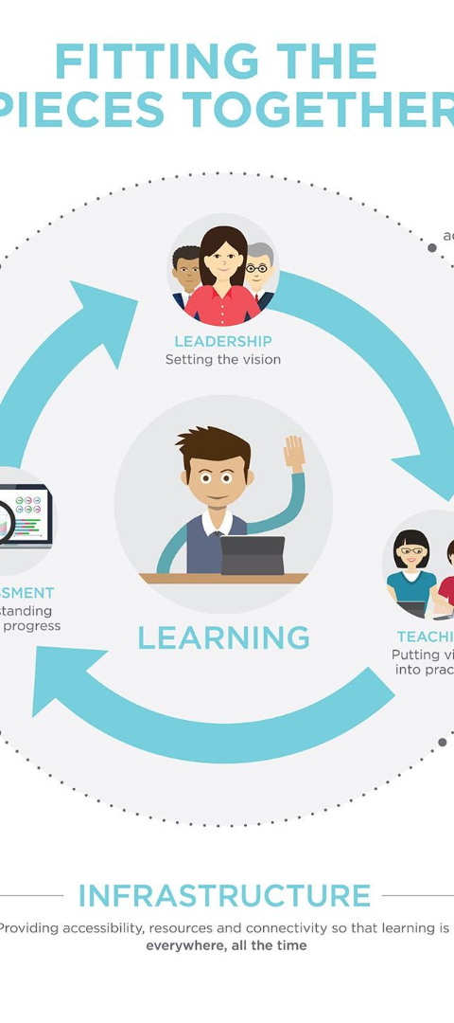
Importance of Personalized Course Recommendations
Enhanced Engagement
Improved Learning Outcomes
Personalized course recommendations can lead to higher engagement levels as users are more likely to find relevant and appealing content.
By tailoring courses to individual preferences, the learning process becomes more effective and yields better outcomes.
User Satisfaction
Providing a personalized learning journey enhances user satisfaction and encourages continued participation in the platform.

Slide 4
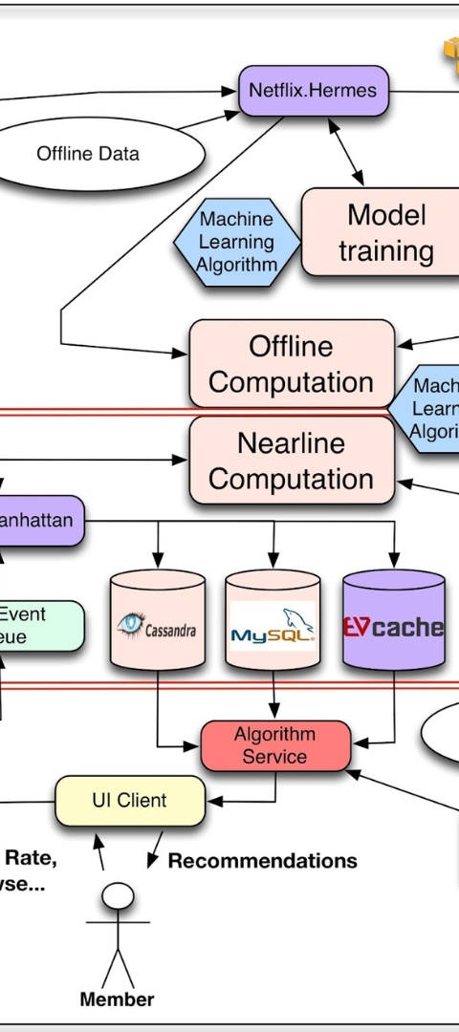



How Our System Works
Data Collection
Collecting user behavior and preferences to understand individual learning patterns.
Algorithm Processing
Utilizing machine learning algorithms to process and analyze user data to generate personalized recommendations.
User Interface
Presenting tailored course suggestions to users through a user-friendly interface for seamless navigation and selection.

Slide 5
Data Collection and Analysis
User Interactions
Learning Paths
Performance Metrics
Tracking user engagement, course completions, preferences, and feedback to gather relevant data.
Identifying common learning paths and sequences to offer cohesive and structured course recommendations.
Using performance metrics to analyze the effectiveness of recommended courses and user satisfaction levels.

Slide 6
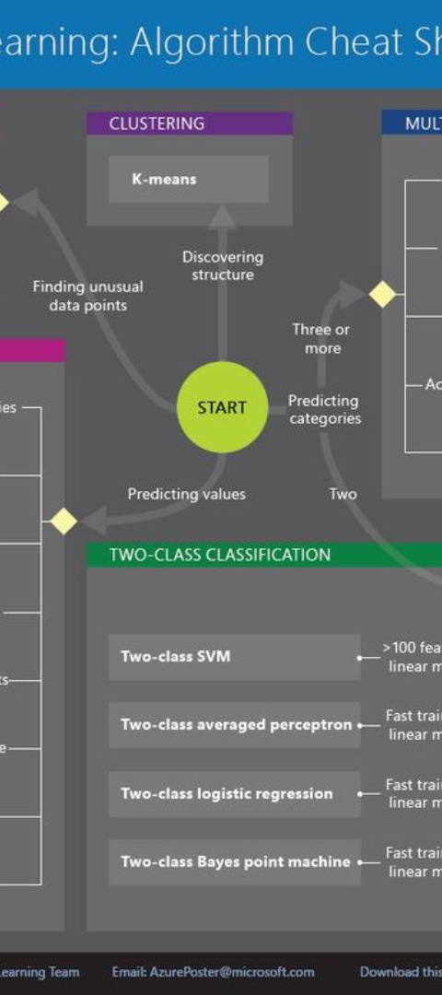
Machine Learning Algorithms Used
XGBoost: Gradient boosting algorithm for machine learning.
Sequential Improvement: Iteratively builds trees for progressively improved predictions.
Efficiency: Optimized for speed, supports parallel computing.
Versatile: Widely used for accuracy in competitions and diverse applications.

Slide 7
WEB Deployment
Deployed using Flask framework with app.py.
Model Handling:
  Machine learning model managed in model.py.
User Interface:
  Frontend in index.html for user interaction.
Styling:
  Visual presentation controlled by style.css.

Slide 8

User Interface and User Experience
Intuitive Design
Creating a user-friendly interface that allows for easy navigation and course selection, enhancing the overall user experience.

Slide 9
Benefits of Using Our Course Recommendation System
1
Personalized Learning Journey
Users can embark on a personalized learning journey tailored to their individual needs and interests.
2
Higher Engagement
Increased engagement levels due to relevant course suggestions and improved user satisfaction.
3
Learning Efficiency
Enhanced learning efficiency and better outcomes resulting from personalized learning paths.

Slide 10
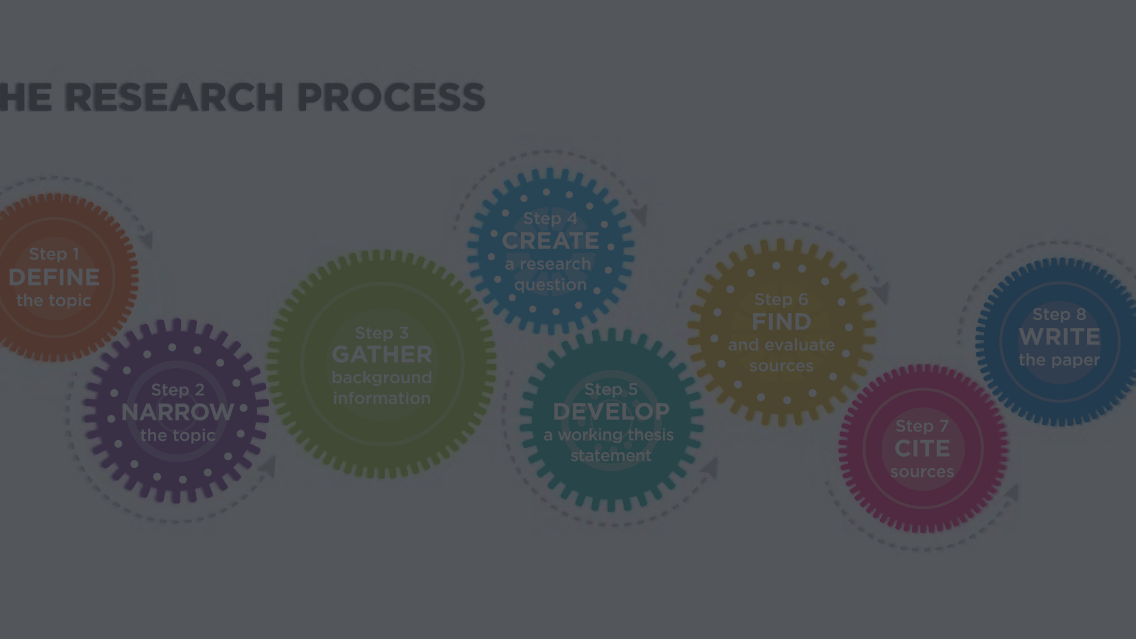
Conclusion and Next Steps
Future Development
User Feedback Integration
Expansion and Adaptation
Continual enhancement of the recommendation system through iterative updates and feature additions.
Further integration of user feedback to refine the recommendation algorithms and improve user experience.
Adapting the system to accommodate new learning trends, technologies, and user preferences for continued relevance and effectiveness.

