Slide 1

Interfacing LCD and Keypad
Jayshil Patel(18EC068)

Slide 2
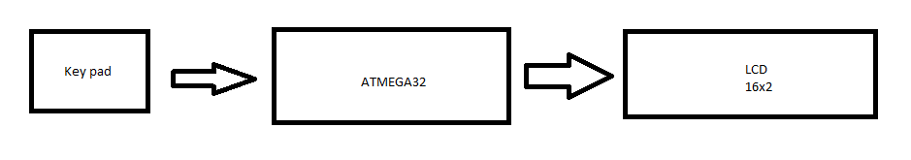
Block Diagram

Slide 3
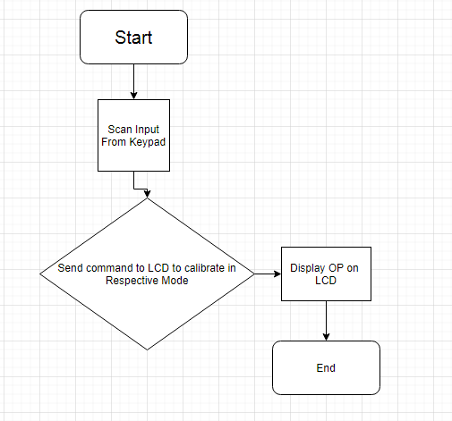
FlowChart

Slide 4
How to read character from Keypad?

Slide 5
Since Keypad is have 16 keys 8 pins
Read which column is selected
Then read in that particular column which row is pressed
By using the matrix we can decode that which button was pressed
Hence the keypad keys are multiplexed

Slide 6
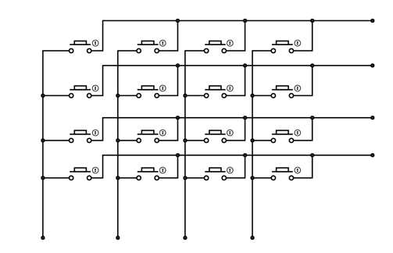
Internal connection of Keypad

Slide 7
How to display a character on LCD

Slide 8
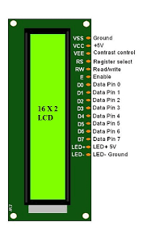
Pins on LCD

Slide 9
Selecting a particular Register we can either send a command or data which is to be displayed on LCD
When data register is selected
We can send data which is to be displayed on LCD
We can send character in their ASCII value
We can send the 8-bit ASCII value in either 8-Bit mode or 4-Bit mode
Using 4 bit form is preferred because it occupies less GPIO pins of controller
When command register is selected
We can send commands like to clear the lcd screen
To set the cursor
To set position of cursor
To increment the cursors position
And there are many more other commands

Slide 10
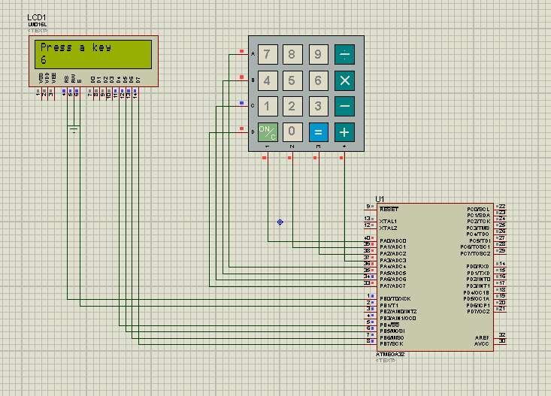
Proteus Simulation

Slide 11
References
https://www.electronicwings.com/avr-atmega/4x4-keypad-interfacing-with-atmega1632
https://circuitdigest.com/microcontroller-projects/keypad-interfacing-with-avr-atmega32
https://www.youtube.com/watch?v=6FjrKXmquxU&ab_channel=BuildYourCNC

