Slide 1
Revitalizing Kalamang: Language Expansion through Large Language Models
Aaditya Bhargav aaditya23006@iiitd.ac.in
Vishal Singh vishal21575@iiitd.ac.in
Mohit mohit21542@iiitd.ac.in
Shah Jayshil Ketankumar jayshil23138@iiitd.ac.in
Vani Mittal vani23102@iiitd.ac.in

Slide 2
Outline
Introduction
Problem Statement
Literature Review
Dataset Overview
Methodologies
Results and Analysis
Novelty
Conclusion
Future Scope

Slide 3
Introduction
Preservation of Endangered Languages:
Importance of linguistic diversity
Risks of language extinction
About Kalamang:
Spoken by fewer than 200 people
Located on a small island in Indonesian Papua
Objective:
Utilize Large Language Models (LLMs) to develop translation frameworks
Empower the Kalamang-speaking community with digital tools
Develop innovative methods using LLMs to work with minimal data while preserving cultural context.

Slide 4
Problem Statement
Language Endangerment:
Kalamang has fewer than 200 speakers, making it critically endangered.
Limited number of speakers and usage
Translation Challenges:
Existing MT models require extensive parallel corpora, which are unavailable for Kalamang.
Cultural Significance:
Risk of losing unique linguistic nuances and culturally rich expressions.
Digital Resource Scarcity:
Minimal digital and written resources hinder language preservation efforts.
Challenges in creating effective machine translation models

Slide 5
Literature Review
The paper "A Benchmark for Learning to Translate a New Language from One Grammar Book" introduces MTOB (Machine Translation from One Book), a benchmark for translating between English and Kalamang, a low-resource language with fewer than 200 speakers. Mimicking human language learning, it relies on a single grammar book, word lists, and a small corpus instead of large datasets. The study evaluates models like LLaMA-2 and GPT-4 for in-context learning and lightweight fine-tuning, comparing them to human performance. It highlights challenges such as data scarcity, hallucination, and context retrieval, and proposes future directions to enhance translation for low-resource languages, expand to diverse languages, and leverage multimodal models for endangered language preservation.
The paper "An Incomplete Loop: Instruction Inference, Instruction Following, and In-Context Learning in Language Models" examines language models' reasoning capabilities—deductive, inductive, and abductive—through tasks like hypothesis proposal, in-context learning, and instruction following. Using models like GPT-3.5-turbo, GPT-4, and LLaMA-2, it introduces instruction inference, where models generate and refine instructions during problem-solving, diverging from instruction back-translation approaches. The study identifies abductive reasoning as a weakness in current models and suggests future improvements in hypothesis verification and autonomous learning for greater reasoning accuracy and consistency.

Slide 6
Literature Review
The study "Low-Resource NMT with Smaller Vocabulary Sizes" explores optimizing subword vocabulary sizes in neural machine translation (NMT) for low-resource languages. It highlights that state-of-the-art models like Transformers underperform on low-resource languages due to sensitivity to hyperparameters, particularly vocabulary size. Experiments with smaller vocabularies (as low as 1k tokens) on language pairs like English-Akkadian and English-Manipuri show improved ChrF scores (up to 322%), reduced model size (66%), and faster training (17%). The findings advocate for tailoring vocabulary sizes to enhance efficiency and translation quality in low-resource NMT settings.
The paper presents “Knowledge-Augmented Reasoning Distillation (KARD)”, which enhances small language models (LMs) for knowledge-intensive tasks. KARD fine-tunes small LMs by incorporating external knowledge, using large LMs for high-quality simulations and non-parametric memory for document retrieval. It outperforms traditional methods like DAPT and RAG in tasks such as MedQA-USMLE, requiring fewer training samples. KARD's reordering component improves document retrieval over methods like BM25. While promising, the study acknowledges limitations in sampling methods and suggests extending KARD to larger LMs like GPT-3 or LLaMA for further improvements.

Slide 7
Detailed Dataset
1. Kalamang-English Sentence Pairs
Structure: Parallel corpus with Kalamang and English columns
Size: 1554 training entries, 100 test entries
Content: Declarative, imperatives, interrogatives, idiomatic phrases
Preprocessing: Tokenization, lowercasing, normalization
2. Kalamang Grammar Text
Content: Phonology, syntax, semantics, sociolinguistic aspects
Structure: Annotated examples, recorded corpus, cultural notes
Application: Learning syntactic structures, verb morphology, contextual narratives
3. Kalamang-English Word Pairs
Content: Bilingual dictionary in JSON format
Features: Single words, phrases, multiple meanings, cultural-specific terms
Purpose: Enrich vocabulary, synonym recognition, infer linguistic roles

Slide 8
Methodology 1
Fine-Tuning Pretrained Models:
Data Preparation:
Load parallel datasets (CSV) using pandas.
Specify source and target columns dynamically for translation direction.
Preprocess and tokenize text data (max length: 128 tokens).
Model Fine-Tuning:
Models: T5-Small, GPT-2, Helsinki-NLP, Bart-Base
Convert data to PyTorch Dataset objects for efficient batch processing.
Training setup: Learning rate 2e-5, batch size 64 (gradient accumulation), fp16 precision, 32 epochs.
Multi-GPU training optimized using the Accelerator API.
Evaluation:
Quantitative: ChrF score using sacrebleu library.
Qualitative: Inspect translations for semantic accuracy, syntax, and rare word handling.

Slide 9
Methodology 2
Fine-Tuning for Grammar Understanding:
Data Description:
Grammar Dataset: Text file with rules and sentence examples.
Dictionary Data: Two JSON files with word mappings and grammatical information.
Test Dataset: CSV with parallel translations for evaluation.
Model Selection:
Helsinki-NLP/opus-mt-en-mul and facebook/mbart-large-50-many-to-one-mmt for multilingual translation.
Fine-Tuning:
Grammar Text: Add prefixes ("grammar:") for task context, tokenize, and fine-tune.
Dictionary Data: Merge JSON files, add "translate:" prefixes, tokenize, and fine-tune for accurate mappings.
Evaluation:
Bidirectional Evaluation: Kalamang ↔ English translations using ChrF metric.
Normalize and preprocess data for accurate performance measurement.

Slide 10
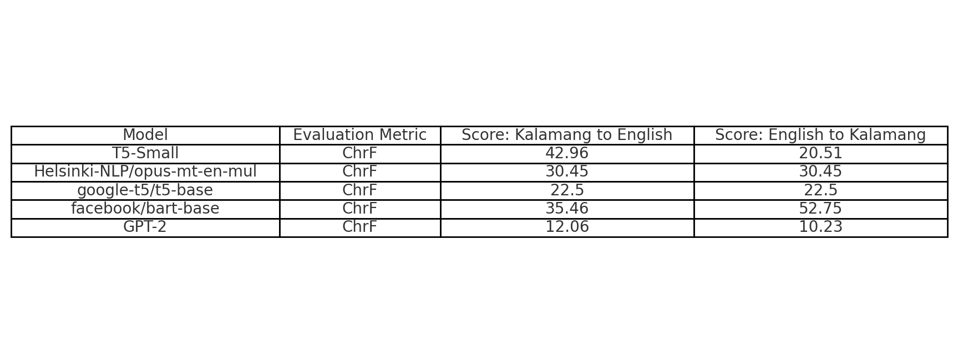
Results and Analysis
Method-1 Analysis for Kalamang-to-English and English-to-Kalamang Translations
T5-Small: Strong performance in Kalamang-to-English with coherent translations, but struggles with rare expressions and complex phrases in both directions.
Helsinki-NLP/opus-mt-en-mul: Provides consistent but shallow translations, lacking depth in contextual understanding compared to task-specific models.
google-t5/t5-base: Slightly better in English-to-Kalamang, but overall performance is limited by the absence of task-specific fine-tuning.
facebook/bart-base: Excellent performance in both directions, particularly in English-to-Kalamang, capturing the morphological and syntactic complexities of Kalamang.
GPT-2: Poor performance in both directions, often producing irrelevant or incomplete translations with minimal semantic accuracy.

Slide 11
Results and Analysis
Method-2 Analysis for Kalamang-to-English and English-to-Kalamang Translations
Helsinki-NLP/opus-mt-en-mul: Limited capacity for Kalamang-to-English translation, with translations often lacking grammatical coherence. It performs slightly better in English-to-Kalamang, relying on lexical mappings with basic accuracy.
facebook/mbart-large-50-many-to-one-mmt: Moderate performance in Kalamang-to-English, showing better syntactic understanding and contextually relevant translations. It outperforms Helsinki-NLP/opus-mt-en-mul, especially in English-to-Kalamang, where translations are more fluent and grammatically accurate.

Slide 12
Novelty
Fine-Tuning Pretrained Models:
Optimized Transformer Use: Achieved highest ChrF score (52.75) for English-to-Kalamang with fine-tuned BART model.
Efficiency: T5-Small model achieved a competitive ChrF score (42.96) for Kalamang-to-English, balancing performance and efficiency.
Multilingual Model Evaluation: Helsinki-NLP/opus-mt-en-mul showed balanced ChrF scores (30.45) without task-specific tuning.
Comparison Across Architectures:
Extensive Benchmarking: Evaluated diverse models like BART, T5-Small, GPT-2, and Helsinki-NLP.
Architectural Insights: BART excelled in capturing Kalamang morphology; GPT-2 had general limitations.
Resource-Performance Trade-off: Smaller models like T5-Small performed well with lower resource needs, while Llama-30B required significant resources for higher scores.

Slide 13
Novelty
Linguistically Informed Methodology:
Addressing Morphological Complexity: Used task-specific pretraining for Kalamang's rich morphology and syntactic variability.
Error Mitigation: Techniques like padding token masking and learning rate adjustments improved model performance.
Tailored Training Strategies:
Efficiency Techniques: Applied gradient accumulation and mixed precision training to handle small datasets with limited computational resources.
Custom Tokenization: Developed a pipeline to align source and target sentences and reduce noise using loss masking techniques.

Slide 14
Conclusion
Structured Data Transformation: Successfully converted raw linguistic data into CLDF-compliant format for comprehensive documentation of the Kalamang language.
Task-Specific Pretraining: Models like T5-Small and BART showed strong performance in handling both syntactic and semantic translation aspects.
Versatility of Multilingual Models: Models like Helsinki-NLP/opus-mt-en-mul provided robust baseline results, useful when specialized resources are limited.
Limitations of General Models: General-purpose models like GPT-2 underperformed without significant task-specific fine-tuning or adaptations.
Resource Constraints Impact:
Importance of data augmentation (e.g., back-translation, paraphrasing).
Need for morphological analysis to encode linguistic complexity.
Future Directions:
Data Augmentation: Use back-translation and learn from similar languages.
Model Adaptation: Integrate linguistic rules with transformers for better performance.
Accessibility: Deploy efficient models like T5-Small for practical use, while exploring larger models for research.

Slide 15
Future Scope
Data Augmentation and Expansion:
Use back-translation and paraphrasing to create synthetic data.
Apply cross-lingual transfer learning from similar high-resource languages.
Engage native speakers for crowdsourced data collection.
Model Enhancements:
Integrate linguistic features (morphology, syntax, phonetics) into models.
Develop efficient architectures like DistilBERT for on-device deployment.
Explore meta-learning for rapid adaptation to new low-resource languages.
Contextual and Cultural Understanding:
Implement context-aware translation for better coherence.
Train models to handle cultural references and idiomatic expressions.
Deployment and Accessibility:
Create user-friendly translation tools for education and communication.
Develop low-latency models for real-time translation.
Collaborate with linguists to support language preservation efforts.

Slide 16
Thank You for Listening…

