Slide 1

EverShop:- E-Commerce Website
Group members
Shruti Pinjarkar(20104016)
Aryan Sankholkar(20104010)
Yash Umredkar(20104012)
Project Guide
Prof. Neha Deshmukh

Slide 2
Contents
Introduction
Objectives
Scope
Literature Survey
Proposed System
Project Outcomes
Block Diagram
DFD
Technology Stack
Suggestion in Review-1
Result and Discussion
Conclusion and Future Scope
References

Slide 3
1. Introduction
E-commerce: A website that allows people to buy and sell physical goods, services, and digital products over the internet
Problem Identified :
    People have to visit stores offline for the various day to day necessary needs.
    Not everything is available in one store people have to visit many stores for different needs required.
Solution Proposed :
    In our project we are trying to bring many stores with different objects under one platform so user can online purchase the things they need .

Slide 4
2. Objectives
To design a website for the purpose of viewing products and for purchasing them.
To generate bill for the products purchased.
To enable customers for quick and easy find of the best solution for their needs to deliver better results consistently.

Slide 5
3. Scope
Easy provision of various category of products to every user.
User can purchase any product available on the website from any place via online mode
Save time of the user and make various work easier .
Availability of user’s data through registration for future use

Slide 6
4.Literature Survey
[1] In this paper it has been stated that, internet has opened the door for e-commerce. Post that the correlation between e-commerce, culture, and website design is mentioned with a literature review of required areas. Also, the businesses shipping process including the delivery of orders to the consumer’s doorsteps is highlighted. At the end a brief overview of e-commerce, including what it is and how it differs from existing related ideas has been mentioned.

Slide 7
5. Proposed System
The aim of E-commerce recommendation is to take advantage of Ecommerce site to provide information and suggestion, to help consumers make right choices.
An Ecommerce system is a process in which people (specifical customers) are being provided with the option of purchasing good sand services directly from the seller, all in a real-time environment.
Online shopping is an application of the internet as electronic commerce.

Slide 8
5. Outcome of Project
The outcomes of the project are:
Easily able to add items to their cart.
Can easily make payment through payment gateway.
User can get invoice of their order

Slide 9
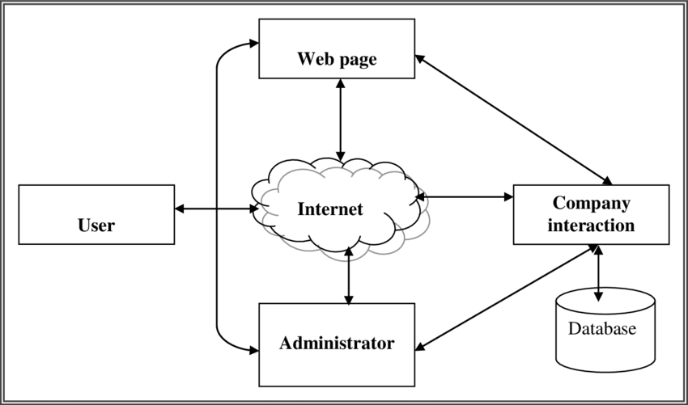
6. Block Diagram

Slide 10
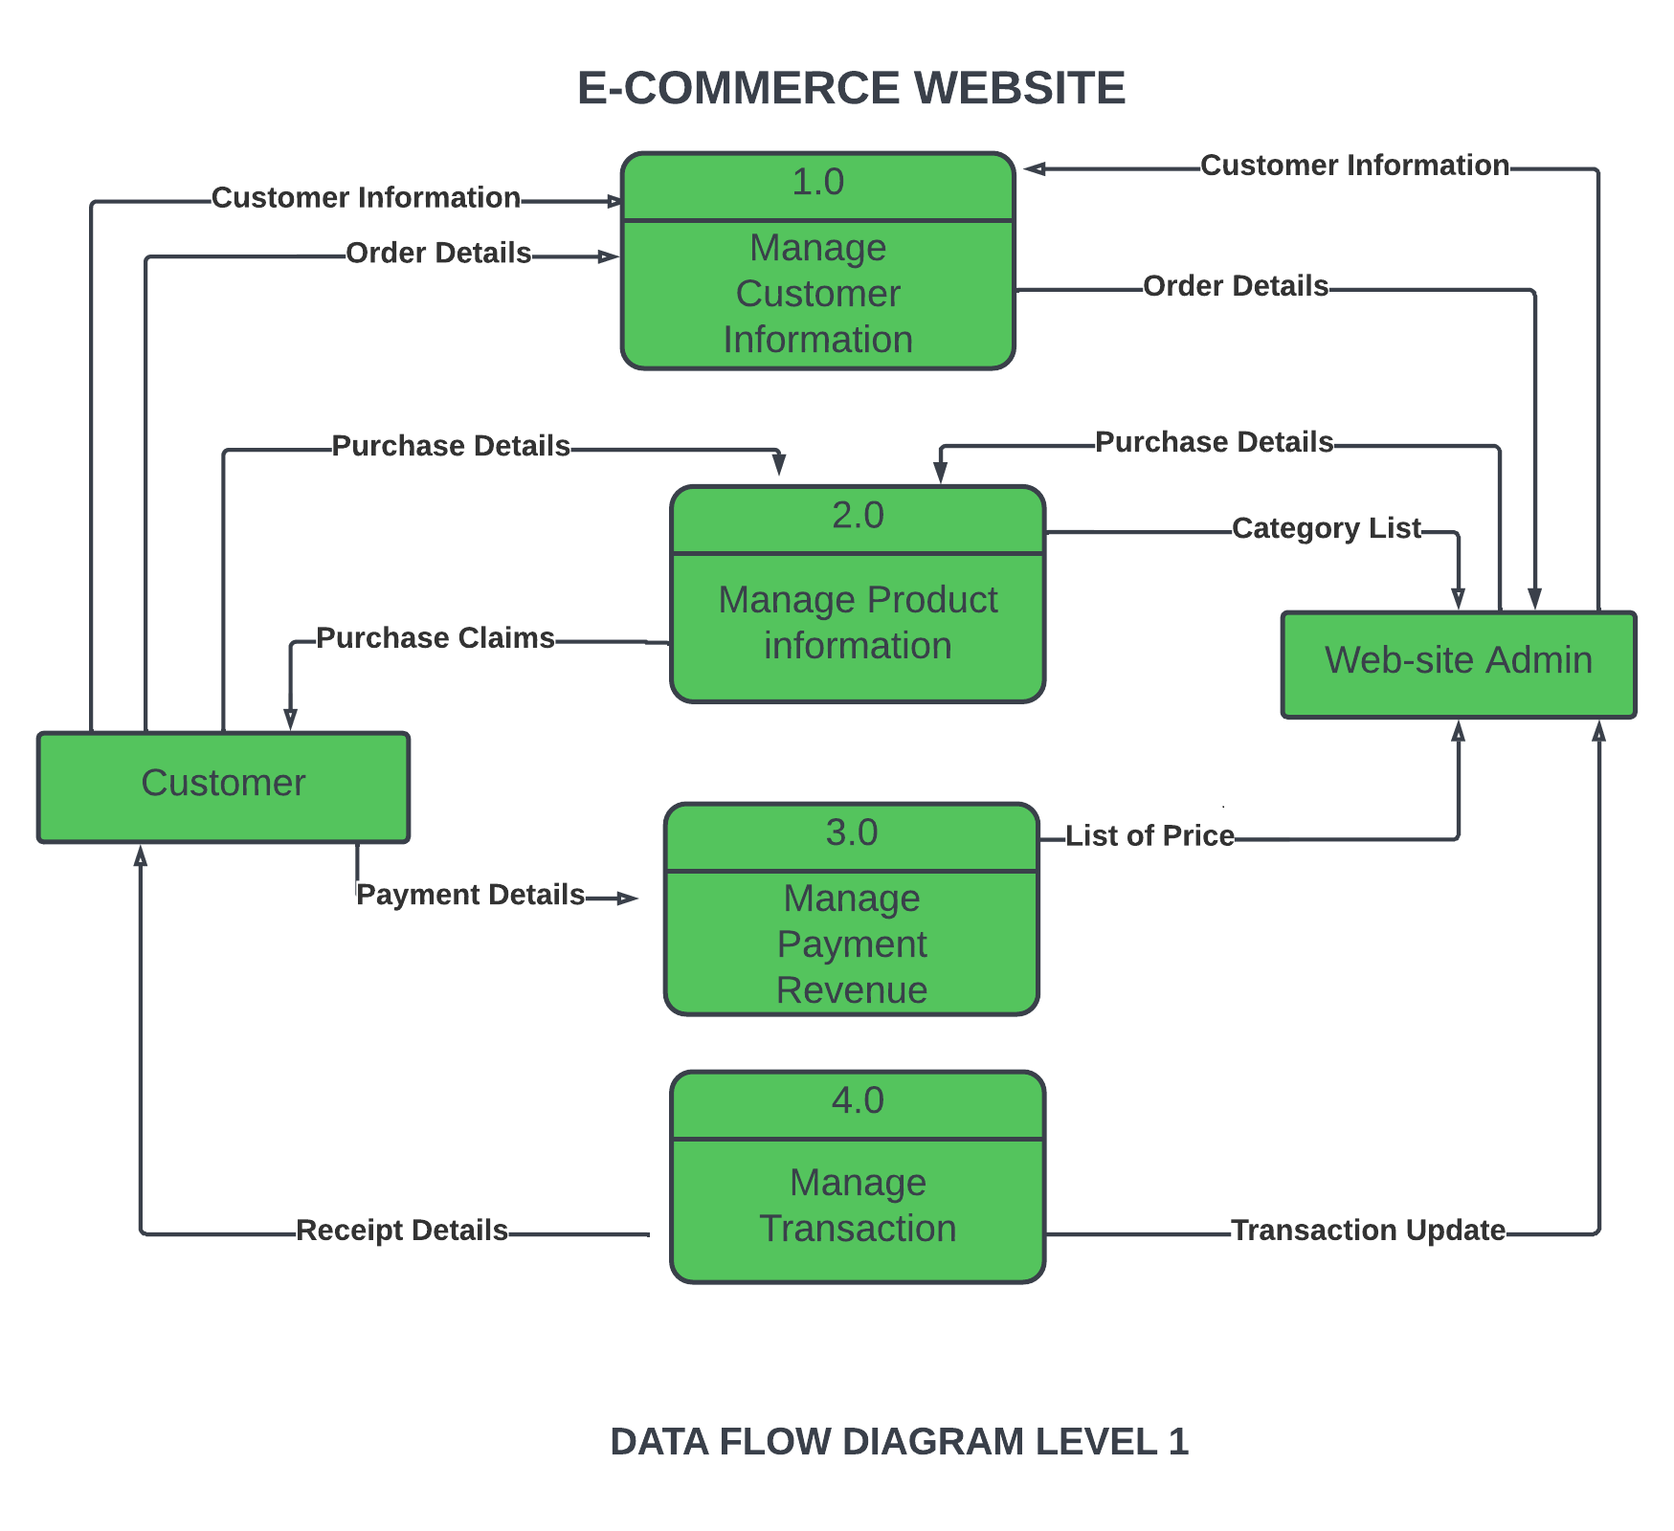
7. Data Flow Data

Slide 11



8. Technology Stack
Frontend
HTML
CSS
ReactJS
Backend
MongoDB
Stripe API

Slide 12
9. Suggestions in Review-1
Login and Signup page.
Add Categories Function.
Invoice to Email by SMTP

Slide 13
10.Result and Discussion
This project results in lower transaction cost and higher margin as expenses related to land, labour etc. are very less in online transactions as compared to offline transactions that results in high profit margin.
This project will result into buying and selling of goods and services, or transmitting the funds or data, over an electronic network in a more efficient way.
This project will cater business-to-business (B2B), business-to-consumer (B2C), consumer-to-consumer or consumer-to-business transactions.

Slide 14
11. Future Scope
After the successful transaction an invoice of the order will be sent to a registered e-mail address via SMTP server provision.

Slide 15
12. Conclusion
E-Commerce has undeniably become an important part of our society. The successful companies of the future will be those that take E-Commerce seriously, dedicating sufficient resources to its development.
Companies moving towards re-designing their business processes are likely to reap the greatest benefits using E-commerce.
E-Commerce is a helpful technology that gives the consumer access to business and companies all over the world.

Slide 16
13.References
https://www.researchgate.net/publication/304703920_A_Review_Paper_on_E-Commerce
https://stripe.com/docs/api/errors
https://www.w3schools.com/REACT/react_components.asp
https://www.mongodb.com/docs/manual/reference/exit-codes/

Slide 17
Thank You...!!

