Slide 1
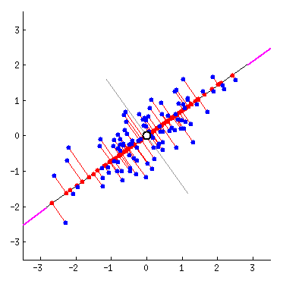
Principle Component Analysis
algorithms for finding the eigenvector

Slide 2
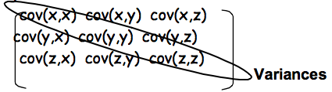
PCA is a linear transformation technique to diaganolize the covariance matrix.
(eliminating features that are colinear)
S = V Λ V^{T}

Slide 3
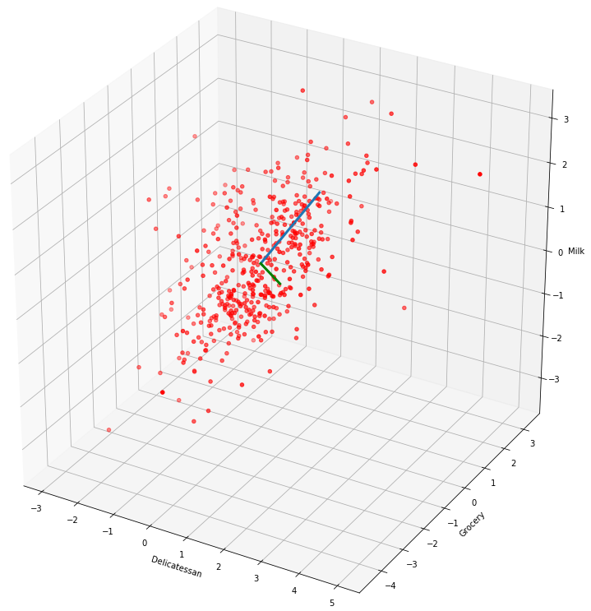
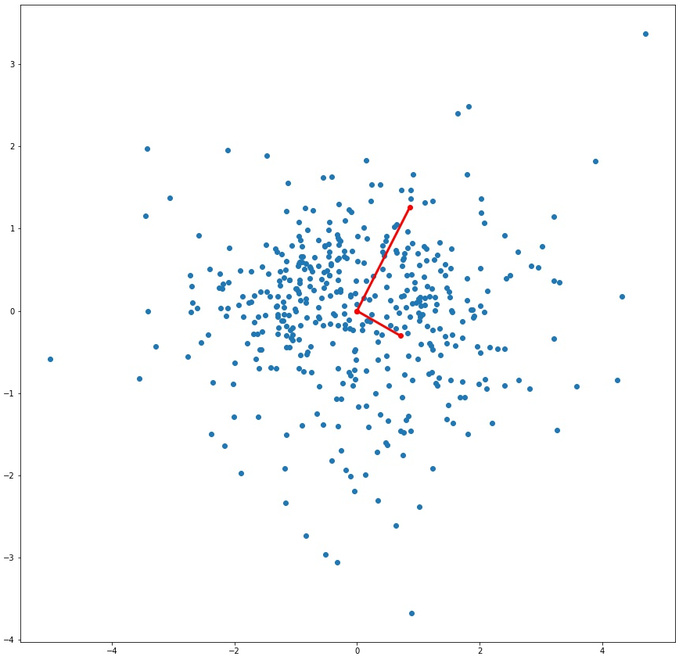
Find direction of maximum variances from dataset.
Find perpendicular vector to 1PC, which are greatest variance of what is left
And so on until original dimensionality
Select k components with high variances
Change coordinate of every datapoint to new basis
Data from wholesale grocery dataset

Slide 4
How to find principle components?
Lanczos algorithm, power method
Gradient descent

Slide 5
A) Lanczos algorithm, for square, symmetric matrices
Choose a random unit vector of compatible shape.
Multiply covarince matrix with random vector. This rotates and scales the vector. Note, the matrix will rotate any vector in a similar fashion, as it is a linear transformation.
Upon iterative transformation, vector will reach a direction that will no longer change; this is the first principle component.
Normalize the vector, unit length. (Without this constraint, you will get many vectors instead of 1)
Subtract the projection of the first principle components from the matrix and repeat the process to find the next principle component analysis.

Slide 6
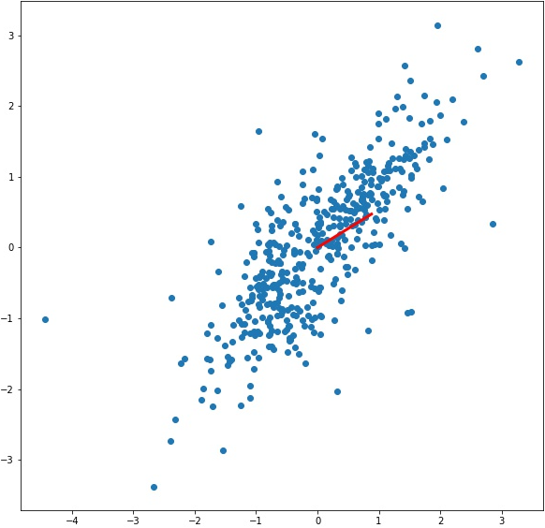

Slide 7
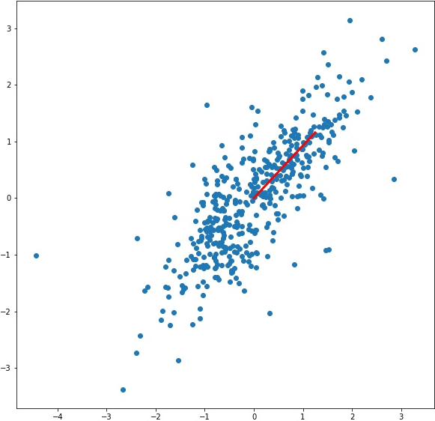

Slide 8
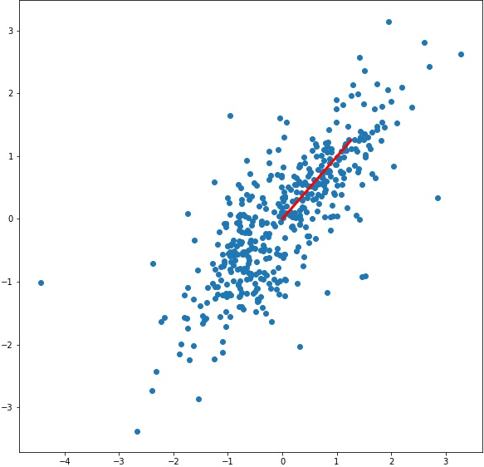

Slide 9


Slide 10
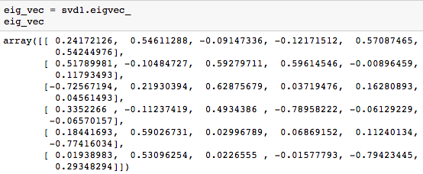
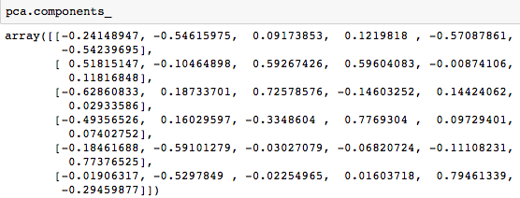
svd1, instance of PCA class I implemented
pca, instance of sklearn PCA implementation

Slide 11
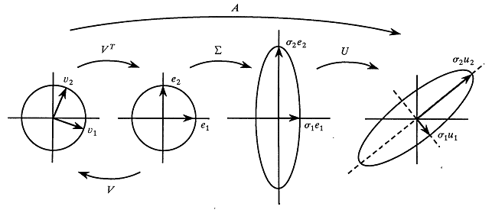
B) Gradient descent on variance function, SVD
Any centered matrix m X n A, can be decomposed into 3 matrices
A=UΣV^{T}
No need to calculate A^{T}A, it directly spans the dataset instead of deviation from mean

Slide 12
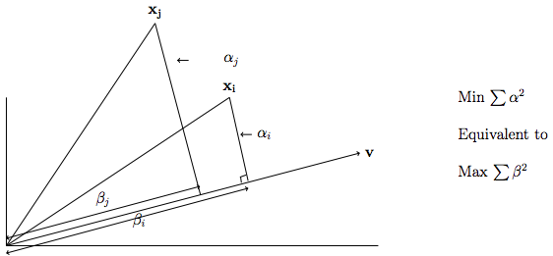
Variance = X (v) * X (v) /n

Slide 13
Gradient descent for variance function wrt to vector
Center the data around mean.
Choose random compatible unit vector u, and initialize the update to 1.
Set epoch to 50. At each epoch, calculate projections of datapoints wrt vector and find variance.
Slope of function = 2*X.dot(u) and update, u = u+ learning_rate*X.dot(slope) -2*u
At each iteration update is made to vector, and when the difference between 2 consecutive updates is e-05, vector is found.
Subtract the projection of the first principle components from the matrix and repeat the process to find the next principle component analysis.

Slide 14
Transformed data
Y= X (V_{P}^{T})
Using p principle components, where p << n
Reconstruct original data
X’ = Y (V_{P}) = X (V_{P}^{T}) (V_{P})
contains most of the information about original data

Slide 15
Final thoughts:
My implementation of PCA is too slow
Need to implement faster PCA algorithm in future
Finish DBscan

