Slide 1

Easy Study
SRH
Usability Testing & Verification
Conclusion
Idea
Demo
Testing
Introduction
Design process
Jayshree Kolhe
Sunakshi Jaitly

Slide 2

Team Members
Jayshree Kolhe
Sunakshi Jaitly
Paper Prototype
Mockup
Implementation
GitHub Setup
Usability testing
Presentation
Paper Prototype
Usability testing
Presentation
Part of Implementation
Design process
Conclusion
Testing
Introduction
Demo
Idea

Slide 3


Idea
Outcome
PaperPrototype
Mockup
Implemented Prototype
Usability Testing
Design process
Use survey to suggest online courses for students
Conclusion
Demo
Testing
Introduction
Idea

Slide 4
Use Cases
Our Web application:
Suggest Courses: Suggest only those courses which are required for SRH study modules.
Design process
Other websites :
Conclusion
Idea
Demo
Testing
Introduction
Suggest Courses: Other websites like Udemy , skillshare suggest courses based on your search history.

Slide 5
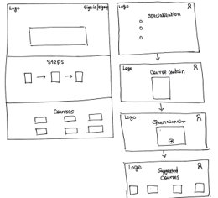
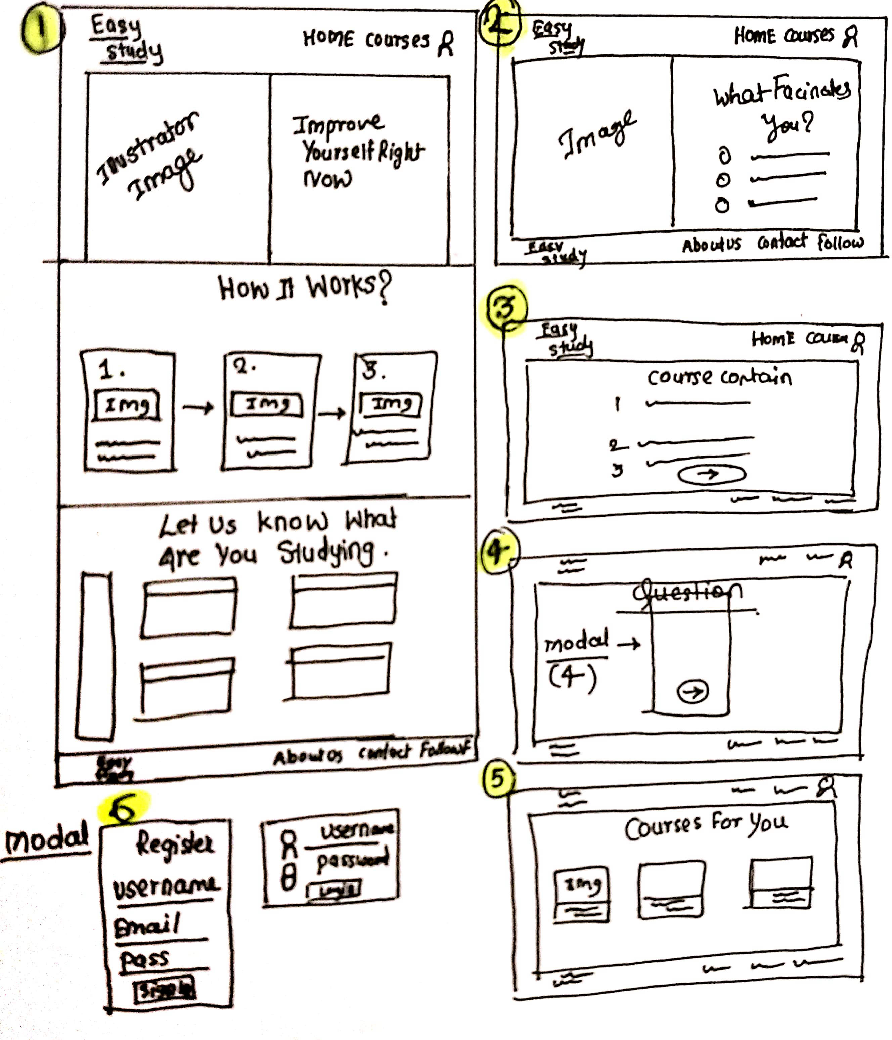
Paper Prototype
01
02
First Paper Prototype
Second Paper Prototype
Design process
Conclusion
Idea
Demo
Testing
Introduction

Slide 6
Components
Home Page
Select Specialization
Landing Page
Steps
Select course
ComboBox : Select specialization
1
2
Survey Page
Course Contain
Checkbox: Answer the questions
Able to see course contain
Design process
Conclusion
Idea
Demo
Testing
3
4
Introduction
Suggested Courses
Sign In | Sign Up
Except in which you have expertise
Only required for your study module
Modal:Sign in & Sign Up
5
6

Slide 7
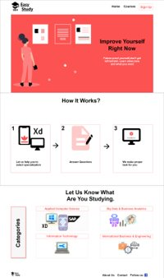
Mockup Components
Design process
Home Page
Conclusion
Landing Page
Steps
Select course
Idea
Demo
Testing
Introduction
1

Slide 8
Components
Home Page
Select Specialization
Landing Page
Steps
Select course
ComboBox : Select specialization
1
2
Survey Page
Course Content
Design process
Checkbox: Answer the questions
Able to see course contain
Conclusion
Idea
Demo
Testing
3
4
Introduction
Suggested Courses
Sign In | Sign Up
Except in which you have expertise
Only required for your study module
Modal:Sign in & Sign Up
5
6

Slide 9

Components
Design process
Select Specialization
Conclusion
ComboBox : Select specialization
Idea
Demo
Testing
Introduction
2

Slide 10
Components
Home Page
Select Specialization
Landing Page
Steps
Select course
ComboBox : Select specialization
1
2
Survey Page
Course Content
Design process
Checkbox: Answer the questions
Able to see course contain
Conclusion
Idea
Demo
Testing
3
4
Introduction
Suggested Courses
Sign In | Sign Up
Except in which you have expertise
Only required for your study module
Modal:Sign in & Sign Up
5
6

Slide 11
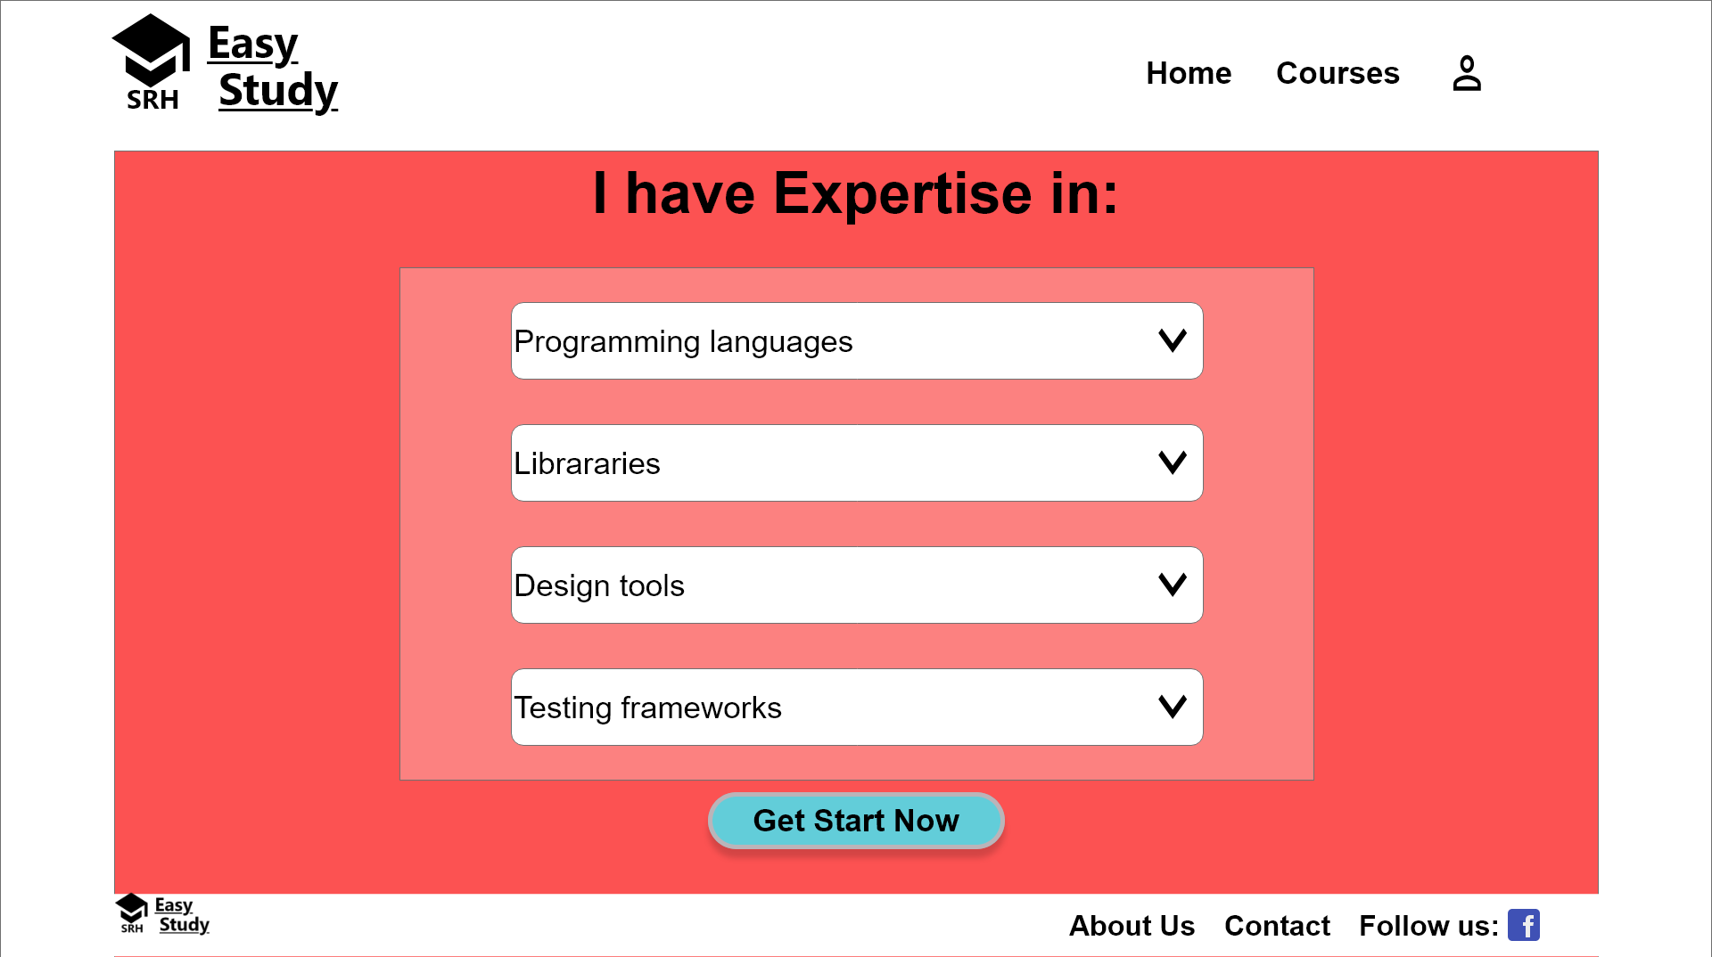
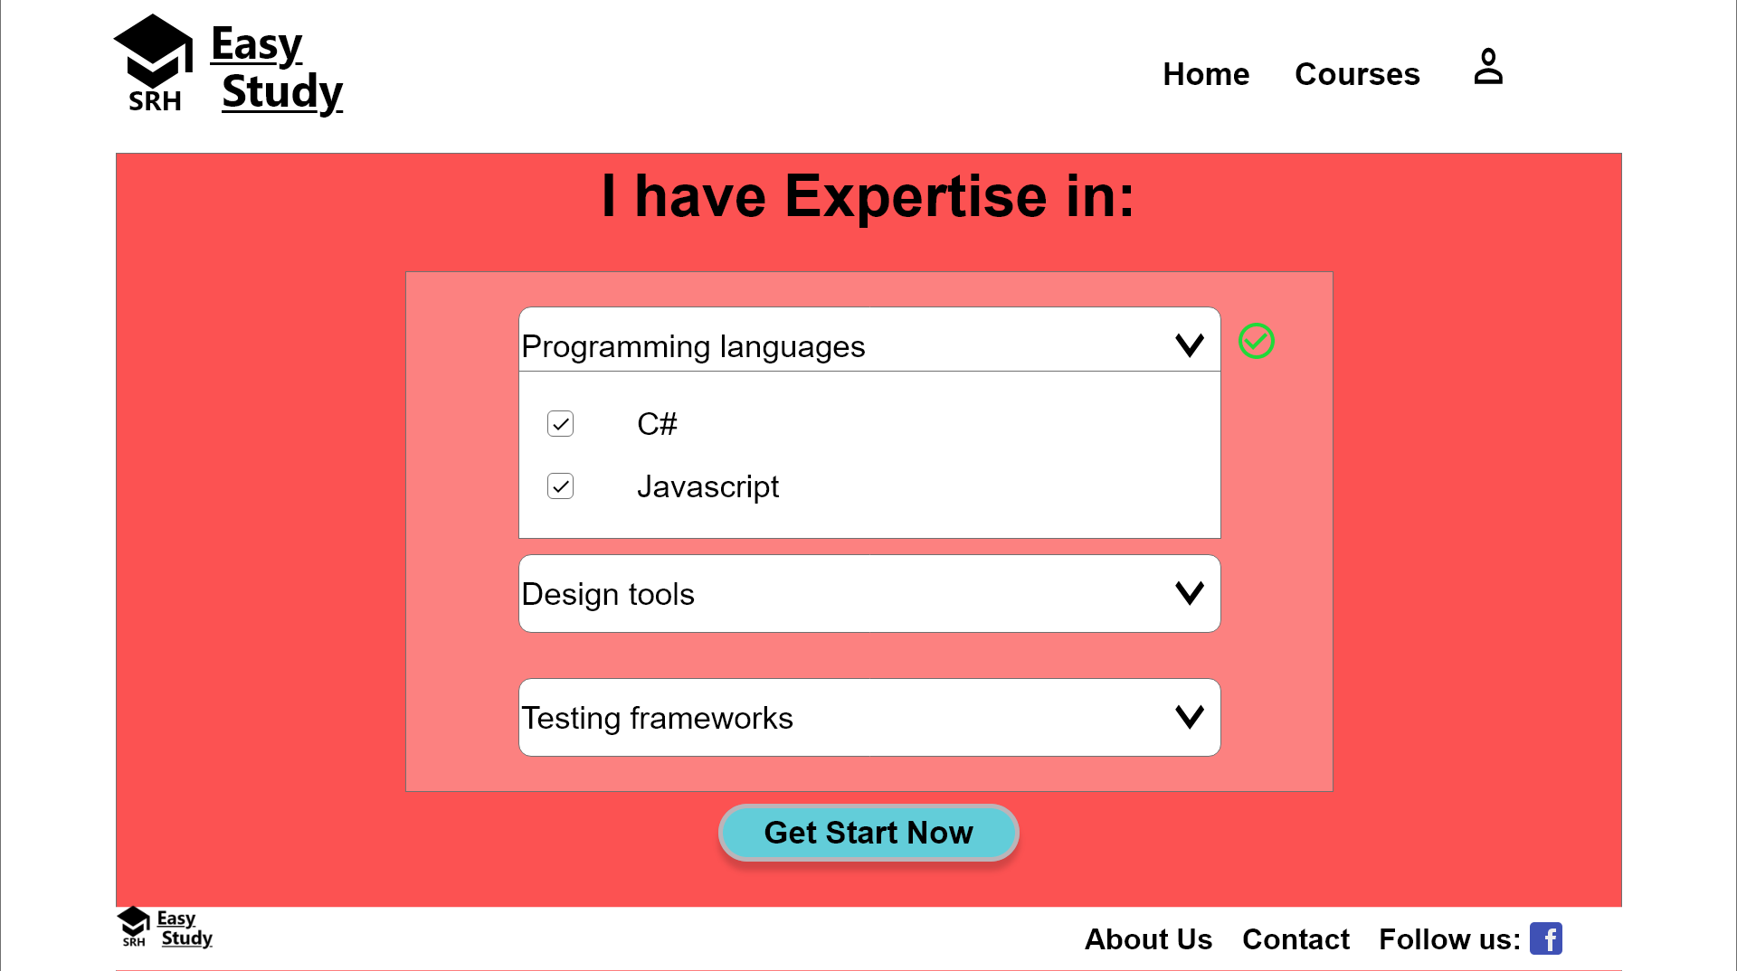
Components
Design process
Conclusion
Idea
Demo
Testing
Survey Page
Introduction
Checkbox: Answer the questions
3

Slide 12
Components
Home Page
Select Specialization
Landing Page
Steps
Select course
ComboBox : Select specialization
1
2
Survey Page
Course Content
Design process
Checkbox: Answer the questions
Able to see course contain
Conclusion
Idea
Demo
Testing
3
4
Introduction
Suggested Courses
Sign In | Sign Up
Except in which you have expertise
Only required for your study module
Modal:Sign in & Sign Up
5
6

Slide 13
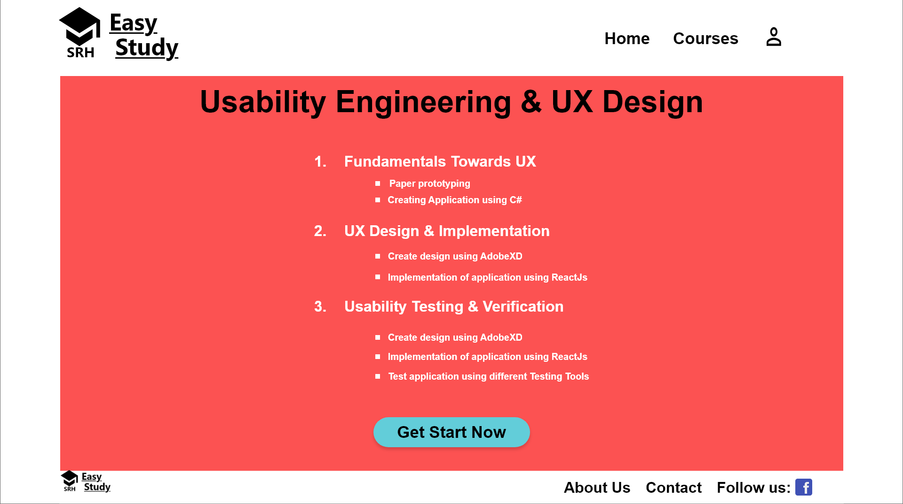
Components
Design process
Course Content
Idea
Conclusion
Demo
Testing
Able to see course contain
Introduction
4

Slide 14
Components
Home Page
Select Specialization
Landing Page
Steps
Select course
ComboBox : Select specialization
1
2
Survey Page
Course Content
Design process
Checkbox: Answer the questions
Able to see course contain
Conclusion
Idea
Demo
Testing
3
4
Introduction
Suggested Courses
Sign In | Sign Up
Except in which you have expertise
Only required for your study module
Modal:Sign in & Sign Up
5
6

Slide 15
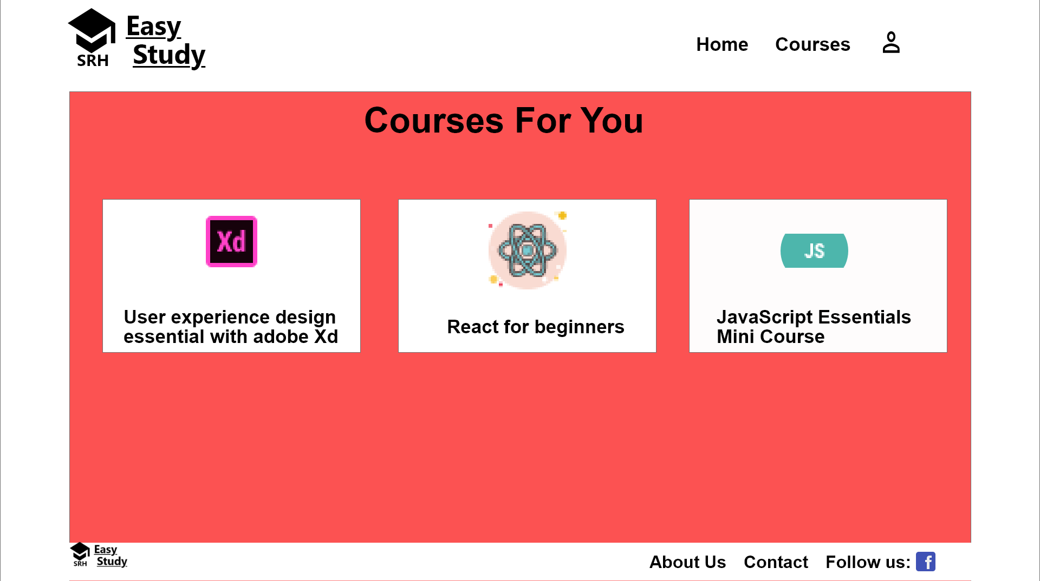
Components
Suggested Courses
Design process
Conclusion
Except in which you have expertise
Only required for your study module
Idea
Demo
Testing
Introduction
5

Slide 16
Components
Home Page
Select Specialization
Landing Page
Steps
Select course
ComboBox : Select specialization
1
2
Survey Page
Course Content
Design process
Checkbox: Answer the questions
Able to see course contain
Conclusion
Idea
Demo
Testing
3
4
Introduction
Suggested Courses
Sign In | Sign Up
Except in which you have expertise
Only required for your study module
Modal:Sign in & Sign Up
5
6

Slide 17
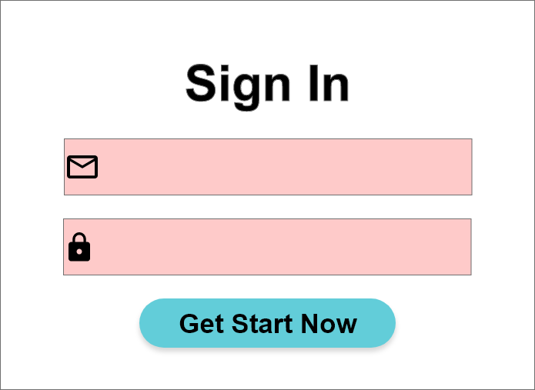
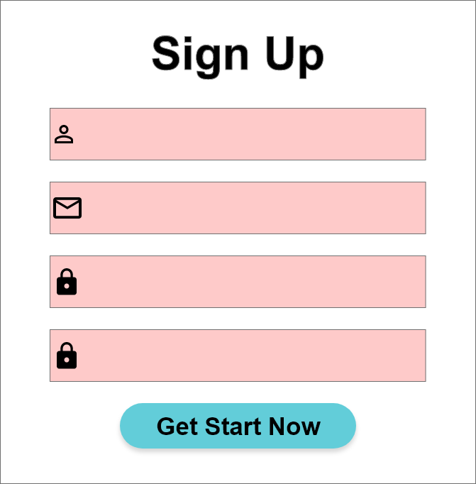
Components
Design process
Sign In | Sign Up
Conclusion
Modal:Sign in & Sign Up
Idea
Demo
Testing
Introduction
6

Slide 18
Components
Design process
Conclusion
Idea
Demo
Testing
Introduction

Slide 19
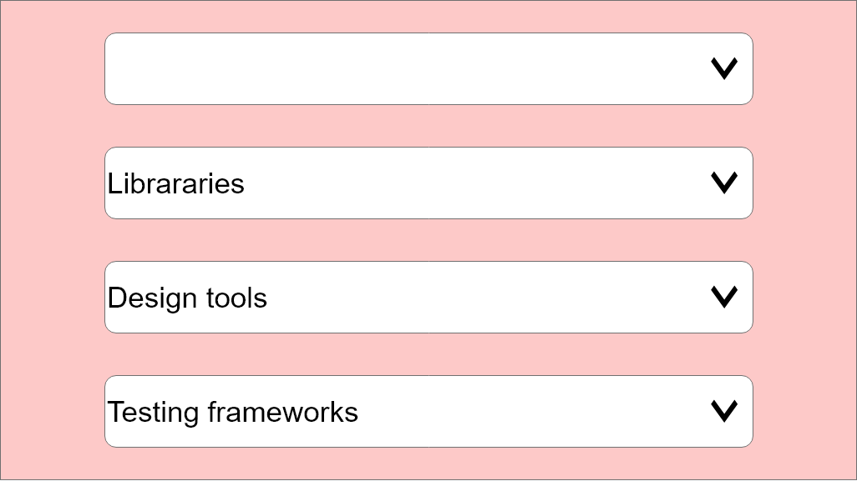
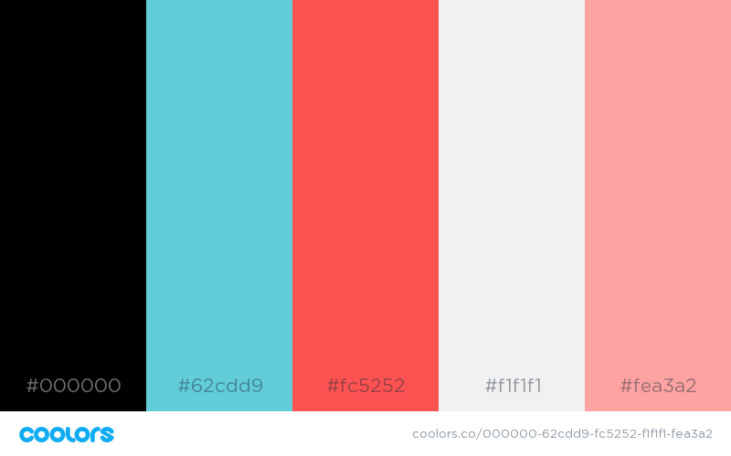

Color Palette
Created using: Colors.co
Design process
Conclusion
Idea
Demo
Testing
Introduction

Slide 20
Testing
01
02
03
Demo
Testing
Idea
Conclusion
Introduction
Design process
Survey Monkey
Test Plan
Think aloud

Slide 21
Testing
01
Survey Monkey
Analysis of result
10 Questions
Recruit participant
Red routes
Demo
Testing
Idea
Conclusion
Introduction
Design process

Slide 22
Testing
RedRoute
All of the time | Discuss with the Professors | Prior Experience | Job Prospects | Online Courses
Most of the time | Research opportunities | Give it a try for new things | Feedback from seniors | Gain insight about the Course Structure
Some of the time | Workload | Faculty | Select Interested Area | Select Specialization
Very little of the Time | Group/Individual project | Mode of Examination | Class Schedule | Study material availability
 | Few of the people | Some of the people | Most of the people | All of the people
Demo
Testing
Idea
Conclusion
Introduction
Design process

Slide 23
Testing
01
02
03
Demo
Testing
Idea
Conclusion
Introduction
Design process
Survey Monkey
Test Plan
Think aloud

Slide 24
Testing
02
Test Plan
5 Facts about user
Needs served by your product
5 Users
Demo
Testing
Idea
Conclusion
Introduction
Design process

Slide 25
Usability test plan
USABILITY TEST PLAN DASHBOARD
PRODUCT UNDER TEST
website designed for SRH Specializations.
To make a website in order to guide the students to select the specialization and refer them the online courses required for the specific module.
BUSINESS CASE
Why are we doing this test? What are the benefits? What are the risks of not testing?
We are doing the test to check if the students are satisfied with the content of the website and is the website helpful for them.
If website is not tested, then we as developers will never be able to get user’s view point.
RESPONSILITIES
Moderator- Jayshree
Observer- Sunakshi
EQUIPMENTS
Laptop
All the data was recorded in the data logger.
TEST OBJECTIVES
What are the goals of the usability test? What specific questions will be answered? What hypotheses will be tested?
As a user, I am confused in deciding my specialization and I need some guidance.
As a user, I am not able to understand which specialization actually suits my interest.
As a user, I want to know the course content of all the modules being offered.
As a user, I want to know the job prospects in the particular specialization.
As I user, I want to do online courses required for my specialization.
PARTICIPANTS
How many participants will be recruited? What are the key aspects of selecon criteria?
We will recruit 5 Participants.
The participants should be the students of SRH.
TEST TASKS
Task 1: The user is able to Register and Sign Up.
Task 2: To browse and search the desired course.
Task 3: To find the content of the module in which the user is interested.
Task 4: Able to understand all the questions asked in order to guide the user to choose specialization.
Task 5: Search the desired online course as per the requirements of the user.
Demo
Testing
Idea
Conclusion
Introduction
Design process

Slide 26


Users
01
02
03
Demo
Testing
Idea
Conclusion
Introduction
Design process
Gauri Lahare
Sandeep
Ankita Patil
Student, ACS
Student , ACS
Master Thesis
Internship , Fraunhofer
Joined SRH , 2019 Winter Semester
SAP

Slide 27
Testing
01
02
03
Demo
Testing
Idea
Conclusion
Introduction
Design process
Survey Monkey
Test Plan
Think aloud

Slide 28
Task 1: The user is able to Sign up and Sign in.
Task 2: To browse and search the desired course.
Task 3: To find the content of the module in which the user is interested.
Task 4: Able to understand all the questions asked in order to guide the user
to choose specialization.
Task 5: Search the desired online course as per the requirements of the user.
Testing
Tasks
Demo
Testing
Idea
Conclusion
Introduction
Design process

Slide 29
Testing
03
Think aloud
Think aloud test
Usability testing scoresheet
Test plan dashboard
Demo
Testing
Idea
Conclusion
Introduction
Design process

Slide 30
Testing
Analysis of Result
Effectiveness
Efficiency
Satisfaction
Demo
Testing
Idea
Conclusion
Introduction
Design process

Slide 31
Effectiveness
Participants | Task 1 | Task 2 | Task 3 | Task 4 | Task 5
User 1 | 100% | 0% | 60% | 10% | 50%
User 2 | 100% | 100% | 0% | 60% | 40%
User 3 | 100% | 100% | 70% | 100% | 50%
User 4 | 100% | 100% | 80% | 100% | 70%
User 5 | 100% | 0% | 100% | 50% | 60%
Average | 100% | 60% | 62% | 64% | 54%
Demo
Testing
Idea
Conclusion
Introduction
Design process

Slide 32
Efficiency
Participant | Task 1 | Task 2 | Task 3 | Task 4 | Task 5
1 | 200 | 60 | 135 | 240 | 180
2 | 210 | 50 | 140 |  | 160
3 | 190 | 70 |  |  | 90
4 | 195 | 85 | 120 | 210 | 75
5 | 230 | 55 | 90 | 245
Average | 205 | 64 | 121.25 | 231.666667 | 126.25
SD | 15.81 | 13.87 | 22.5 | 18.92 | 51.53
RT(+) | 235.98 | 91.18 | 165.35 | 268.75 | 227.24
RT(-) | 174.01 | 36.81 | 77.15 | 194.58 | 25.25
Demo
Testing
Idea
Conclusion
Introduction
Design process

Slide 33
SUS Survey
Ratings | 1 | 2 | 3 | 4 | 5
1.
2.
3.
4.
5.
6.
7.
8.
9.
10.
Demo
Testing
Idea
Conclusion
Introduction
Design process
TOTAL SCORE=18
SUS SCORE= 18*2.5=45

Slide 34
Word Art
Useful
Easy to use
Demo
Testing
Idea
Conclusion
Introduction
Organized
Design process
Relatable
Clear

Slide 35

Demonstration
Demo
Conclusion
Testing
Design process
Introduction
Idea

Slide 36
Conclusion
A lot of functions are missing in the current prototype , but contained in the mock-up
To navigate to next page , one has to scroll down on landing page.(A landing page without a scroll)
Recruited participants were confused between the clickable option and simple text (There should be a hover for clickable components)
All the testers like the concept of course suggestion.
While taking survey :Checkbox ( none of the above )
Demo
Conclusion
Testing
Design process
Introduction
Idea

Slide 37
Future Development
Implementation of all components which are in mock-up
More UI details
Student would able to see Job prospect for every specialization (Dashboard design )
More generic
Demo
Conclusion
Testing
Design process
Introduction
Idea

Slide 38
Thank You !
Any Questions?
Demo
Idea
Testing
Conclusion
Design process
Introduction

