Slide 1
BlackFriday Analysis

Slide 2
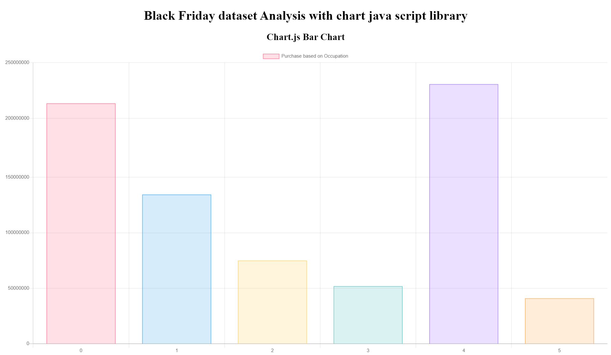

Slide 4
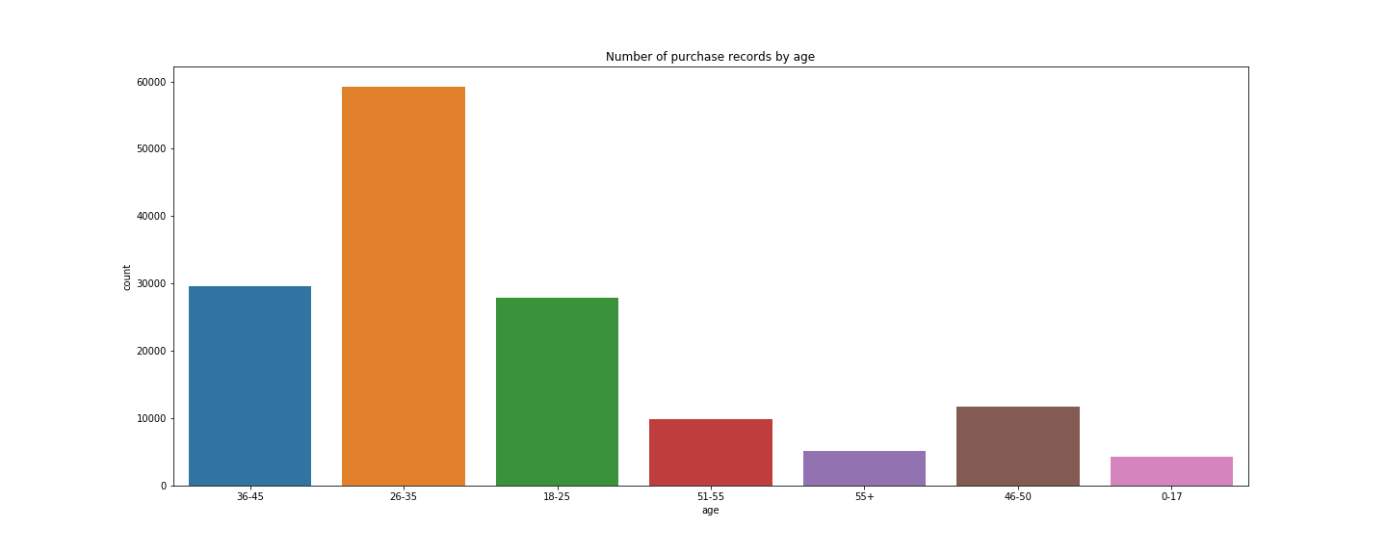

Slide 5
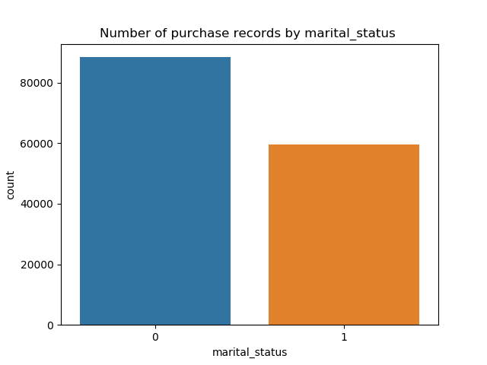
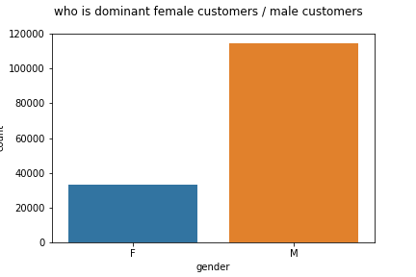

Slide 6
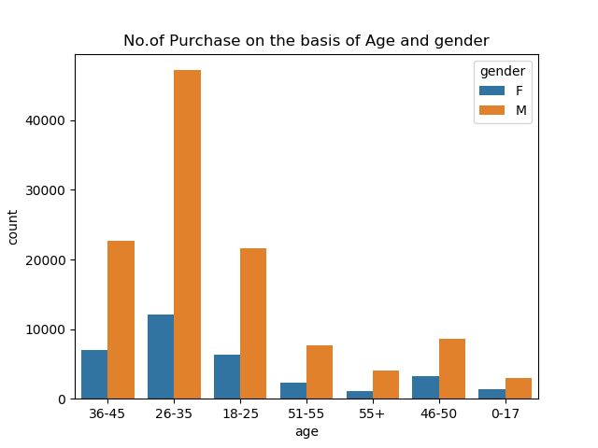

Slide 7
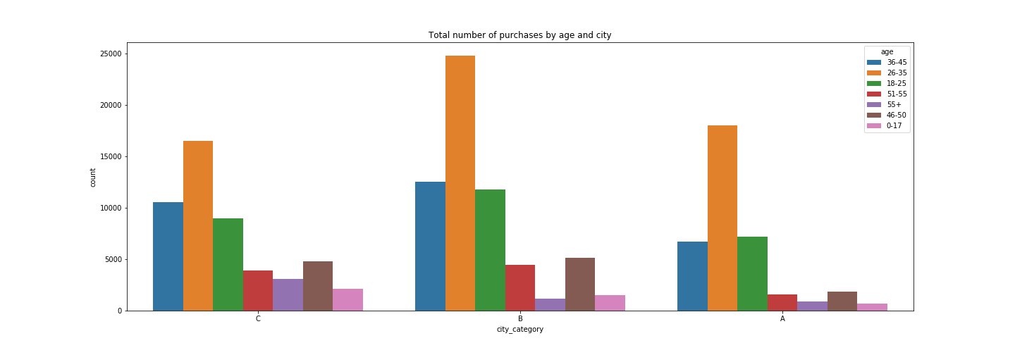

Slide 8
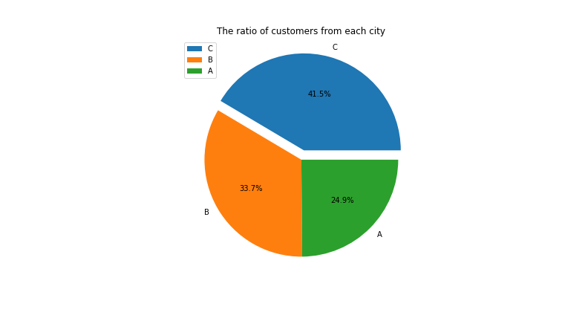

Slide 9
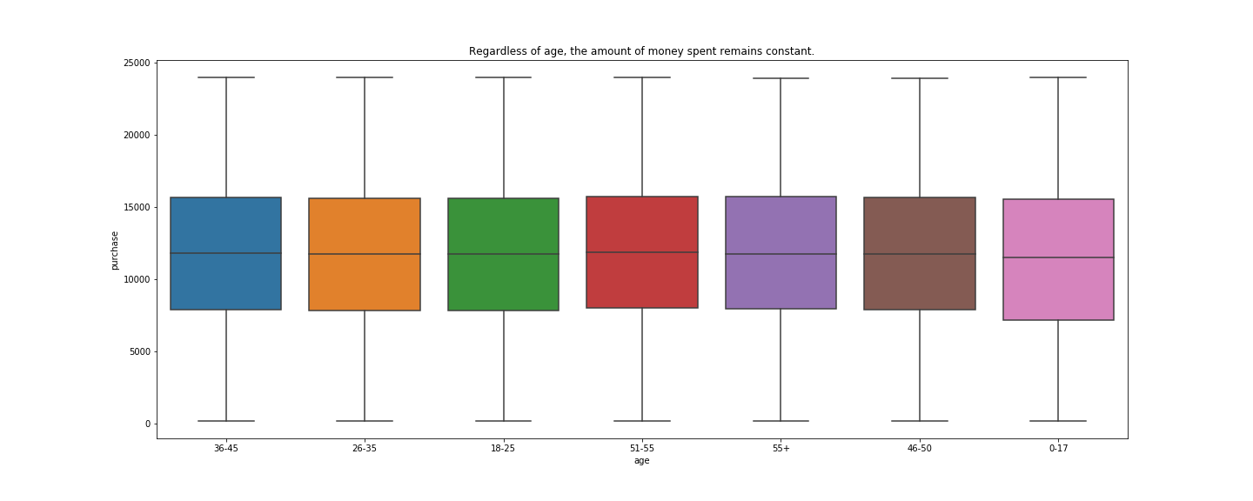

Slide 10
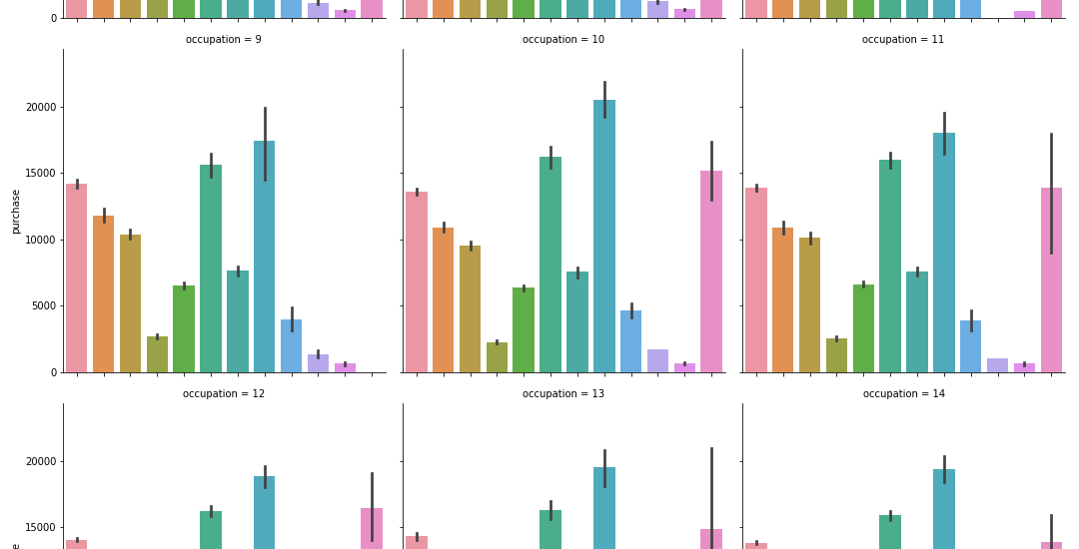

Slide 11
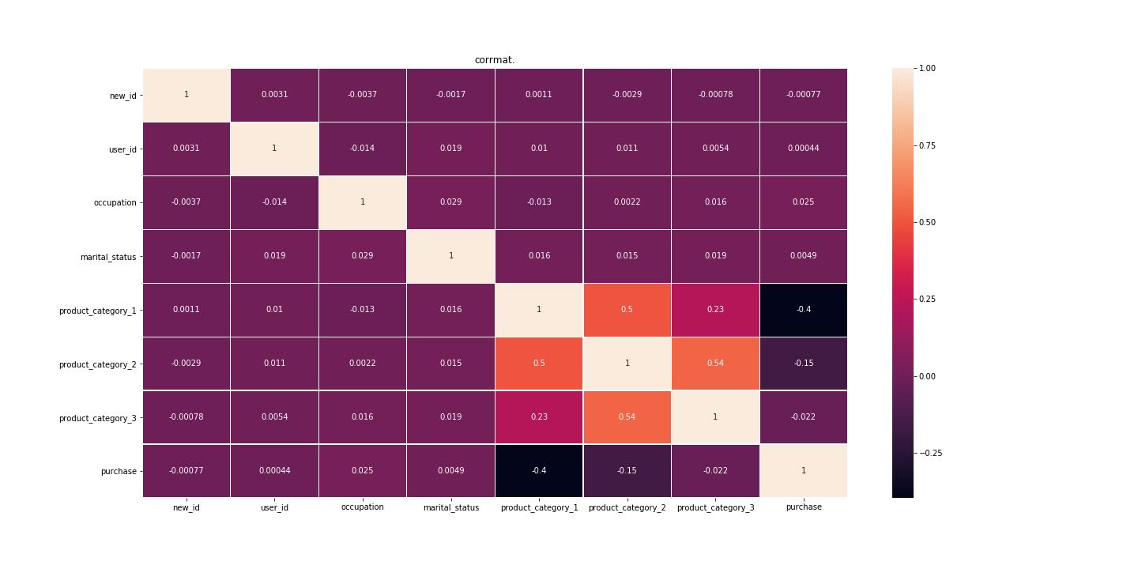

Slide 12
We can see how age and marital status are quite related things, which is something very normal.
But we can also see some relation between the categories. Relationship between category 1 and 2 is very strong 3 is very good too
Relationship between category 2 and 3 is quite good as well, in fact more than the relationship between category 1 and 2.
We can say that these relationships tell us that depending on the category you buy, users will normally repeat the categories.
Corrmat will explain the correlation between two columns or category

Slide 13
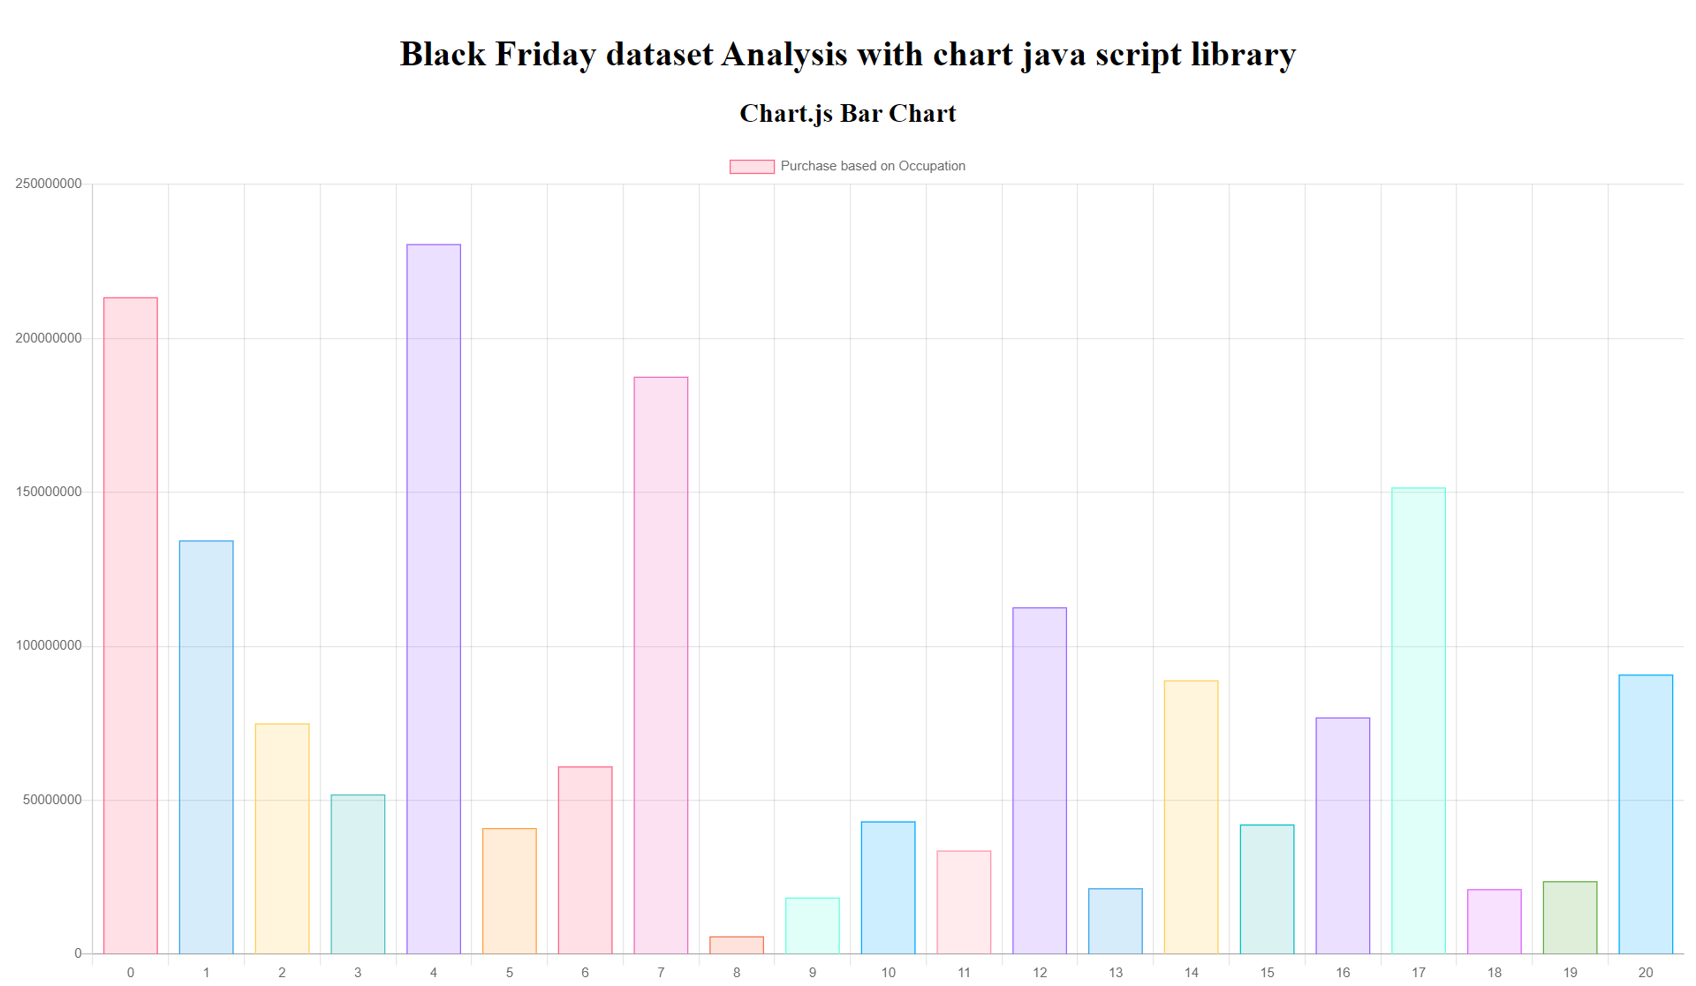

Slide 14
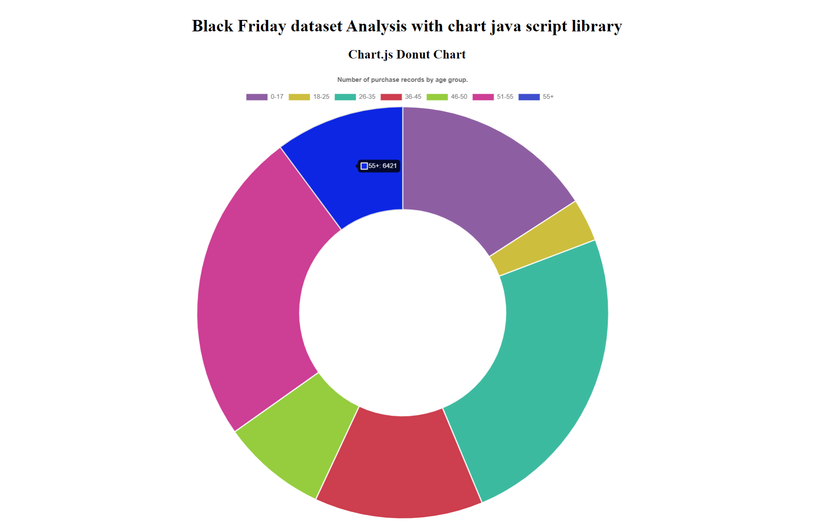

Slide 15
