Slide 1



BlackFriday Deals Dataset Analysis

Slide 2
Which type of customer spends more?
According to age and gender what are the most bought products?
Which cities spend the most?
Does client’s income has an impact on his/her purchase?

Slide 3
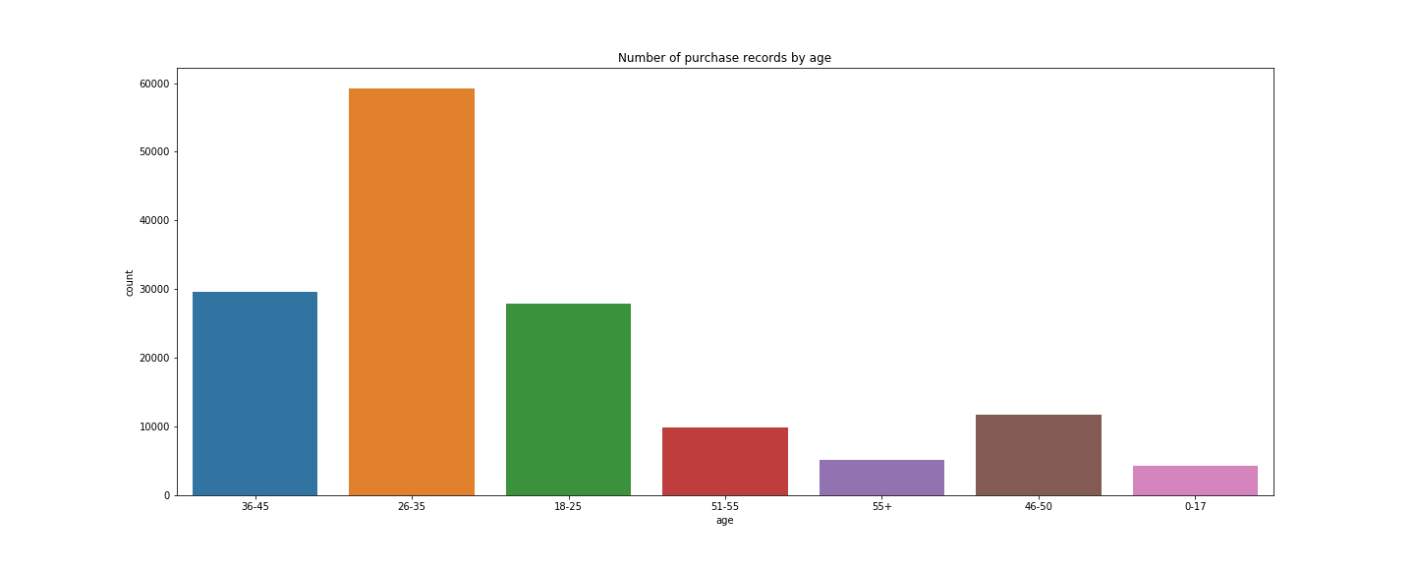
Age vs Purchase Plot

Slide 4
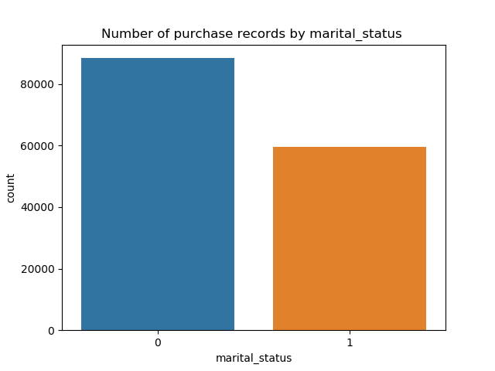
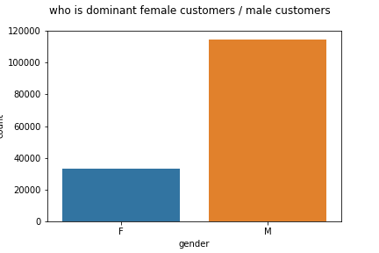
Gender and Marital Status Vs Purchase Plots

Slide 5
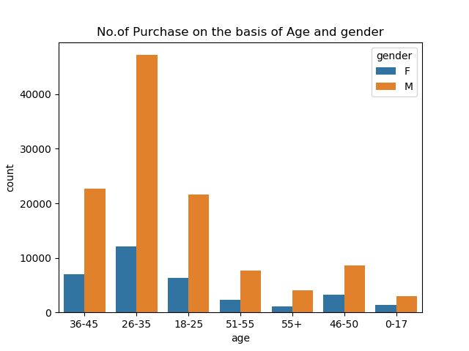

Slide 6
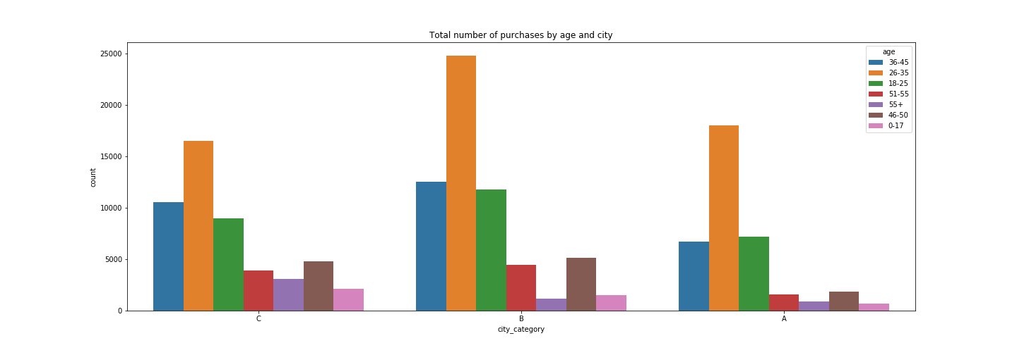
Total number of purchases by Age and City Plot

Slide 7
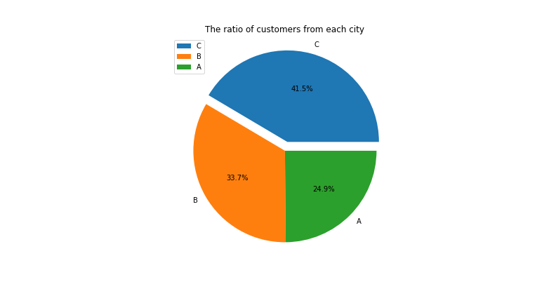

Slide 8
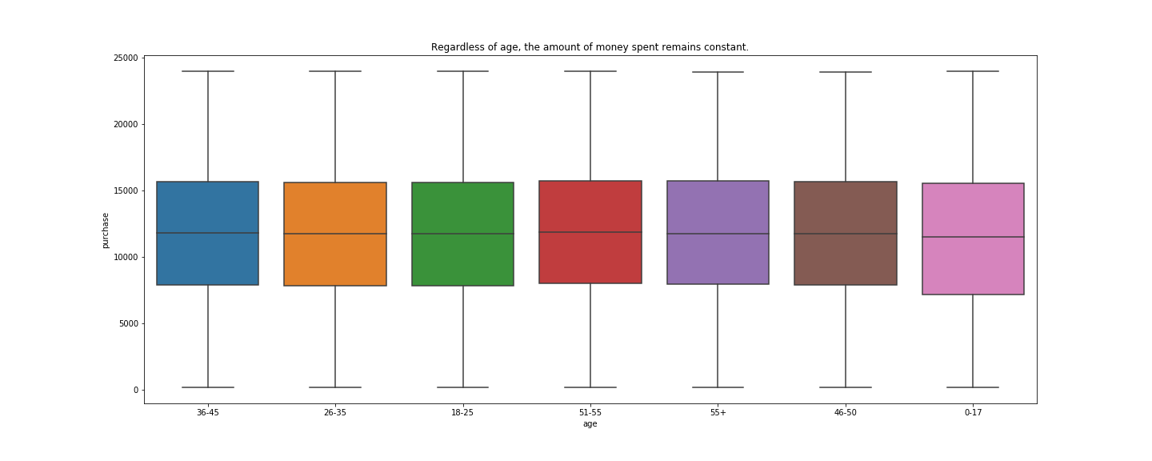

Slide 9
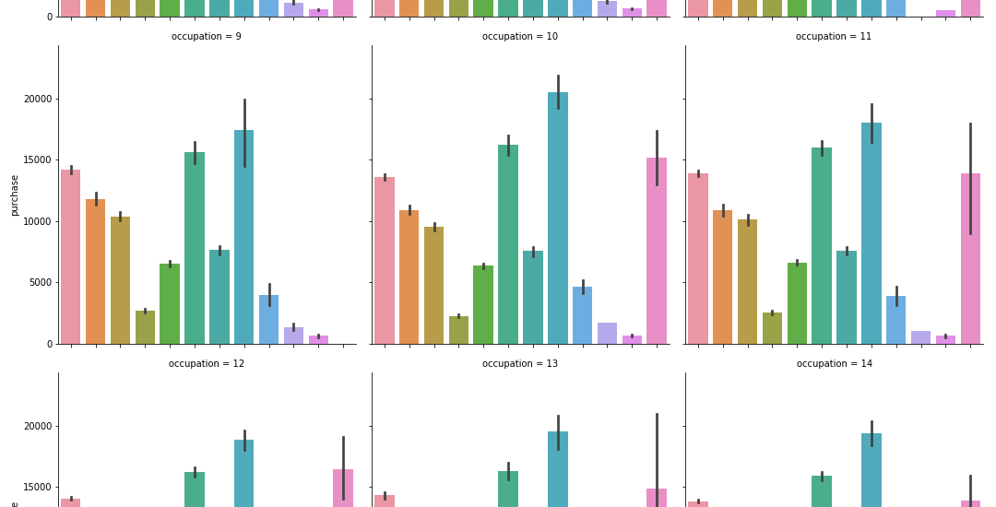

Slide 10
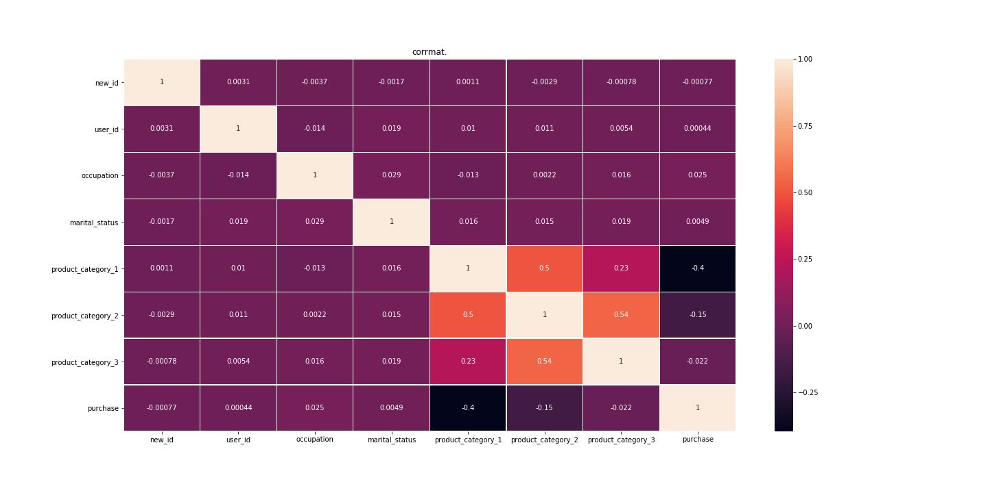

Slide 11
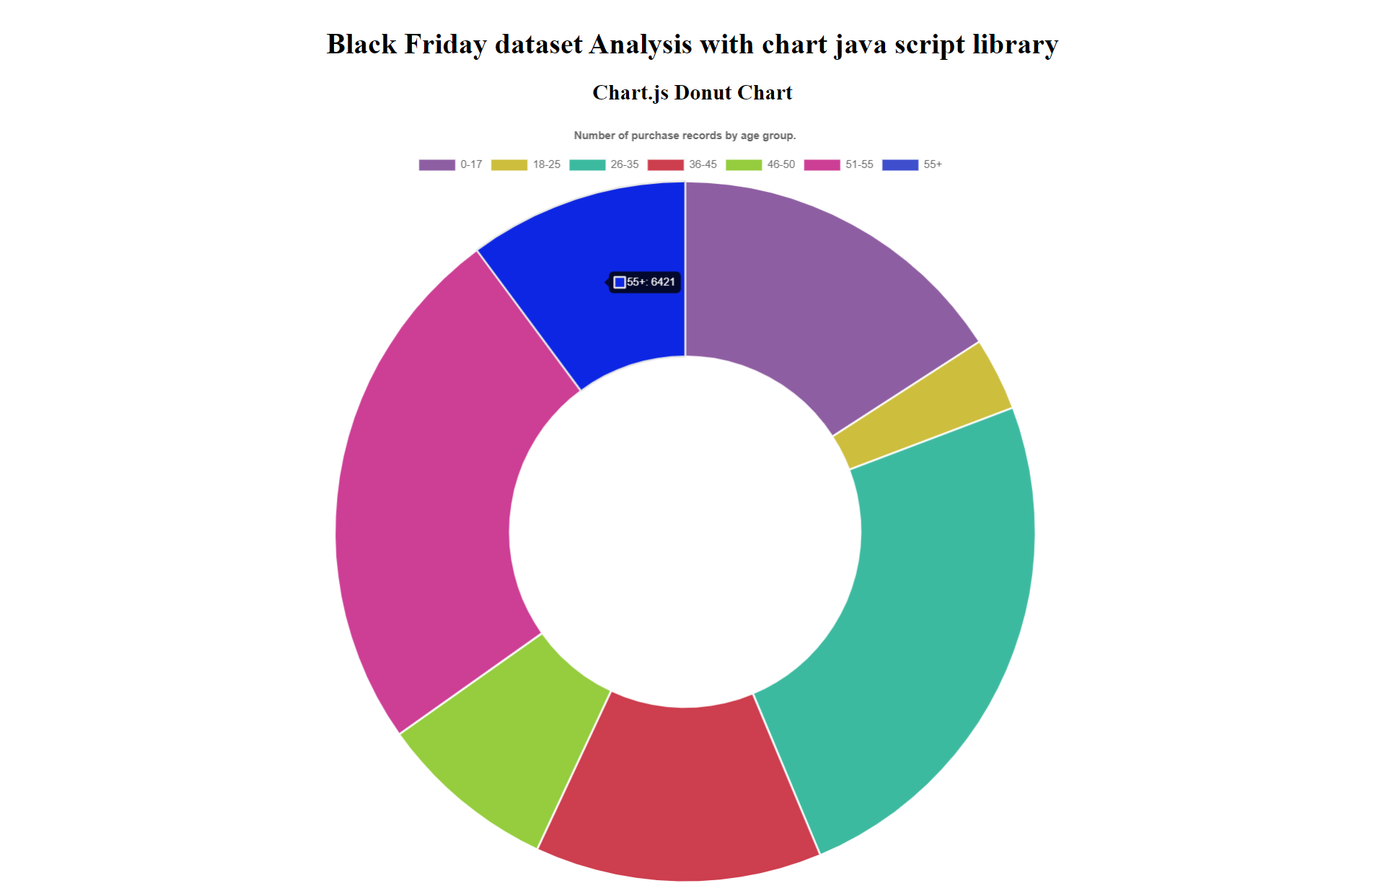

Slide 12
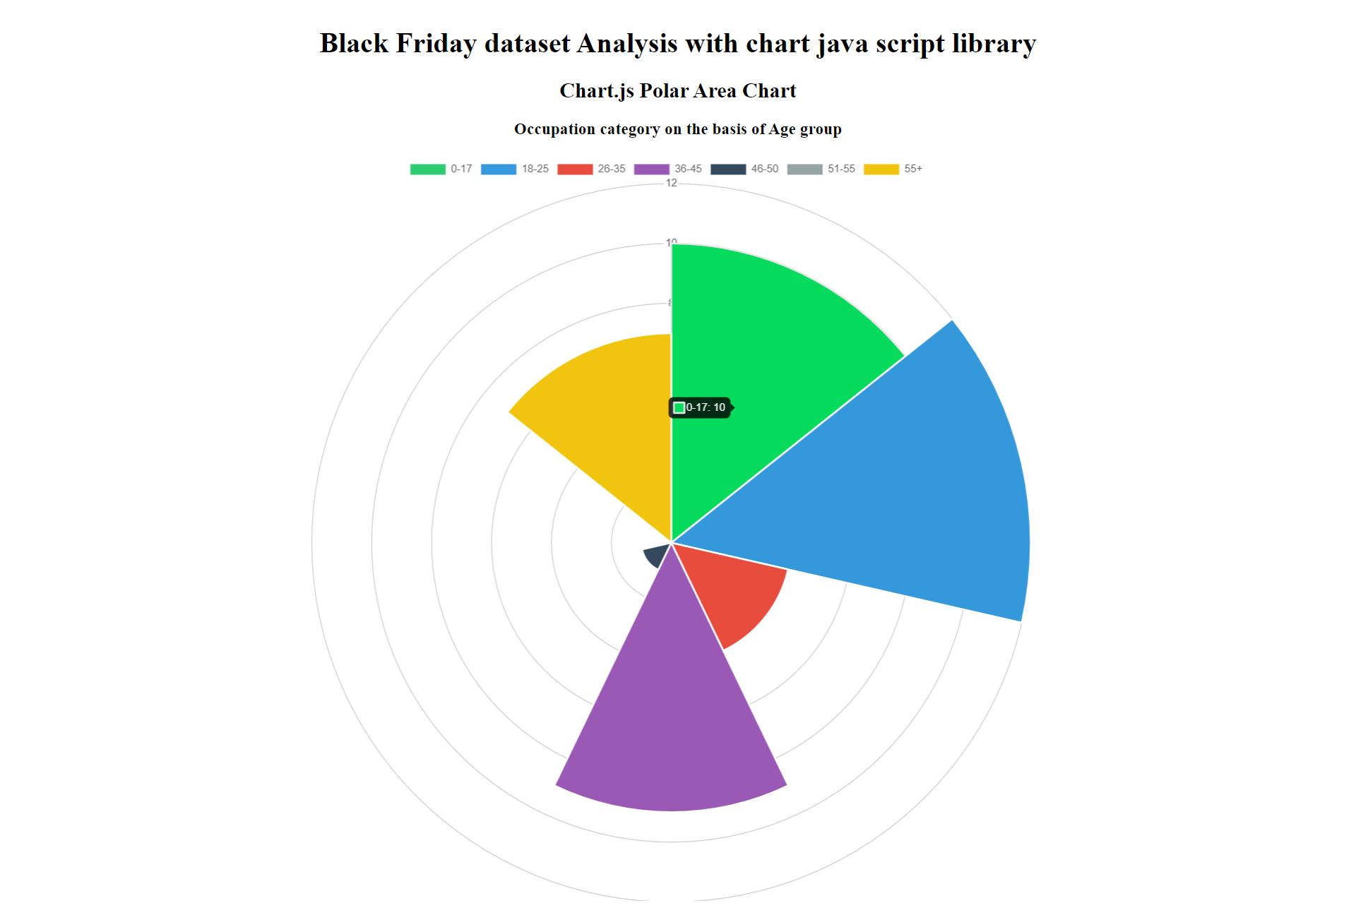

Slide 13
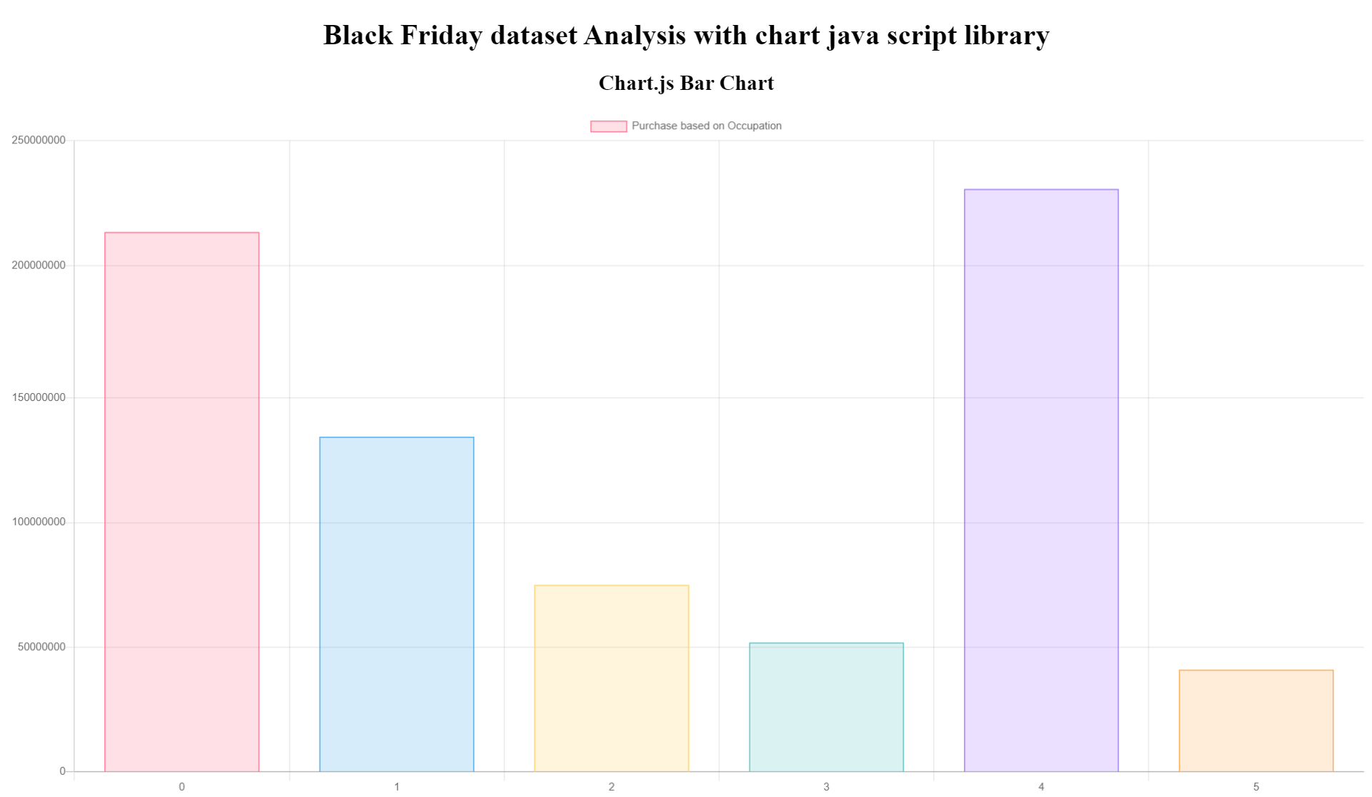

Slide 14
Analysis
We can see how age and marital status are quite related things, which is something very normal.
But we can also see some relation between the product categories. Relationship between category 1 and 2 is very strong. Category 3 is very good too
Relationship between category 2 and 3 is quite good as well, in fact more than the relationship between category 1 and 2.
We can say that these relationships tell us that depending on the category you buy; users will normally repeat the categories.
Most of the buyers are male.
As expected, most purchases are made in 26-35 age group.
Assuming A represent the smallest city whereas C is the biggest city, so we can see the most purchase and number of customers are more in metro city.
Money spend is consistent regardless of age group.

Slide 15
Challenges
To transfer data from webserver to app server .This is a big challenge for us.
During data cleaning and plotting the graph we faced the problem because of ‘-’ and ‘+’ sign.
We faced problem with Heroku too.

Slide 16
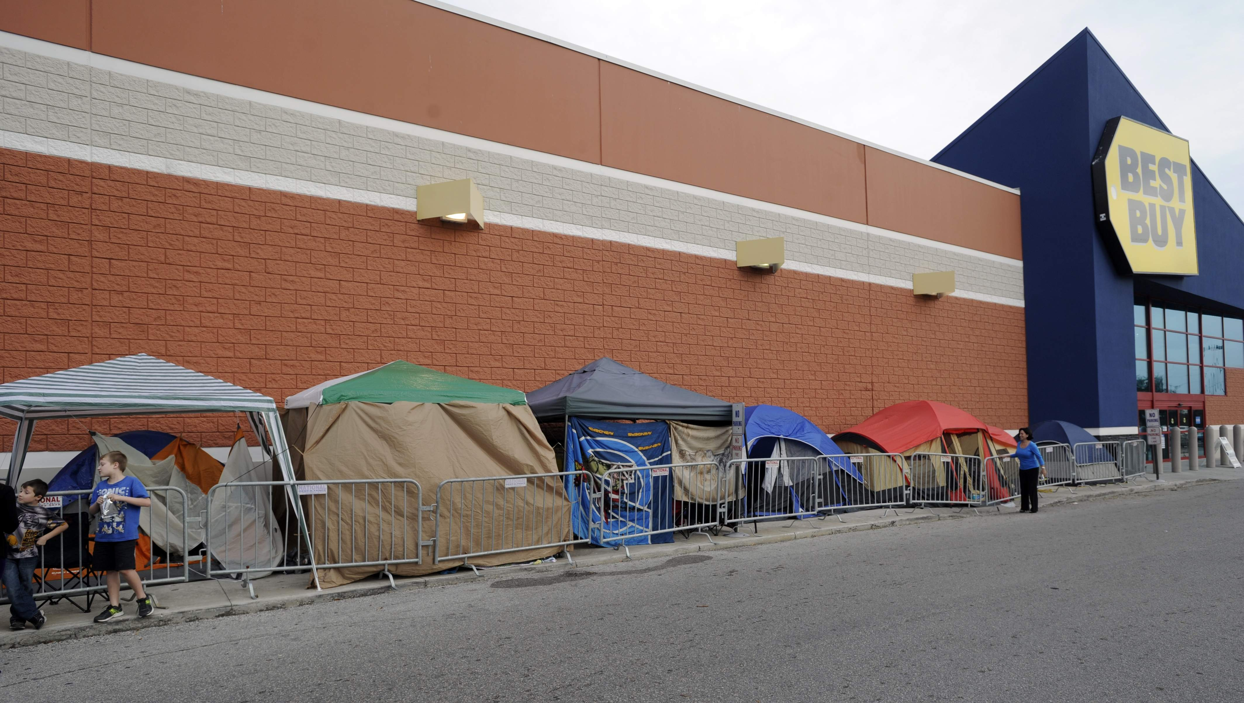
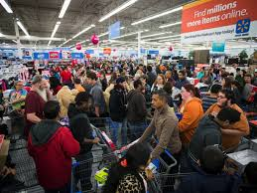
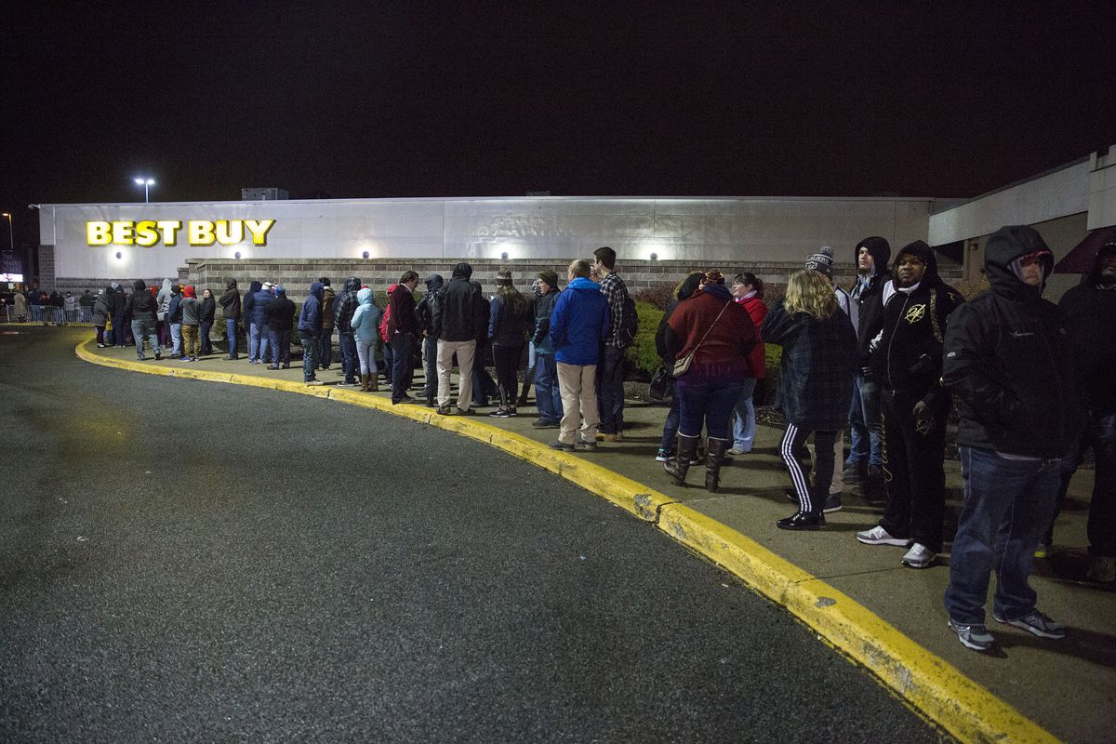
Happy Shopping Everyone!

Slide 17
Thank you
Presented by Neeta, Zareen and Jayshree
UT Bootcamp 2019

