Slide 1

Syncc: Voice controlled robotic vehicle
SRM INSTITUTE OF SCIENCE AND TECHNOLOGY
FACULTY OF ENGINEERING AND TECHNOLOGY
DEPARTMENT OF NETWORKING AND COMMUNICATIONS
21CSE305P
Student 1 Reg No: RA2211032010059
Student 2 Reg No: RA2211032010065
Student 3 Reg No: RA2211032010067
Student 4 Reg No: RA2211032010069
Guide name and Designation: Dr. Kayalvizhi R
Department of Networking and Communications

Slide 2
TABLE OF CONTENTS
Objective
Introduction
Problem Statement
Innovation
Features
Abstract
Parts Used(Hardware)
Architecture

Slide 3
TABLE OF CONTENTS
Circuit Diagram
UML Diagram
Output
Conclusion

Slide 4
OBJECTIVE
The objective of this project is to design a robotic vehicle that can be controlled remotely using voice commands, allowing for precise directional movement through Bluetooth communication with ESP32 microcontrollers. This voice-controlled bot can navigate forward, backward, left, or right, making it ideal for various applications, such as assisting individuals with mobility challenges, performing routine tasks in hazardous or hard-to-reach environments, and serving as an educational tool in robotics and voice-recognition technology.

Slide 5
INTRODUCTION
This project presents a sophisticated voice-controlled robotic vehicle through user voice commands. The system enables efficient control over the vehicle's movements by utilizing an ESP32 microcontroller alongside a speech-recognition module and Bluetooth communication. The design is divided into a transmitter and receiver configuration: the transmitter unit captures voice or button-initiated commands and relays them to the receiver via Bluetooth. The receiver then interprets these commands to operate dual motors, allowing the robot to move forward, backward, left, and right directions. Additionally, a laser mounted on the robot is controlled by the ESP32, enhancing its precision in navigation tasks. This approach demonstrates a seamless integration of voice recognition and wireless communication, offering an effective solution for hands-free robotic control.

Slide 6
PROBLEM STATEMENT
A robot that can be controlled intuitively through voice commands, offering a seamless and natural human-robot interaction.

Slide 7
INNOVATION
Integration of voice recognition with Bluetooth communication for hands-free control.
Use of ESP32 microcontrollers for reliable command transmission and reception.
Real-time control of robotic movements, enabling smooth navigation.
Laser module controlled by voice commands, adding precision for tasks like marking or alignment.
Cost-effective solution using readily available components for accessible robotic control.
Adaptable for various applications, including assistance in mobility, hazardous tasks, and educational purposes in robotics and IoT.

Slide 8
FEATURES
Voice-Controlled Navigation: Allows hands-free operation through voice commands, enhancing ease of use and accessibility.
Dual ESP32 Communication: Employs separate ESP32 microcontrollers for transmitting and receiving, ensuring reliable Bluetooth communication and responsive control.
Multi-Mode Control: Supports both voice and push-button inputs, providing flexibility in command input.
Precise Directional Movement: Capable of moving forward, backward, left, and right, enabling precise control in various environments.
Laser Module Integration: Equipped with a laser beam feature, controlled remotely, suitable for tasks requiring alignment or marking.
Compact, Battery-Powered Design: Fully self-contained with rechargeable batteries, allowing mobility without tethered power.
Cost-Effective Components: Built using affordable components, making it accessible for educational and experimental purposes.

Slide 9
ABSTRACT
Voice recognition has emerged as an intuitive bridge between human intent and machine action, simplifying remote control of devices. In this work, we introduce a Bluetooth-based robotic vehicle system that can be operated solely through voice commands, eliminating the need for manual control. This project introduces a Bluetooth-based robotic vehicle that responds to voice commands, eliminating manual operation. Using an ESP32 microcontroller, speech-recognition module, and Bluetooth, the robot can navigate forward, backward, left, and right through voice or push-button inputs. A laser module adds precision functionality, enabling applications in assistance, hazardous environments, and robotics education.

Slide 10
PARTS USED (Hardware)
ESP32- The ESP32 is a powerful, low-cost microcontroller with integrated Wi-Fi and Bluetooth capabilities, making it ideal for IoT (Internet of Things) applications. It functions as the central control unit, enabling Bluetooth communication, motor control, and operation of the laser module for the voice-controlled robotic vehicle.
L298N MOTOR DRIVER- The L298N motor driver is a popular dual H-bridge driver used for controlling the direction and speed of DC motors and stepper motors. It interfaces with the ESP32 microcontroller to receive control signals, allowing the robot to navigate forward, backward, left, and right based on voice commands or push-button inputs.
BATTERY- the battery serves as the primary power source for the robotic vehicle, supplying the necessary energy to both the ESP32 microcontroller and the L298N motor driver.
DC GEAR MOTOR- the DC gear motors are used to provide the mechanical movement for the robotic vehicle. They convert electrical energy from the battery into rotational motion, allowing the robot to navigate in various directions. The gear mechanism enhances torque and reduces speed, which is essential for precise control and stable movement of the vehicle, especially when maneuvering in different environments.
RUBBER WHEEL AND CHASSIE- The rubber wheels are used to provide traction and stability for the robotic vehicle, enabling it to move smoothly over various surfaces.
BATTERY HOLDER- the battery holder is used to securely house the battery that powers the robotic vehicle. It ensures a proper connection between the battery and the electronic components.

Slide 11
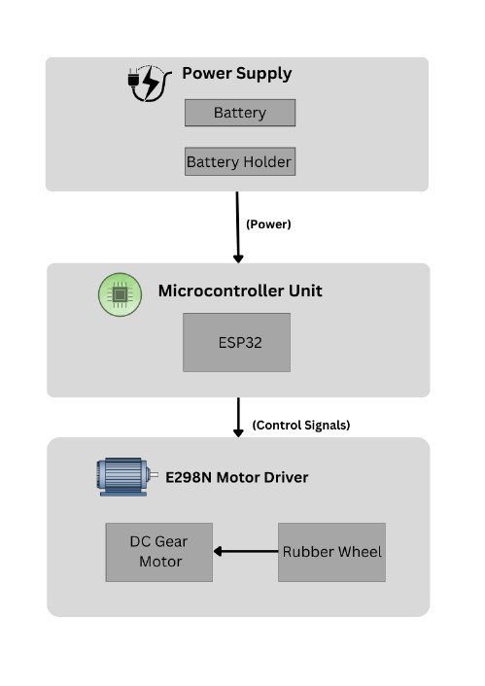
ARCHITECTURE

Slide 12
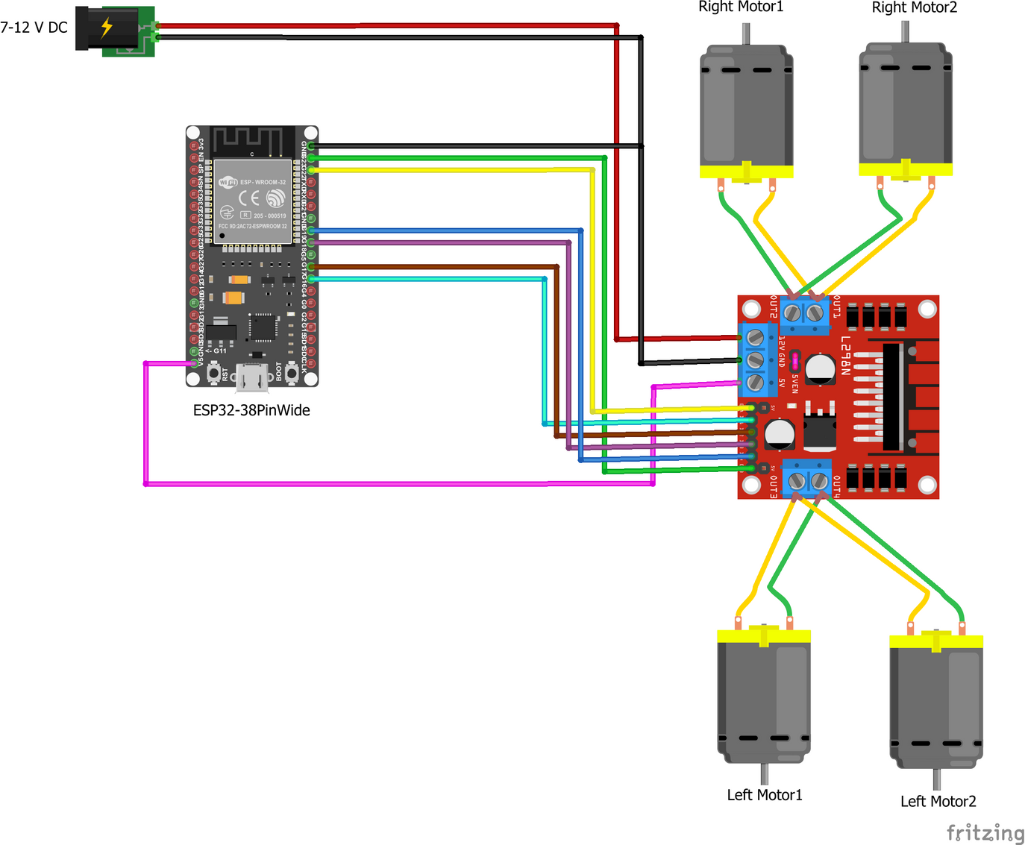
CIRCUIT DIAGRAM

Slide 13
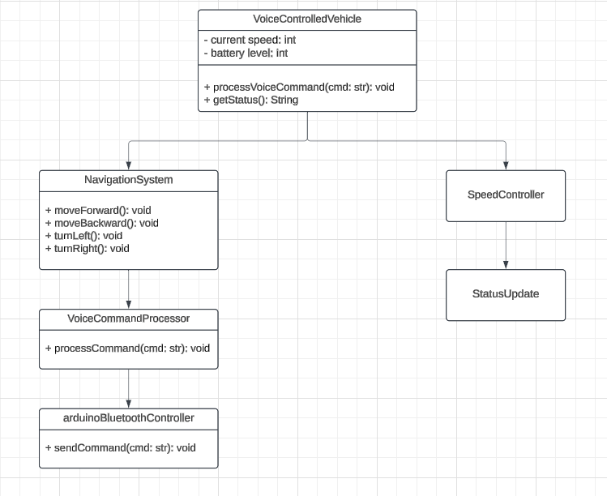
UML DIAGRAM

Slide 14
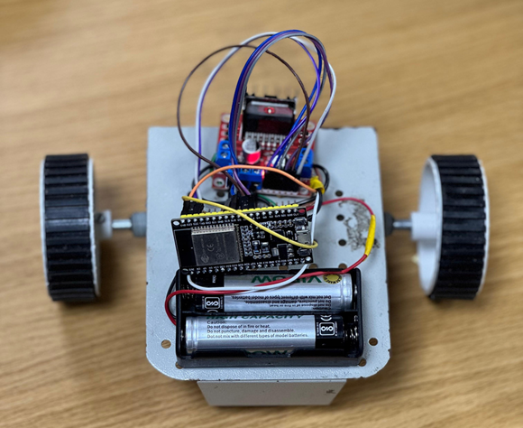
OUTPUT
fig 1.1: Robotic vehicle
The above figure 7.1 shows the image of the final robotic vehicle after completion of the project

Slide 15
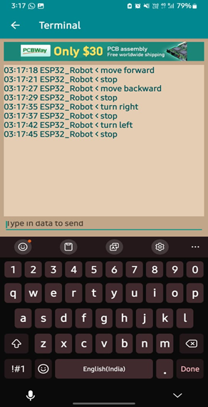
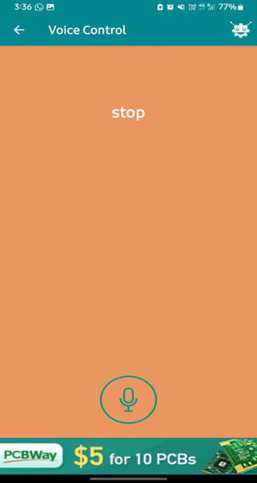
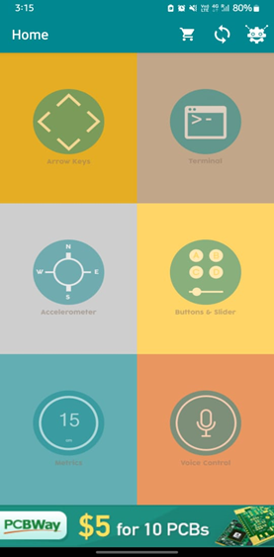
OUTPUT

Slide 16
CONCLUSION
In conclusion, the voice-controlled bot project successfully showcases how speech recognition, microcontroller functionality, and Bluetooth communication can work together to enable hands-free, remote robotic control. By integrating an ESP32 microcontroller, a Bluetooth module, and a speech recognition system, this project allows the bot to interpret voice commands and execute corresponding movements, such as turning or moving forward and backward, with accuracy and reliability.
This project demonstrates the convenience and usability of voice-activated systems, making it a valuable solution for applications in fields like home automation, assistive robotics, and autonomous vehicle control. Additionally, it offers a solid platform for future advancements, such as obstacle detection, refined motor control, and potential integration with IoT networks for even greater functionality. Ultimately, this voice-controlled bot represents an efficient, intuitive, and scalable approach to modern robotic control, combining ease of use with a versatile, adaptable design that can be extended to meet more complex needs.

Slide 17

Thank you.

