Slide 1

Use Cases
Advanced Software Engineering
COS550
Full Sail University

Slide 2
What’s a use case?
Presents a high-level story
  Describing the interactions between the users and the system.
  How an end user interacts with the system under specific set of circumstances
Depicts the system from the end user point of view

Slide 3
Use case representations
Can be represented:
  Narrative text
  Outline of tasks or interactions
  A template-based description
  Diagram representation

Slide 4
How to build a Use Case?
First step: Define the set of actors
  Different people or devices that use the system
  External to the system
  Have one or more goals when using the system
  Two types:
    Primary actors:
      Work directly and frequently with the system
      Interact with the system to achieve required system functions
    Secondary actors:
      Help the primary actor to complete his task

Slide 5
How to build a Use Case? (cont.)
Answer the following questions to define the actors:
  Who are the primary users of the system?
  Who are the secondary users of the system?
  Are there any other (external) systems that interact with the system?
  Does any of the actors have multiple roles?
  Are there any other entities that use the system’s output?

Slide 6
How to build a Use Case? (cont.)
Second step: build the use case
  Pick one of the end-users
  Define the different actions that the user can do.
    Each action corresponds to one use case.
  For each use case:
    Define the preconditions
    Define the course of events to perform the action
    Define the course of events if an exception happens

Slide 7
Use Case Template
Use Case: Name of use case
Primary actor:
Goal in context: Brief description of the use case
Preconditions: Any conditions that must be true before the use case can be started
Trigger: Event that initiates the use case
Post conditions: The state of the system after the execution of the use case.
Scenario: Detailed description of the actor’s actions and the system responses.
Exceptions: Detailed description of error conditions that could occur as well as the system responses in these cases.

Slide 8
Example of Use Case
Use Case: Withdraw cash
Primary actor: Customer
Goal in context: Brief description of the use case
Preconditions:
  Customer has active account
  Customer has a debit card
Trigger: Event that initiates the use case
Post conditions:
  Customer receives cash
  Account balance is reduced by the amount of the withdrawal
Scenario:
  Customer inserts debit card
  Customer enters PIN number
  System validates if customer has a valid account with the bank
  Customer chooses the required account Checking/Savings
  Customer selects the amount to withdraw
  Customer confirms the amount to withdraw
  System ejects money
  System ejects the debit card
Exceptions:
  Customer enters an invalid PIN number
    System displays a message to the customer to re-enter their PIN
  Customer selects an amount higher than the available balance
    System displays a message to the customer informing them that they do not have sufficient funds
    System displays a message to the customer to re-enter a new amount

Slide 9
Use Case Diagram
A diagram presenting how:
  Actors relate to use cases.
  Use cases relate to use cases
Built in early stages of development
Presents a high-level view of the system
Gives an overview of the system
  Specifying the system requirements
  Validating the system’s architecture

Slide 10
Elements of use case diagram
Actors
Use case or Process
  Task to be performed
  Is presented by a verb
  Each actor is linked to a use case
Relationships/Links
  Association
  Generalization
    Child/parent relations
  Include
    One use case incorporates the functionality of another use case
  Extend
    One use case extends the behavior of another use case

Slide 11
How to build a use case diagram?
Determine the main system functionalities
  Use cases/tasks to be performed
  Use verbs
The functions should be in ovals
Determine the actors of the system
Connect the actors to the use cases
Specify the type of relationships (include, extend, etc)

Slide 12
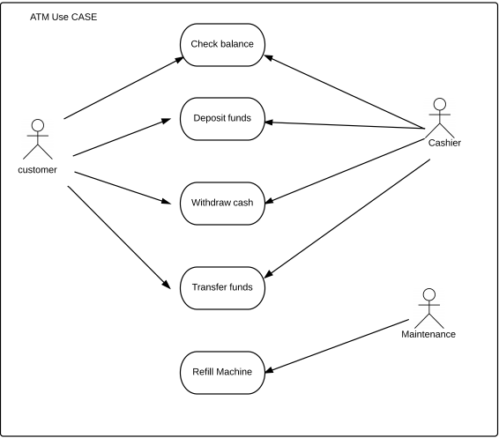
Example of Use Case Diagram

Slide 13
Additional links
https://www.visual-paradigm.com/guide/uml-unified-modeling-language/what-is-use-case-diagram/
http://www.agilemodeling.com/artifacts/useCaseDiagram.htm
http://www.tutorialspoint.com/uml/uml_use_case_diagram.htm

