Slide 1
Zepto Grocery Data Analytics Case Study

Slide 2
Overview
Quick-commerce platforms like Zepto operate on thin margins where pricing accuracy, discount strategy, and inventory availability directly impact revenue and customer experience. This project focuses on cleaning and analyzing Zepto’s product-level dataset using SQL to uncover pricing inefficiencies, stock gaps, and category-level revenue opportunities.

Slide 3
Business Problem
1.Pricing data may contain inconsistencies (zero prices, paise vs rupee units)
2. Some high-value products may be out of stock,
leading to lost revenue
3.Discount strategies may not be uniform across
categories

Slide 4
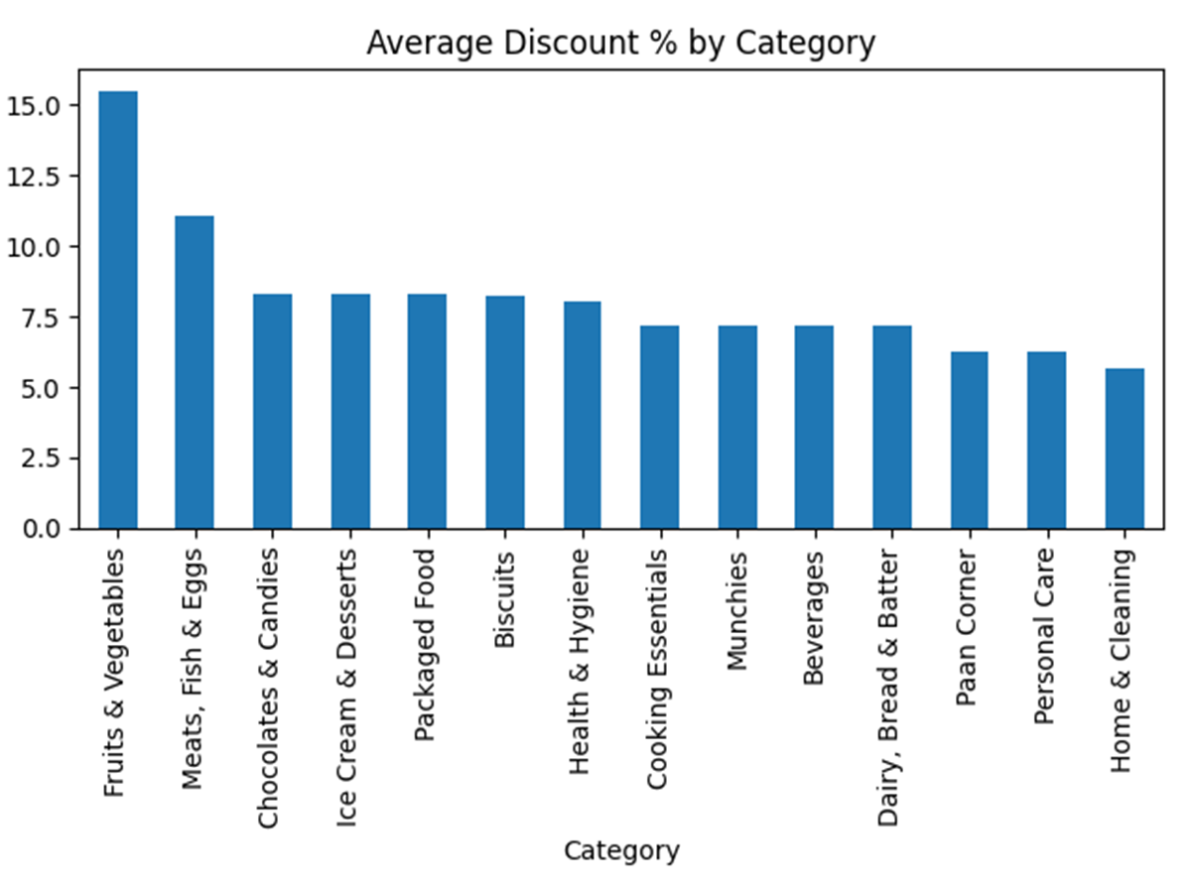
Q1. Which products offer the highest discount value?

Slide 5
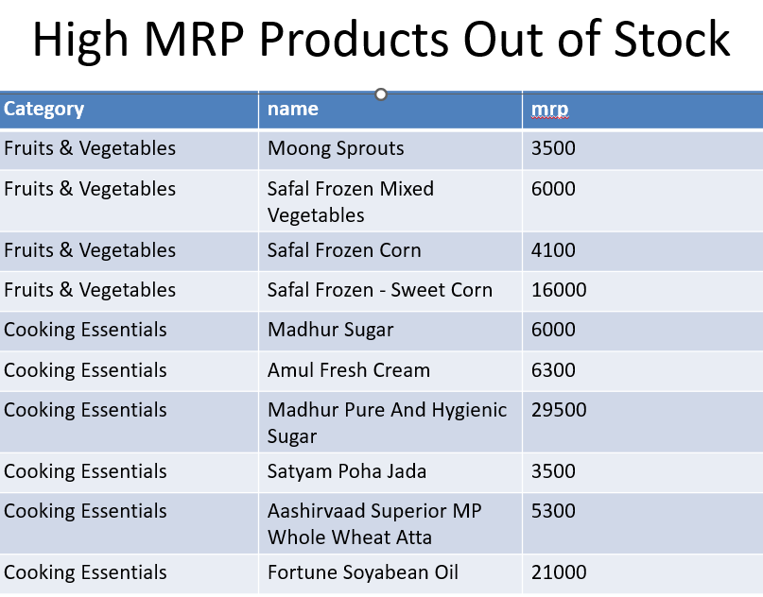
Q2. Are high-MRP products unavailable?

Slide 6
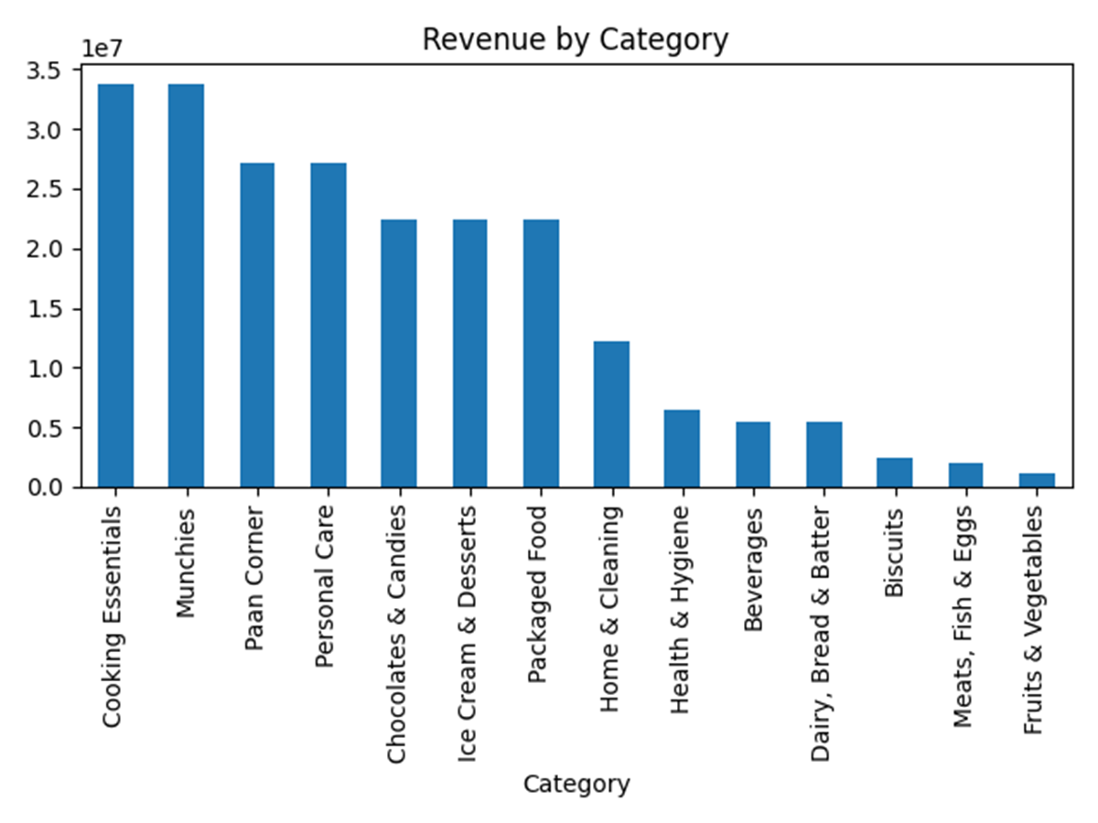
Which Products Contribute the Most to Revenue?

Slide 7
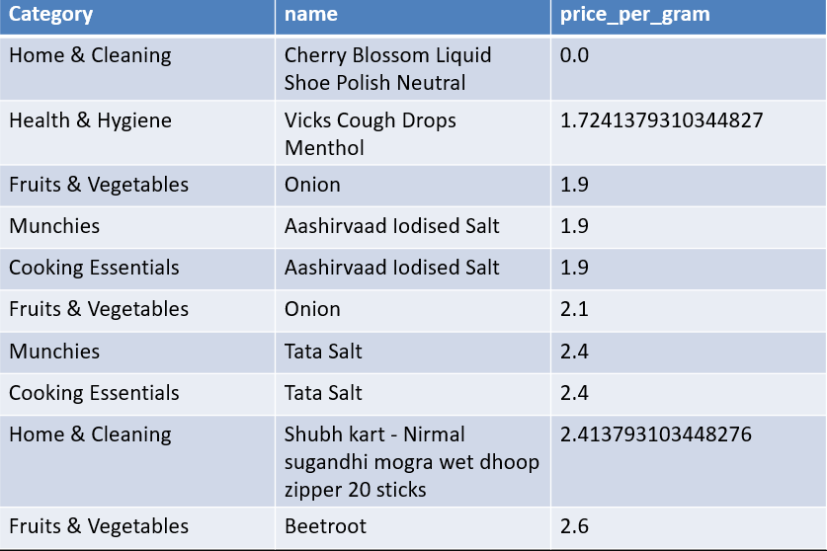
Which products provide the best price-per-gram value?

Slide 8
Key Insights
-Detected multiple high-MRP products marked out of stock, indicating missed revenue opportunities
-Identified significant variation in discount strategies across categories
-Price-per-gram analysis revealed better value in medium and bulk-sized products
-Certain categories contributed disproportionately higher revenue despite fewer SKUs

Slide 9
Key takeaways
Business Recommendations
-Prioritize restocking of high-MRP, high-demand products
-Standardize discount policies within categories to stay competitive
-Promote bulk products with better unit economics
-Optimize warehouse inventory allocation using total category weight insights

Slide 10
Thank You!

