Slide 1

Contactless Biometric Authentication and Actuation
Group No.- Mon-22
Sujay Kandalkar(210070088), Reet Singh Solanki(21d070054), Jayveer Singh Sikarwar(21d070033), Sujeet Mehta(21d070076)
Project description: A palm vein-based biometric authentication and actuation system can be installed in offices and colleges, ensuring hygiene and reliability due to the unique internal structure of veins.

Slide 2

Demo Video

Slide 3
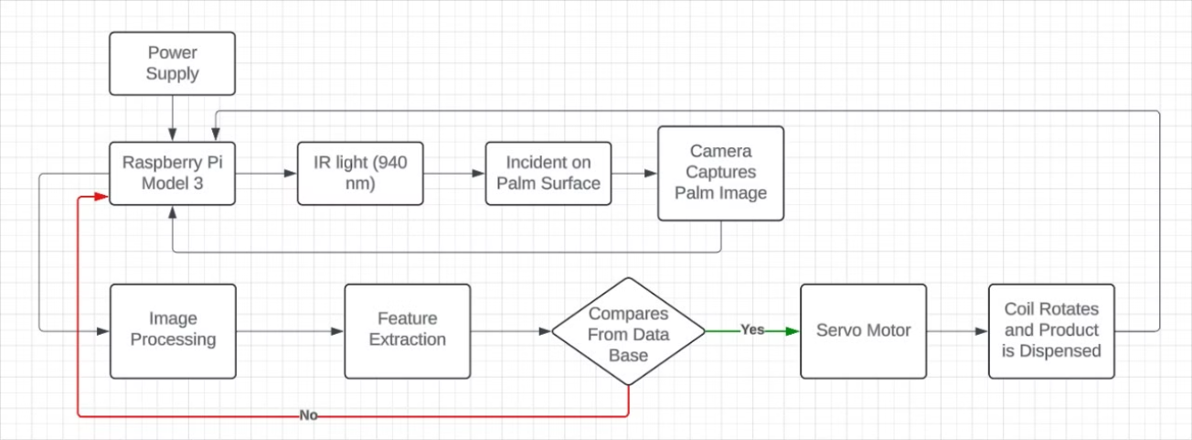
Methodology

Slide 4
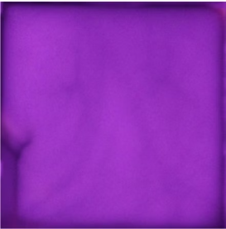
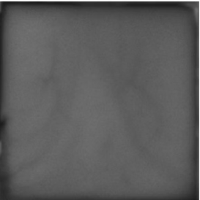
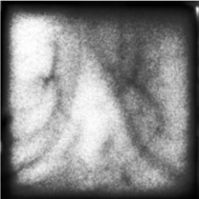
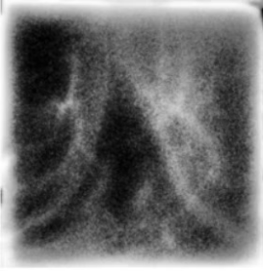
Methodology
IR Image
Gray Scale Image
Histogram Image
Inverted Pixels Image

Slide 5
Challenges Faced and their Solutions
Challenges Faced
Solutions
Remarks
Legacy camera not turning on in Geanny, leading to extra zoomed(3x) and bad quality image,
Decided to capture image using terminal as it was easy to turn legacy camera on.
successful
Unable to make the setup work without laptop
Planned to install sensor to detect hand and proceed but failed
Failed
Large no. of LEDs causing bright patches on hand
Decreased no. of LEDs and tried reducing their intensity.
successful
Use of ethernet was making system messy and complex
Used WIFI as an alternate and trading off with internet speed
successful
Camera got damaged while increasing focus
Thankfully, another camera was available in WEL
successful
Image quality dropped while transferring LEDs from breadboard to PCB
Took 3 days to focus LED again for proper image
successful

Slide 6
Individual Contributions
Member
Contributions made over entire duration of project
Average hours spent on EDL per week in Jan and Feb
Average hours spent on EDL per week in March and April
Sujay
Image processing, CAD design, Raspberry pi configuration, authentication.
9
14
Jayveer
PCB designing, Camera setup for image acquisition, PCB soldering, Vending machine code.
8
12
Reet
Camera setup for image acquisition and coding, making flow for final prototype.
7
12
Sujeet
Setup for image capturing, Setup for actuation part i.e. Vending Machine
5
8

Slide 7

Conclusions
Key functionalities: When, we put hand on the window of the box, the IR rays from LEDs gets absorbs by blood and camera captures this. Camera then captures this and we then match this image with database. Product is released for valid input.
Lessons Learnt: Working of Raspberry pi board and its camera module and how we have to focus IR LEDs for a good image.
Key Gaps to be addressed: Making the system totally hardware remained a key problem for us and would have been done for a good final product.
Accuracy in authentication could have been increased. It will require a good knowledge of image processing for good accuracy and accurate results.

